Slide 1

Cañada College Sustainability Plan
Past… Process/Structure…Goals..

Slide 2

Cañada College Sustainability Plan first developed in 2013.

Slide 3
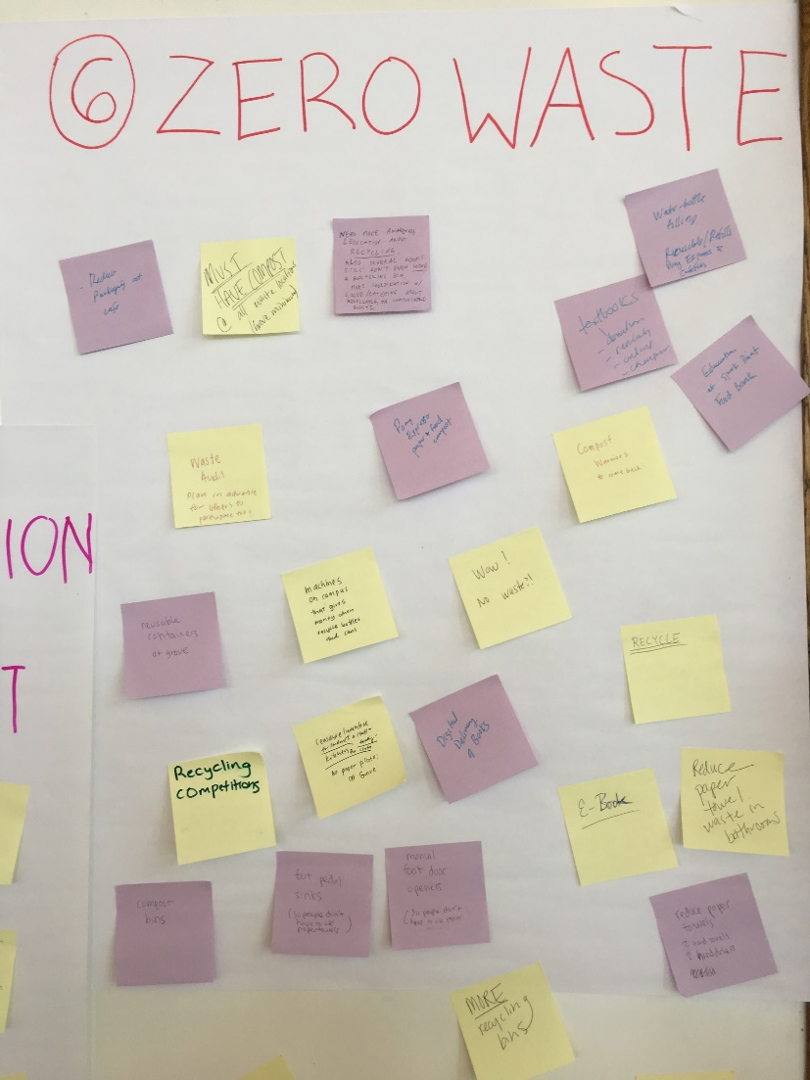
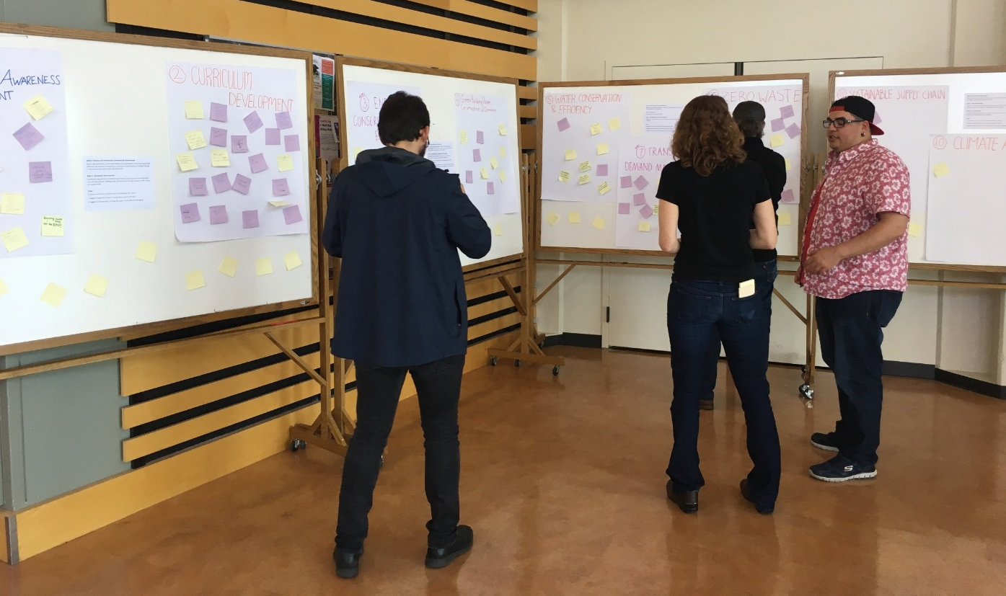
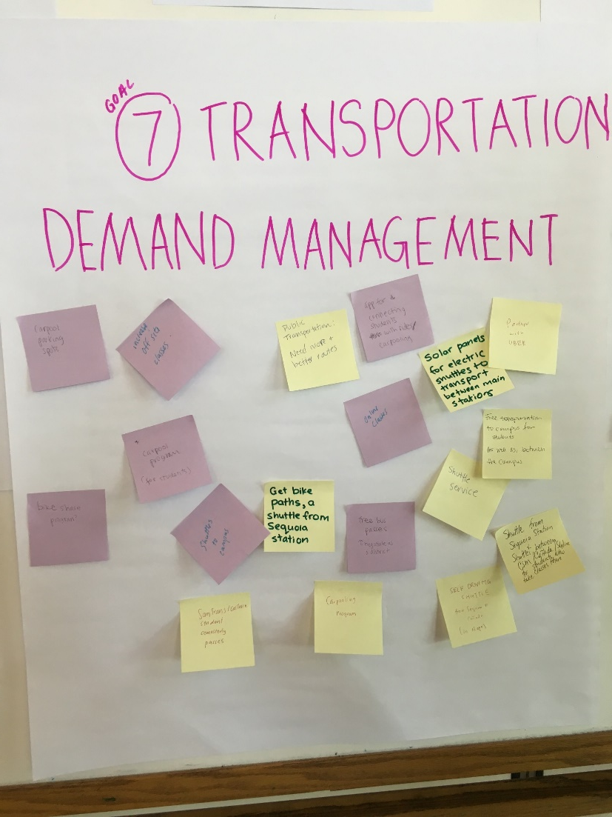
Conversation, Collaboration and Feedback

Slide 4
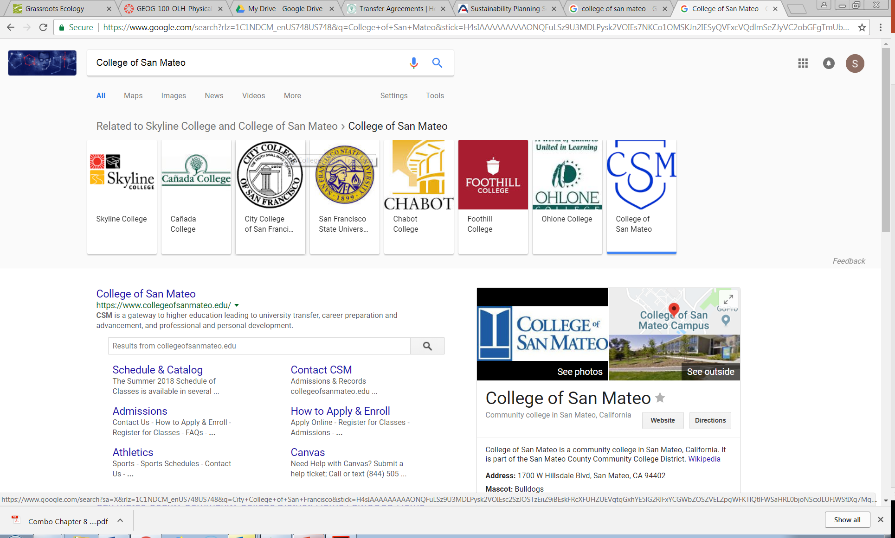

Conversation, Collaboration and Feedback

Slide 5

Sustainability Goals in 9 Areas
Campus and Community Awareness & Involvement
Curriculum Development
Energy Conservation and Efficiency
Built Environment
5. Water Management
Zero Waste
7. Transportation Demand Management
8. Sustainable Supply Chain
9. Climate Action

Slide 6
Sustainability Goals 1 - 3
Campus and Community Awareness & Involvement
Encourage awareness of and participation in sustainability efforts and positively influence the campus community to champion sustainability at Cañada College, in the community, and in their personal lives.
Curriculum Development
Creatively integrate sustainability (including social equity) into existing courses and develop new curriculum and programs with a focus on sustainability.
Energy Conservation and Efficiency
Accomplish Net Zero Energy by 2030 by reducing energy consumption while prioritizing safety, security, comfort, and functionality.

Slide 7
Sustainability Goals 4-6
4. Built Environment
Modify and construct facilities using/exceeding the highest sustainability standards in the industry while ensuring that the college community is engaged in the planning process and that all facilities focus on college community needs, including the use as a living lab.
5. Water Conservation and Efficiency
Reduce fresh water consumption per square foot of building space by 50% by 2025 compared to 2013 baseline.
Zero Waste
Accomplish Net Zero Waste by 2025.

Slide 8
Sustainability Goals 7-9
7. Transportation Demand Management
Reduce the reliance of students, faculty, staff, administration, on single occupancy vehicle gasoline vehicles by 20% over the next 5 years.
8. Sustainable Supply Chain
Work collaboratively with General Services, Auxiliary Services, and others to establish a green purchasing policy and meet incremental goals.
9. Climate Action
Establish a GHG emissions baseline and set targets for reduction based on stationary and mobile emission categories

Slide 10
Working to further “institutionalize” sustainability
Beyond compliance and efficiency…
Toward more synergistic benefits to academic and operational outcomes…
Plan is structured to optimize learning opportunities (for students, staff, faculty, and the community) in every goal.
e.g. Campus as a Living Laboratory +++

Slide 11
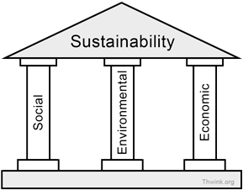
Three pillars of sustainability
For sustainability to be achieved all three pillars of sustainability must be sustainable.
Environmental sustainability is most important because societies and their tools (economics) are dependent on the environment.

Slide 12
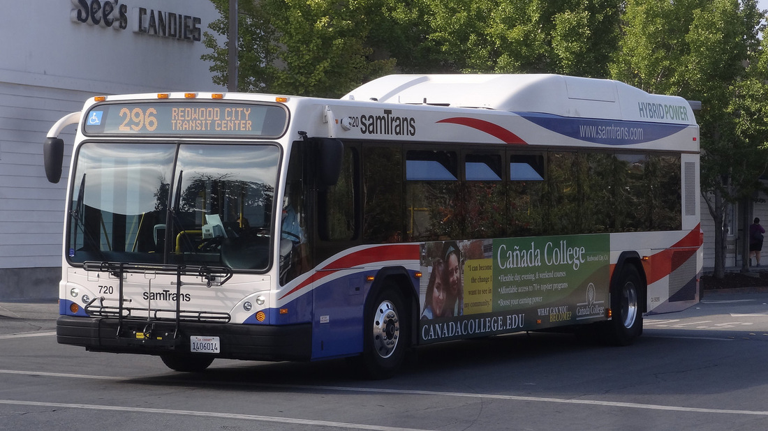
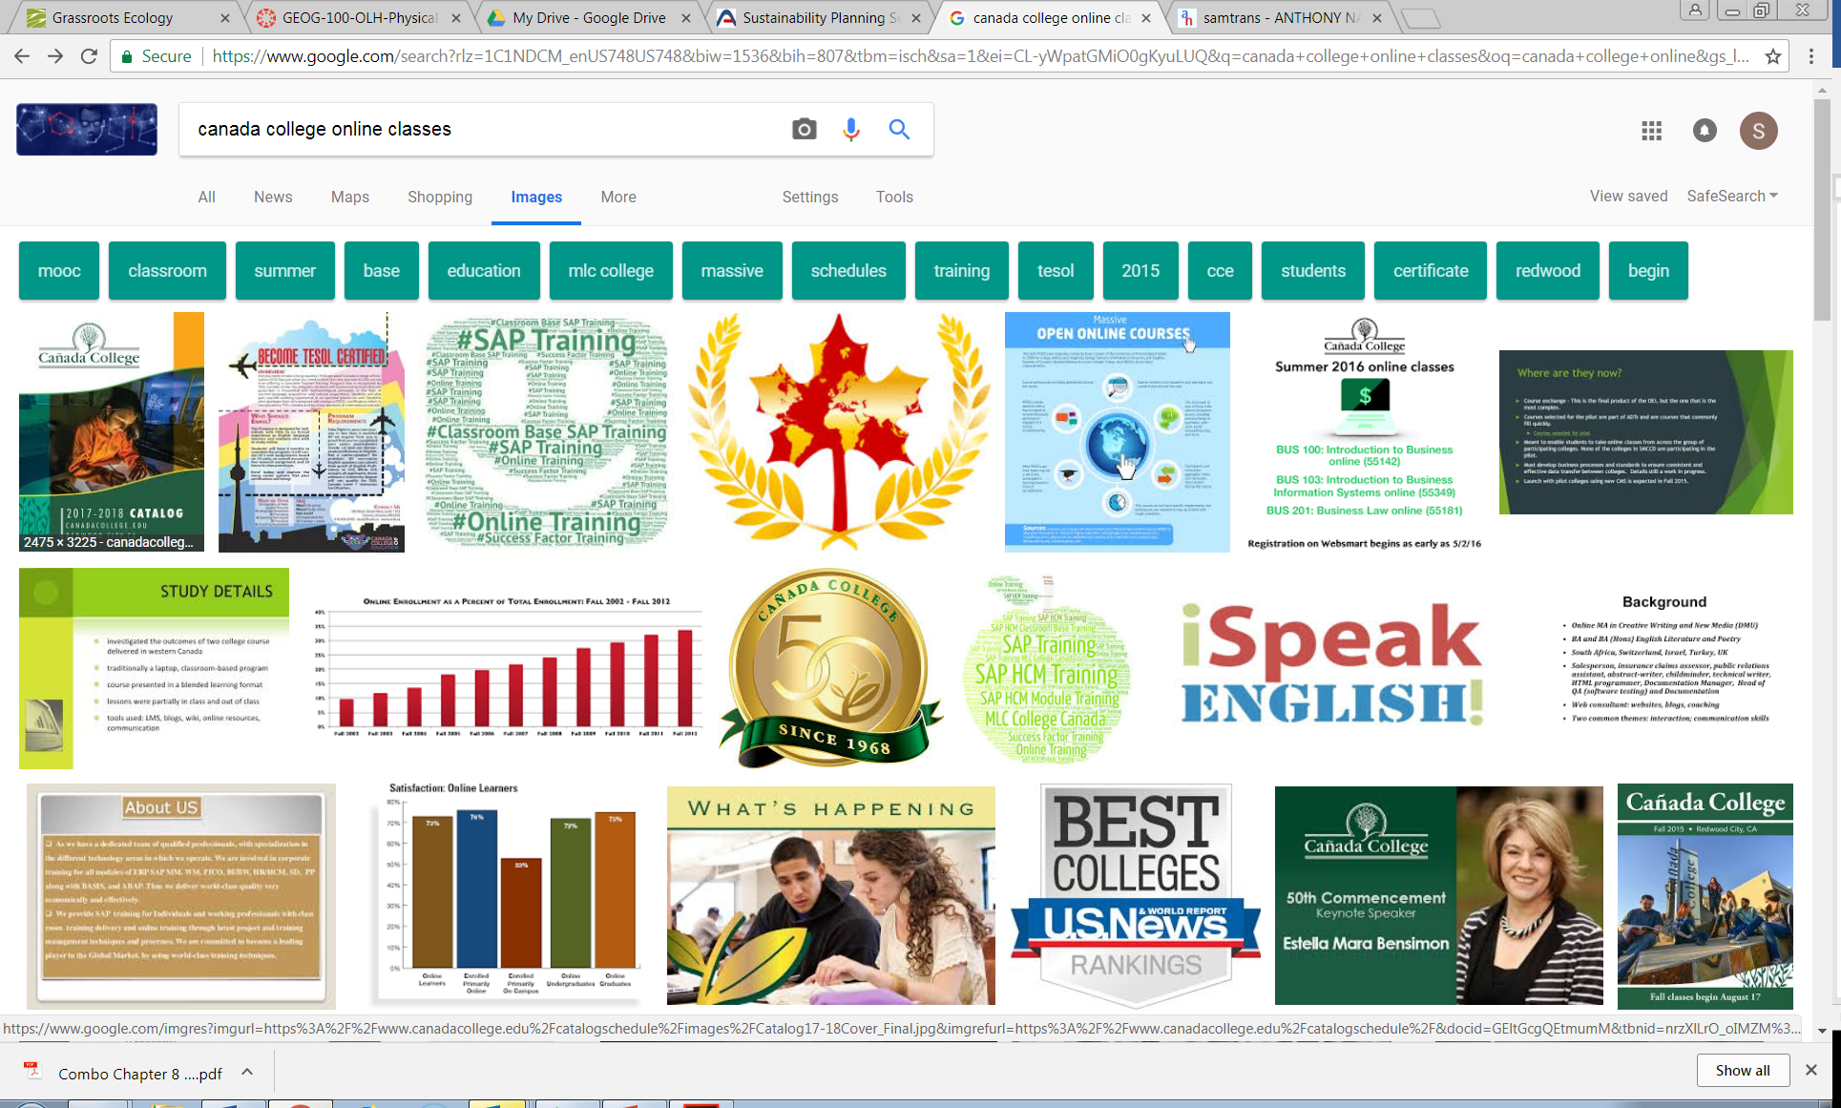
Not just “environmental action”… we strive to address critical objectives of the college and district
E.g. Transportation

Slide 13
Process…

Slide 14
What do you need from us?

Slide 15
Thank you!

