Slide 1
Academic Standing
A look at Cañada College students on Academic Notice

Slide 2
Summary
Title 5 reframes academic standing as a support‑triggering system, not a punishment system. Academic Notice and Pause policies require early identification, mandatory counseling access, GPA‑focused intervention, and protection of student equity and financial aid eligibility

Slide 3
Revisions to Title 5, California Code of Regulations
Academic Notice (Academic Probation)
Progress Notice (Progress Probation)
Academic or Progress Pause (Subject to Dismissal)

Slide 4
Academic Standing Count as of Spring 2026
Category | Count (overlap)
Total | 364
FAFSA recipients | 245
DREAM/AB540 | 19
No Financial Aid | 100
Promise Scholars | 134
Evening students | 58
Students in Academic Difficulty Belong to Multiple Overlapping Groups

Slide 5
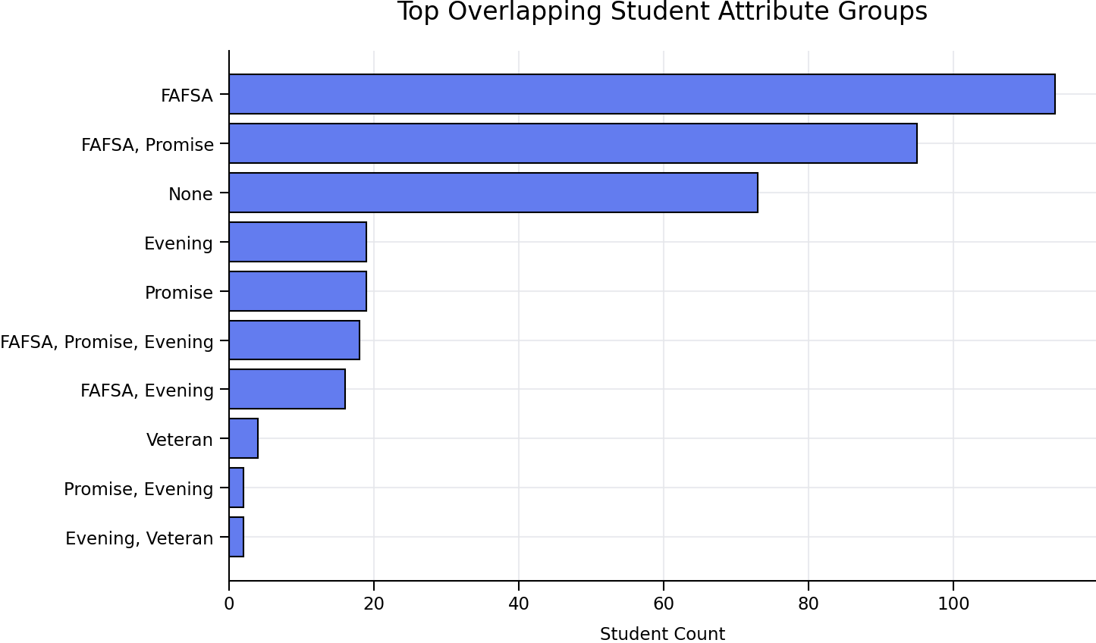

Slide 6
Academic Standing by classification

Slide 7
Racial and Ethnic Demographics
Race/Ethnicity | Total
Latinx | 258
White | 51
Black | 14
Asian | 8
Race/Ethnicity | Total
Filipino | 7
Pacficic Islander | 5
Multiraces | 10
Unknown | 11
Latinx students represent 71% of all academic notice and dismissal cases, far exceeding their proportional enrollment.

Slide 8
Academic Notice by Gender
Gender | Total
Female | 198
Male | 155
Other/not reported | 7
Nonbinary | 2
Blank | 2

Slide 9
Interest Areas
Science & Health (largest)
  Allied Health
  Radiologic Technology
  Medical Assisting
  Engineering
Business Administration
Psychology
Early Childhood Education
Art, Design & Performance

Slide 10
Program of Study
Business Administration 2.0 (ADT) (44)
Allied Health (AA/AS) (26)
Psychology (ADT) (26)
Computer Science (ADT & Certificates) (15)
Medical Assisting (AA & Certificate) (15)
Engineering (ADT) (14)
Early Childhood Education (12) (AA/ADT/Certificate)
Biology (12)

Slide 11
TAKEAWAYS
Low GPA Is the Primary Driver of Academic Difficulty
  about 80% or more of students are flagged due to Low GPA alone
Early Intervention at Academic Notice 1 Is the Greatest Opportunity
  missed or insufficient support at AN1 leads directly to later escalation
Students in Academic Difficulty Are Financially Vulnerable
  245 of 364 students (≈73%) are FAFSA recipients, and 134 are Promise Scholars
Academic Difficulty Is Concentrated in Specific Pathways
  need for targeted, program‑specific interventions
Support Programs Are Under‑Utilized Relative to Need
  opportunity to better align Student Services outreach and equity programs with academic notice data

