Slide 1

REDWOOD CITY, CA
EMP 3.11 Create and Expand Career Exploration Experiences for Students 4/8/26

Slide 2
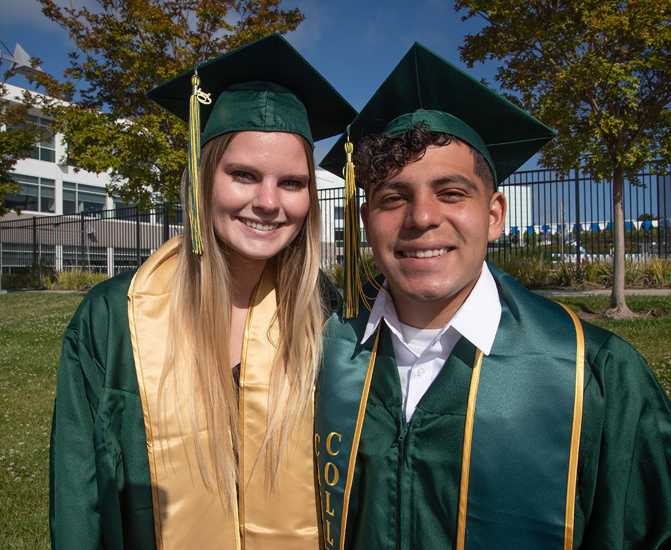
Progress So Far
9/16 Internal Stakeholders Fall Meeting
10/7 Internal and External Stakeholders Fall Meeting
10/20 Follow up meeting with JobTrain CEO Barrie Hathaway
11/11 Follow up meeting with Christopher Bernhard NOVAWorks
11/20 Follow up meeting of Internal Stakeholders
12/3 Update Presented to PBC
3/12 Internal Stakeholders Spring Meeting
4/8 Internal and External Stakeholders Spring Meeting
4/8 Update Presented to SSPC

Slide 3
Internal and External Stakeholders
Internal Stakeholders
Lizette Bricker - VPSS
Max Hartman – Dean of Counseling
Bob Haick – Career Center
Dr. Karen Engel – Dean of PRIE
Megan Rodriguez- Antone – Director of Community Relations and Marketing
Danny Lynch – Lead IA Counselor, Science and Health
Jose Manzo – Lead IA Counselor, Art Design & Performance
Dr. Kassie Alexander – Lead IA Counselor, Human Behavior and Culture
Nadya Sigona – Lead IA Counselor, Business
Alex Kramer – Dean, Business Design & Workforce
Lorraine Barrales-Ramirez- Counselor/Coordinator EOPs/CARE/NextUP/FYSI (Career Launch)
Diego Payan- Retention Specialist, Art, Design and Performance (and undecided)
John Omar – Retention Specialist, Business and Human Behavior and Culture
Jackie Gonzalez – Retention Specialist, Science and Health
Dr. Ron Andrade – Director of Student Support
External Stakeholders
Barrie Hathaway - JobTrain
Suzanne Dedeaux – JobTrain
Amanda Anthony – City of Redwood City
Chris Bernhadt – Nova Works
Dr. Maeve Katherine Bergman and Dr. Sunny Green - Bay Area California Community College Consortium (BACCC) to explore the FREE Gladeo Platform
Sample Text in Franklin Gothic Book
Border is in Yellow. Copy picture and right-click -> replace picture

Slide 4
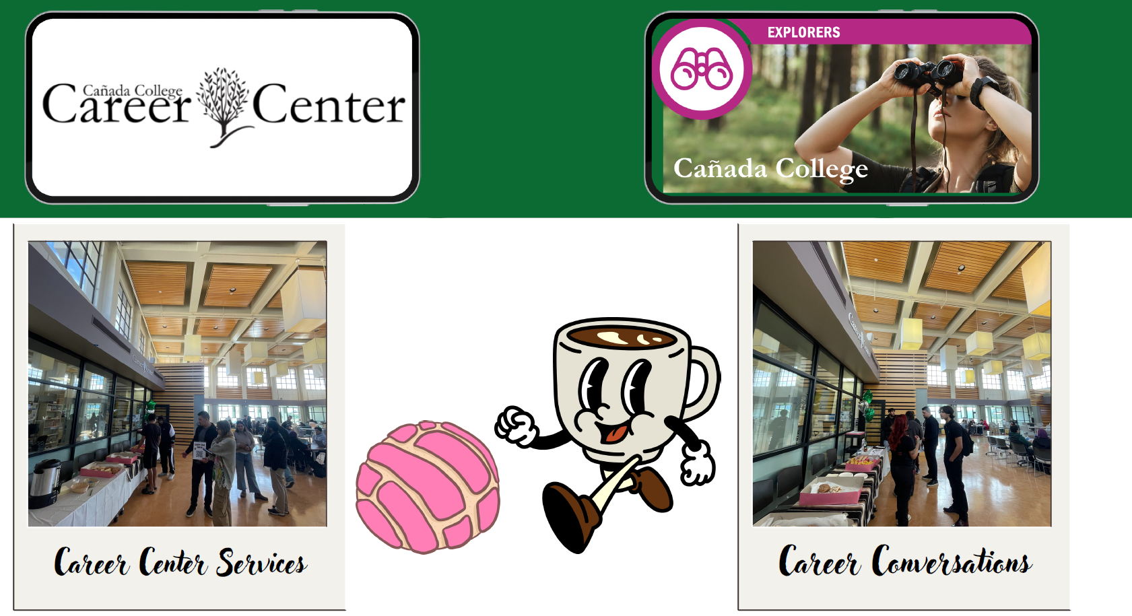
Sample Text in Franklin Gothic Book
Border is in Yellow. Copy picture and right-click -> replace picture

Slide 5


Slide 6
Spring 2026 – Introducing the Career Café
Overview & Purpose
Career Café is a monthly, community-building career event designed to bring students, faculty, staff, and professionals together over culturally welcoming refreshments.
This space encourages informal career conversations, networking, and student engagement.
Goals of Career Café
Create a culturally welcoming and inclusive space where students can explore career pathways.
Strengthen relationships between students, faculty, staff, and external partners (industry professionals, community organizations, alumni).
Encourage organic low-stakes career conversations and networking.
Promote visibility of Interest Areas, peer mentors, career courses, and the Career Center resources.
Sample Text in Franklin Gothic Book
Border is in Yellow. Copy picture and right-click -> replace picture

Slide 7
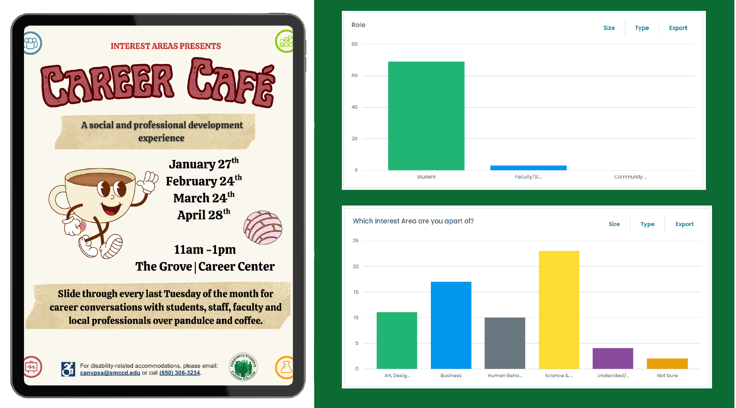
Sample Text in Franklin Gothic Book
Border is in Yellow. Copy picture and right-click -> replace picture

Slide 8
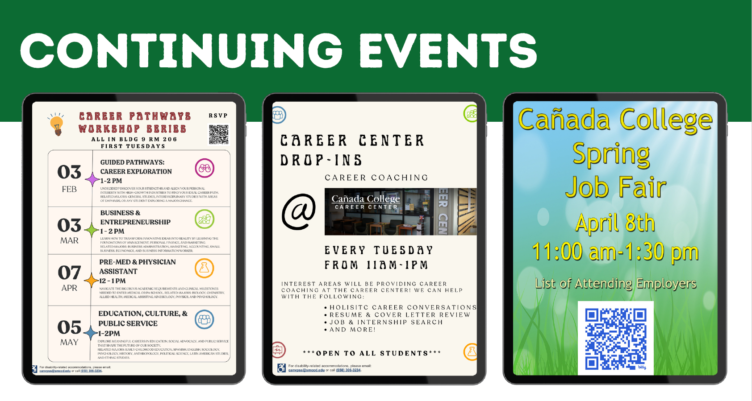
Sample Text in Franklin Gothic Book
Border is in Yellow. Copy picture and right-click -> replace picture

Slide 9
Spring 2026 – Weekly Drop in Support
Interest Area Drop-Ins – Every Tuesday (11am–1pm) (Not during Career Café)
Staffed by:
Interest Area Counselors
Retention Specialists
Career Center Staff
Services offered:
Career readiness support (Resume, Cover Letter, LinkedIn, etc...)
Career exploration tools and assessments
Job & internship search resources (College Central Network)
Student support within each Interest Area
These drop-ins function as continuous student support throughout the semester.
Sample Text in Franklin Gothic Book
Border is in Yellow. Copy picture and right-click -> replace picture

Slide 10
Spring 2026 – Monthly Workshops
Workshops (Monthly Workshops, Tuesdays)
Workshops will not occur during Career Café events—they are separate and will still be on Tuesdays.
“Career Pathways Series” (1 hour) can run during weekly drop-ins and may include:
Crafting an Elevator Pitch
Résumé Basics
LinkedIn for Beginners
Career Exploration Mini-Sessions
Networking 101
Career Conversations
Interview Prep
Finding Internships & Work-Based Learning
These short workshops add value without overwhelming the informal vibe of Career Café and can assist preparing students for upcoming speaker series, job fairs, and career opportunities.
Sample Text in Franklin Gothic Book
Border is in Yellow. Copy picture and right-click -> replace picture

Slide 11
Centralized Job Board
The number one most common ask so far during Career Café/Weekly Drop-In/Monthly Workshop events:
“Can you help me find a job?”
Equity Plan Initiative: Centralize and Update Student Work Oppportunities
Current Partnerships
Financial Aid posts Federal Work Study Opportunities on the Career Center College Central Job Board
Has been their practice for at least the last 3 years
Usually post in August, or early September and also sometimes in Spring depending on need
Athletics Center posts their Student Employment Opportunities to the Career Center College Central Job Board
Has been their practice for at least the last 2 years
The Career Center team has reached out to the Learning Center and Library to offer they post their positions to the Job Board but they have not needed to, they are filling their positions currently through other means, likely word of mouth.
Next Steps
The Career Center is crafting an email that they plan to send out at the beginning of each fall and spring semester to all campus programs offering an opportunity to post their positions on the Career Center College Central Bob Board.
The district is looking to create a single job board across all 3 campuses and to standardize posting for student worker positions
Discussions locally and across the district about moving to “Handshake”
Sample Text in Franklin Gothic Book
Border is in Yellow. Copy picture and right-click -> replace picture

Slide 12
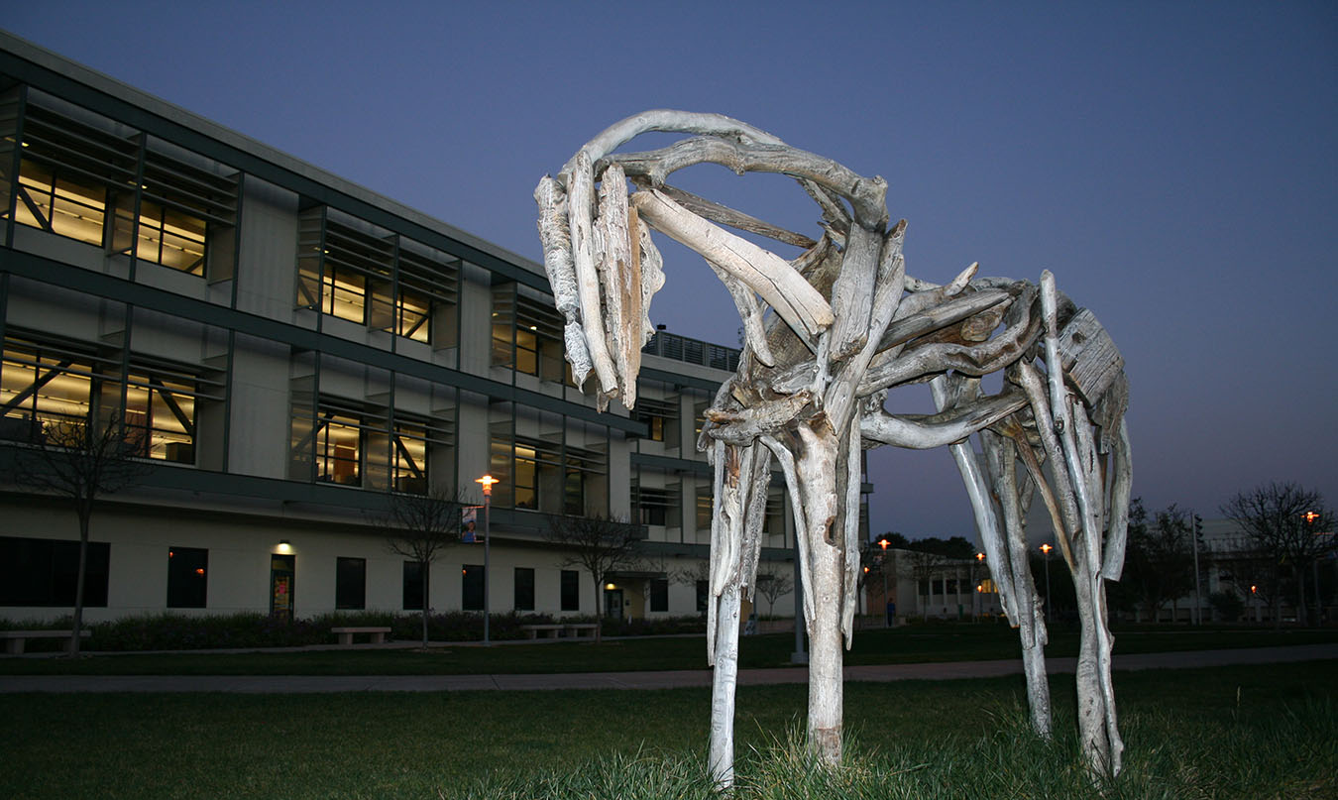
Thank you!

