Slide 1


2017 ASPIRES Final Presentation
CE2 – Using Acoustic Sensors for
Structural Health Monitoring
Ryan Yedinak
Moises Vieyra
Oskar Granados
Vincent Tran
Prof. Zhaoshuo Jiang
Alec Maxwell
Cañada College
San Francisco State University

Slide 2
Outline
Project Background
Structural Dynamics
System Identification with Traditional Accelerometers
Acoustic Theory
System Identification with Acoustic Sensors
Conclusions and Future Applications

Slide 3
Background – SHM and Current Infrastructure
Structural Health Monitoring (SHM)
  Monitoring structures for damage to improve safety and reduce life-cycle costs.
Infrastructure
  Structurally deficient
  End of life cycle

Slide 4
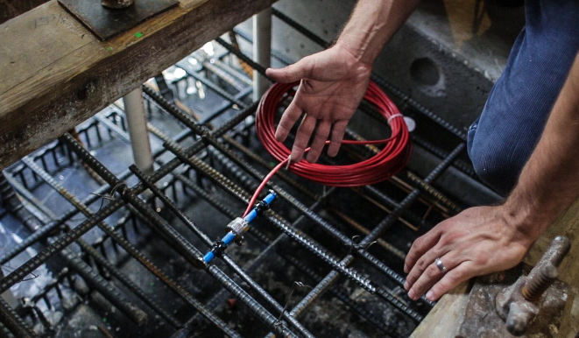
Background – Current Technique
Accelerometers embedded within structures
Advantages:
  Accurately characterize health of a structure
Disadvantages:
  Costly and time consuming to maintain
  Inconvenient to replace and repair
Notes:
Traditional method of SHM is use of embedded sensors (strain gages, accelerometers) to continuously monitor the health of a structure.
A picture of a sensor. While embedded sensors are a great way to get very precise measurement and with an array of them you can get a good look at the global health of the bridge they come with some cons. Cost of installing the sensors can be high. For instance if you want to place a sensor in the mid span of the bridge the wire to connect it to its data acquisition system can be more expensive than the sensor itself. Furthermore maintenance of the sensor can also cost more than the sensor over its lifetime. Another drawback to these sensors is any time maintenance needs to be done on the sensor or the sensor needs to be replaced lanes of traffic must be blocked off for a crew to do the job.

Slide 5
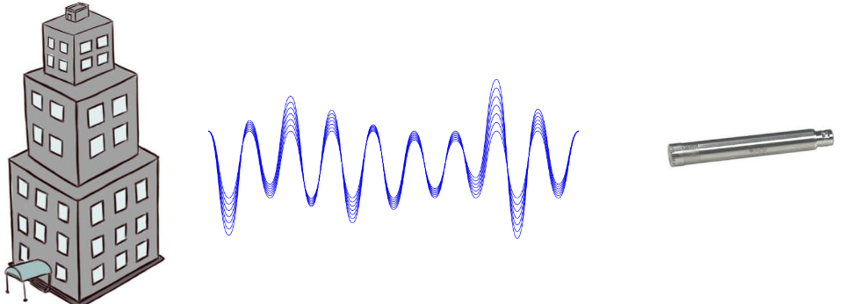
Background – Proposed Technique
Array of microphones placed strategically around a structure to monitor and asses structural integrity
Portable system
  Does not need to be embedded into structure
Only one person needed to set up sensors and monitor data acquisition system
Notes:
SAVE TIME AND MONEY

Slide 6
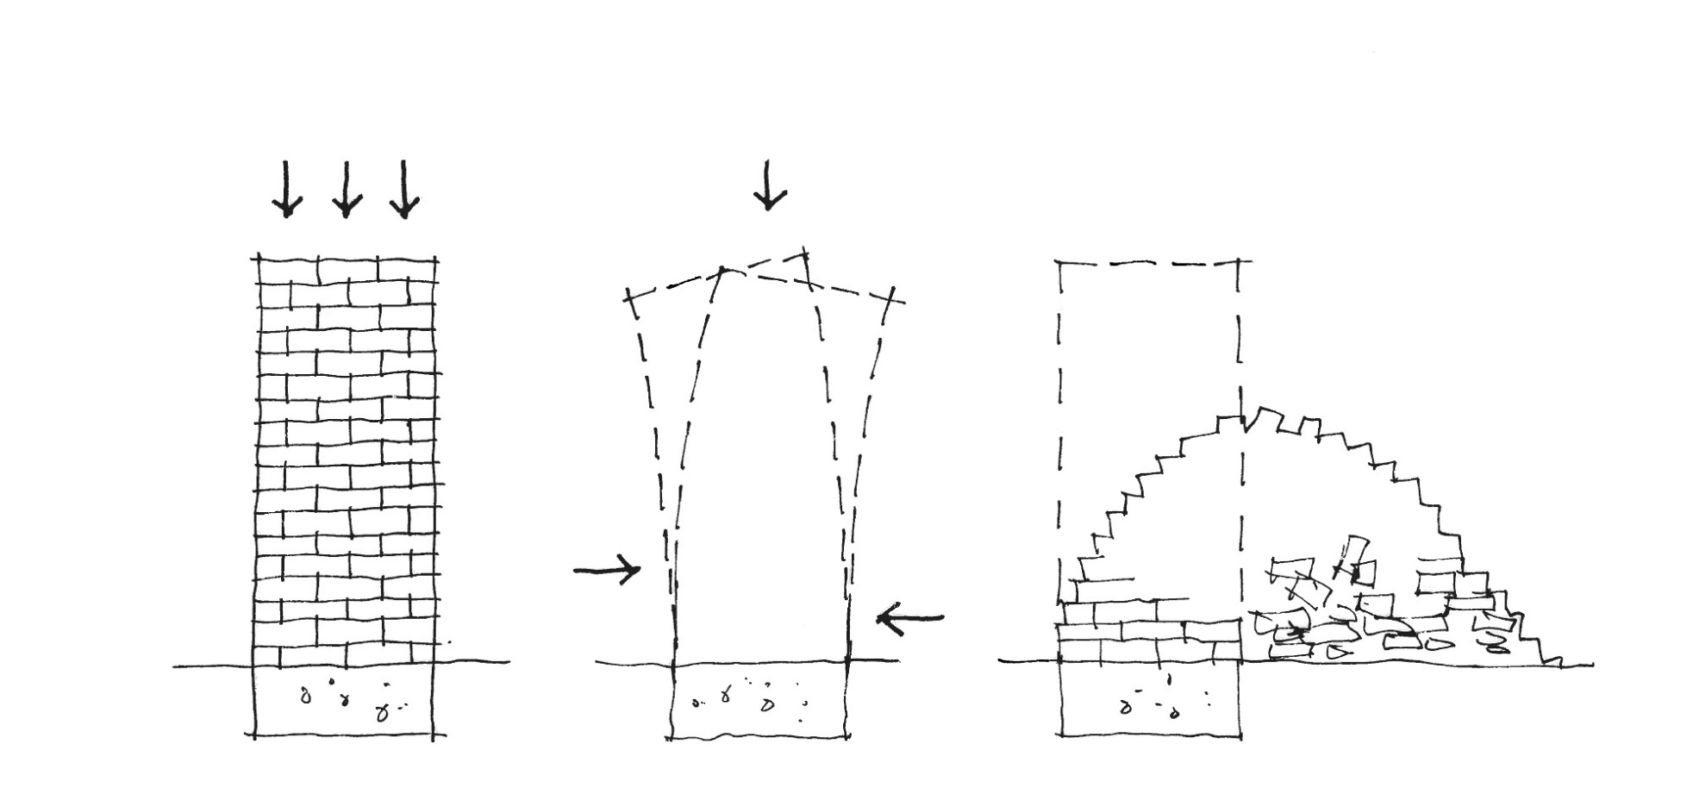
Structural Dynamics – Natural Frequency
Natural frequency is an inherent property of the structure
The natural frequency helps monitor the structural health
  Understand structure properties
Notes:
Lets talk about structural dynamics and the natural frequency, which is an inherent property of a structure. The natural frequency is important for structural health monitoring because it will allow us to understand any changes in the structural properties of a building or bridge.

Slide 7



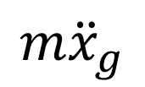
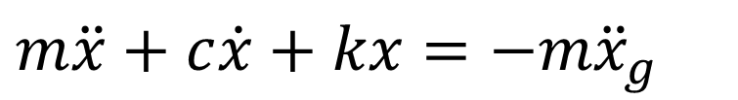

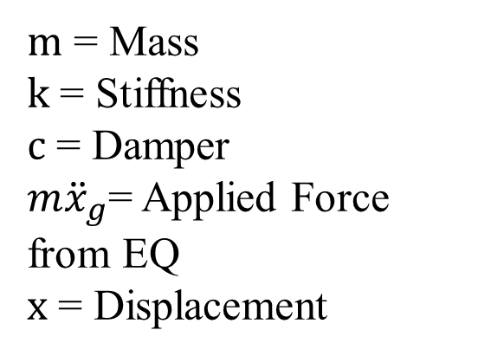




Structural Dynamics – Equation of Motion
$$x$$
$m$ = Mass
$k$ = Stiffness
$c$ = Damper
$m{\ddot{x}}_{g}$= Applied Force from EQ
$x$ = Displacement
$$k$$
$$m$$
$$m{\ddot{x}}_{g}$$
$$c$$
$$kx$$
$$m\ddot{x}$$
$$c\dot{x}$$
$$m{\ddot{x}}_{g}$$
$$m\ddot{x}+c\dot{x}+kx=−m{\ddot{x}}_{g}$$
Notes:
In order to find that natural frequency in our experiment working with a SDOF structure, we needed to develop an equation of motion using a FBD represented through a simple diagram.
The forces affecting the FBD are the mass m, the stiffness k, the damping force c and the applied force f(t)
Where we use Newton’s second law F=ma and came up with the equation.
In our equation we have
Model of motion
Things in motion- Rigid body motions
Structures has certain characteristic of mass, stiffness and damper to describe motion
Take the FBD we can combine the forces to equal to some mass times acceleration.
We rearrange the formula to have the characteristic properties proportional to the applied force(earthquake).
With the equation of motion we can derive the transfer function.

Slide 8
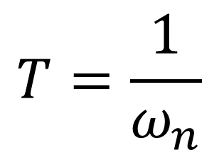
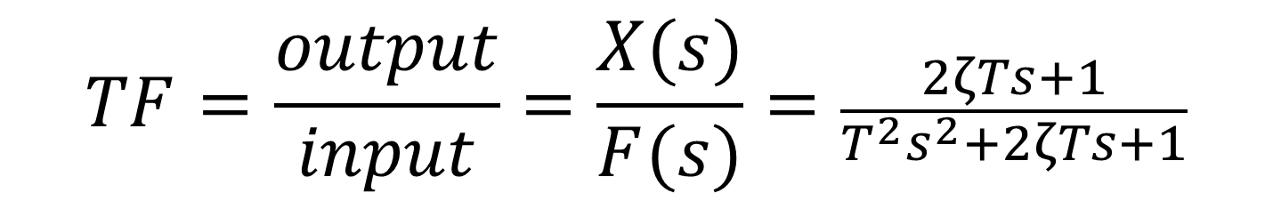
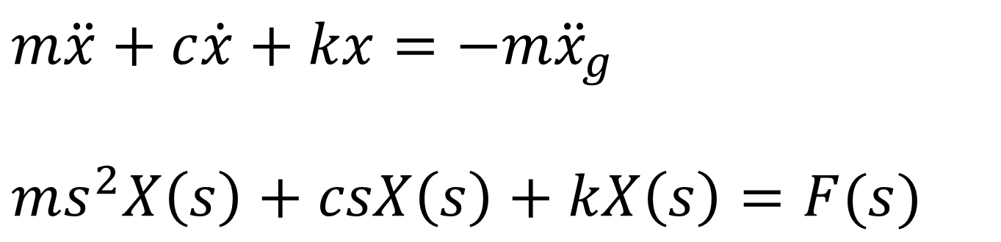
Structural Dynamics – Transfer Function
$$m\ddot{x}+c\dot{x}+kx=−m{\ddot{x}}_{g}$$
$$ms^{2}X\left(s\right)+csX\left(s\right)+kX\left(s\right)=F(s)$$
$$T=\frac{1}{ω_{n}}$$
$$TF=\frac{output}{input}=\frac{X(s)}{F(s)}=\frac{2ζTs+1}{{T^{2}s}^{2}+2ζTs+1}$$
Notes:
Our equation of motion developed through the FBD is in the time domain measuring time vs acceleration.
However we do not get a clear data set from this equation therefore we used the Laplace transformation and took it to the frequency domain where the results would be frequency vs pressure
Why the transfer function is important in our research( can change input and predict the outcome.)
This is the transfer function which was calculated numerically when we did our project with the mobile app.
Our equation is in the time domain and we would want our results to be in the frequency domain so we can determine the natural frequency so we take the
Equation of motion we have and transform it using Laplace transformation and take it into the frequency domain.
Why the transfer function is important in our research( can change input and predict the outcome.)
This is the transfer function which was calculated numerically when we did our project with the mobile app.

Slide 9
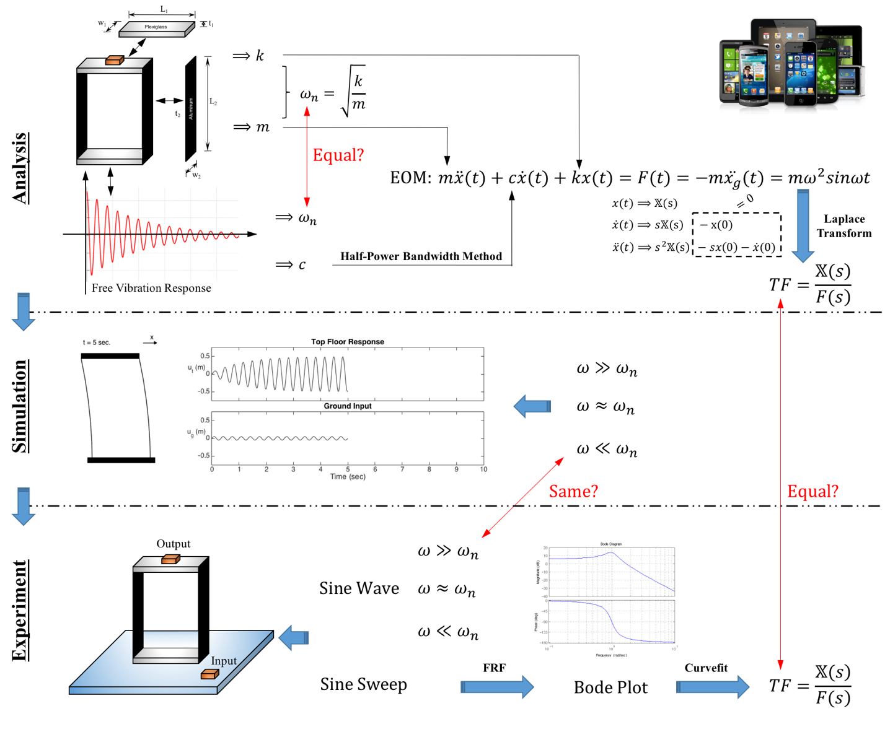
System Identification - Overview
Notes:
In order to understand the behavior of the SDOF structure we went through some system identification progress and here is a little overview. We were given the dimensions of the structure and we were able to get the stiffness of the columns and the mass and use these values to calculate the natural frequency numerically, which we found to be 3.89 Hz. We also found the damping ratio of the structure through analysis of a free vibration response simulation. We used these parameters to find the equation of motion and eventually the transfer function numerically. After numerical analysis we ran simulations in the app to have an idea of the behavior of the structure when subjected to different input frequencies. Then we moved on to experimentation on the shake table in order to determine the natural frequency and transfer function experimentally. Now we’ll talk a little more in detail about the experimental process.

Slide 10
System Identification - Experimentation
Mobile Device
Accelerometers
Sine Wave
Sine Sweep
Earthquakes
Data Acquisition System
Universal
Power
Module
PC
Shake table
Notes:
Here is the set up of the experiment.
During the lab, through the experiment app, we ran experiments in the shake table to get experimental values and compared them with the numerical results.
The types of excitations are:
Sine Wave: constant forcing frequency
Sine Sweep: Forcing frequency increasing incrementally over a time period.
Scaled down versions of real earthquake excitations
After running simulations on the Qdex Simulations App, we were able to run experiments on the shake table in the lab through the Experiments App to find experimental values and compare to our numerical results.
This diagram shows a setup of the shake table. Commands are sent form the Qdex app (type of excitation, amplitude, forcing frequency, duration) to the PC from mobile device.
The types of excitations are:
Sine Wave: constant forcing frequency
Sine Sweep: Forcing frequency increasing incrementally over a time period.
Scaled down versions of real earthquake excitations
Data transmitted between shake table and accelerometers through UPM.
The accelerometer on the bottom of the structure measures the input excitation (ground motion) and one on top of the structure measures the response of the structure.
Acceleration and time data are sent back to the mobile device in real time for viewing in the time domain.
At the end of the run, the data can be transferred to MATLAB for data processing.

Slide 11
Data Processing - Time Domain
Sine Sweep Trials – Maximum Peak from Structure
Notes:
After transferring data to MATLAB, we can view the data again in the time domain. (red bottom of structure, blue top)
Low frequency will give a similar result for the top and bottom of the structure.
At natural frequency the ace of the top was much higher than the ace of the bottom
High frequency, the acce of the bottom was much higher.
For the sine wave trials, we want to look at the differences in acceleration magnitudes between the structure and the ground and compare the results to the simulations run earlier.
For sine sweep trial we are looking for the location where the acceleration is the largest, will give an indication of where the natural frequency is located.
Most important trials for data processing, allow to find transfer function and natural frequency experimentally.
For the trial at 1 Hz, the acceleration of the top and the bottom are similar for most of the excitation.
Simulation shows that the top and bottom are displacing about the same amount
For the trial at 3.8 Hz, acceleration of top is much greater than bottom
Simulation shows top displacing much more than bottom
For the trial at 8.5 Hz, acceleration of bottom of structure much greater than acceleration at top of structure.
Simulation shows bottom displacing much more than top of structure.

Slide 12
Data Processing – Fast Fourier Transform (FFT)
Deconstruct signal into multiple sine waves
  Time Domain to Frequency Domain
Sine Sweep Trial – Immediately observe natural frequency
Notes:
After observing data in the time domain, we can look at the data in the frequency domain to better understand the signal content.
In order to do this, we need to know what the Fast Fourier Transform is.
Mathematical function that deconstructs a signal into sine waves of all the frequencies included in the signal.
Transfers data from the time domain to the frequency domain
Similar to the Laplace Transform
When breaking down a signal with FFT, we can view the power of each frequency in the signal in the frequency domain.
For system ID, we perform FFT on the sine sweep trials because we know that the structure will be excited at the natural frequency at some point during the 0-10 Hz excitation period.
We will be able to find the transfer function experimentally
Expect largest peak in magnitude at natural frequency

Slide 13
Data Processing – Transfer Function
Compare Numerical and Experimental Transfer Functions
f_{n theoretical} = 3.89 Hz
f_{n experimental} = 3.87 Hz
Notes:
In order to find the transfer function experimentally we must plot the output acceleration data over the input acceleration data in the frequency domain and curve fit the resulting plot.
We want our curve fit to be in the same form as the numerical function so we can compare the two transfer functions and the resulting values.
From the experimental transfer function we calculated the experimental natural frequency to be 3.87 Hz, which is close to the numerical natural frequency that we calculated.

Slide 14

Acoustic Soundwaves
How will acoustic waves translate into using microphones for structural health monitoring?
Sound
Source
Path
Receiver
Notes:
Sound is produced when force or pressure from a vibrating object sets the molecules for a particular median (such as air) into motion.

Slide 15
Acoustic Soundwaves
Source
Wave Propagation
Compression waves
Pressure Amplitude
Change in pressure
High Pressure
Low Pressure
High Pressure
Peak-to-Peak Pressure
Decrease Pressure
Atmospheric Pressure
Increase Pressure
Notes:
Wave propagation is relative to the direction the sound wave moves.
Compression waves experience motion parallel to the direction of wave propagation
Compression waves are used to measure sound
Air molecules move through the vacuum produced by the noise.
Radial frequency = radians/second// $ω=2π∗f$
Useful to determine more accurate distance traveled.
Period=1/f
Pressure amplitude measures
Compression wave: Talk about how the second figure is a slice of what is going on in the first figure.

Slide 16
Frequencies of Interest
Low Frequency
High Frequency
20 Hz
20000 Hz
Audible Sound
Infrasound
Low pitch
High pitch
Ultrasound
0
10
100
1000
10000
100000
1000000
1000000
Frequency (Hz)
Notes:
Audible human hearing is between 20 and 20000 Hz
Lower frequencies have longer wavelengths higher frequencies have shorter wavelength

Slide 17
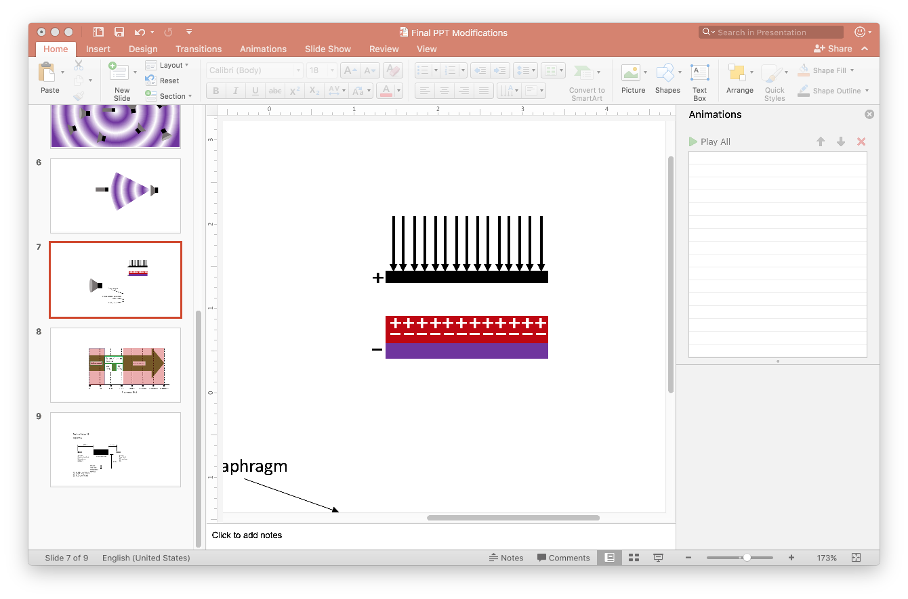
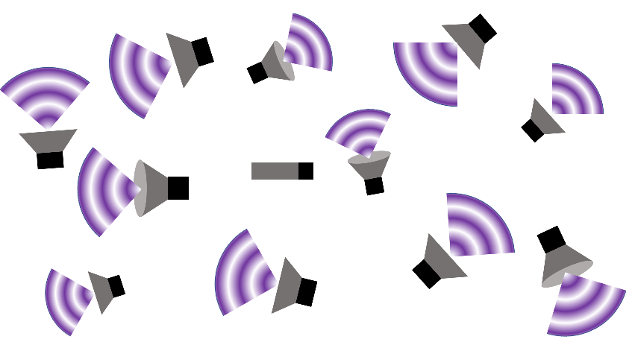
Microphone Types
Pre-polarized Condenser Microphones
  Passive Sensors
Free Field Microphone
  PCB 378A07
  0.25 – 10000 Hz
Random Incidence Microphone
  PCB 377C20
  5 – 6300 Hz
Diaphragm
Electret
Backplate
Microphone
Source
Microphone
Notes:
Pre-polarized condenser microphones have a electret (pre-polarized material)
Measure acoustic wave by change in charge
Free field microphones are made to pick up noise in front of it
Random incident is made to pick up noise around the room
5-6300 is the optimal frequency range for the random incidence microphone, but can detect lower frequencies.
PCB = PicoCoulomB

Slide 18
Preliminary Results
(Hz)
Notes:
Introduce the slide as saying that we ran a preliminary test using the same SDOF structure using a high fidelity accelerometer and a microphone.
Just label the two main peaks on both graphs.
21 runs that’s about 11 minutes worth of data using one microphone aimed at the SDOF structure.
The extra peaks in microphone sensor data is other noise picked up by microphone.
Our goal is to find ways of canceling noise with SDOF
Improve data so that it may be applied to MDOF structures
The graph on the left shows results of capturing the natural frequency of the SDOF structure using high fidelity accelerometers.
The graph on the left shows an accumulation of 21 experimental trials using a microphone sensor.
Both pick up the natural frequency.
Challenge is to figure out ways to cancel out irrelevant frequencies and support the fact that microphones can be used to detect structural properties.
Trying to figure out ways to cancel out irrelevant frequencies
High fidelity accelerometer sensor
Normal Accelerometer is subject to 2.4% error.
Accelerometer (time domain)
Sine sweep (frequency domain)
Filtering unnecessary frequencies
If someone ask about the 36.41 Hz frequency say that it was the bracket on the SDOF structure OR you can say some other part of the set-up but were not able to find out what specifically.

Slide 19
Microphone Sensor Experimentation
3 Microphone Sensors
  2 Free Field
  1 Random Incidence
Experimentation (0.05 cm and 0.1 cm Trials)
  Four Experimental Setups
  Four Post Processing Methods
z
y
x
Direction of Movement
x
y
RefMic1
Mic
RefMic2
Top View
3D View
Notes:
Now that we have a baseline for what the natural frequency of the structure is

Slide 20
Post Processing Methods – Time Domain
Individual Time
Total Time
Pressure Data
RefMic1
RefMic2
Pressure Data
Mic
RefMic1
RefMic2
-
-
Pressure Data
Mic
Filter
Filter
Filter
Filter
FFT
FFT
FFT
FFT
Sum
Sum
-
Sum
Notes:
Change Total Time diagram

Slide 21
Post Processing Methods – Frequency Domain
Individual Frequency
Total Frequency
Spectral Data
RefMic1
RefMic2
Mic
RefMic1
RefMic2
Spectral Data
-
-
Spectral Data
Sum
Sum
Mic
-
Sum

Slide 22
Testing Setup #1 – Diagram
Testing Setup #1 (7-26-2017)
Top View
42.5 in
23.5 in
378A07
Free Field
Mic
378A07
Free Field
RefMic1
SDOF Structure
38.0 in
377C20
Random Incidence
RefMic2

Slide 23
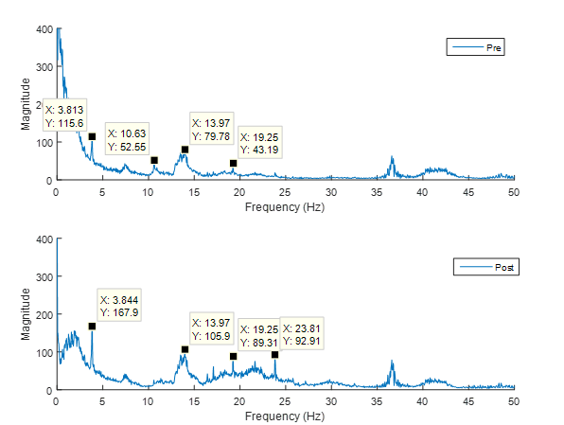
Testing Setup #1 – Individual Time (0.1 cm)
3 Mic Combination
Pressure Data
RefMic1
RefMic2
-
-
Pressure Data
Mic
Filter
FFT
Sum
Notes:
Noise sources are amplified, natural frequency only slightly amplified.

Slide 24
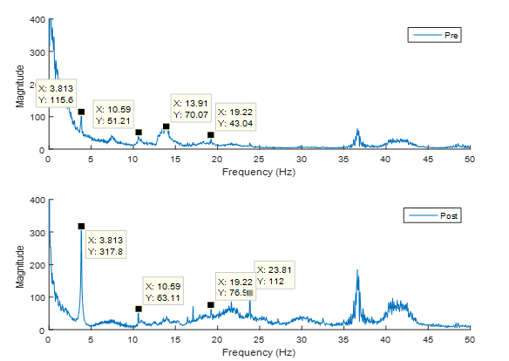
Testing Setup #1 – Individual Time (0.1 cm)
Alternate 3 Mic Combination
Pressure Data
RefMic1
RefMic2
-
-
Pressure Data
Mic
Mic
Filter
Filter
FFT
FFT
Sum
Notes:
Noise signals not amplified as much as before, but not completely eliminated. Magnitude of peak at natural frequency much higher than previous.

Slide 25
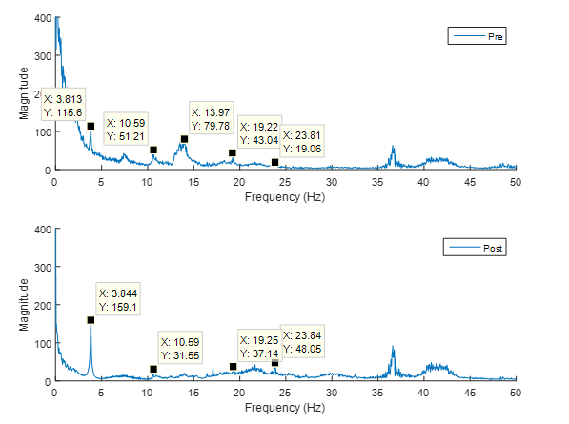
Testing Setup #1 – Individual Time (0.1 cm)
RefMic1 Combination
Pressure Data
RefMic1
-
Pressure Data
Mic
Filter
FFT
Sum
Notes:
Peaks at 10.59 Hz, 13.97 Hz, and 19.22 Hz reduced.
Noise in 0 – 2 Hz range reduced
Noise at 23.81 Hz amplified
Peak at natural frequency much more prominent

Slide 26
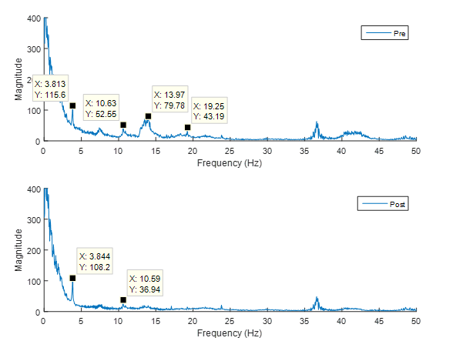
Testing Setup #1 – Individual Time (0.1 cm)
RefMic2 Combination
Pressure Data
RefMic2
-
Pressure Data
Mic
Filter
FFT
Sum
Notes:
Reduction in power at the natural frequency because RefMic2 is picking up some of the natural frequency of the structure
Noise signals reduced at identified sources of noise (not as much as with RefMic2)

Slide 27
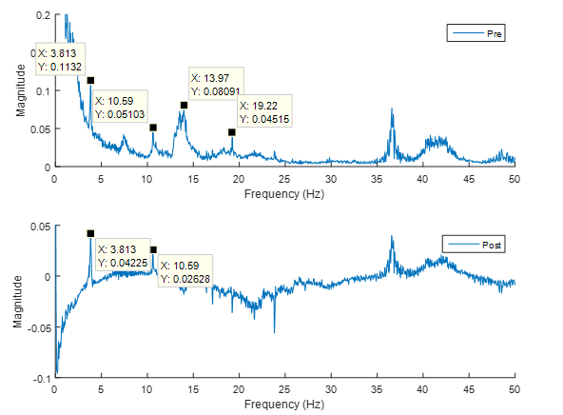
Testing Setup #1 – Total Frequency (0.1 cm)
RefMic1 Combination
Mic
RefMic1
Sum
Sum
-
Notes:
Noise signals at 13.97 Hz and 19.22 Hz eliminated
Reduction of power at natural frequency
0 – 2 Hz Low frequency noise eliminated
Noise at 10.59 Hz reduced, but not eliminated, and still large when compared to peak at natural frequency

Slide 28
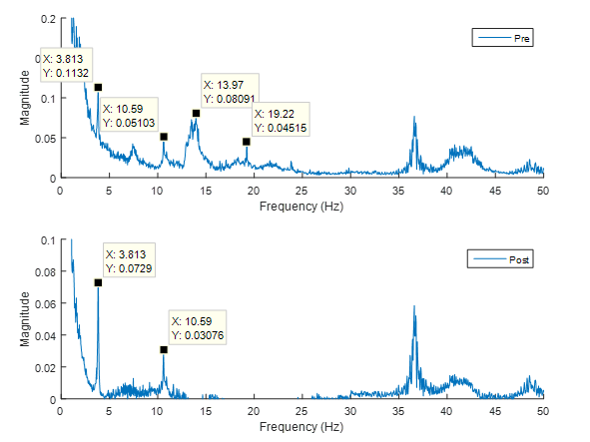
Testing Setup #1 – Total Frequency (0.1 cm)
RefMic2 Combination
Mic
RefMic2
Sum
Sum
-
Notes:
Reduction of power at natural frequency, although it is the most prominent peak
13.97 Hz and 19.22 Hz peaks eliminated
10.59 Hz peak reduced but not eliminated similar to other frequency methods

Slide 29
Testing Setup #2 – Diagram
Testing Setup #2 (7-27-2017)
Top View
42.5 in
23.5 in
378A07
Free Field
Mic
378A07
Free Field
RefMic1
SDOF Structure
27.0 in
377C20
Random Incidence
RefMic2

Slide 30
Testing Setup #3 – Diagram
Testing Setup #3 (7-28-2017a)
Top View
42.5 in
23.5 in
378A07
Free Field
Mic
377C20
Random Incidence
RefMic1
SDOF Structure
38.0 in
378A07
Free Field
RefMic2

Slide 31
Testing Setup #3 – Individual Time (0.1 cm)
RefMic1 Combination
Pressure Data
RefMic1
-
Pressure Data
Mic
Filter
FFT
Sum

Slide 32
Testing Setup #3 – Individual Time (0.1 cm)
RefMic2 Combination
Pressure Data
RefMic2
-
Pressure Data
Mic
Filter
FFT
Sum

Slide 33
Testing Setup #3 – Total Frequency (0.1 cm)
RefMic1 Combination
Mic
RefMic1
Sum
Sum
-

Slide 34
Testing Setup #3 – Total Frequency (0.1 cm)
RefMic2 Combination
Mic
RefMic2
Sum
Sum
-

Slide 35
Testing Setup #4 – Diagram
Testing Setup #4 (7-28-2017b)
Top View
43.5 in
11.5 in
378A07
Free Field
Mic
378A07
Free Field
RefMic1
SDOF Structure
39.5 in
377C20
Random Incidence
RefMic2

Slide 36
Testing Setup #4 – Individual Time (0.05 cm)
RefMic1 Combination
Pressure Data
RefMic1
-
Pressure Data
Mic
Filter
FFT
Sum

Slide 37
Conclusions from Experimentation
Most effective when only two mics included
  3 Mic combos amplify noise signals
  Distance from source matters
Setup #1 – RefMic1 Combo (Time)
  Reduce noise sources the most of all 4 setups
Setup #2 – Similar results to Setup #1
  Less reduction of noise sources
Setup #3 – Free field mic better in RefMic2 location
  Same type as Mic
Setup #4 – 0.05 cm trials better when Mic closer
  Peak at natural frequency amplified

Slide 38
Future Applications
More robust post processing algorithm
  Combine two post processing methods
All microphones are the same type
  All free field or all random incidence
Experimentation on more complex structures
  Double-degree-of-freedom structure
  Field Testing

Slide 39
References
[1] MATLAB & Simulink, Natick, MA: MathWorks, 2017. Computer software.
[2] Rao, Singiresu S. Mechanical Vibrations. 4th ed. Hoboken(N.J): Pearson education, Inc., 2017. Print.
[3] Barnard, Andrew. Fundamentals of Acoustic and Microphone Measurement. PCB Piezotronics, Inc. 2017. Print.
Some of the pictures/figures in this presentation were downloaded from internet and the copyrights of such belong to the original authors:
  http://www.seismicresilience.org.nz/topics/seismic-science-and-site-influences/earthquake-hazards/ground-shaking-2/
  http://www.fansshare.com/gallery/photos/16518226/tacoma-narrows-galloping-gerie-puente-bridge-gif/

