Slide 1


Magneto-Rheological Damper In Structures for Seismic Mitigation
Adam Davies, Chris Amaro, Jesus Caballero, Priscila Silva, Juvi Marin
Dr. Cheng Chen
Jun Jian Liang

Slide 2
Overview
Background/ Motivation
Brief overview of MR Dampers / Computational Models
Data Analysis
Metropolis-Hastings Algorithm
Summary
Conclusion
Notes:
Throughout this presentation we will show you what we have been working on, with, and what we still have to accomplish. This overview shows a simplified timeline of things we have accomplished as well as tools that we have used in order to further the research. Firstly though we are going to explain the reason as to why we are doing this research with background information. Secondly my partners are going to further explain how the software was used and also how it applies to this project. After that we will explain our findings and what they mean and also how it helps us to further this research. Lastly we will go over our remaining goals and also show and state our references

Slide 3
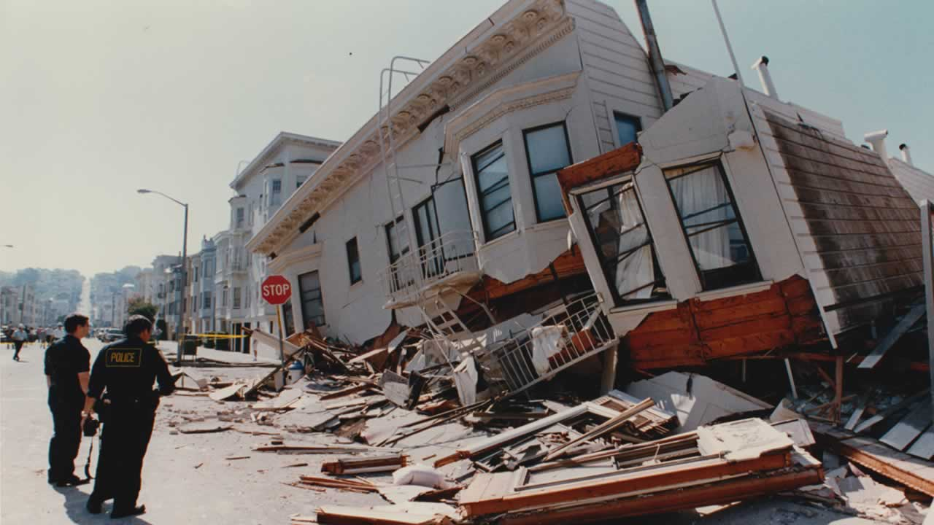
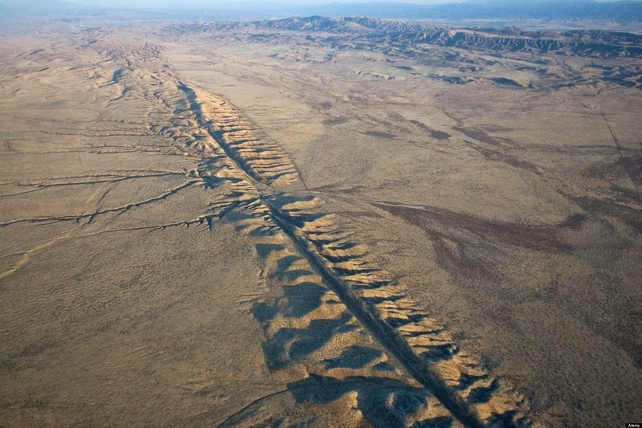
Background
San Francisco, California
Carrizo Plain, California

Slide 4
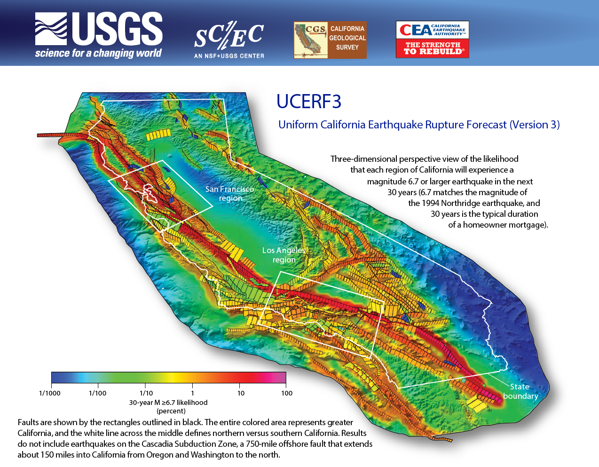

Slide 5
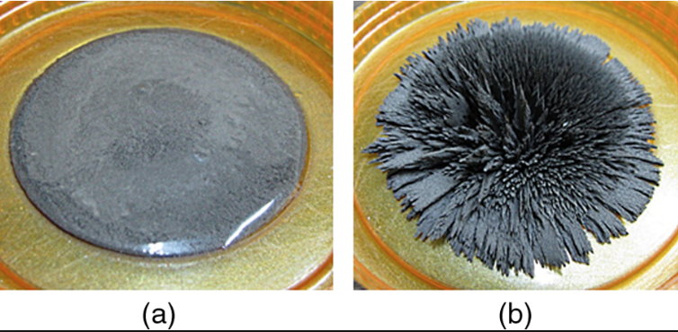
Smart Material
Changes its viscosity when subjected to a magnetic field
Sidpara, Ajay. “Magnetorheological Finishing: a Perfect Solution to Nanofinishing Requirements.”
Notes:
Transition:
As Juvi stated, earthquakes are capable of causing structural damage on a large scale.
Research has been done on a smart material that can help dissipate the energy produced by the earthquake which will reduce the amount of damage caused on a structure which can potentially save lives and money
The damper we focused on during this summer research is a Magneto-Rheological damper, also known as a MR damper.
What is smart material?:
The MR damper consist of smart material
This smart material can change its viscosity when it’s subjected to a magnetic field
Figure Explanation:
Here in figure a, you see the MR fluid that is free flowing
In figure b, you can see what happens when the MR fluid when it’s subjected to a magnetic field
Why is smart material better?
The reason why there has been an emphasis on a smart material damper is because it can change its viscosity quickly and adjust to the applied current
Transition: Slide 4 to Slide 5
In the next slide, I will go into detail of the components of an MR damper

Slide 6
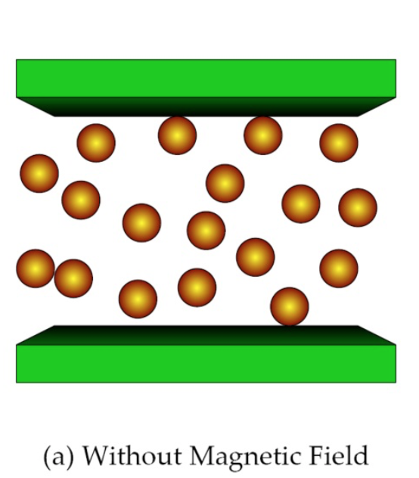
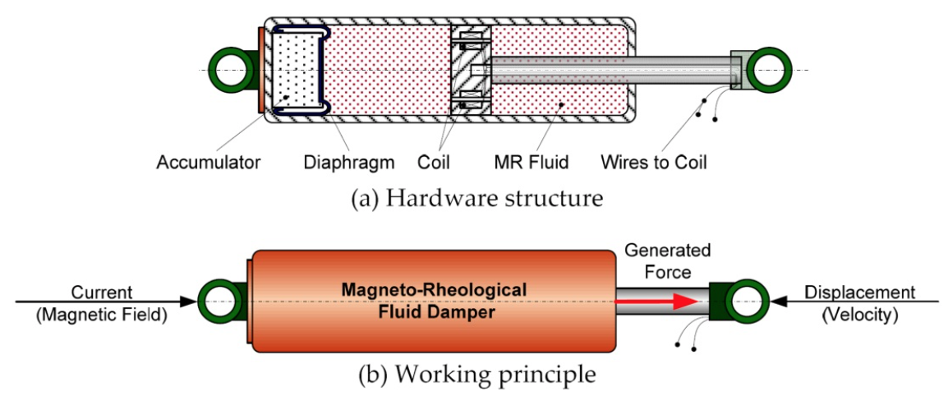
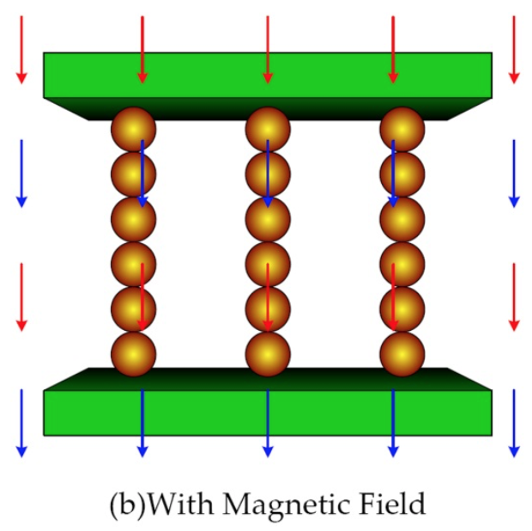
Magneto-Rheological (MR) Damper
Truong, D. Q., and K. K. Ahn. “MR Fluid Damper and Its Application to Force Sensorless Damping Control System.”
Notes:
What’s the point of an MR damper?:
An MR damper is a device mounted in the structure to reduce the amplitude of mechanical vibration
This application can prevent discomfort, damage, or structural failure
Components:
The MR damper, as seen in the top figure, consist of MR fluid, accumulator, diaphragm, coil, and wires to coil
The MR fluid is housed within the cylinder and flows through a small orifice
The force produced by a MR damper depends on the magnetic field induced by the current in the damper coil, as shown in the bottom image
Physics:
At this point you guys may all be wondering how does this all work, and the answer is Physics.
Normally MR fluid is a free flowing liquid having the consistency similar to motor oil
However, in the presence of an applied magnetic field, the iron particles acquire a dipole moment aligned with the external field which causes particles to form linear chains parallel to the field, as shown in figure a
This phenomenon can solidify the suspended iron particles and restrict movement
Consequently, yield strength is developed within the fluid
Transition: Slide 5 to Slide 6
Now that you’ve gotten a better understanding to how the MR damper works and its importance, I will now talk about the different models that we analyzed during our summer research

Slide 7
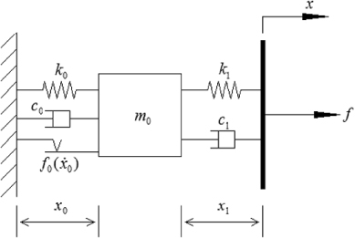
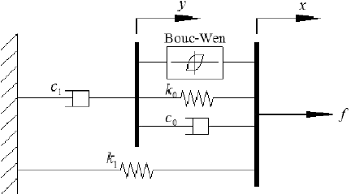
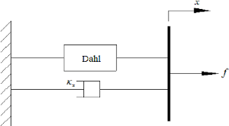
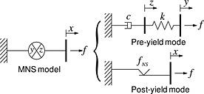
Computational Damper Models
Hyperbolic Tangent Model
Bouc-Wen Model
Viscous-Dahl Model
Maxwell Non-Linear Slider Model
Jiang, Zhaoshuo, et al. “Application of MR Damper in Real-Time Structural Damage Detection Using Extended Kalman Filter.” ResearchGate
Notes:
Transition:
From previous research done we focused on these four different models
Hyperbolic-Tangent
Bouc-Wen
Viscous-Dahl
Maxwell Non-Linear Slider Model
These models are important because we can run simulations of different currents without having to do any testing on a physical MR damper
Meaning of Models:
By focusing on each and independent model and their different parameters we can analyze the pros and cons of each one
The main difference between each model is the different equations required to make these models work and the different parameters associated with the models
Transition: Slide 6 to Slide 7
In the following slides Chris will show you an example of the difference between two models

Slide 8
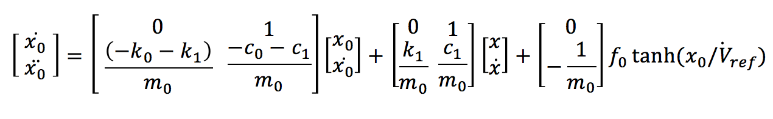
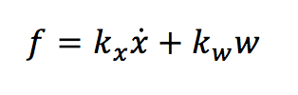
Hyperbolic Tangent Model vs Viscous-Dahl Model
Hyperbolic Tangent Model
Force equation:
Viscous-Dahl Model
Force equation:
Jiang, Zhaoshuo, et al. “Application of MR Damper in Real-Time Structural Damage Detection Using Extended Kalman Filter.” ResearchGate Liang, Jun Jian. "Comparison of Models for Large-Scale Magneto-Rheological Damper to Account for Uncertainty in Seismic Hazard Mitigation."
Notes:
Force differential equations are displayed, we chose not to display all the differential equations of velocity and displacement because it would take up too much space on the slide.

Slide 9
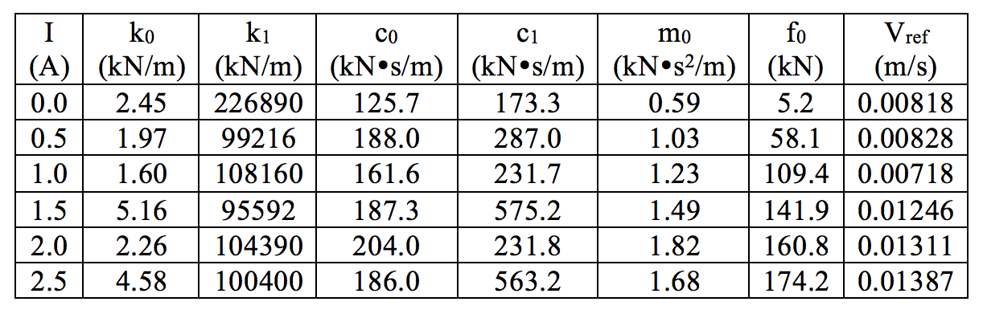
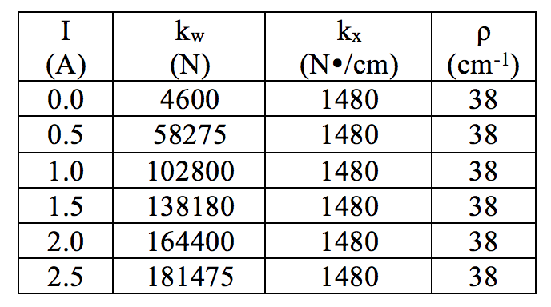
Hyperbolic Tangent Model vs Viscous-Dahl Model
Hyperbolic Tangent Model Parameters
Viscous-Dahl Model Parameters
Liang, Jun Jian. "Comparison of Models for Large-Scale Magneto-Rheological Damper to Account for Uncertainty in Seismic Hazard Mitigation."
Notes:
These parameters correspond to the differential equations of force, velocity, and displacement of each damper model we analyzed.

Slide 10
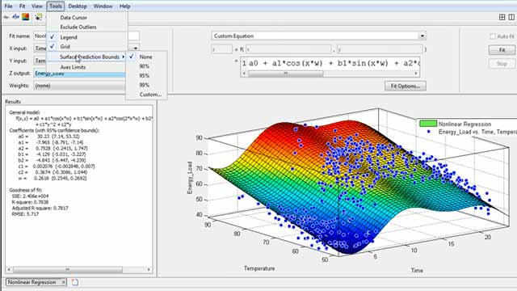


Software Used
MATLAB
Simulink
UQ Lab (Uncertainty Quantification)
Notes:
For the entirety of the project we primarily used MATLAB because it is a powerful research and engineering program. We also used some subprograms that are accessed through MATLAB, those programs are Simulink where you can run simulations within MATLAB and the second program was UQ Lab which allows you to do studies in uncertainty quantification.
Uncertainty Quantification deals with characterization and reduction of uncertainties, essentially it begins to eliminate some of the uncertainties associated with something you have designed.

Slide 11
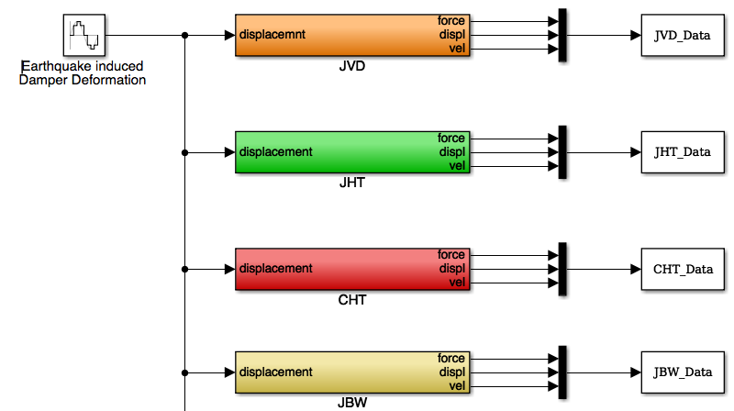
Simulink
Simulation Engine
Easy to create damper models from differential equations
Easy access to simulations in our research
Notes:
So let me go into some more details with simulink. Bullet 2: Simulink is a powerful tool for us because it allows us to EASILY create differential equations by laying out different icons in a blank simulink window. Also with Simulink we don’t have to set up lab equipment, or machines to conduct our work, this reduces expenses to conduct our research.
The diagram on the right represents the different damper models we worked with in Simulink and if you clicked on one of the colored boxes it would show you the layout of the model you selected, which would represent a set of differential equations.

Slide 12
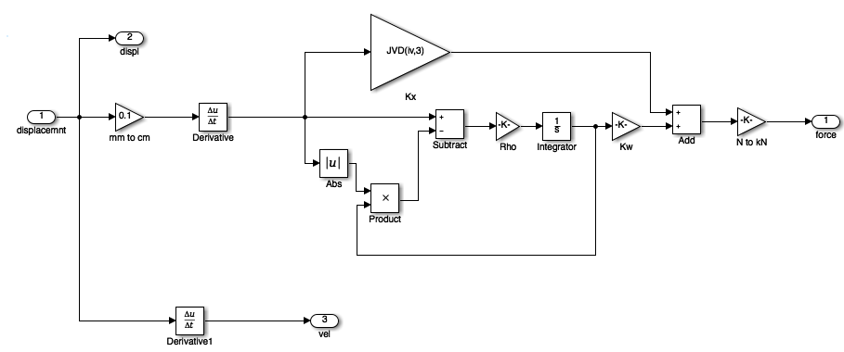
Viscous-Dahl Model in Simulink
Notes:
Here you see several icons in the simulink window, these icons represent the differential equations for the Non Parametric Algebraic damper model. (learn the full name of JNPA but don’t mention the Jiang) Non parametric algebraic model.

Slide 13
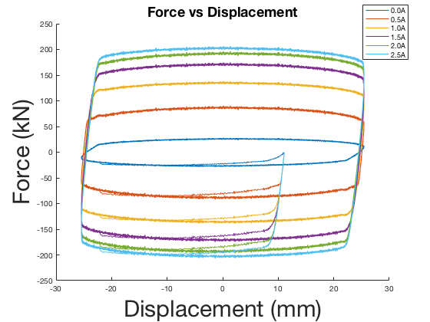
Damper Behavior
Bouc-Wen
Force increases with increasing current
Area in closed curve shows dissipated energy
Notes:
These two plots came directly from simulink. And represent displacement and velocity of the Bouc-Wen Damper model, both are related to force in the damper.
Piston displacement and force represented in curve
If you look at the first blue square in the center, you see it corresponds to a current value of 0.0A. As you may notice there are six different squares. The area in each square represents energy dissipated by damper, the area in each square changes depending on the value of current that runs through the damper, The current ranges from 0A to 2.5A and it increases in increments of 0.5A when the damper experiences larger external forces, there is a larger current that runs through the damper, thus dissipating larger amounts of energy. Our MR dampers are able to determine how much current they need to run through them based on the value of external forces, this is what allows our dampers to behave as smart dampers.
Hysteresis loops also change depending on the current that runs through the damper.
Hysteresis loops show the magnetization of a magnet.

Slide 14
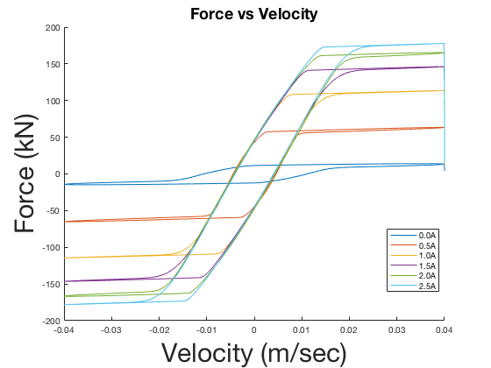
Bouc-Wen
Force increases with velocity and reaches point of saturation
I

Slide 15
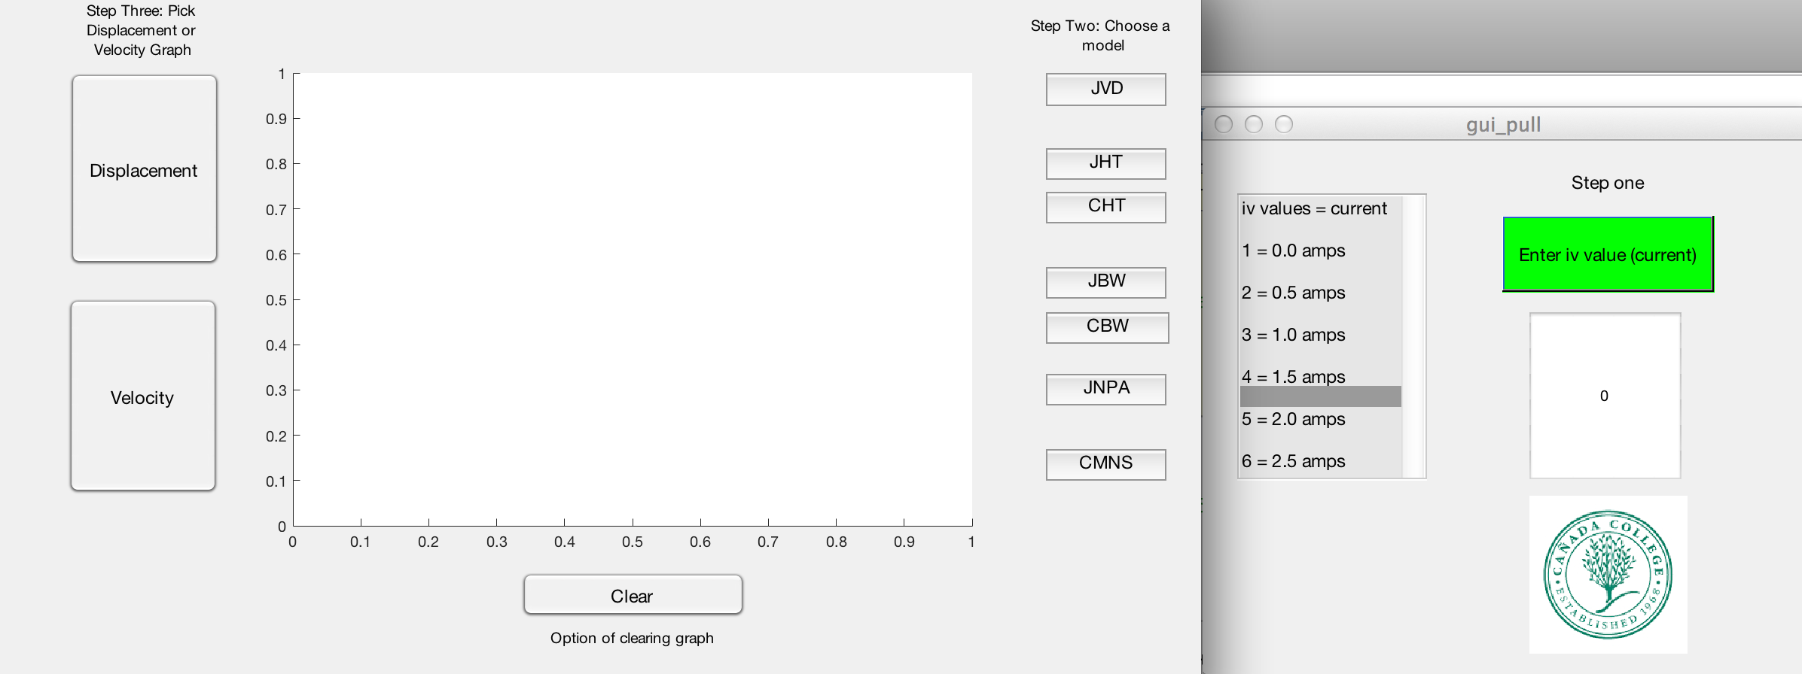
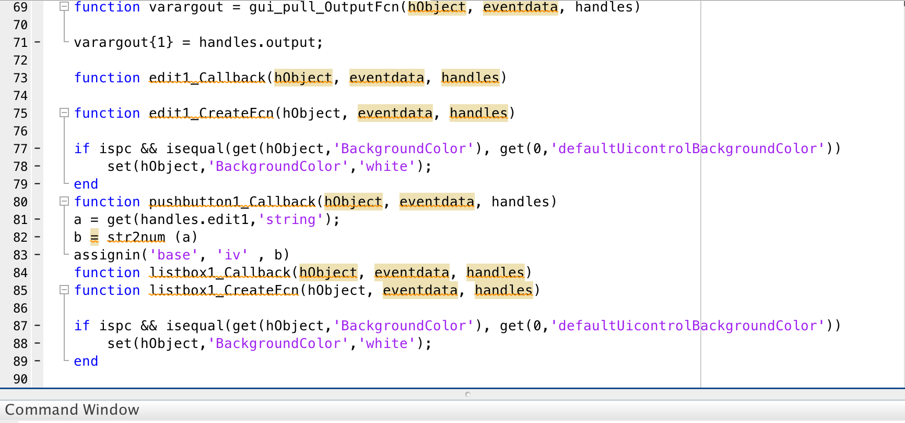
Graphic User Interface (GUI)
Interact using graphical components
Alternative to text based commands
Efficient and easy to use
Notes:
The simulink allows us to compile all the graphs and data. We wanted to be able to look at the graphs for the different models and compare and contrast them easily. To do this we created a GUI or graphic user interface, . This is a tool that will allows user to interact with a computer graphically. This is a alternative to text based user commands. The process is much easier than interacting with the command window directly and is more efficient. The pictures that you see is the GUI that we created to aid use with our research, and the code in the command window is only for the green button and the text box below it.
The pictures you see is the
Possibly stick with only your GUI diagrams
Don’t need to give little/minor details, dont need to show all methods to audience, distracts from main topic of presentation.

Slide 16
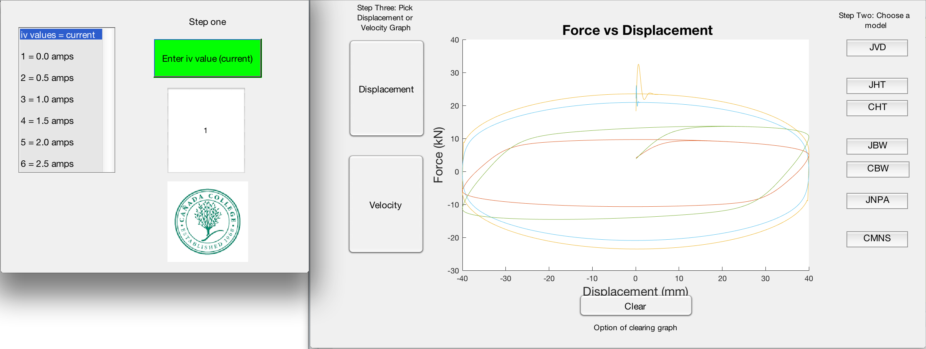
GUI interface
Notes:
This is the gui that we made, it’s a tool that allows use to do our comparisons easily.

Slide 17

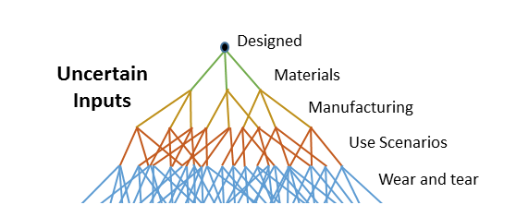
UQ Lab
Uncertainty Quantification
MatLab Based
Sensitivity Analysis Tool
“Uncertainty Quantification.” Uncertainty Quantification | SmartUQ, www.smartuq.com/resources/uncertainty-quantification/.
Notes:
UQ stands for uncertainty quantification. UQ lab is a matlab based program that allows us to run simulation and scenarios. As you see on the right the graph conceptually shows how most simulations work, yet in our case the parameters are different from the ones you see on the graph. Since our models are more computational we are not worried about things like materials, manufacturing and stuff like that we are more focused on the specifics of the theory. For this specific project we stuck to sensitivity analysis to test out the damper models and see if there are uncertain points that need attention or refining. For Sensitivity analysis there are statistical models that the models are put through in order to fully test out the computational models that we have been researching this summer. For example there is input/output correlation, standard regression coefficients, perturbation theory. It’s a powerful tool that allows us to test the model and see if there is any uncertainty.

Slide 18
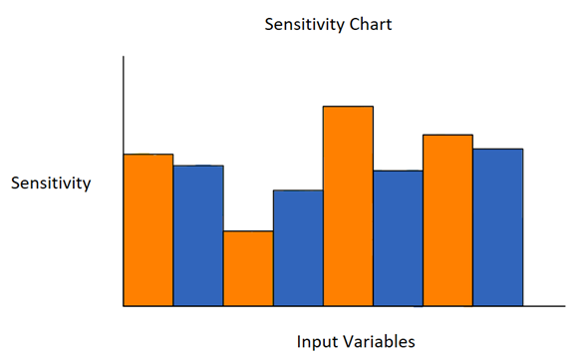
Data Analysis
Parameters correspond to respective model equations
Variable with the highest value = most sensitive
  Each bar corresponds to variable sensitivity
  Charts to be modified are evenly distributed
Notes:
Ideal is not quite true, we aren’t trying to modify stuff, we want to observe results. `

Slide 19
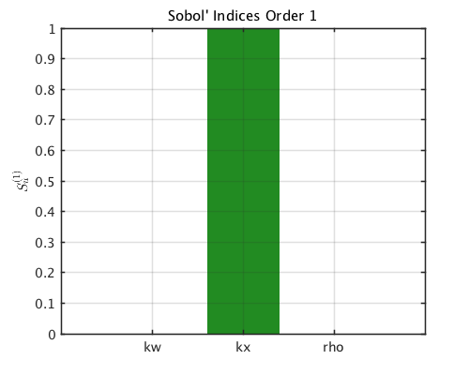
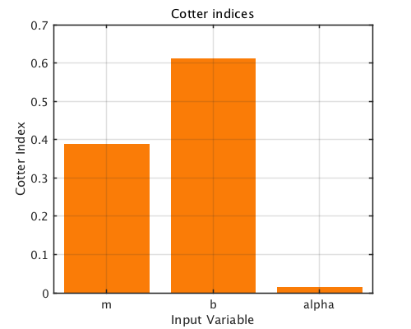
Data: VD, NPA
Identified Parameters for Viscous Plus Dahl Model
Identified Parameters for Non-Parametric Algebraic Model
Notes:
The higher the density value is for a parameter, the larger impact the parameter has on the model.

Slide 20
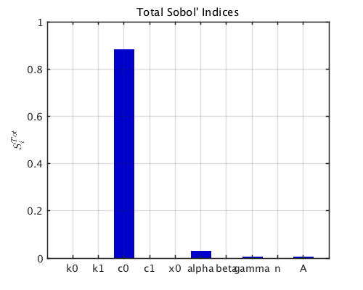
Bouc-Wen Data
Identified Parameters for Bouc-Wen Model

Slide 21
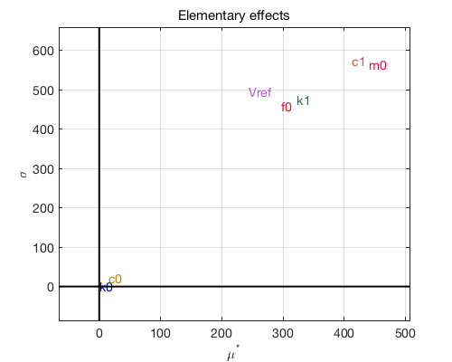
Hyperbolic Tangent Data
Identified Parameters for Hyperbolic Tangent Model

Slide 22
Metropolis-Hastings Algorithm
Notes:
Transition:
The metropolis hastings algorithm, MHA, is a realistic mathematical modeling approach that helps generalize experimental results
Using probabilistic approach means treating the model parameters as random variables, which is how it is analyzed in MHA
MHA generates sample parameter sets that can show potential correlations between parameters, which may provide insight to the uncertainty in the algorithms used for control applications

Slide 23
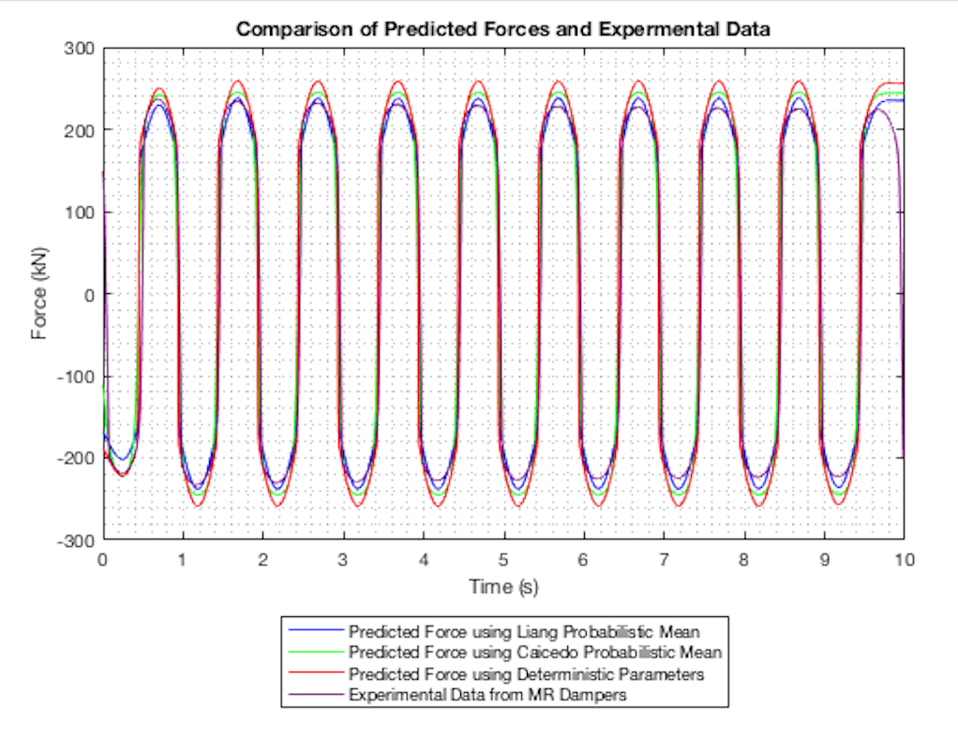
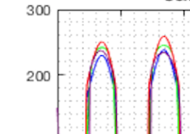
Non-Parametric Algebraic MHA Results
Notes:
Non-Parametric Algebraic Model
In the non-parametric algebraic model we compared the predicted force using deterministic parameters versus
On this particular trial we noticed that our mentors probabilistic parameters is more precise compared to the deterministic parameters

Slide 24
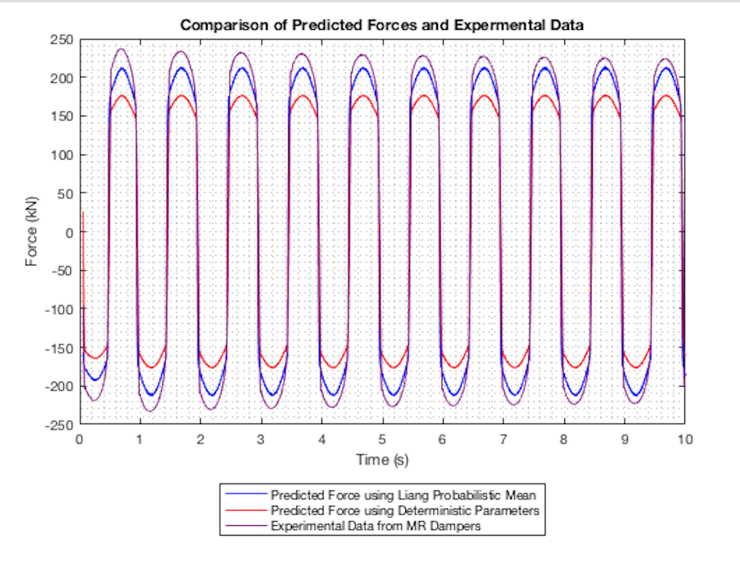
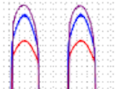
Viscous-Dahl MHA Results
Notes:
JVD

Slide 25
Conclusion
Probabilistic more precise than deterministics for our trials
Recommendation of analyzing parameters of other computational models
Future work including Single-degree of Freedom
Notes:
Recommendation of analyzing parameters of Bouc-Wen, Hyperbolic Tangent, and Maxwell Non-Linear Slider models with the Metropolis-Hasting Algorithm.

Slide 26
Summary
Magneto-Rheological dampers
Computational Models
Analysis of Data Gathered
Conclusions
Future Work

Slide 27


Slide 28
References
Jiang, Z., and R. Christenson. "A Comparison of 200 KN Magneto-rheological Damper Models for Use in Real-time Hybrid Simulation Pretesting." Smart Materials and Structures 20.6 (2011): 065011. Web.
Chae, Yunbyeong, James M. Ricles, and Richard Sause. "Modeling of a Large-scale Magneto-rheological Damper for Seismic Hazard Mitigation. Part I: Passive Mode." Earthquake Engineering & Structural Dynamics 42.5 (2012): 669-85. Web.
Caicedo, Juan M., Zhaoshuo Jiang, and Sarah C. Baxter. "Including Uncertainty in Modeling the Dynamic Response of a Large-Scale 200 KN Magneto-Rheological Damper." ASCE-ASME Journal of Risk and Uncertainty in Engineering Systems, Part A: Civil Engineering 3.2 (2017): n. pag. Web.
4. D.Q. Troung and AhnK.K. “MR Fluid Damper and It’s Application to Force Sensorless Damping Control System.” Intech (2012): DOI: 10.5772/51391. Web
5. Liang, Jun Jian. "Comparison of Models for Large-Scale Magneto-Rheological Damper to Account for Uncertainty in Seismic Hazard Mitigation." Comparison of Models for Large-Scale Magneto-Rheological Damper to Account for Uncertainty in Seismic Hazard Mitigation (2018): 1-14. Web.
6. “USGS: California Has 99.7 Percent Chance of Big Earthquake in Next 30 Years.” Fox News, FOX News Network, 15 Apr. 2008, www.foxnews.com/story/2008/04/15/usgs-california-has-7-percent-chance-big-earthquake-in-next-30-years.html.
7. Truong, D. Q., and K. K. Ahn. “MR Fluid Damper and Its Application to Force Sensorless Damping Control System.” MR Fluid Damper and Its Application to Force Sensorless Damping Control System | InTechOpen, InTech, 17 Oct. 2012, www.intechopen.com/books/smart-actuation-and-sensing-systems-recent-advances-and-future-challenges/mr-fluid-damper-and-its-application-to-force-sensorless-damping-control-system.
8. Sidpara, Ajay. “Magnetorheological Finishing: a Perfect Solution to Nanofinishing Requirements.” Optical Engineering, International Society for Optics and Photonics, 1 Sept. 2014, opticalengineering.spiedigitallibrary.org/article.aspx?articleid=1857354.
9. Jiang, Zhaoshuo, et al. “Application of MR Damper in Real-Time Structural Damage Detection Using Extended Kalman Filter.” ResearchGate, 10 Aug. 2015,
10. www.researchgate.net/figure/281792403_fig2_Figure-31-Schematic-of-the-MR-damper-hyperbolic-tangent-model.
“Uncertainty Quantification.” Uncertainty Quantification | SmartUQ, www.smartuq.com/resources/uncertainty-quantification/.

Slide 29
Questions ?

