Slide 1


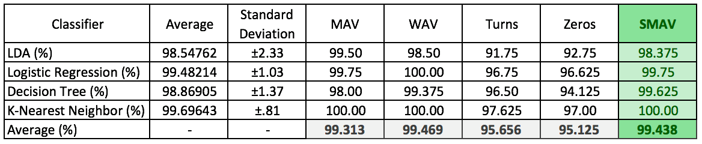
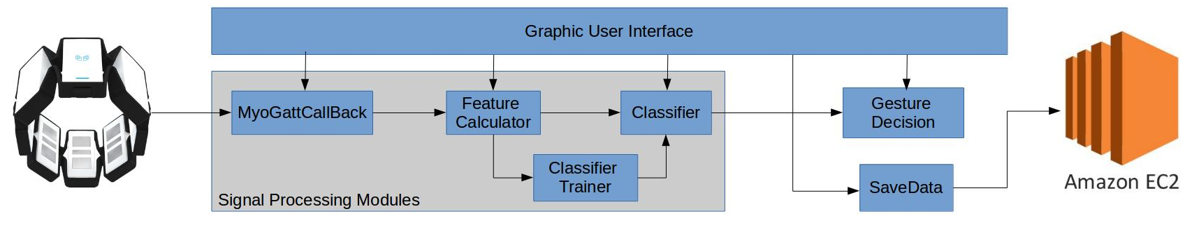
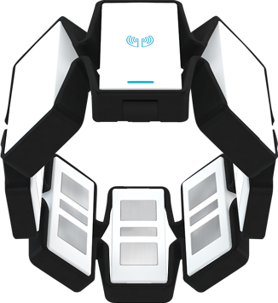
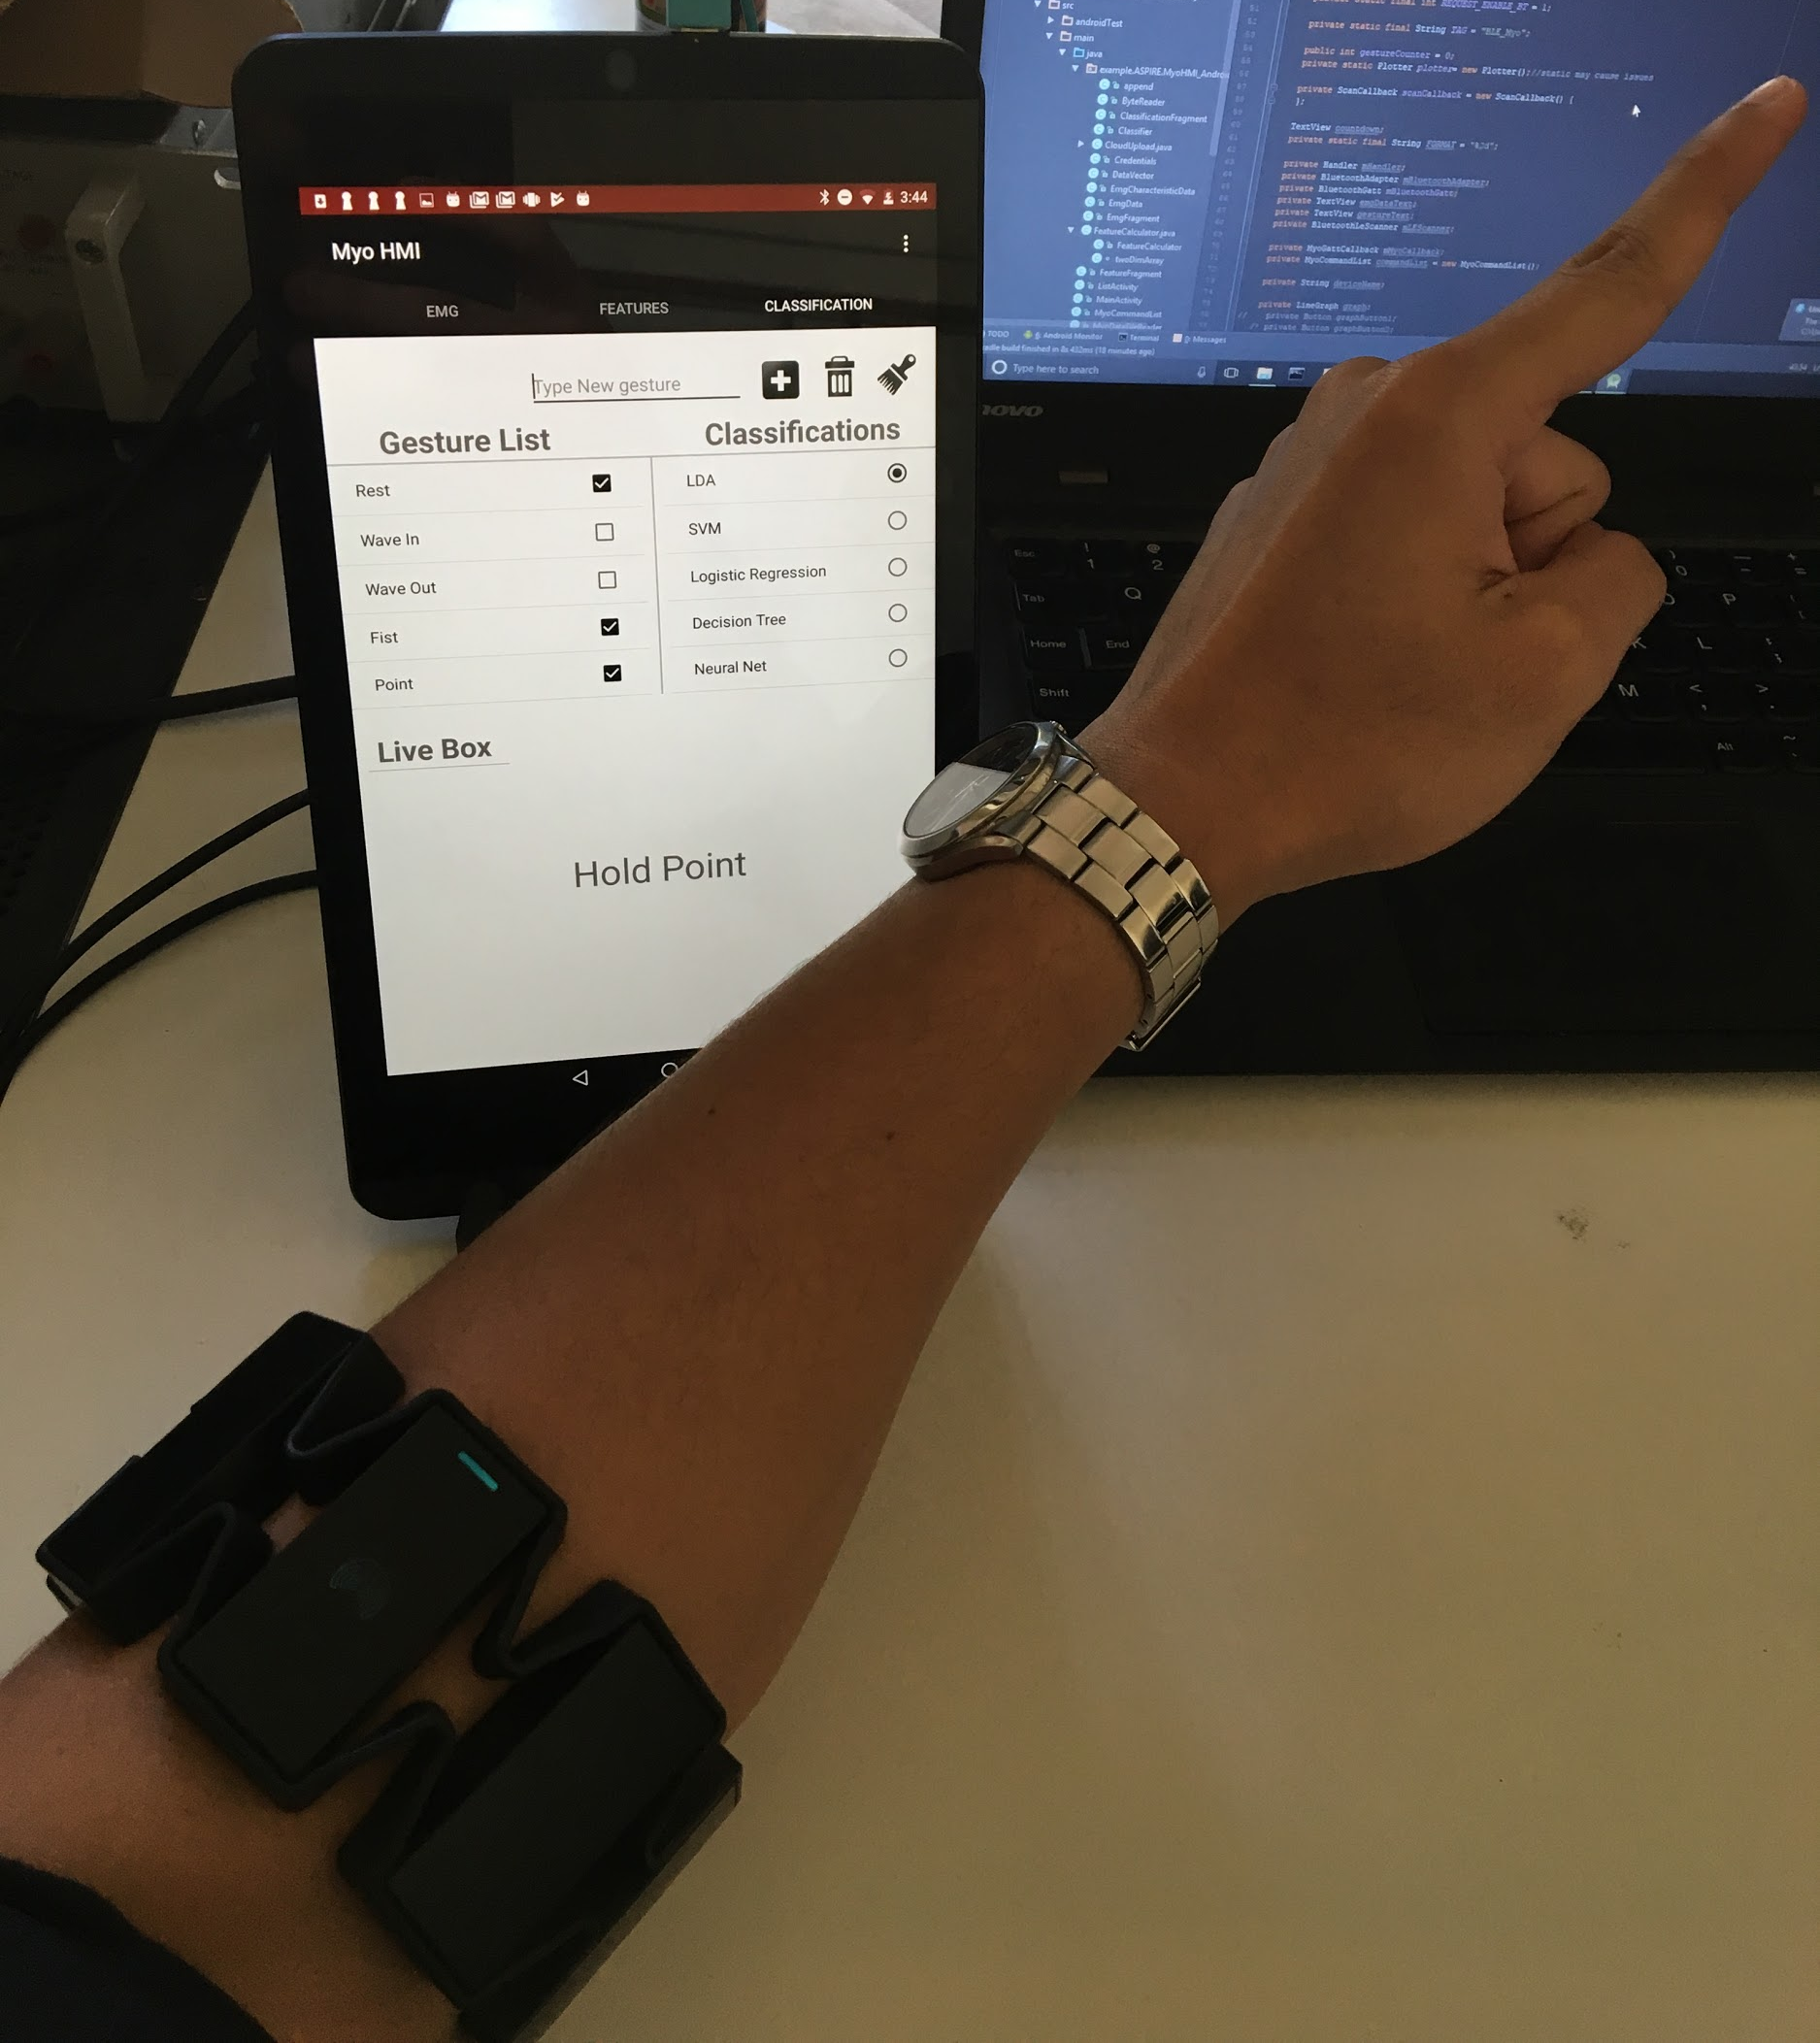
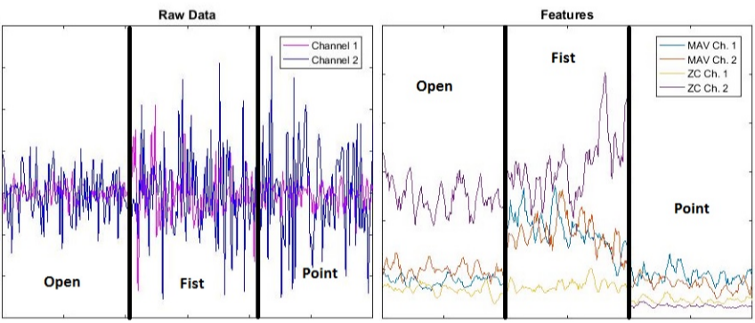

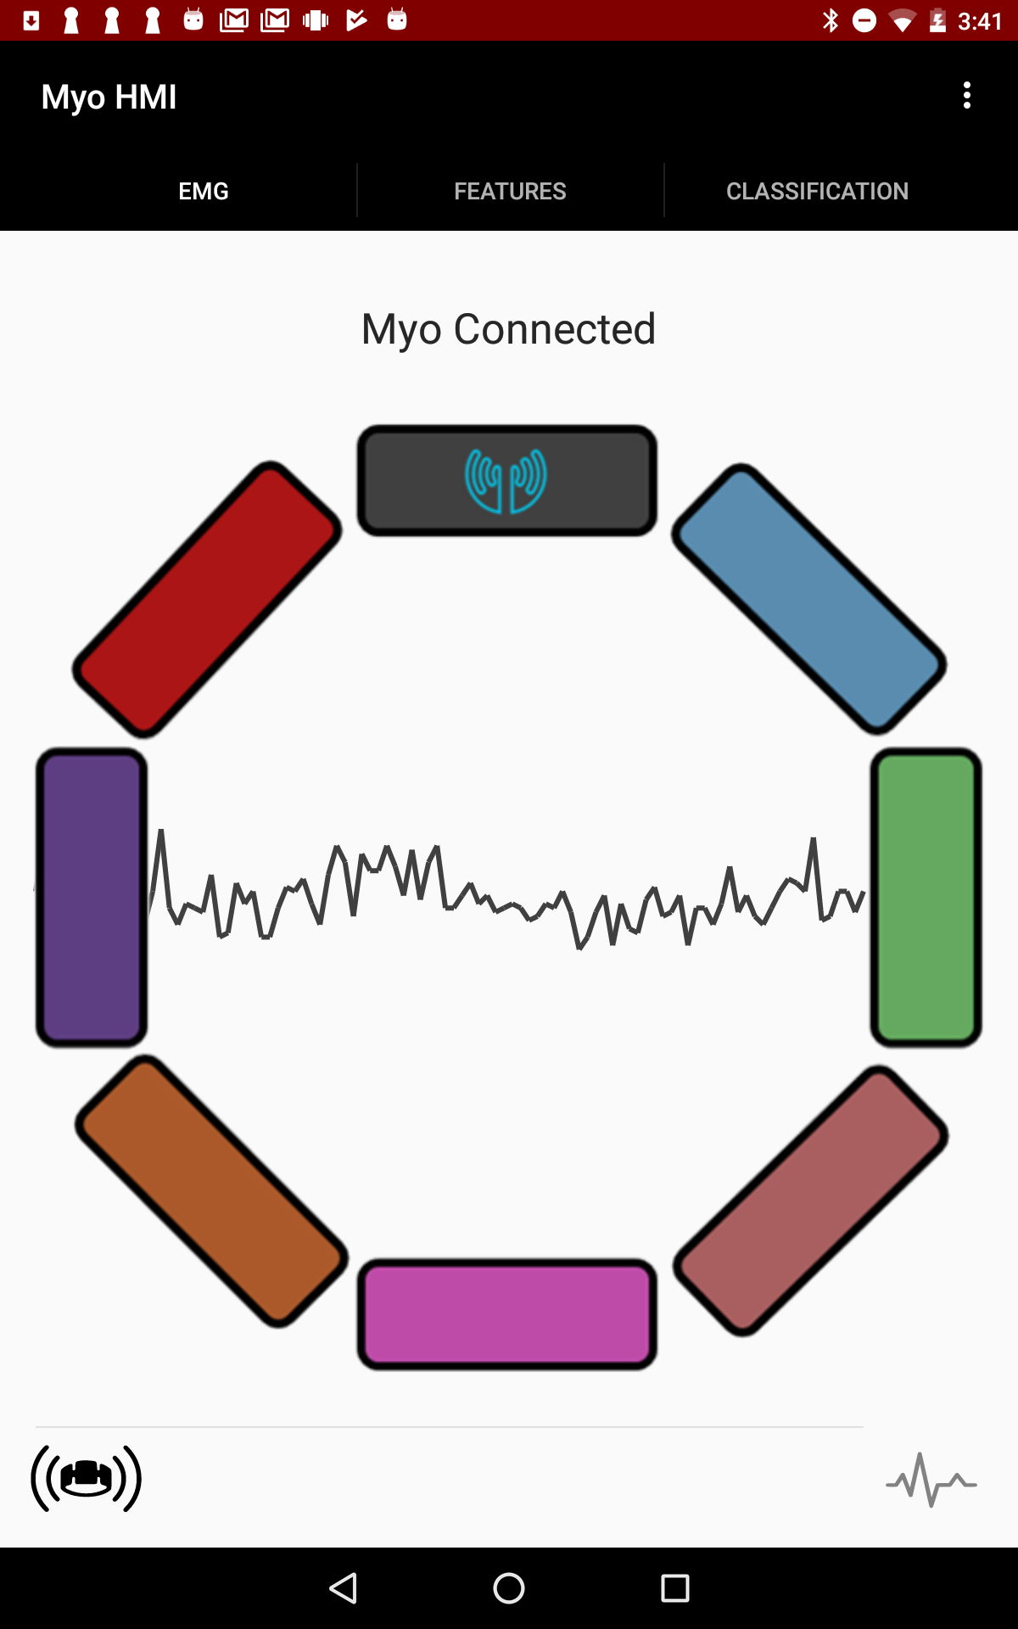
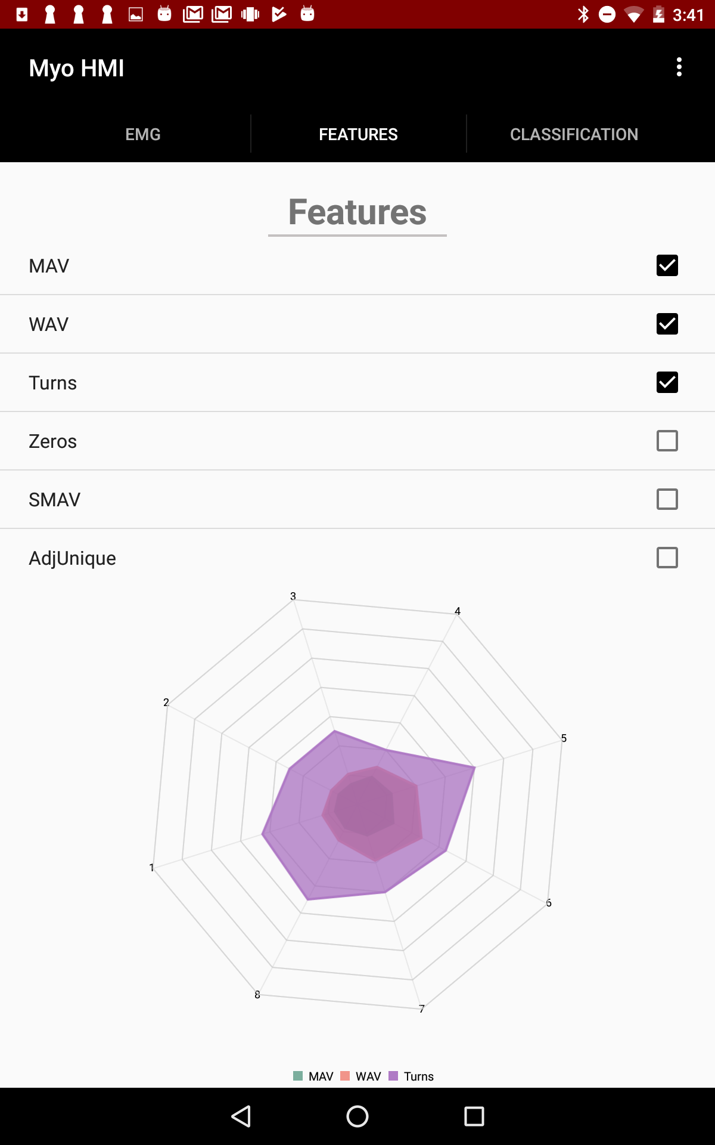
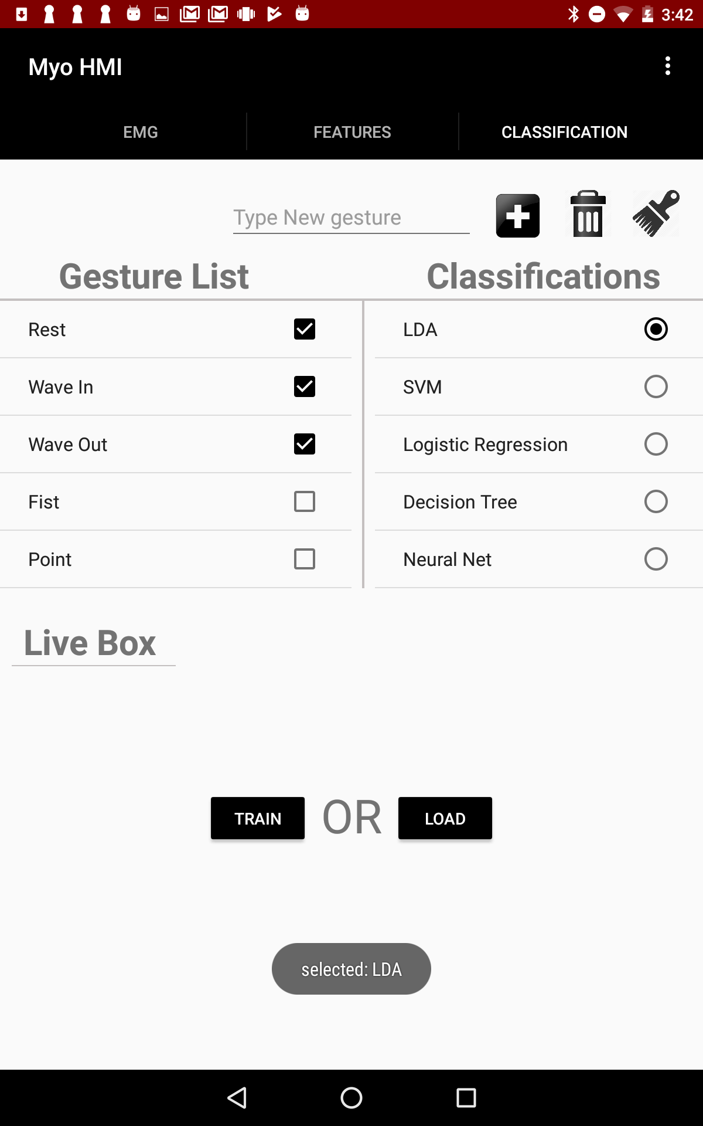
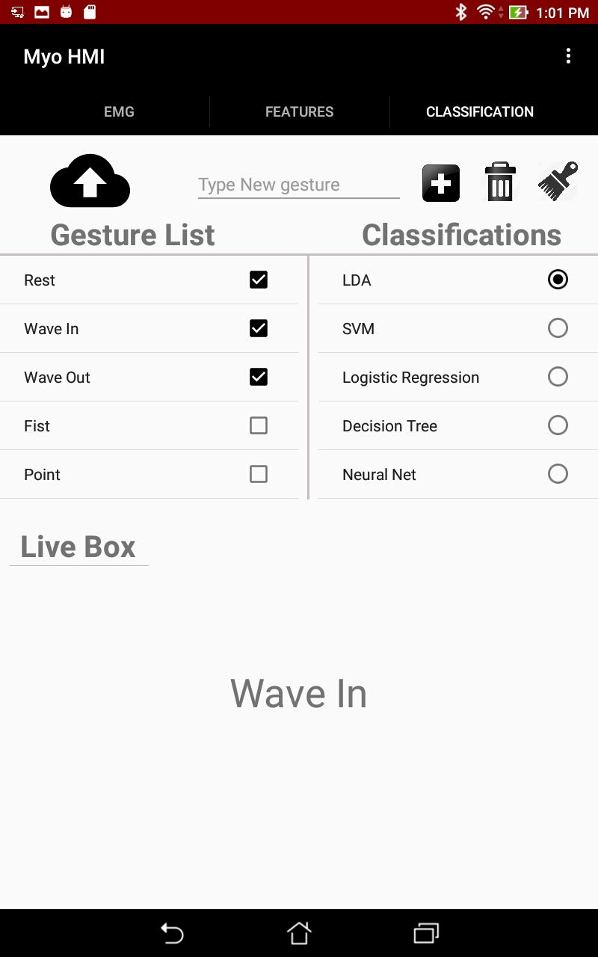
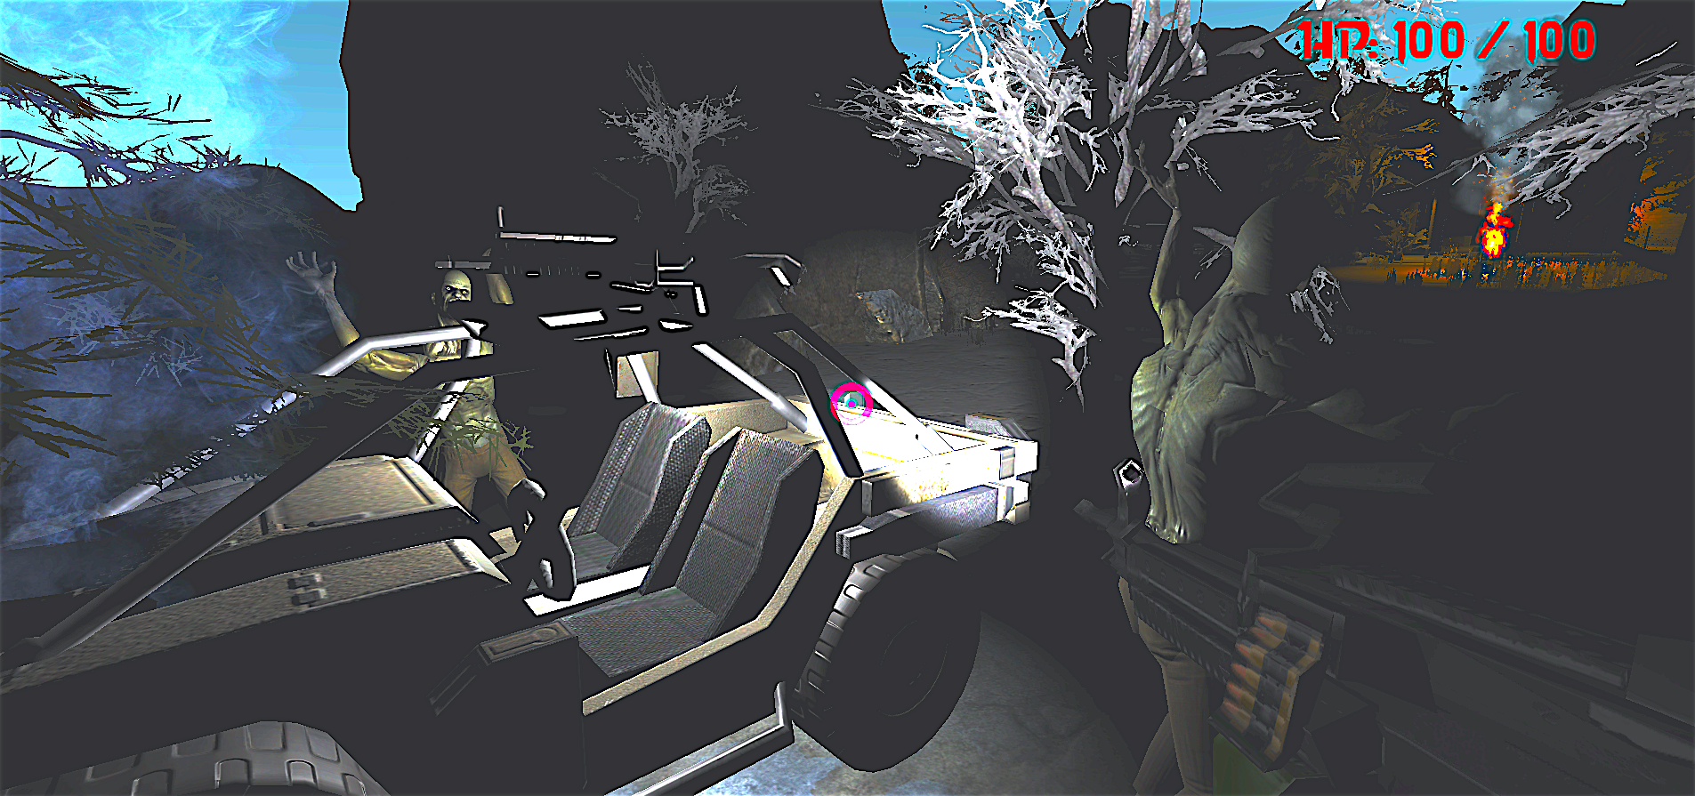
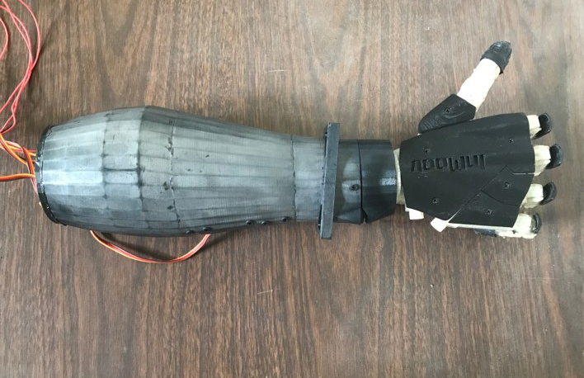
Developing a Mobile Application and Cloud Computing Framework for Gesture Recognition Using Electromyographic (EMG) and Inertial Measurement Unit (IMU) Data
Kattia Chang-Kam¹, Karina Abad¹, Ricardo Colin¹, Cameron Malloy¹, Charles Tolentino¹
Advisors: Dr. Xiaorong Zhang², Dr. Amelito Enriquez¹, Mentor: Alexander David²
¹Cañada College, ²San Francisco State University
BACKGROUND
Experimental Results
MATERIALS & METHODS
Classifier-Feature Accuracy
Goal: Developing the next-generation Neural-Machine Interface (NMI) using Internet-of-Things (IoT) and Cloud
Computing Technology
Motivation: To develop myoelectric controlled applications that allow natural and intuitive motion and gesture control
Other existing methods:
Computer-vision
Mechanical-sensing gloves
MyoHMI App Overview:
10 test subjects perform 3 trials training 8 gestures
Gestures: rest, wave in , wave out, point, fist, open hand, supination, and pronation
Post-training real-time gesture prediction testing
Subjects given a survey to rate app performance and aesthetic from 1 to 5
Myo Armband
Classifiers
Gesture Output
8 EMG sensors, 200 Hz
9-Axis IMU sensors, 50 Hz
Haptic Feedback
Low Energy Bluetooth 4.0
Linear Discriminant Analysis
Support Vector Machine
Logistic Regression
Question Topic | Responsiveness | Accuracy | Ease of Use | Aesthetic
Average Rating | 4.4 | 3.6 | 4.5 | 4.5
Decision Tree
K-nearest Neighbor
Feature Extraction
Features
CONCLUSIONS
Mean Absolute Value (MAV)
Expanded the HMI from a desktop application to a mobile application
Produced a reliable, portable, durable, fast and functional yet appealing HMI
Implemented a cloud storage platform that is accessible over an established cellular signal
OBJECTIVES
Develop a mobile application and cloud computing framework for gesture recognition using EMG and IMU data
Design a framework for the IoT-based
NMI
Develop a usability assessment test
Waveform Length (WAV)
Slope Sign Change (TURN)
Zero Crossing (ZERO)
Scale MAV (SMAV)
Adjacent Uniqueness (AU)
FUTURE WORK
Project Outcomes
Implement more classifiers and features
Integration of EMG and IMU data
Quantification of computational and communication latencies of each computing layer
Documentation and webpage development of the project to make it open to the public
Visual output of the raw EMG data and features are shown to the user
The app is able to train and classify predetermine and custom gestures
It enables data sharing and storage through the cloud and locally on the device
SIGNIFICANCE
Low cost and open source
Portable and flexible
Customizable gestures
Applications:
ACKNOWLEDGEMENTS
ASPIRES (Accelerated STEM Pathways through Internship, Research, Engagement, and Support) program Grant No. P120A150014. Special acknowledgements to Dr. Amelito Enriquez of Cañada College and Dr. Xiarong Zhang and Alexander David of San Francisco State University
Trained Classifier
REFERENCES
Hudgins, B., P. Parker, and R.n. Scott. "A New Strategy for Multifunction Myoelectric Control." IEEE Transactions on Biomedical Engineering IEEE Trans. Biomed. Eng. 40.1 (1993): 82-94.
Phinyomark, Angkoon, Chusak Limsakul, and Pornchai Phukpattaranont. "A Novel Feature Extraction for Robust EMG Pattern Recognition." Journal of Computing, (2009).
Smile - Statistical Machine Intelligence and Learning Engine. 2017. Retrieved from: https://haifengl.github.io/smile/
Notes:
Analyze feature data in Amazon’s Elastic Compute Cloud (EC2)
Connect the application an external client

