Slide 1


Design and Comparison of Anti-Fuse-Based Non-Volatile Latch
By Alex Hercules, Anthony Lal, Michael Gee
Student Assistants: Tyler Rasay, Amelia Bowlin
Led by Dr. Mahmoodi and Tyler Sheaves

Slide 2
Outline
Background and Motivation
Non-Volatile Memory Technologies
Competing Existing Volatile Solution
Previous NV Design: MTJ-Based NV-Latch
Proposed NV Design: Anti-fuse based NV Latch
Design Methods
Results
Comparisons & Conclusions
Notes:
We’ll begin with our motivation for pursing this technology. First, we’ll explain the difference between volatile and non-volatile memory. Next, we’ll introduce the two types of competing non-volatile solutions. We used last summers research for data on MTj. This summer we developed our own standard size cell for implementation. We then show how we developed and optimized our design. Finally, we’ll compare the characteristics of Mtjs and AF.

Slide 3

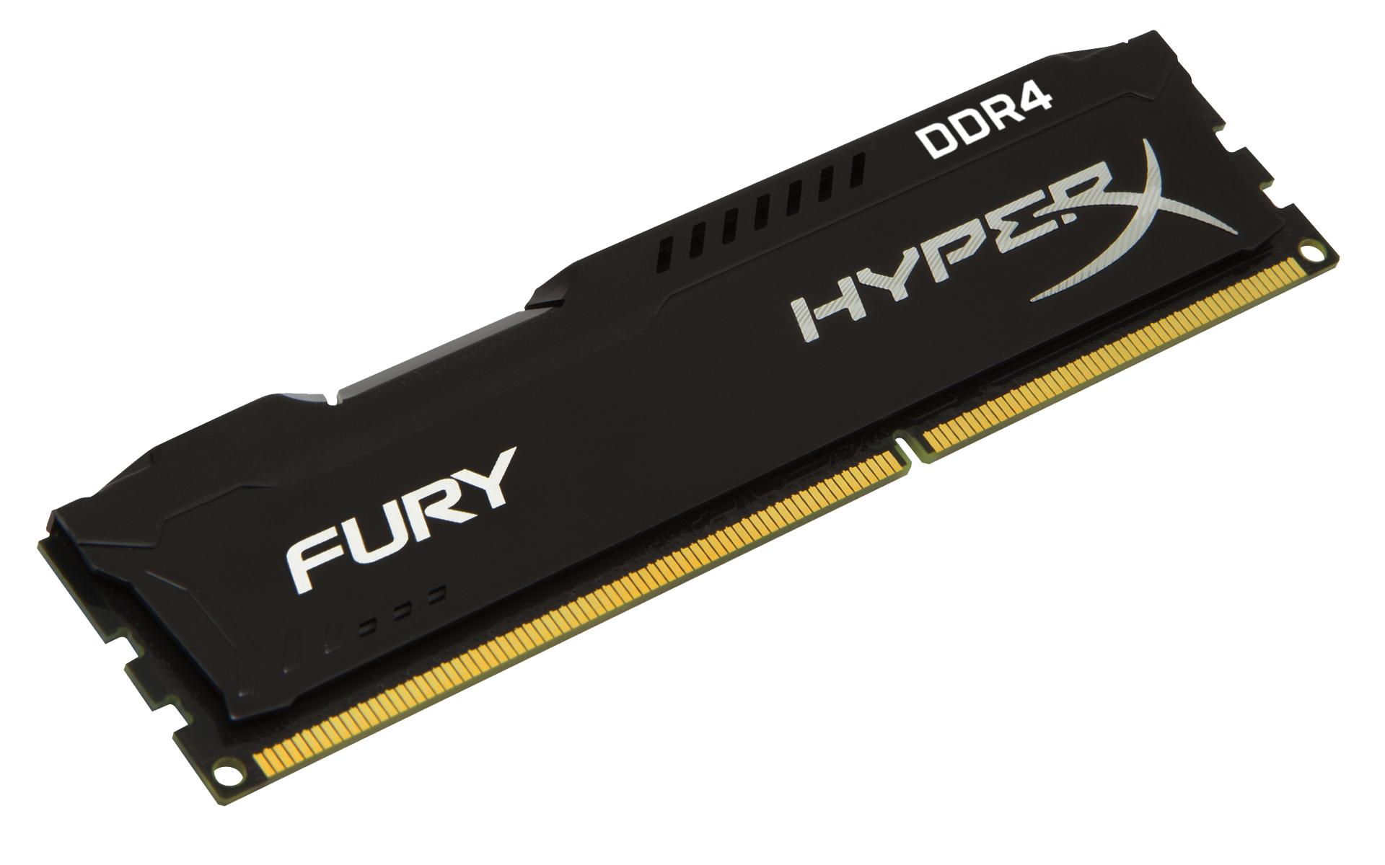

Background and Motivation
On CPU Chip
Increasing Latency
Increasing Cost
CPU Register
Stored Volatile information is erased upon power loss.
Stored Non-Volatile information is preserved independent of power state.
L1, L2, L3
Cache
Volatile
Main Memory
Ex. DRAM
Non-Volatile
Secondary Memory (storage)
Ex. Magnetic or Flash Memory
Memory
Notes:
Speed comes at the cost of volatility.
The path that memory follows.
Data that the user does not want erased upon power loss should be stored in secondary memory i.e. Operating System Application data etc.
When a program is used, it gets loaded into DRAM. i.e. for example when we use powerpoint, components of the application get loaded into DRAM.
The memory highlighted in orange is on the same chip as the CPU
CPU does all of the computations that are done on a typical system
System control and the fastest system calculations are done on the CPU
Fastest forms of memory/lowest access times are data that is loaded on the CPU
Lowest power overhead comes from accessing data that is on the CPU
If we had non-volatile Storage on-chip(meaning on the CPU chip)
Slowest form of memory is secondary storage
Next slowest is dram but becomes volatile
Next fastest is cache which is the first level of memory on chip
CPU Register holds two types of data, operands and instructions. These are small packets of data which can be rapidly processed by the CPU.
Example of CPU instruction: ADD SUBTRACT DIVIDE COMPARISON…
Other types of intsructions load, store, read, write

Slide 4
Background and Motivation
CPU Reg (Bits)
Volatile
Access Time/Power/Security Issues
  Access Time is based on speed of data transferred through buses, and component performance.
  Power is dissipated as it travels through the buses and components to the CPU.
  Security Issues become more susceptible off-chip i.e. off of CPU.
Cache
(Mega bytes)
DRAM
(Giga bytes)
Secondary
Storage
(Tera Bytes…)
Non-Volatile
Notes:
Opennig Device: So now that we have a working understanding of the types of memory, their applications and trade offs, we can talk more in depth about what their issues are and give motivation for why this research is significant
Well go over delay, power and security.
There are issues that arise from the delay, power and security cost of propagating data from component to component:
Delay: Comes from pushing information across long distances, also small delays can be present within components (access time of large memory arrays. ( delivering packages)
Power: Much like delay as data propagates through buses and component, power is consumed.
In modern digital logic we have two types of power loss (static and dynamic) Static comes from states that are retained, power will leak out of system when that data is retained. States that also use power (The same parasitic component which introduce delay also dissipate power)
Security: becomes an issue, because data has to travel from storage to storage, there is enough time for a savvy hacker to take advantage of this
One current solution is encryption, but even encryption is not perfect (side channel attacks, power analysis, decryption algorithms) Data is most susceptible when transferring from components to components.
Some data is fine to transfer, but sensitive data is not, it would be better to have the packages made and delivered at home.
Data would live on the CPU that is considered a security risk
What out research hopes to achieve are slashing delay, minimizing power consumption and significantly boosting our security.

Slide 5
Resistive Memory Technologies:
Competing Volatile Memory
Typical Volatile Memory:
  SRAM
  D-Flip Flop
Charge is placed on a node and data is stored as long as system power is present
Data is permanently lost in the event of a power outage due to discharge.
CPU Register
L1, L2, L3
Cache
Main Memory (DRAM)
Notes:
Currently, all computers and devices use volatile memory to store data.
Data is represented in either the form of a lack of voltage potential or voltage potential.
Examples of volatile memory are SRAM and D-flip flops which can be found on the CPU of a device
When power is present, you can think of a node as a capacitor that can accumulate charge and store data.
Volatile memory requires electronically conductive material to function.
The property of this material will remain constant.
Therefore, when power is lost, the data stored on that node is permanently lost.

Slide 6
Non-Volatile Memory Technologies:
Existing Technologies
Typical Non-Volatile Memory:
  SSD
  HDD
Data retained independent of power state.
NOT COMPATIBLE WITH CPU MANUFACTURING TECHNOLOGY!!
Secondary Memory (storage)
Ex. Magnetic or Flash Memory
Notes:
Typical examples of non-volatile memory are solid-state drives (SSD) and hard disk drive (HDD).
These devices operate by using altering the resistance of the material to store data.
Data is then read out as a resistance value.
In order for non-volatile memory to function, it requires the material whose resistance can change under specific electronical biasing.
The main reason we want to implement this technology is that data is independent of power state.
NV tech is not compatible however, we propse

Slide 7
Resistive Memory Technologies:
Embedded NV Memory
By embedding non-volatile memory inside the CPU chip, data frequently used by the CPU will not be lost upon power down, and the benefits of NV storage without the drawbacks of intra-component data transfers can be achieved.
Notes:
Over the summer we looked at two competing technologies: MTJs and Anti-fuse. We used the data and research from the previous group for MTJs. For Anti-fuse, we used findings from Dr. Mahmoodi and developed the necessary circuitry to implement the read and write capabilities. Finally, we then compared the two in terms of area, reliability, power, and programmability.
All of our research operates under the premise that if we can embed nv memory inside the cpu it can offer savings time, power, and security. If this technology takes of in the future, we can create computers without secondary storage.

Slide 8
Resistive Memory Technologies:
OTP vs. MTP
One Time Programmable (OTP):
  A device that can only be programmed once.
  Ex. Circuit Breaker Fuse
Multi-Time Programmable (MTP):
  A device that can be programmed multiple times.
  Ex. Hard Disk
Notes:
There are two general types of resistive memory technologies, one time programmable devices and Multi-Time Programmable (or MTP for short).
Circuit Breaker Fuse: Once the fuse breaks in your circuit breaker, the fuse is no longer usable.“Or when a lightbulb breaks”
Hard Disk: You can delete a program, add a program, update your device. You can change it as many times as you want.
And the reason this distinction is important is because our team has looked at two types of non – volatile devices that allows us to store data independent of Power – The Magnetic Tunnel Junction and The Anti-Fuse

Slide 9
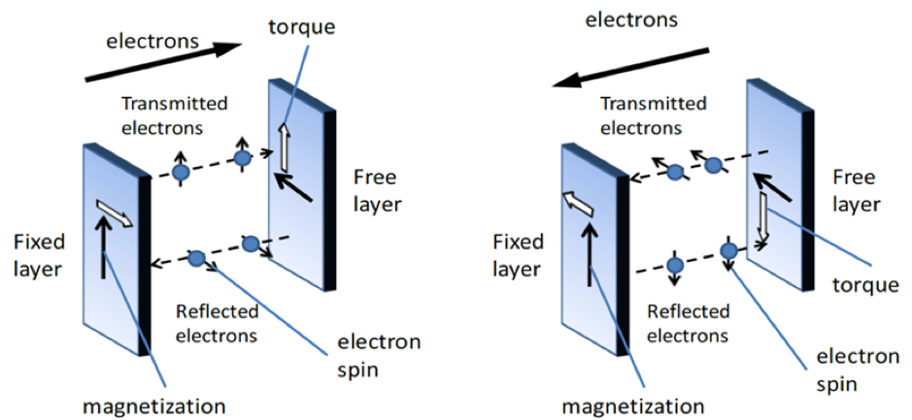
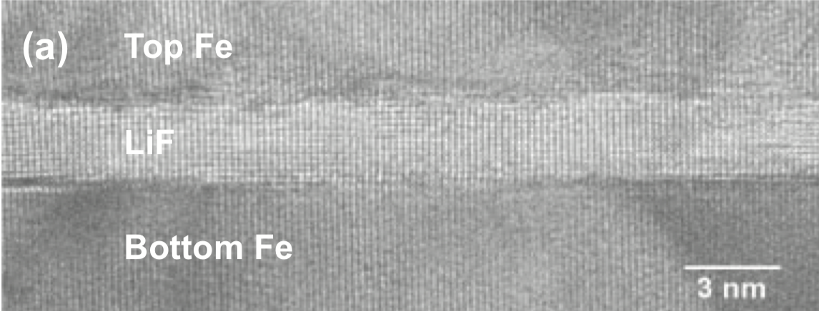
Resistive Memory Technology #1:
Magnetic Tunnel Junction (MTJ)
Reprogrammable Device with two ferro-magnetic layers with insulating layer in between
Current runs bidirectional through the device
Change in Resistance becomes Binary value dependent on current direction and quantity
Resistive ratio of 2 at best.
Notes:
Here we have a Magnetic Tunnel Junction (or MTJ for short) one of the resistive memory technologies.
MTJs are made of a ferromagnetic material which is a metallic material whose magnetic field polarity can be influenced by a stronger magnetic field.
The MTJ is a non volatile element whose resistive state is dependent on the magnetic polarity of two magnetic layers.
If you pass current in one direction, the magnetic layers will be parallel to one another. More easier for electrons to travel. Less Resistive.
If you pass current in the other direction, the magnetic layer will be anti-parallel. Harder for electrons to travel. More Resistive.
Therefore, the resistance of this device is configurable based on the amount and direction of current.
While this device is theoretically compatible with standard transistor manufacturing techniques , it has not been implemented on a wide scale yet.
Ideally, we have a resistive ratio of the states of our devices close to infinity because of a open and close circuit.
One potential drawback of implementing this technology is its low resistive ratio which is 2
For example if I had a low resistance of 1kohm the largest high resistance I could expect is 2kohms
This is much more difficult for surrounding circuitry to reliably detect making MTJs more difficult to implement.

Slide 10
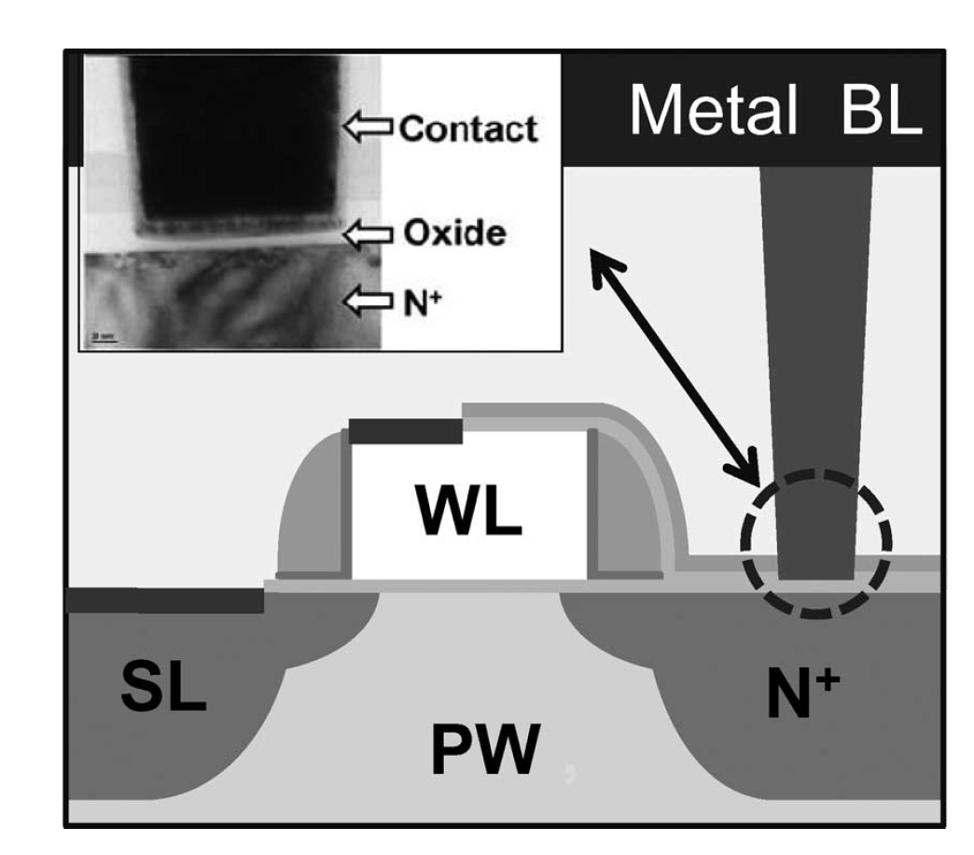
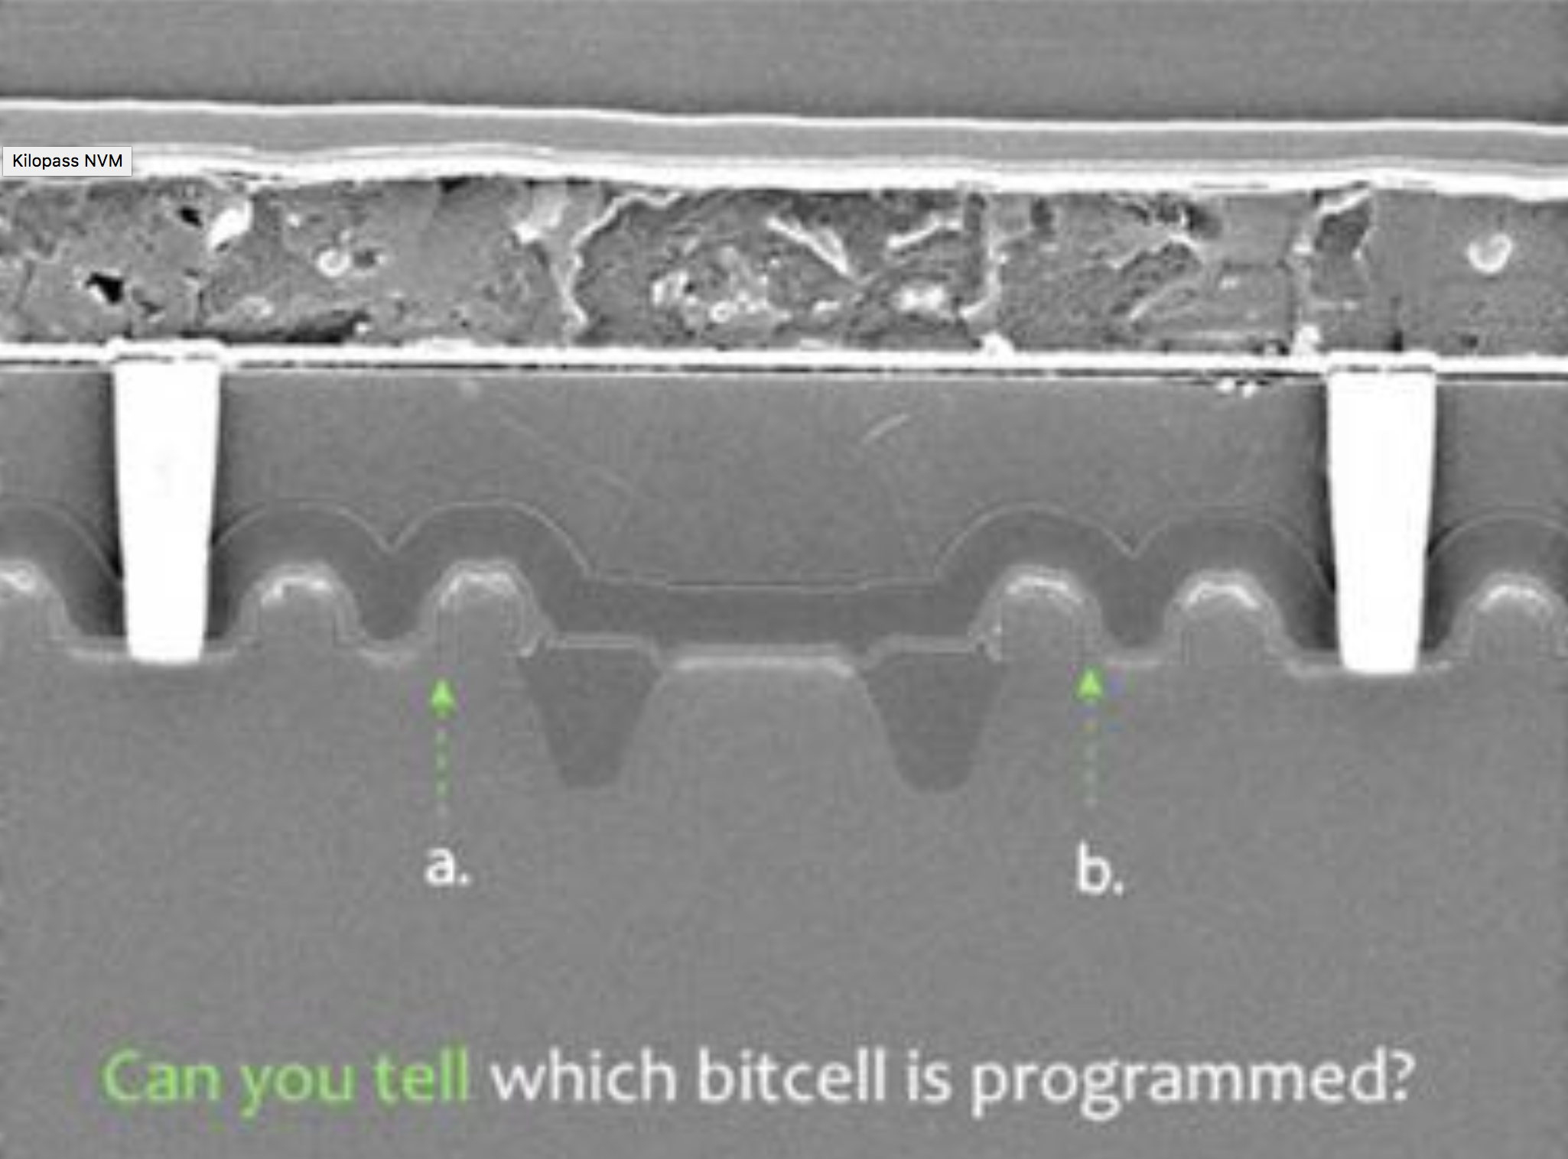

Resistive Memory Technology #2:
(AF) Anti-Fuse
One-time Programmable Device made of dielectric, metallic, and insulating materials
Can be blown by placing a large electric field across it.
${10}^{5}$ resistive ratio!
Notes:
Openning device: Another Non-volatile element is the AntiFuse. And true to its name, it works the opposite of a typical fuse.
Here well go over its function, properties and electrical characteristics
The AF is an OTP element meaning it is only programmable once…
The AF when presented with enough voltage will transistion to a blown state….
Afs are made of dielectric, metallic and insulating materials and they are It is fully compatible with and has been implemented on standard transistor manufacturing techniques and has proven very difficult to reverse engineer (look at bottom picture) The change of resistance occurs at the atomic making it difficult to image. Kurzgesagt: This is something we can do today! ….unlike the MTJ

Slide 11
Competing Existing Volatile Solution:
Volatile vs Non-Volatile Data Storage
Non-volatile cell stores data in resistive form
Write driver changes the state of the NV cell
Sense Amplifier sets the state of the volatile cell based on the state of non-volatile cell
Volatile
Resistively
Represented
Data
Volatile
Volatile
Converted
Resistive
State
Retained
Data
Non-Volatile Component
Volatile
Component
Data
Volatile
Component
Data
Sense Enable
Write Enable
Sense Enable
Notes:
Opening device: Lets wrap everything we know up to know and compare the difference between volative and non volatile storage.
Well go over the two cell diagram below.
Present data to the volatile device, the data is retained once sense enable is turned on, and data will continue to be retained also long as power is present or new data is sensed.
Data is presented once again but there is an intermediate step. The intermediate step is you convert data to a resistive form by writing to our nonvolatile component, that data is then converted again but to a voltage. The resistance stored the data non-volatilely. You do not risk the loss of the data at power down.

Slide 12
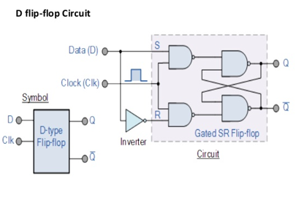
Competing Existing Volatile Solution :
D Flip-flop
Consist of 2 inputs: Data and Clock.
If clock is high, data propagates to output ‘Q’ .
If clock is low, data will NOT affect the output.
Used to temporarily store data such as logic block inputs/outputs.
Notes:
I would like to indroduce a volatile solution a D flip-flop.
This here is the logical circuit design and it consist of 2 inputs: Data D and Clock.
When the clock is high or on, data passes to the output
When the clock is low or off , data has no affect on the output, in other words it holds its original output.
Due to being volatile it is used to temporarily store data.

Slide 13
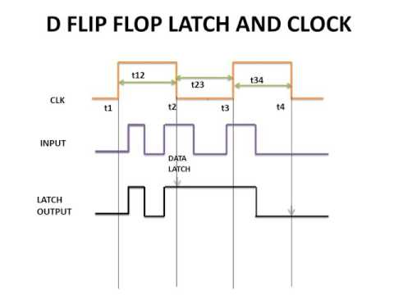
Competing Existing Volatile Solution :
D Flip-flop
Data stored in the form of accumulated charge
  Maintained only while system maintains power
Low cost, volatile, standard cell.
Notes:
The way a D flip flop works is by storing data in the form of charge, but is only contained while the system is being powered.
A D flip flop gives the benfit of low cost, volatility, and is a standard cell.
A standard cell is a collection of low level electrical logic functions such as AND gates, OR gates, or inverters.
Standard cells are provided by manufacturers and are highly reliable therefore have an extremly low failure rate.

Slide 14
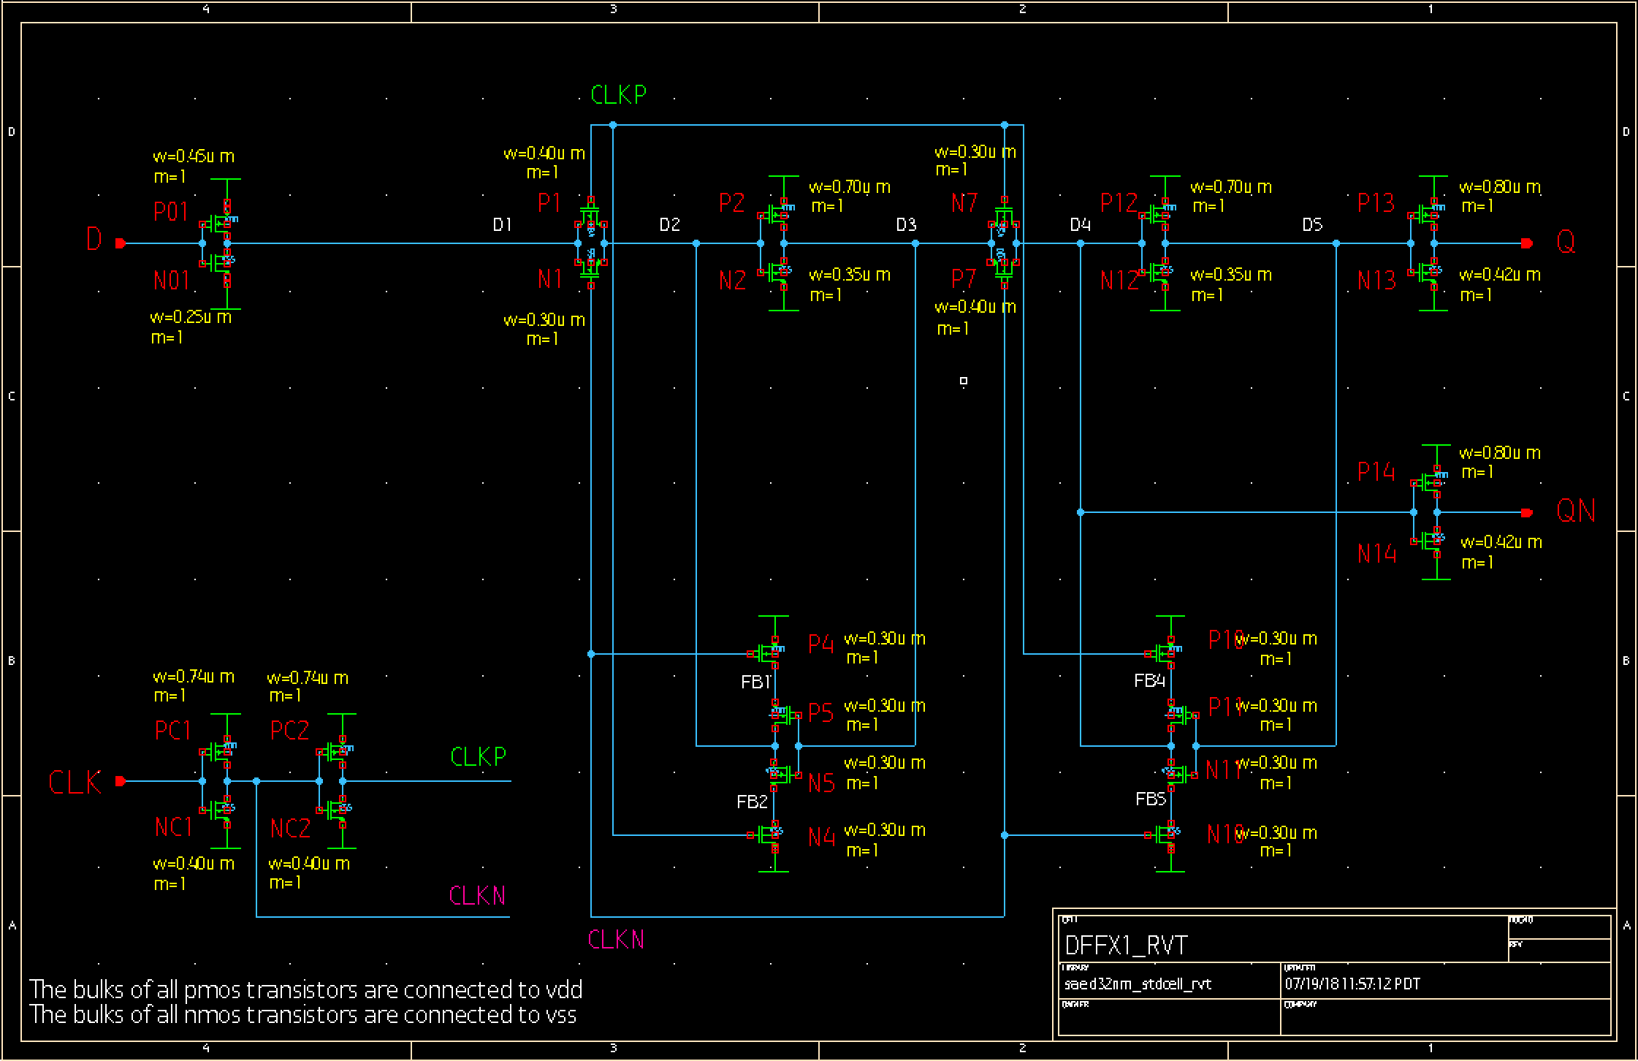
Competing Existing Volatile Solution :
D Flip-flop
NV Latch should emulate the same functions, with the added benefit of non-volatility.
DFF overhead metrics a base-line to determine overhead of adding non-volatility.
Notes:
The nv latch act like a dff. The dff looks different from an no lach, but the no latch allows for and input dats to go in and have an output independent of power.
We subtract the dff with the moose he added non-volatile to understand the base line cost.

Slide 15
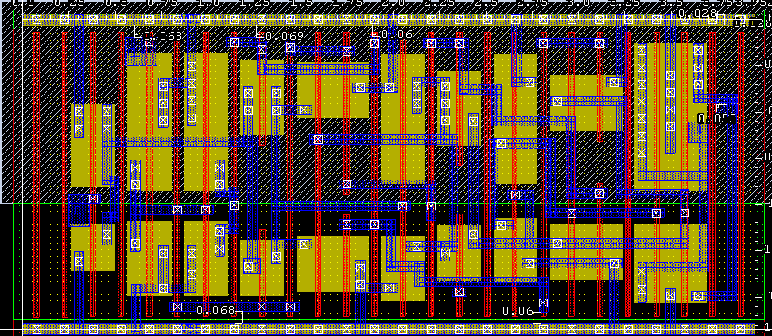

Competing Existing Volatile Solution :
D Flip-flop
DFF Overhead Metrics:
  Area:$6.61μm^{2}$
  Static Power: $140.8nW$
  Delay: $3.12ns$
Layout: A manufacturable representation of an IC functional block.
  Provides device parasitic for accurate device modelling.
Notes:
Here we have a view of the D flip flop's layout.
The overhead metrics shows the minimum area, power, and time delay to achieve an extremely low failure rate.
A layout is a manufacturable reprasentation of an integrated circuit functional block.
Creating a layout provides devices parasitic for accurate device modeling,
Such as identifing non idealities.
Non idealities are introduced in electrical componants such as transistors.
When combining these electrical components, even more non idealities are introduced.
These non idealities can only be seen after the layout is complete.

Slide 16
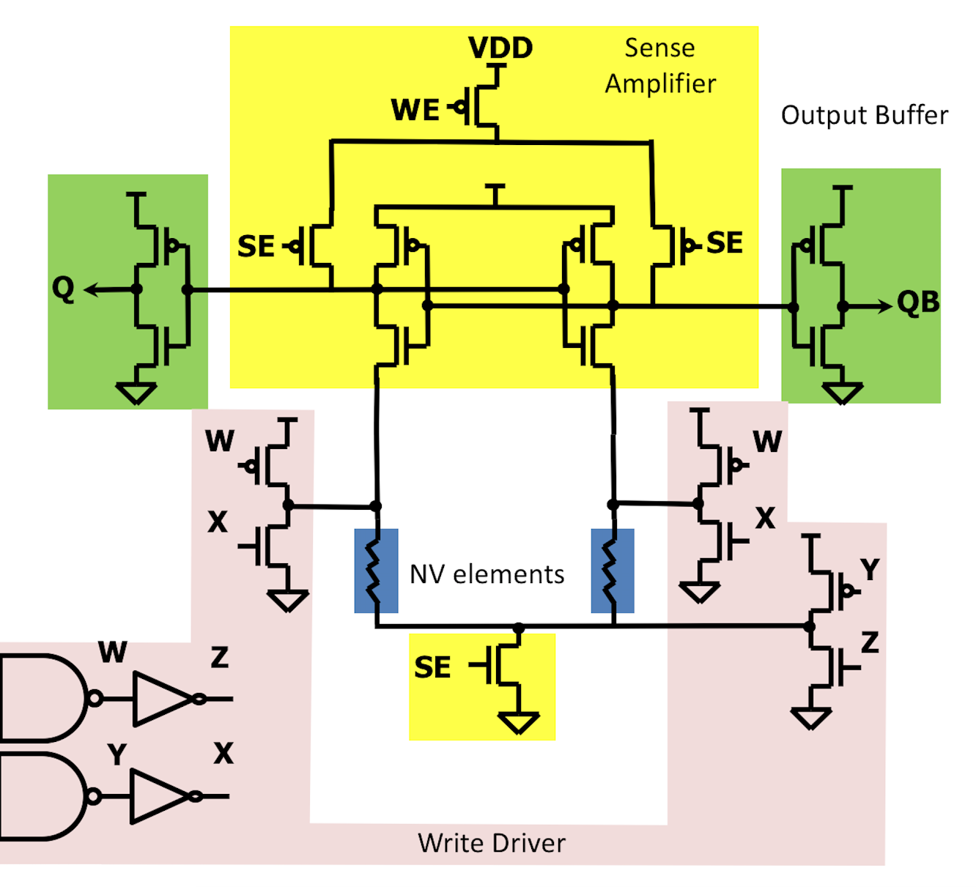
Previous NV Design:
MTJ-Based NV-Latch
Sense Amplifier
Output Buffer
Write Driver Path
NV MTJ Element
Parallel
Anti-Parallel
Notes:
We have two devices, two mtjs both with a relatively low resistive ratio. Both MTJs have opposite orientations (Free and Pinned Layers reversed).
The mtj latch is designed to handle the low resistive ratio by using a differential scheme.
The sense amplifier places charge throughout the two MTJ elements during read.
MTJs are oriented in parallel and antiparallel positions.
When the MTJs receive charge, the antiparallel oriented MTJ will dissipate charge slowly and thus giving parallel MTJ more time to rapidly dissapate its charge.
The first MTJ whose charge dissipates will decide Q and Qb.
Additionally, which ever side dissipates its charge first it's respective output is set to '1’.
Next, highlighted in green The output buffer is a volatile component and reads out the resistive states.
The write driver is a non-volatile component composed of inverted AND gates, Nmoses, and Pmoses.
During write, the user have ability to apply Vdd and GND across the mtjs by changing W/X/Y/Z and therefore we can change the direction of each mtj.
Current is the same direction in both mtj but because they’re both MTJ are oriented differently, they’ll be written to opposite resistive states.

Slide 17
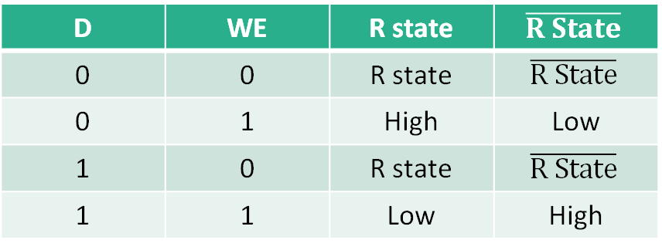
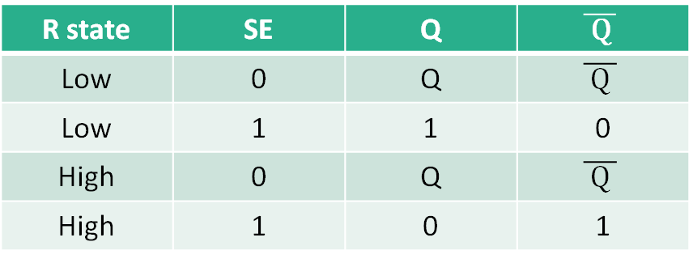
Previous NV Design: MTJ-Based NV-Latch
Truth Table
D | WE | R state | $$\overline{R State}$$
0 | 0 | R state | $$\overline{R State}$$
0 | 1 | High | Low
1 | 0 | R state | $$\overline{R State}$$
1 | 1 | Low | High
Write Logic
R state | SE | Q | $$\overline{ \text{Q} }$$
Low | 0 | Q | $$\overline{ \text{Q} }$$
Low | 1 | 1 | 0
High | 0 | Q | $$\overline{ \text{Q} }$$
High | 1 | 0 | 1
Sense Logic
Notes:
[Write Logic]
Data = 0 – High resistance
Data = 1 – Low reisitance
When WE is 0, resistive state is retained.
[Sense Logic]
When resistive state is low and SE is 1, Q is High
When resistive state is high and SE is 1, Q is zero
SE = 0, Q is retained

Slide 18


Previous NV Design: MTJ-Based NV-Latch
Findings
$$V_{DD}$$
Completed by last Summer’s interns.
Found that switching of magnetic tunnel junctions requires massive write drivers (high current).
Large leakage due to high current needs.
Low sensing delay, high write delay, sensing reliability can be impacted by MTJ $R_{low} and R_{high}$ due to low resistive ratio.
Sense Amplifier
Output Buffer
Write Driver Path
NV MTJ Element

Slide 19
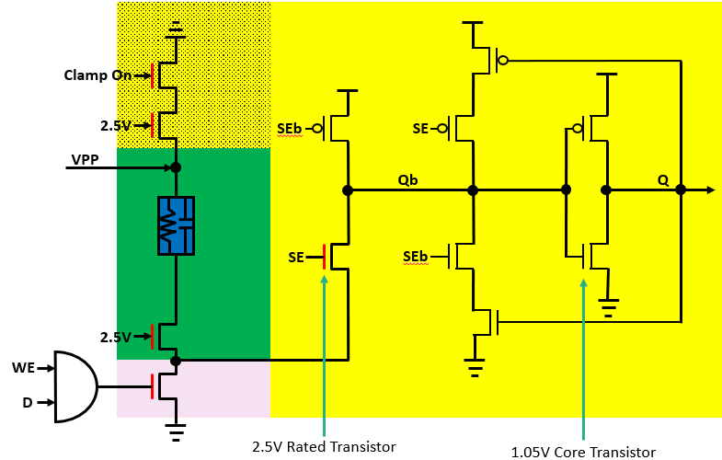
Proposed NV Design: Anti-fuse-Based NV Latch Topology
Read Critical Path
Read/Write Critical Path
Write Critical Path
Global Read Critical Path
Anti-Fuse Element
WE
Write
Sense
Unblown
Blown
SE
ClOn
Notes:
Here we have the topology for an antifuse based NV latch
In this topology, due to the anitfuses high resistive ratio we can get away with a single ended topology
When the antifuse is Blown It behaves like a relatively small resistor from 100s of ohms to several kilaohms
When the antifuse in Unblown it behaves like an extremely large resistor on the order of several MegaOhms
When in the write mode, our goal is to either apply a voltage drop close to VPP across the antifuse if we want to program a low resistance,
Or apply no voltage drop by not providing a path to ground. We control ground in write mode with the data input.
To ensure no alternative path to ground, the clampon transistor is turned off during write mode
In write mode, write enable gets set to 1.
We then turn on VPP (which is approximately 4-5Volts)
During Sense mode, write enable gets turned off to ensure that the voltage across the antifuse is measured.
ClampOn gets turned on and VPP is disconnected.
In order to update Q and Qbar, a pulse gets enabled
As shown on the waveform below, we can determine when the design is in write mode and read Mode
When write enable is high and sense enable and ClampOn is low, we are in write mode.
When write enable is low and sense enable and ClampOn is low, we are in read mode.

Slide 20
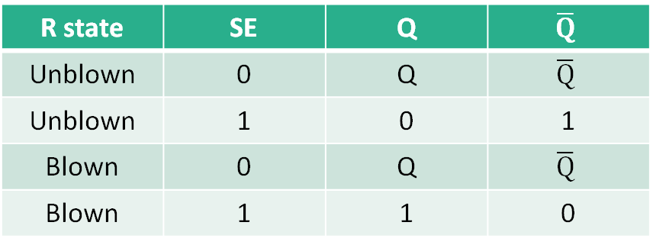
Proposed NV Design: Anti-Fuse based NV Latch
Truth Table
D | WE | R state
0 | 0 | R state
0 | 1 | R state
1 | 0 | R state
1 | 1 | Blown
Write Logic
R state | SE | Q | $$\overline{Q}$$
Unblown | 0 | Q | $$\overline{Q}$$
Unblown | 1 | 0 | 1
Blown | 0 | Q | $$\overline{Q}$$
Blown | 1 | 1 | 0
Sense Logic
Notes:
Here we have the Truth Tables for Write and Sense Logic.
When Write Enable is Off (or if Data = 0), we retain the resistive state
When Write Enable is On and Data = 1, we the anti-fuse gets Blown
When Sense Enable is 0, Q gets retained
When Sense Enable is 1, Q gets updated to the corresponding resistive state
Qbar is always the inverse of Q

Slide 21

Design Methods: Optimization Algorithm
Select transistors which impact device reliability.
Size transistors minimally such that no failures are detected after 10,000 random variations.
Complete layout of properly sized schematic.
Retest reliability.
Resize if necessary.
D
D
G
G
-
+
S
S
$$ΔV_{th}$$
Notes:
The first thing we did was point 1
Then we had to upsize the transistors so that no failures will be present in 10000 iterations
We completed layout and
Retested reliability
Resized transistors if necessary ( being it failed)
The way monte Carlo test random transisto variation and test our circuit reliability is by applying a small random threshold voltages bias voltage at every iteration at the gate at each transistor which stands in as randomness from the environment. Then we measure critical device signals to confirm the device still functions as expected.

Slide 22





Design Methods:
Anti-Fuse Optimization
$$V_{DD}$$
Read Critical Path
Read/Write Critical Path
Write Critical Path
Global Read Critical Path
Anti-Fuse Element
$$R_{{\overline{SE}}_{on}}$$
Should be sized for a high on resistance!
Monitor red highlighted transistors to show their $V_{GS}, V_{GD}, and V_{DS}$doesn’t exceed 2.5V during programming.
$\overline{Q}<\frac{V_{DD}}{2}$
-
+
$$R_{SE_{on}}+{2R}_{2.5V_{on}}+R_{ClampOn_{on}}+R_{AF_{Blown}}\left(≈15kΩ\right)$$
Unblown
Blown
Notes:
Now that we have a working understanding of Monte Carlo, lets talk more indepth about specific failure scenarios
Talking about likely scenartios of failure
As we analysze at the device schematic, we saw there was only one motive operation that may introcuce failure into our design. We had to properly size the PMOS transitor SEb such that at nide Qd the voltage was less thabn half of VDD. So we can model this problem with the blow circuit
Every transistor has a resistance when it is on. Talk about why we want to optimate the circuit.
Current follows purple path during read

Slide 23
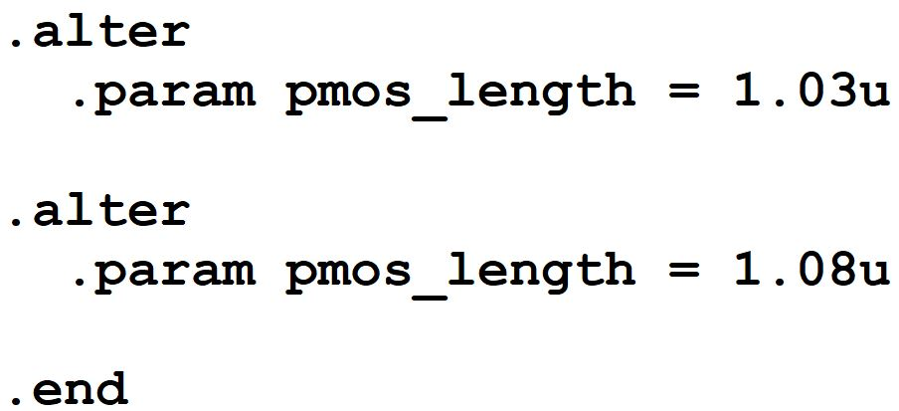
Design Methods:
Transistor Sizing
Size transistors minimally such that no failures are detected after 10,000 random variations.
Select Transistors which impact device reliability.
At risk transistors exceeding 3V.
Notes:
To operate the circuit, we varied a single variable (PMOS). This transistor is essential to how our circuit functions. We ran Monte Carlo simulations with 10,000 iterations and if any one of them failed or exceeded 3V we would need to resize the transistor. We optimized the length through this process.

Slide 24
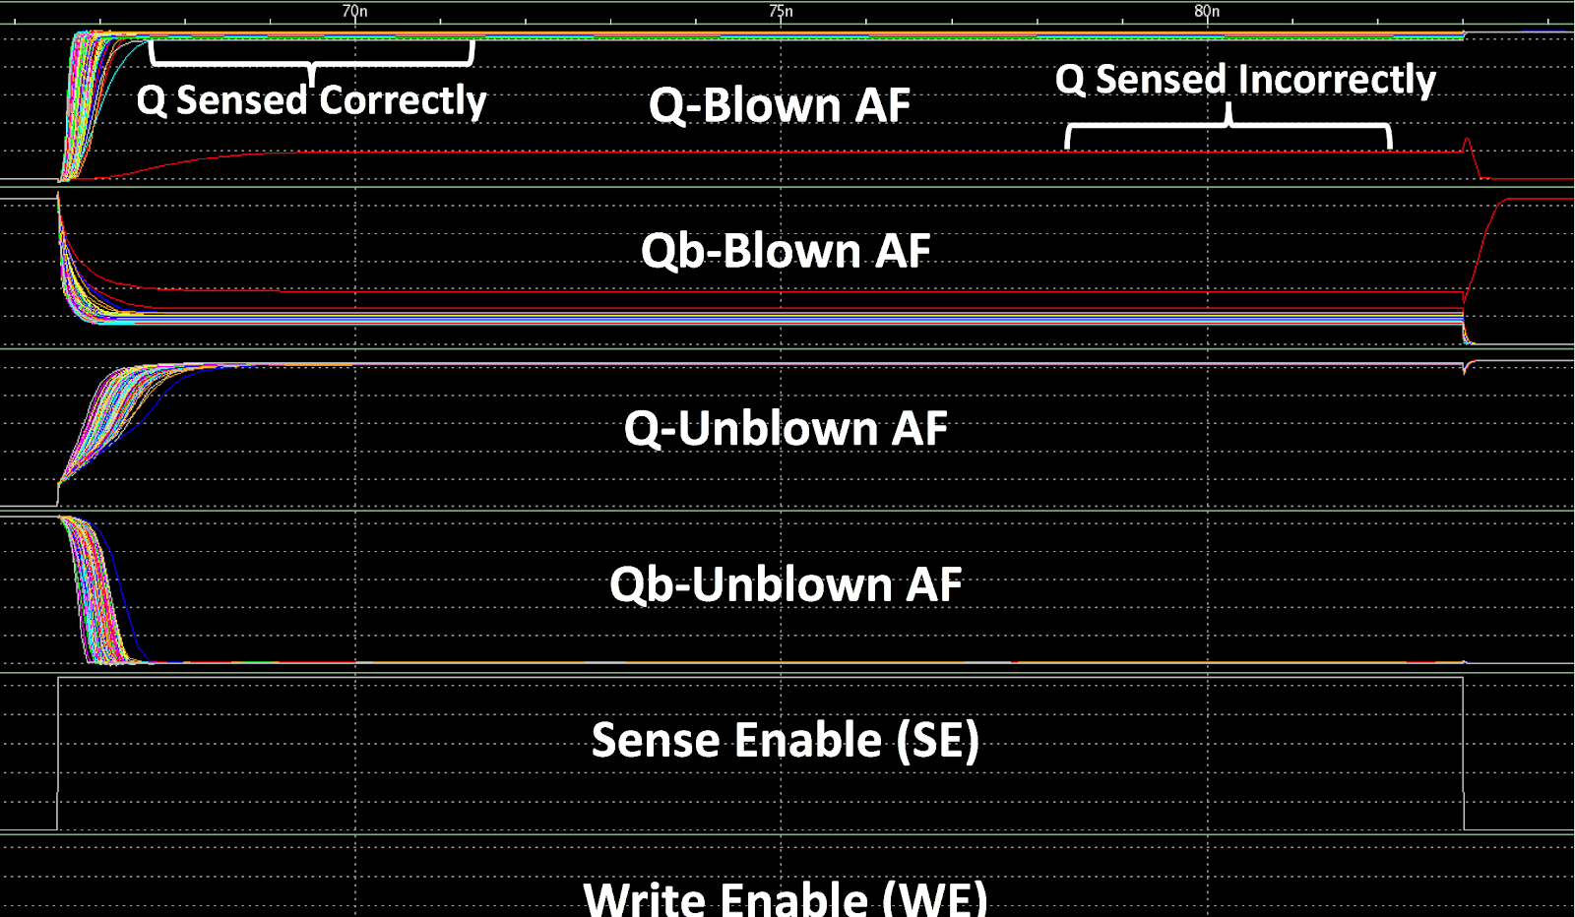
Design Methods:
Monte Carlo Failure
Size transistors minimally such that no failures are detected after 10,000 random variations.
Failure Possibilities:
  Sensing failure during Anti-fuse read cycles.
  At risk transistors exceeding 3V.
  Voltage/Current insufficient across the Anti-fuse.
  Lack of robust available model.
Notes:
After running a monte carlo simulation with 10000 iterations, we sized the pmos transistor to be approximately .8 microns length
In the waveform shown here, we can see that we have obtained the correct outputs for our design and there were no failures in write and sense enable.

Slide 25
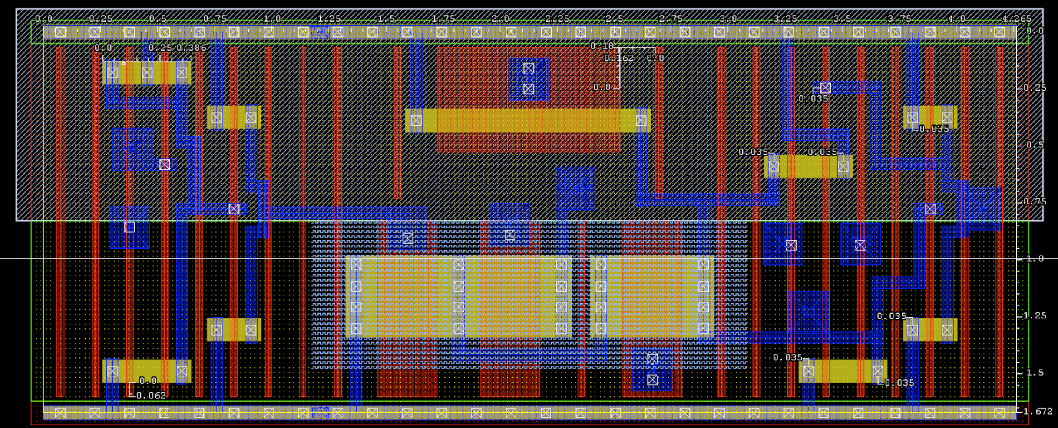
Design Methods: Layout
Control
Logic
2.5V Transistors,
Long-Channel PMOS,
Pin-Out to AF
Volatile
Latch
Component
Complete layout of properly sized schematic.
Provides parasitic components for robust simulation.
Large portion dedicated to protection during programming.
Small Control Logic block.
Notes:
Complete layout that provided robust simulation. The 2.5V area has the least amount of transistors but

Slide 26

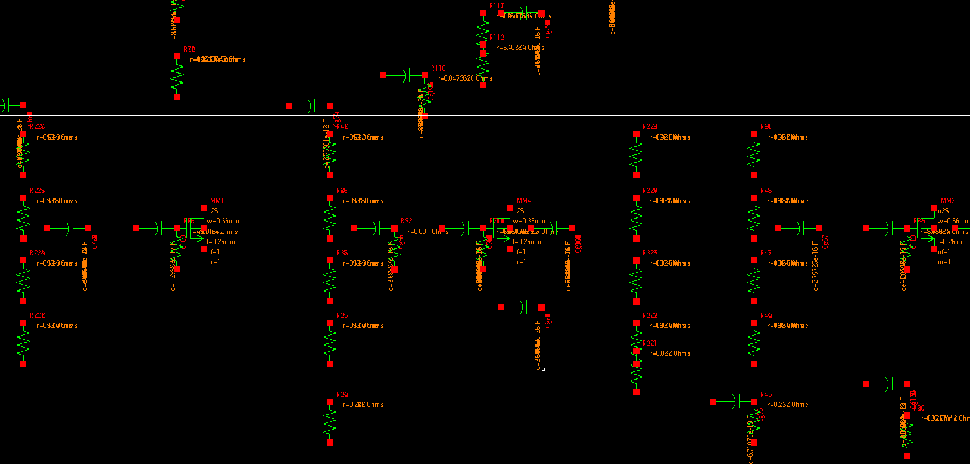
Results: Performance Evaluation
After layout completed and parasitics are extracted, and design is revalidated for reliability, extract the following performance metrics:
  Design Area
  Design Static Power
  Design Sensing Delay
Then Compare to volatile DFF
Notes:
Once the layout was completed, parasitics were extracted.

Slide 27
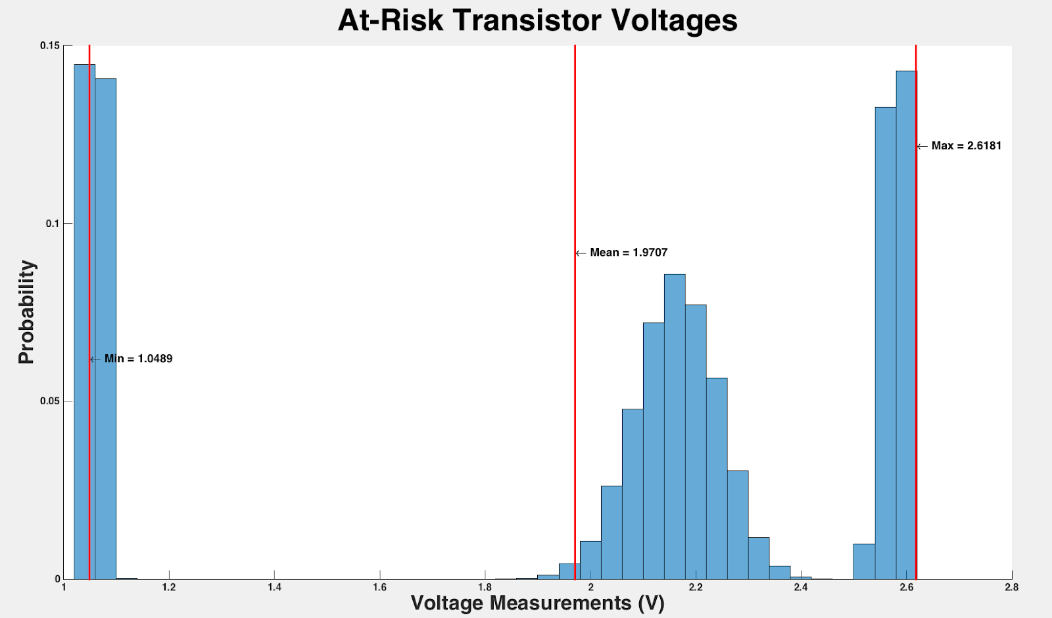
Post-Layout Monte Carlo Results (99.99% Reliability):
At-Risk Transistor Voltage Distribution
Target Max Voltage Delivery
  2.75V
Achieved Max Voltage Delivered
  2.6181 V
Notes:
The transistors that were physically connected close to VPP would be considered at risk
The max voltage that could be passed through our transistors was 3 volts
As you can see on this graph, the worst case that we got was 2.6181 volts which means all of our transistors passed the necessary voltage required.

Slide 28
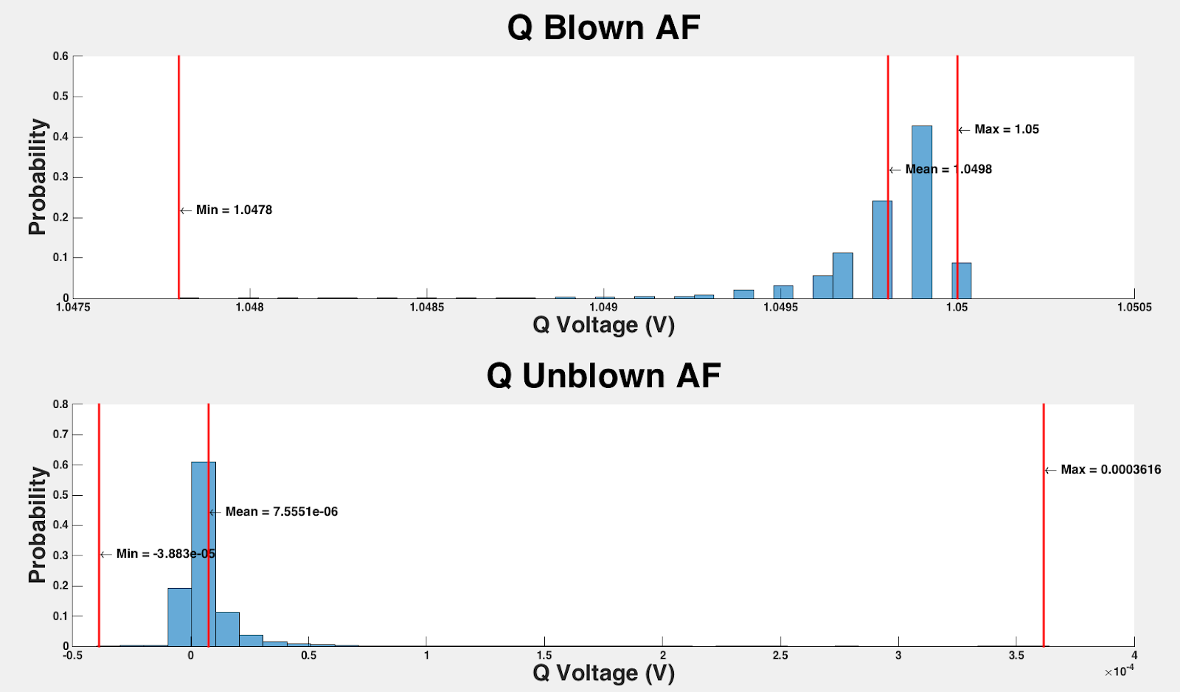

Post-Layout Monte Carlo Results (99.99% Reliability):
Output Q Voltage
Target output Q-Unblown:
  Less than $105mV$
Target output Q-Blown:
  Greater than $.895V$
Achieved output Qb-Blown:
  Less than $.3616mV$
Achieved output Qb-Unblown:
  Greater than $1.048V$
Notes:
A blown cell should evaluate to a Q of about 1.5V an unblown cell should evaluate to 0. So what we defined as failure if after sensing if either a blown cell evaluated to a value of less then 90% of VDD or an unblown cell greater 10% of VDD ( arbitrary it seemed reasonable. Many critical reading are made at 10 and 90% of VDD, safe to assume)

Slide 29
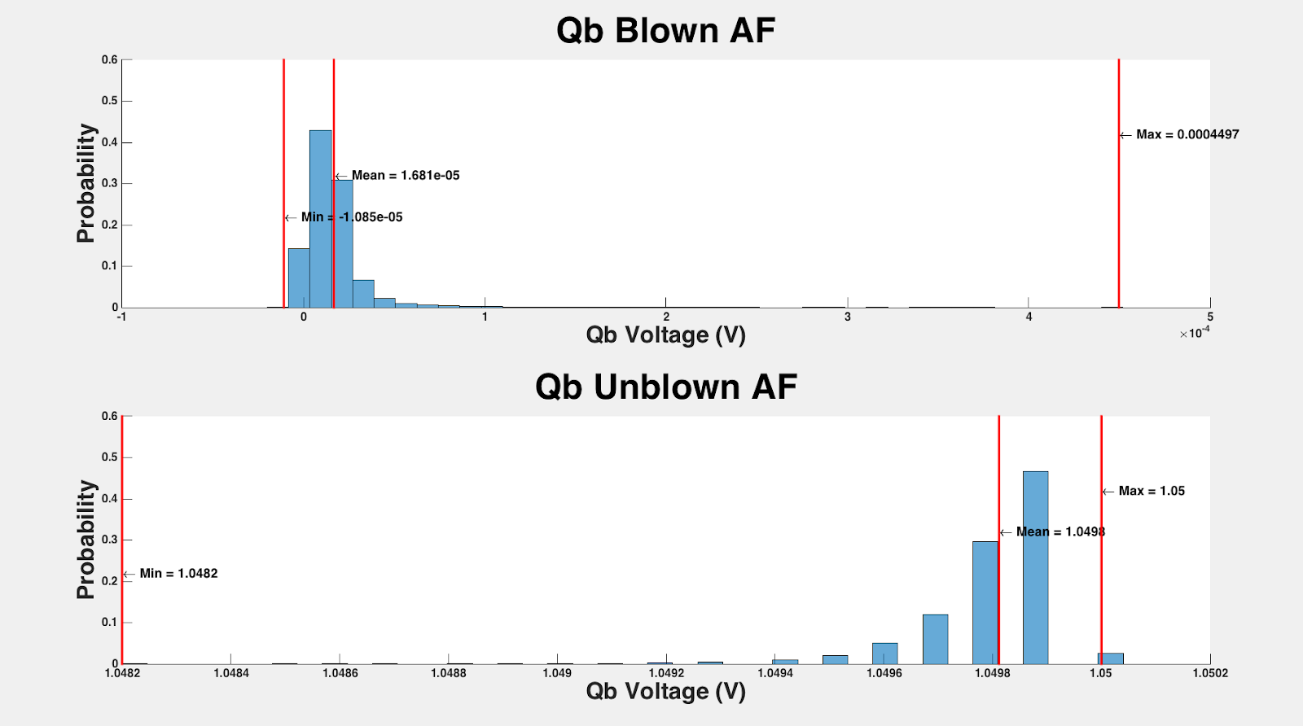

Post-Layout Monte Carlo Results (99.99% Reliability):
Output Qb Voltage
Target output Qb-Blown:
  Less than $105mV$
Target output Qb-Unblown:
  Greater than $.895V$
Achieved output Qb-Blown:
  Less than $.4497mV$
Achieved output Qb-Unblown:
  Greater than $1.0482V$
Notes:
So going to Qb we expect to follow Q but inverted.

Slide 30
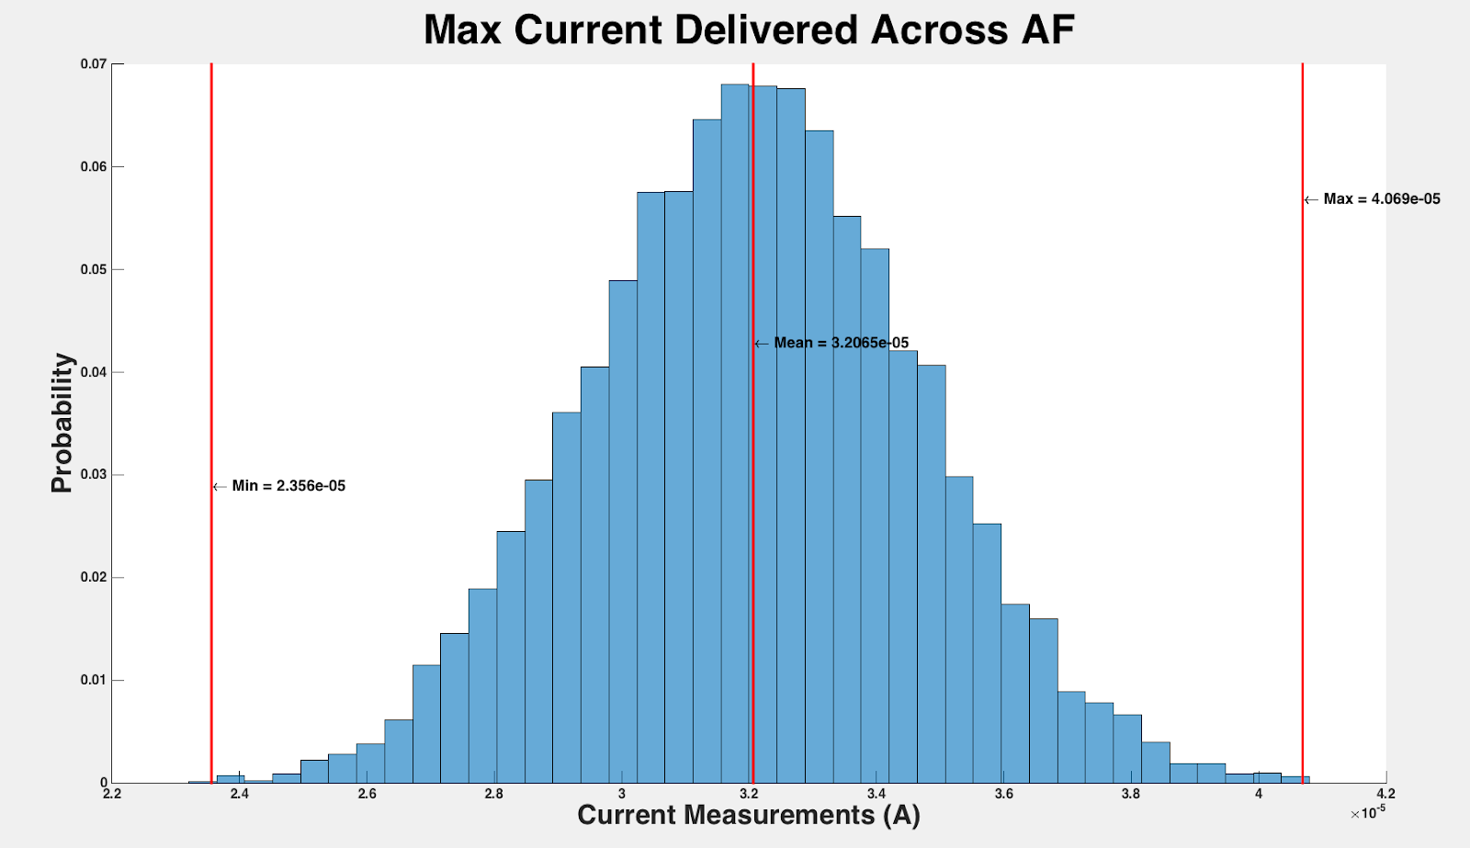

Post-Layout Monte Carlo Results (99.99% Reliability):
Output Qb Voltage
Target current delivery:
  Greater than $20μA$
Achieved current delivery:
  Greater than $23μA$
Notes:
From research papers, it was ideal to achieve greater than a minimum of 20 micro amps. Analyzing our design, we achieved a minimum current of 23 micro amps.

Slide 31
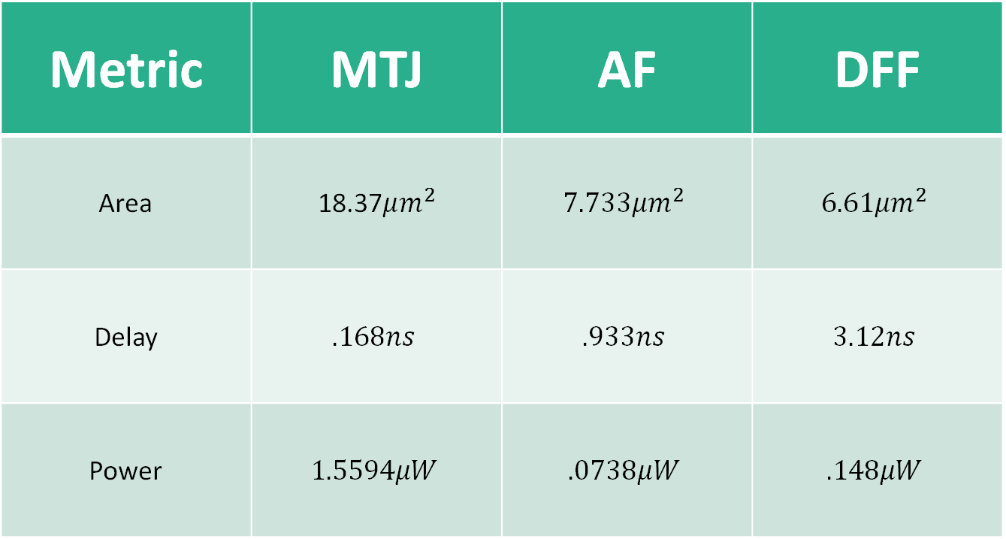
Results: Performance Evaluation
Metric | MTJ | AF | DFF
Area | 18.37$μm^{2}$ | $$7.733μm^{2}$$ | $$6.61μm^{2}$$
Delay | $$.168ns$$ | $$.933ns$$ | $$3.12ns$$
Power | $$1.5594μW$$ | $$.0738μW$$ | $$.148μW$$
Notes:
Lower is better for any one of these values
Due to the large requirements of the write drivers the mtj shows the largest area
The antifuse was surprisingly compact and in fact only 117% of the area of the dflipflop so that means only 17% of overhead in area when compared to dflipflop
The mtjs differential scheme sensed the quickest so it has the lowest delay
The dflipflop is not optimiszed for delay because it’s a standard cell its optimized for reliability therefore it show the largest delay of any of the cells
Mtj has high power leakage due to its high area based on the write drivers

Slide 32
Comparison
&
Conclusion
Magnetic Tunnel Junction (MTJ) | Anti-Fuse (AF)
Reprogrammable | One time programmable
Low Resistive Ratio | High Resistive Ratio
Large area overhead | Small area overhead
High static power consumption | Low static power consumption
Large switching (programming) delay | Small switching (programming) delay
Low sensing (read) delay | Relatively high sensing (read) delay compared to MTJ
Requires new on-chip magnetic layer | Requires typical Anti-fuse / standard cells
We surveyed two existing non-volatile technologies and implemented them as a solution to on-chip non-volatile memory
Notes:
The Anti-fuse bit-cell is favorable if a smaller area overhead is desired and one-time programmability is sufficient.
The anti-fuse also provides smaller power consumption and relatively smaller switching (programming) delay.
The MTJ-based bit-cell provides reprogrammability at a much higher cost in area and power (both static and switching), but offers lower sensing (read) delay and does not require many different global voltages like the Anti-fuse.

Slide 33


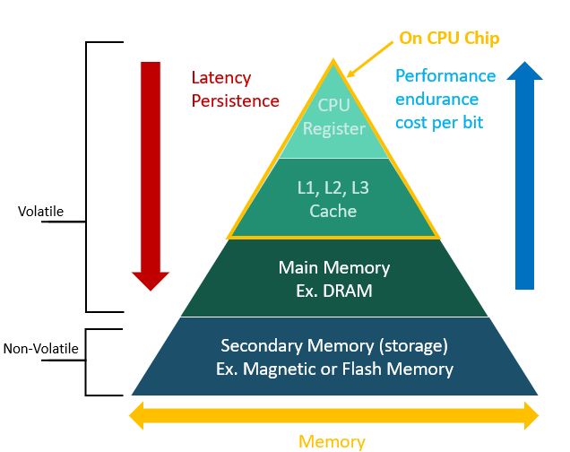
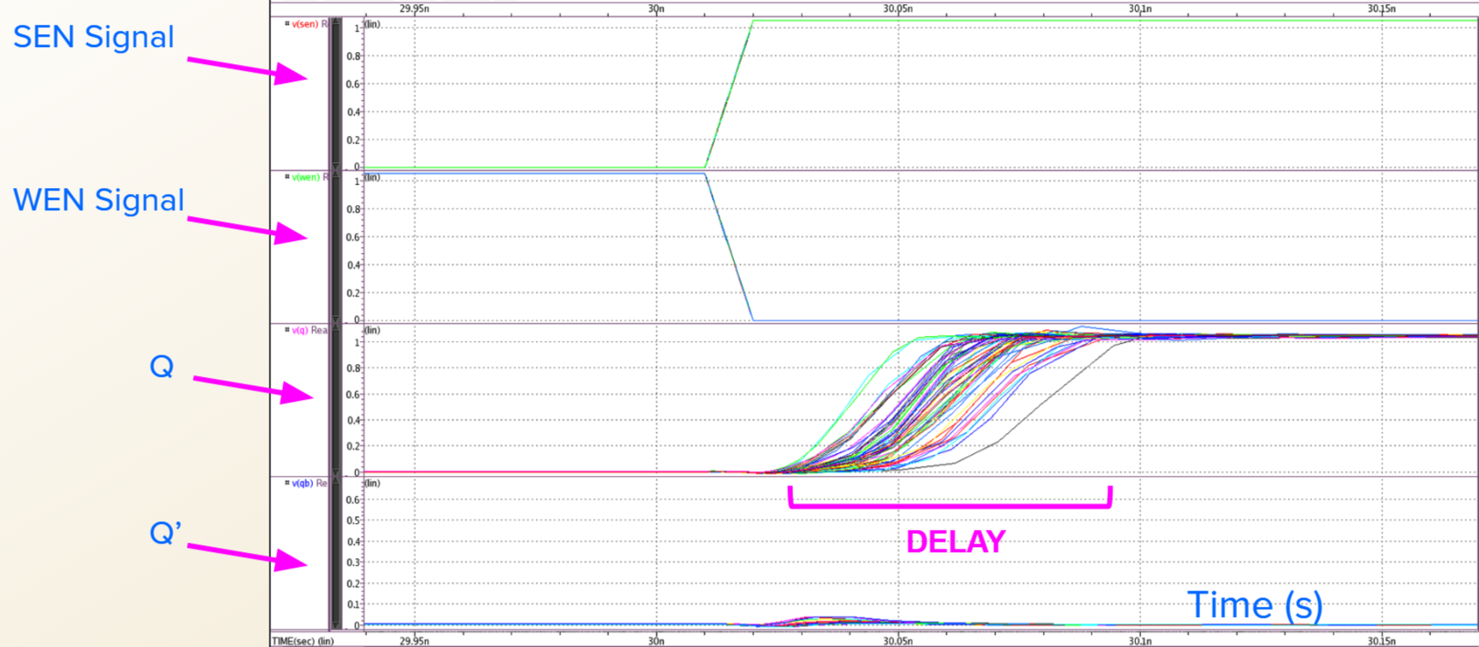
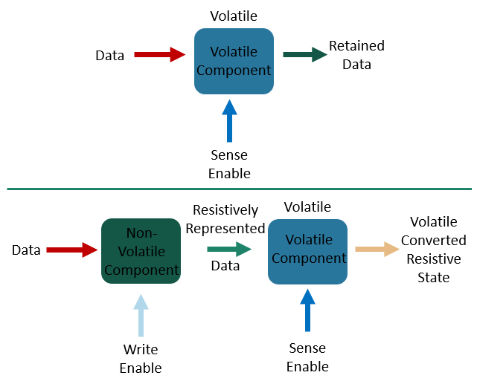
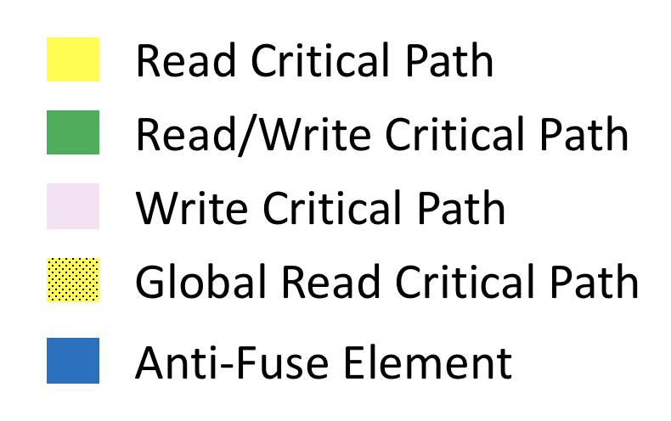
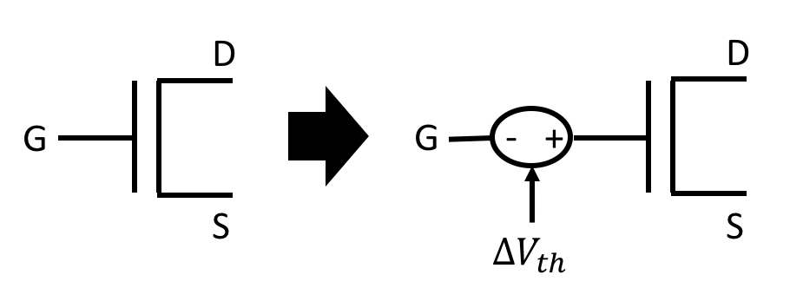
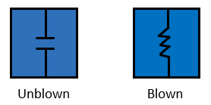
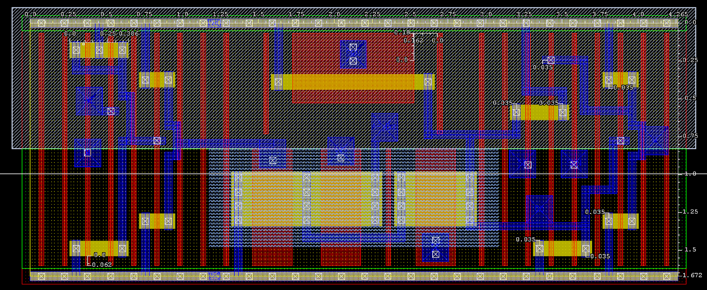

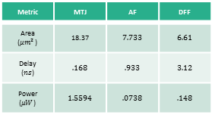
Design and Optimization of Non-Volatile Antifuse Latch using Resistive Memory Technology
Alex Hercules¹, Anthony Lal¹, Michael Gee¹
Graduate Mentor: Tyler Sheaves², Advisor: Hamid Mahmoodi²
¹Cañada College 4200 Farm Hill Blvd. Redwood City, CA 94061
²San Francisco State University: Dept. of Engineering 1600 Holloway Ave. San Francisco, CA 94132
1. Introduction
Logic
Monte Carlo Read & Write Failures
6. Results
Conventional method of storing data for typical electronic and devices use electrically charged capacitors to store binary information.
If power is lost, data is permanently lost.
Depending on the voltage potential across the AntiFuse during write operation determines if it will blow.
When reading, we expect the cell output Q to match the user input D from write.
We ran multivariable simulations with six variables to see how the transistor values are affected and to find read and write failures
Metric | MTJ | AF | DFF
Area ($μm^{2}$) | 18.37 | $$7.733$$ | $$6.61$$
Delay ($ns$) | $$.168$$ | $$.933$$ | $$3.12$$
Power ($μW$) | $$1.5594$$ | $$.0738$$ | $$.148$$
D | WE | R state
0 | 0 | R state
0 | 1 | R state
1 | 0 | R state
1 | 1 | Blown
R state | SE | Q | $$\overline{Q}$$
Unblown | 0 | Q | $$\overline{Q}$$
Unblown | 1 | 0 | 1
Blown | 0 | Q | $$\overline{Q}$$
Blown | 1 | 1 | 0
This type of capacitor based memory is known as volatile memory.
We propose a technology called non-volatile embedded memory that use resistive based memory as the long term solution.
Optimization of read (12 Transistors)
Optimization of the read cycle was performed by using HSpice and a netlist that allowed delay and area to be used as weighted goals.
Write Truth Table
Read Truth Table
The anti-fuse is favorable if a smaller area overhead is desired and one time programmability is sufficient
MTJ provides programmability at a higher cost in area and power (both static and switching) but offers a lower sensing (read) delay
Compared to DFF, Anti-fuse has minimal overhead of (117%) and MTJ is much higher due to large write drivers
2. Non-volatile embedded memory
Write Operations
When writing, if WE and D are both on, the AntiFuse will become blown. Else, the previous resistive state is kept
It is important to note that while D = 0 and WE = 1, will achieve an unblown state, we can not assume the initial condition and cannot guarantee that the AntiFuse is unblown. We can however guarantee the previous R state is retained
Read Operations
During read, Q only updates when SE is also on, otherwise the previous saved state is retained
Issues with the Antifuse may have too large of a low resistance to evaluate to a proper high output. To mitigate this we create larger resistance on PMOS-type transistor with an input of SEb.
The netlist contained a parameter which allowed an area goal to be set so that HSpice would determine the best possible transistor size.
Resistive memory technology to replace traditional charge-based memory.
Information storage by use of resistive material, data is then read out as resistance value.
By embedding non-volatile memory inside the CPU chip, data frequently used by the CPU will not be lost upon power down, and the benefits of NV storage without the drawbacks of intra- component data transfers can be achieved.
Monte Carlo Simulations
A Monte Carlo failure rate netlist program was used to test each set of values recorded in the optimization process.
Each set of our values was run at 1000 iterations to ensure reliability of the circuit to within 0.1% accuracy.
We looked for values that passed simulations with 0% failure rate, which meant a minimum of 99.9% reliability.
The optimization for 100 run Monte Carlo yielded best values that had higher delay, lower reliability, and lower area.
7. Conclusion
Magnetic Tunnel Junction (MTJ) | Anti-Fuse (AF)
Reprogrammable | One time programmable
Low Resistive Ratio | High Resistive Ratio
Large area overhead | Small area overhead
High static power consumption | Low static power consumption
Large switching (programming) delay | Small switching (programming) delay
Low sensing (read) delay | Relatively high sensing (read) delay compared to MTJ
Requires new on-chip magnetic layer | Requires typical Anti-fuse / standard cells
3. Anti-fuse (AF)
AF is one time programmable and functions inversely of a eFuse.
A cell whose insulating element breaks down under high electric field, made of transistor-dielectric or metallic materials.
A high resistance device whose resistance can be permanently altered to a low resistance value by placing a sufficient electric field across it.
Once programmed, resistance cannot be reversed.
We compared proposed solutions’ power, delay, and area overhead metrics which showed the tradeoff between programmability and cost.
8. References
[1] H. Mahmoodi, A. Attaran, T. Sheaves, “Design of a Non-Volatile Latch using Resistive Memory Technology”
[2] H. Mahmoodi, S. Srinivasan Lakshmipuramᐩ, M. Aora, Y. Asgarieh, H. Homayoun, B. Lin and D. M. Tullsen “Resisitive Computation: A Critique.” IEEE COMPUTER ARCHITECTURE LETTERS, VOL. 13 NO.2, JULY-DECEMBER 2014
[3] W. Zhao, E. Belhaire and C. Chappert “Spin-MTJ based Non-Volatile Flip-Flop.”
Proceedings of the 7th IEEE International Conference on Nanotechnology August 2-5
2007, Hong Kong
[4]Wicht, Bernhard, Thomas Nirschl, and Doris Schmitt-Landsiedel. "Yield and Speed Optimization of a Latch-Type Voltage Sense Amplifier." IEEE JOURNAL OF SOLID-STATE CIRCUITS , VOL.39 NO.07, JULY 2004
[5]Welser, Jeffrey, S.A. Wolf, and Phaedon Avouris. " 282 CHAPTER 8 APPLICATIONS: NANOELECTRONICS AND NANOMAGNETICS ." Nanotechnology Research Directions for Societal Needs in 2020. London: Springer Dordrecht, 2011.
5. Methodology
Design Methods: Optimization Algorithms
Layout
Select transistors which impact device reliability.
Size transistors minimally such that no failures are detected after 10,000 random variations.
Complete Layout of properly sized schematic.
Retest Reliability and Resize if necessary.
The goal of the layout was to minimize the area the circuit would take up while still being able to perform as desired.
The first test we ran once our layout was constructed was the Design Rules Checking (DRC), which checks to make sure our design follows the current rules and conventions used in manufacturing.
All of the nmos and pmos layers must overlap each other and the VDD and VSS must all be formed into one bar across all instances respectively to create one continuous circuit.
4. Design and Parameters
Anti-fuse consists of two states: Unblown and blown
  Unblown – Resistor
  Blown – Capacitor
9. Acknowledgements
Thank you to Dr. Hamid Mahmoodi and Tyler Sheaves for mentoring us in this project with technical, aesthetic, and presentation guidance. Thank you to Synopsys for providing EDA licenses to NECRL and to DARPA for continued funding for this research. We are very grateful for this opportunity brought to us by Dr. Amelito Enriquez and the ASPIRES program.
Diagram of Monte Carlo Threshold Bias Voltage
Notes:
Fix references

