Slide 1


Time Synchronization of Smart Wearable Devices For Recording Seismic Activity
Civil Group 2 - Professor Zhaoshuo Jiang
Alex Furlanic
Jessie Armas
Rene Parra Medina
Philip Thomas
Notes:
Alex
Hello, my name is Alex, ___, we are the second civil engineering group and today we’re going to be talking about our research on time synchronization of smart wearable devices for recording seismic activity.

Slide 2
Outline
Objective
Wearable Devices
Time Synchronization Procedure
Testing and Results
Analysis
Future Work
Notes:
Alex
We will be talking about our main objective for this research, what smart wearable devices are, important concepts that we had to learn and understand, what our current focus is, and the challenges that we’ve faced throughout this research.

Slide 3
Outline
Objective
Wearable Devices
Time Synchronization Procedure
Testing and Results
Analysis
Future Work
Notes:
Alex
We will be talking about our main objective for this research, what smart wearable devices are, important concepts that we had to learn and understand, what our current focus is, and the challenges that we’ve faced throughout this research.

Slide 4

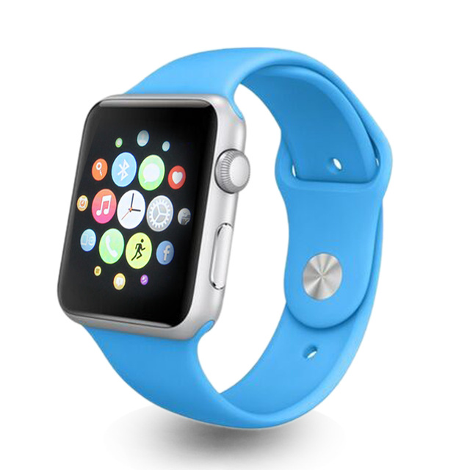
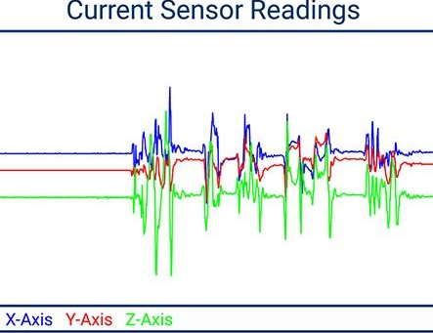
Objective
Use smart wearable devices to collect and share earthquake data on a large geographic scale
Notes:
Alex
Our main goal for this research is to be create a system where we can use smart wearable devices to collect and share earthquake data on a large geographic scale. We want to utilize the technologies in smart wearable devices to gather useful information both during and after earthquake disasters and transmit that data.

Slide 5
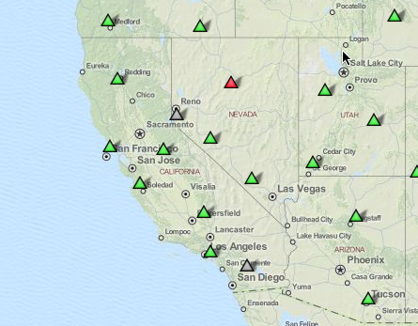
Why It Matters
Seismic Monitoring Stations in California
Useful in the following applications:
Record seismic movement
Retrofit infrastructure
Improve building codes
Send early earthquake warnings
Respond to post-earthquake disasters
Notes:
Alex
This research is very important because seismic monitoring is crucial for minimizing the destruction and loss of life that earthquakes can cause. Currently, seismic monitoring stations are very scarce. For instance, there are only six working seismic monitoring stations here in California, a state with high risk earthquake zones. Our research could act as an addition to seismic monitoring. This will be useful information towards retrofitting infrastructure, improving building codes, sending our early earthquake warnings, and assisting first responders during a post-earthquake disaster.

Slide 6
Outline
Objective
Wearable Devices
Time Synchronization Procedure
Testing and Results
Analysis
Future Work
Notes:
Jessie
We will be talking about our main objective for this research, what smart wearable devices are, important concepts that we had to learn and understand, what our current focus is, and the challenges that we’ve faced throughout this research.

Slide 7
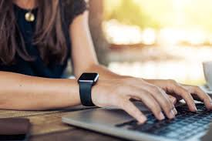
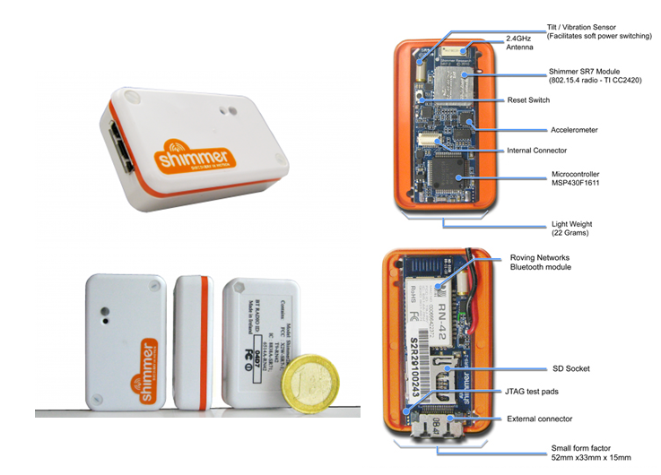
Wearable Devices
Popularity of Smartwatch
Shimmer
Notes:
Jessie - Smartwatches are becoming popular in today's tech world. They’re becoming ubiquitous around the world so you see more people with them.We want to use the sensors embedded in the smartwatch to detect seismic activity such as earthquakes. It would be an addition to seismic stations we have today so we can collect and analyze more data. If thousands of people or even millions are wearing a smartwatch during an earthquake then we have more data to analyze.
Shimmer- is a device that contains the same sensors a smartwatch has so we are using this device instead of a smartwatch to test the accuracy and reliability of the sensors. We’re just creating a procedure to synchronize the sensors and not having to create whole new interface or application that would do that. It makes it easier for us to focus on synchronization of the sensors.
Smart wearable devices image source: https://botnlife.wordpress.com/category/health-monitor-devices/
Wireless sensors image source: http://spine.deis.unical.it/spine.html

Slide 8
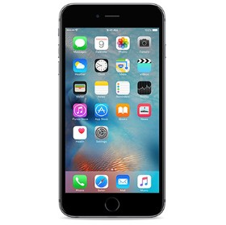
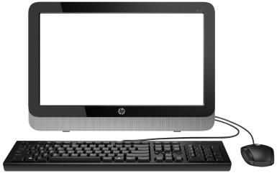
How It Will Work
The use of smart wearable devices involves the following:
Activity Recognition
Time Synchronization
Wireless Sensor Networks (WSNs)
Potential Sensor Data from Smart Watch
USGS
Or another information center
Notes:
Philip

Slide 9
Outline
Objective
Wearable Devices
Time Synchronization Procedure
Testing and Results
Analysis
Future Work
Notes:
Alex
We will be talking about our main objective for this research, what smart wearable devices are, important concepts that we had to learn and understand, what our current focus is, and the challenges that we’ve faced throughout this research.

Slide 10
Problems in Wireless Sensor Networks (WSNs)
Problems related to time
Individual clocks have slightly different rate of counting time (clock drift)
Delays in software and message delivery
Message loss
Notes:
Philip

Slide 11
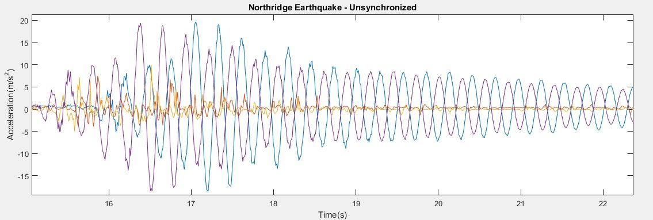
Time Synchronization
The alignment of the data collected by sensors to a common reference time
Importance:
Data accuracy and readability
Notes:
Philip
THOROUGH description of the graph

Slide 12
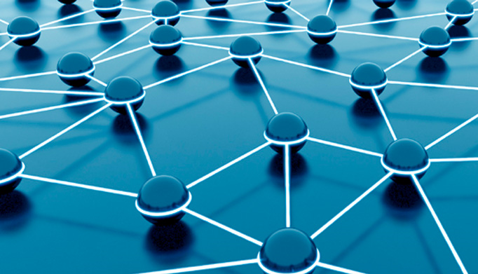
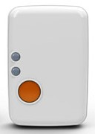
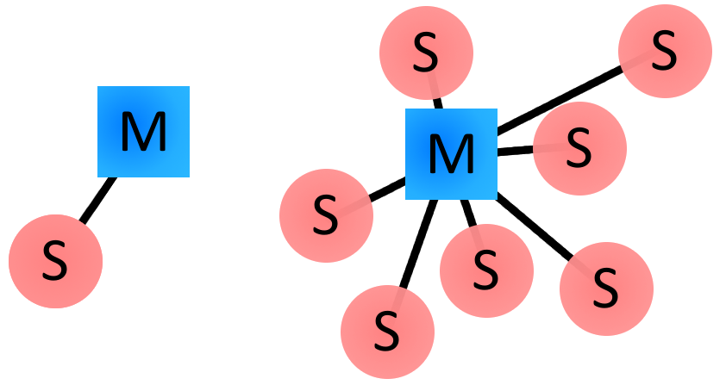
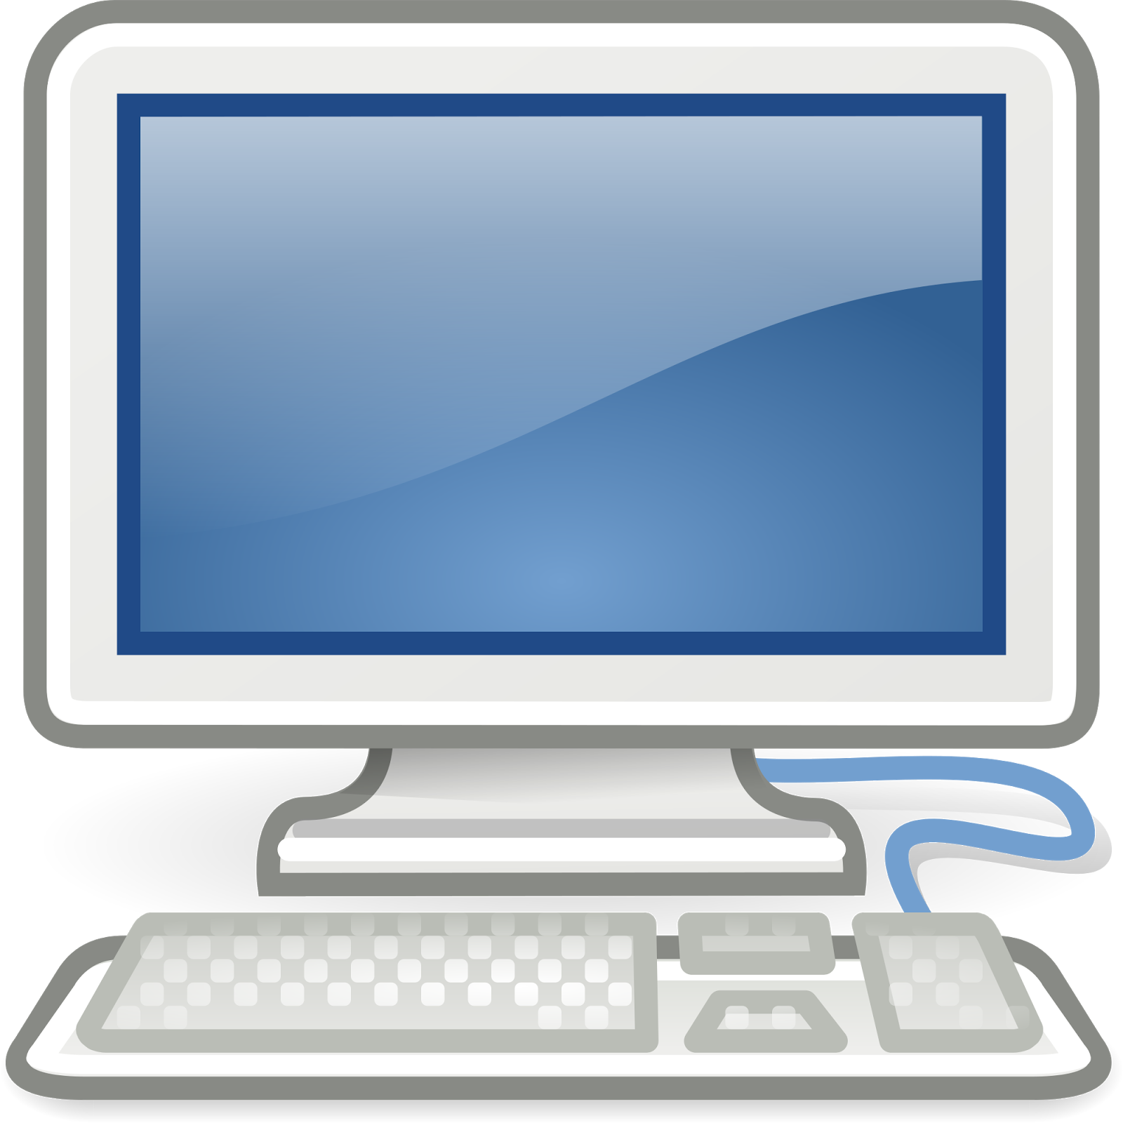
Time Synchronization Scheme
Time Synchronization Schemes
Peer-to-peer vs. Master-slave
Pros and Cons
Peer-to-peer network
Master-slave scheme
Notes:
Philip
[Talk about what we’ve accomplished so far.] add picture of the sdof structure (or just mention it)

Slide 13
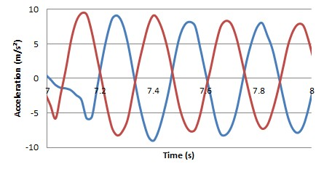
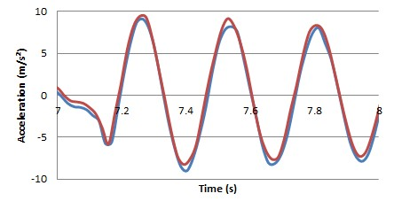
Time Synchronization Procedure
offset
Post-Processing Synchronization
Device’s local timestamp (t)
Unix timestamp (u)
Offset
Offset = (u₂ - u₁) - (t₂ - t₁)
Apply offset to local timestamp
Saves the synchronized data
Device 1
Device 2
Device 1
Device 2
Notes:
Alex
Local timestamp is the time that each individual device tracks
Unix timestamp is the universal timestamp. It's the amount of time that has elapsed since Thursday, 1 January 1970.
The offset can be found using the equation…
The offset can then be added to the local timestamps in the other devices

Slide 14
MATLAB
Shimmer MATLAB Instrument Driver v2.6
Control Shimmer devices
Collect data from the Shimmers
Process
Connects via Bluetooth
Sets calibration values and sampling rates
Collects data
Disconnects
Synchronization
Uses Unix timestamps and local timestamps to find offset
Graphics
Displays both synchronized and unsynchronized data
Notes:
Alex
We decided to use MATLAB because: can be used to control Shimmer Devices, we all had access to the software, and we all had experience using it.
The way we used MATLAB is we took an example function that plots and writes data from a Shimmer device for a specified duration. We modified the function so that it would connect to four Shimmers at the same time.
The way it works is

Slide 15
Outline
Objective
Wearable Devices
Time Synchronization Procedure
Testing and Results
Analysis
Future Work
Notes:
Alex
We will be talking about our main objective for this research, what smart wearable devices are, important concepts that we had to learn and understand, what our current focus is, and the challenges that we’ve faced throughout this research.

Slide 16
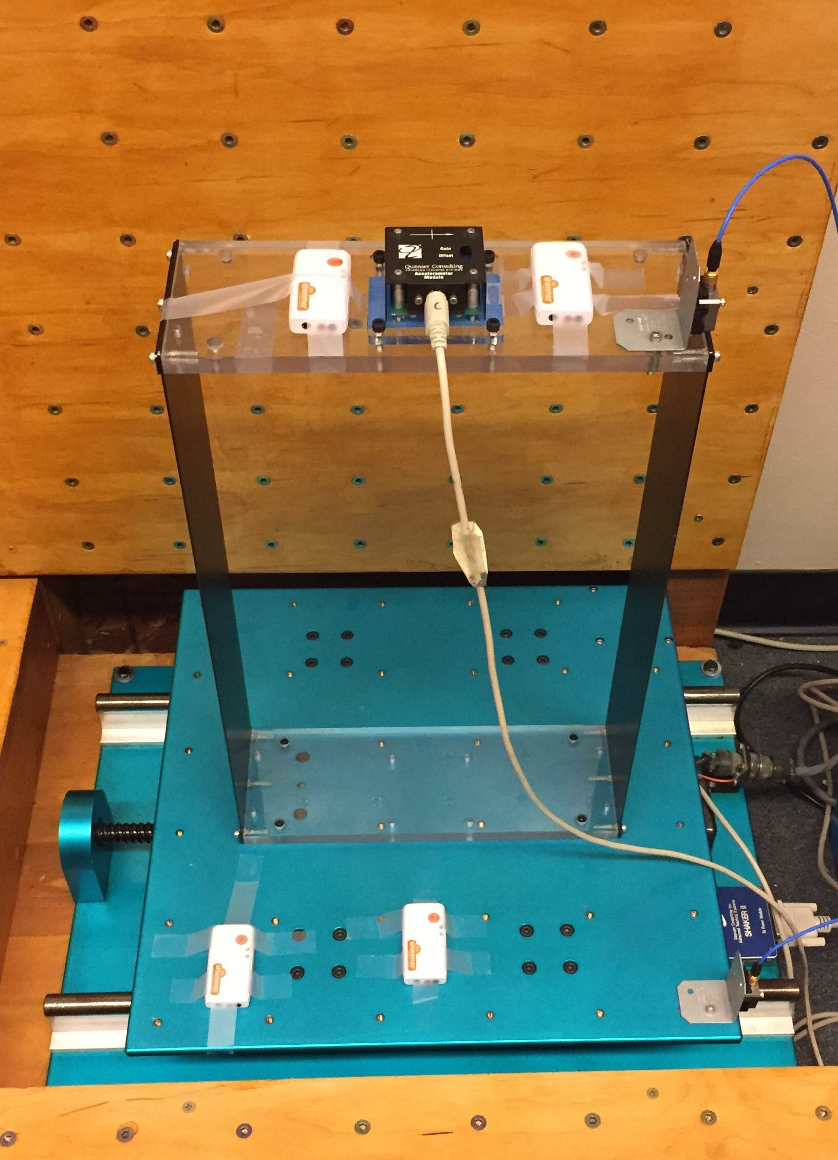
Testing
PCB high fidelity sensor
Quanser
Shimmers
Two on structure
Two on shake table
High Fidelity Sensors
One on structure
One on Shake table
Four Types of Tests
Free Vibration
Sine Wave
Sine Sweep
Earthquake
Single degree of Freedom Structure
Shimmer
Shake table
PCB high fidelity sensor
Figure 1: Shows an image of the Single Degree of Freedom Structure on a shake table with four Shimmer Devices, a Quanser Accelerometer Module, and a PCB high fidelity sensor.
Notes:
Jessie
here on the image we have the shake table we used to conduct our tests to collect data.
We had a total of four Shimmers and two high fidelity sensors, so we used half of each on top of the SDOF structure and half on the shake table.
The ran a total of four different tests, and those tests were: free vibration, sine wave, sine sweep, and earthquakes.
Describe and compare the results using the nanopads

Slide 17
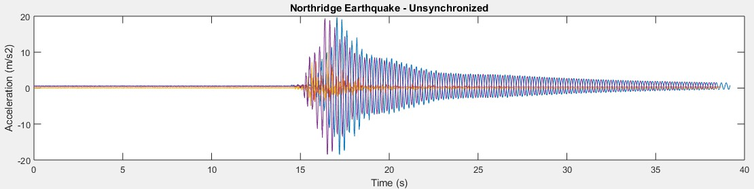
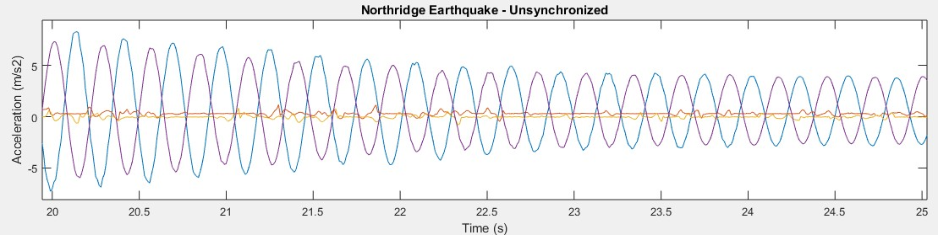
Results - Unsynchronized Data
a.
b.
Figure 10: Shows (a.) a graph of the the unsynchronized data from the Northridge earthquake simulation that was conducted and (b.) a zoomed in section of that graph.
Notes:
Jessie
This graph represents the simulation we ran for the Northridge Earthquake that occurred in the Los Angeles Area in 1994. As we can see when we zoom into a specific region of the data collected, the wavelengths registered by each of the Shimmers are offset from each other.

Slide 18
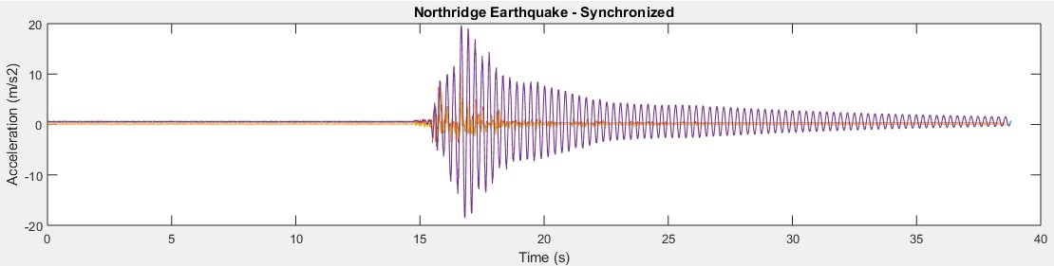
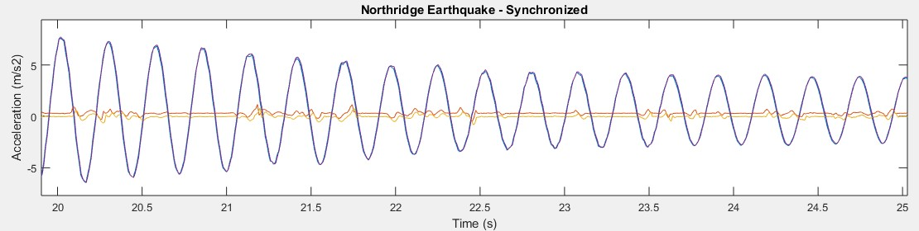
Results - Synchronized Data
a.
b.
Figure 11: Shows (a.) a graph of the the synchronized data from the Northridge earthquake simulation that was conducted and (b.) a zoomed in section of that graph.
Notes:
Jessie
This graph also shows the synchronized data collected by the two sensors on top of the SDOF structure. As we can see, when the data is synchronized, the time offset changes drastically and becomes very small.

Slide 19
Outline
Objective
Wearable Devices
Time Synchronization Procedure
Testing and Results
Analysis
Future Work
Notes:
Rene
We will be talking about our main objective for this research, what smart wearable devices are, important concepts that we had to learn and understand, what our current focus is, and the challenges that we’ve faced throughout this research.

Slide 20
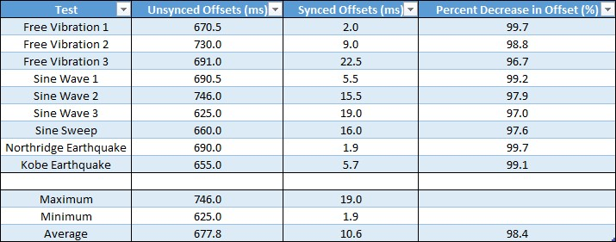
Analysis
Figure 12: Numerical comparison of the synced and unsynced data. This table shows how far apart the top two shimmers are from each other.
Unsynchronized
Offsets are large
Synchronized
Offsets are small
Time synchronization procedure is effective for reducing the offset between each wireless device
Notes:
Rene
Time synchronization procedure lets us reduce that offset to a smaller number that can align all the data to a better reading
We compare the numerical offsets between Unsynchronized and synchronized data.
Before synchronization: offsets range from about 600 to 700 milliseconds
After synchronization: offsets reduce to a range from about 2 to 20 milliseconds
Looking at the average, we can quantitatively represent the effectiveness of the time synch. procedure

Slide 21
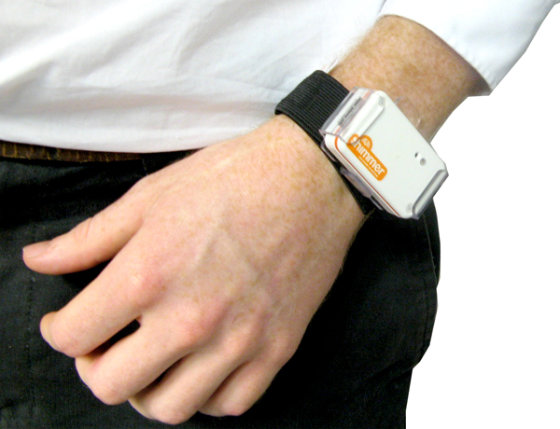
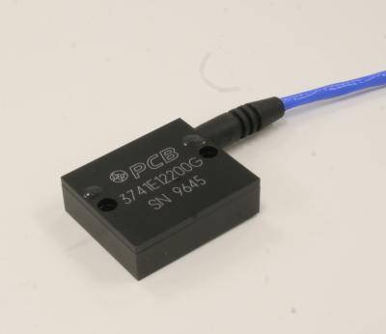
Sensors
Test the reliability and accuracy of Shimmers by comparing them to high-fidelity wired sensors
Shimmer Sensor
High Fidelity Wired Sensors
Notes:
Rene
We tested the reliability and accuracy of the Shimmer sensors compared to the high fidelity wired sensors by attaching them all to the shake table and running four different types of tests. What we looked for when comparing the two types of sensors was that the offsets between each type was similar to the data collected with the other type.

Slide 22
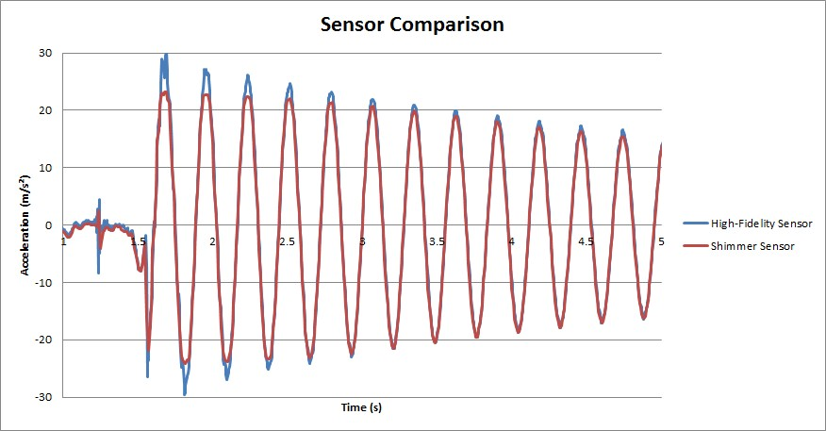
Shimmer vs. High-Fidelity Sensors
Notes:
Alex

Slide 23
Outline
Objective
Wearable Devices
Time Synchronization Procedure
Testing and Results
Analysis
Future Work

Slide 24
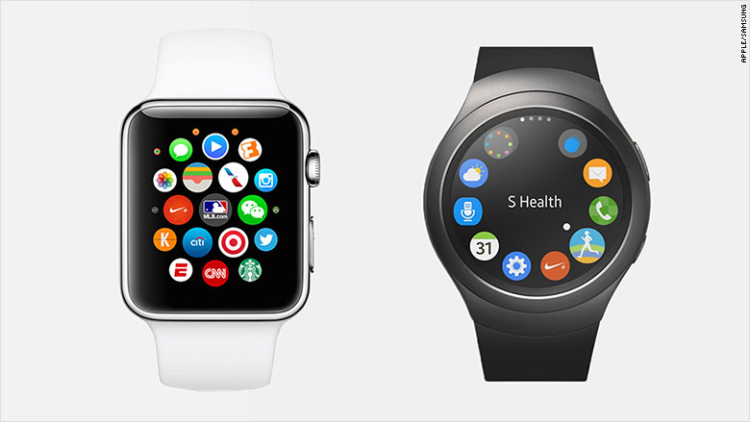
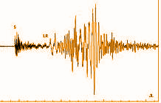
Future Work
Use this time synchronization procedure for smartwatches
Test using a smartwatch on a shake table
Modify MATLAB time synchronization procedure for more accurate offset estimation by calculating offset for each individual sample
Alert: 5.0 Mag
Alert: 5.0 Mag
Notes:
Rene - modify MATLAB time synchronization by finding offsets for each individual sample.

Slide 25
Acknowledgments
Thank You!
Advisors:
Dr. Amelito Enriquez
Dr. Zhaoshuo Jiang
Student Mentors:
Jackie Lok
Alec Maxwell

Slide 26
References
1. Ali, Shaukat. "Sensors and Mobile Phones: Evolution and State-of-the-Art."Pakistan Journal of Science (2014): n. pag. ResearchGate. Web. 5 July 2016.
2. Feng, M., Fukuda, Y., Mizuta, M., & Ozer, E. (2015). Citizen Sensors for SHM: Use of Accelerometer Data from Smartphones. Sensors, 15(2), 2980-2998. doi:10.3390/s150202980
3. Roche, Michael. "Time Synchronization in Wireless Networks." Time Synchronization in Wireless Networks. Washington University in St. Louis, n.d. Web. 03 Aug. 2016. <http://www.cs.wustl.edu/~jain/cse574-06/ftp/time_sync/index.html>.
4. Sundararaman, Bharath, Ugo Buy, and Ajay D. Kshemkalyani. "Clock Synchronization for Wireless Sensor Networks: A Survey." Ad Hoc Networks 3.3 (2005): 281-323. Web.
*Some of the photos used were taken from the internet and the rights belong to the original owners.

