Slide 1


Evaluating Parameter Estimation of Stability and Accuracy of Structural Property-Dependent Integration Algorithms
Cañada College Undergraduate Interns:
Manuel Ramirez
Nathan Carlson
Oskar Granados
Madoka Oyama
Mentor:
Maryam Khan, Structural Engineering Graduate Student
Advisor:
Cheng Chen, Ph.D.

Slide 2
2
Outline
Goals
Real Time Hybrid Simulation
Structural Property Estimation
Methods
Results
Summary

Slide 3
3
Goals
Explore Real Time Hybrid Simulation
Learning Computational Software With Team
Research the Effects of Structural Property Estimation
Research the Effects of Numerical Energy Dissipation

Slide 4
4
Real Time Hybrid Simulation
Numerical Model
Structure To Be Tested
Physical Model

Slide 5
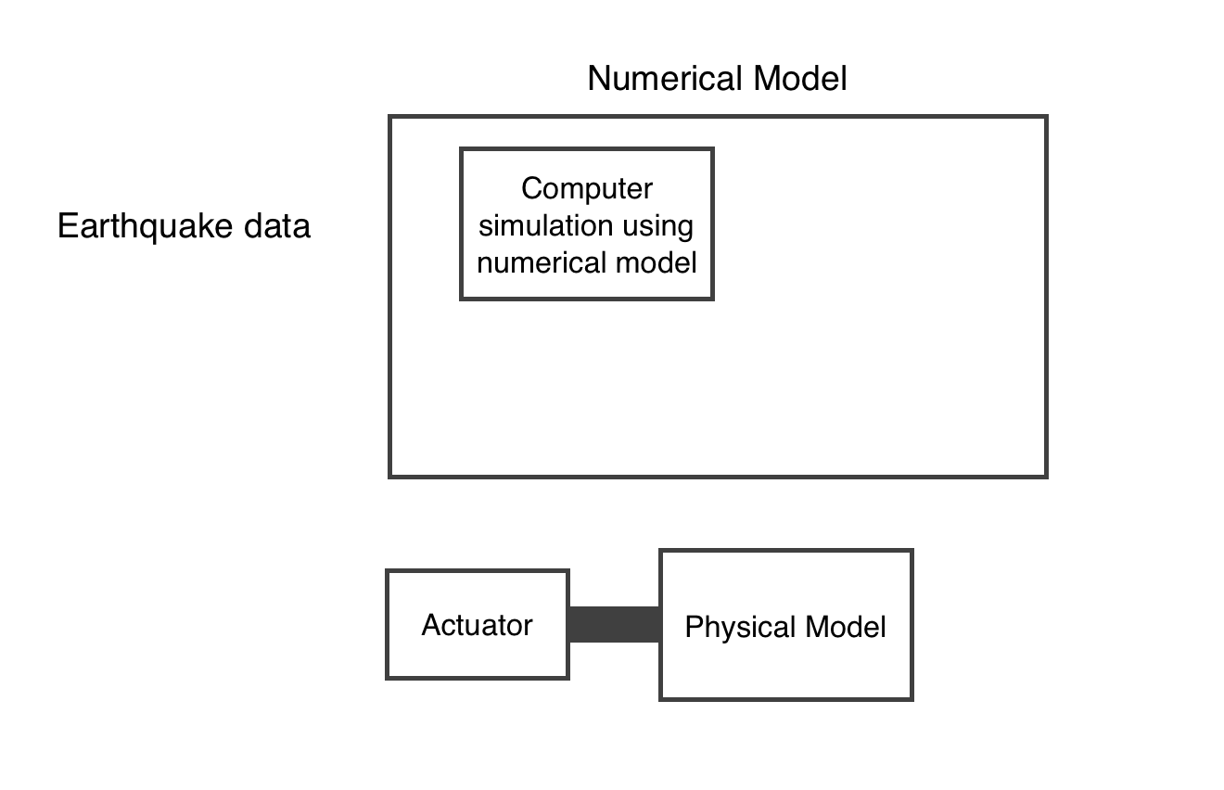
5
Real Time Hybrid Simulation

Slide 6
6
Real Time Hybrid Simulation
Advantages:
Cheaper
Faster
Challenges:
Delay
Structural Property Estimation

Slide 7
7
Real Time Hybrid Simulation
Criteria for Stability and Accuracy
Boundary Conditions
Nonlinear Servo Hydraulic Dynamics of Actuators
Integration Algorithms
Notes:
Boundary Conditions:
-Along the computational and physical substructures
Nonlinear Servo Hydraulic Dynamics of Actuators:
-Its Impact on the stability of the test
Integration algorithms:
-Stability
-Parameters

Slide 8
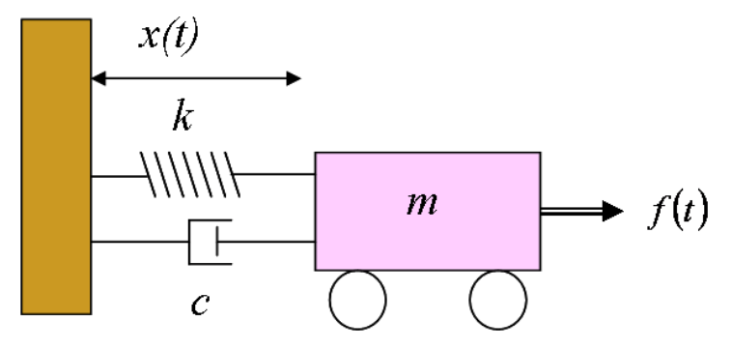
8
Real Time Hybrid Simulation
Structural Dynamics
Single Degree of Freedom:
mẍ + cẋ + kx = f(t)
Notes:
Simple mass spring damper system

Slide 9


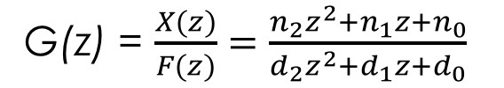

9
Real Time Hybrid Simulation
Explicit Integration Algorithms
S-Domain
Laplace
Z-Domain
CR-Algorithm
KR-𝛼
S-Transform function:
G(s) = $\frac{1}{ms^{2}+cs+k}$
Z- transform function:
G(z) = $\frac{X(z)}{F(z)}=\frac{n_{2}z^{2}+n_{1}z+n_{0}}{d_{2}z^{2}+d_{1}z+d_{0}}$
Notes:
If someone askes about Implicit: We use explicitly conditional algorithms(Lap, CR, KR), we would use implicit if we were to analyze multiple degrees of freedom(ie. a multi-story building). Implicit would run algorithms within algorithms and would take much too long.

Slide 10
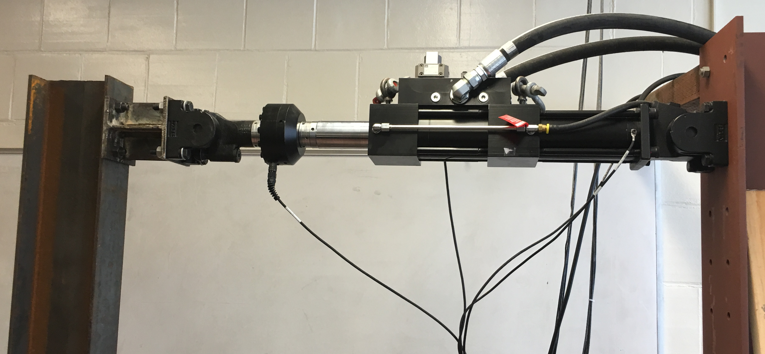
10
Structural Property Estimation
Structural Properties:
Mass(m), Damping(c), Stiffness(k)
Notes:
What is it? Why are we doing it?
Taking a close guess as to the structural properties.
We do it because we cant tell the exact mass, damping and stiffness without physically testing them, so we can guess.

Slide 11



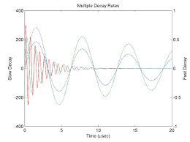
11
Structural Property Estimation
Method
Maple
Simulink
MATLAB
Graphs
Notes:
Add program logos
Talk about Maple equations a bit.
Line 2: solving three equations w/3 unk(x, xd, xdd)
Flow chart. Maple->Simulink->MATLAB->graphs

Slide 12
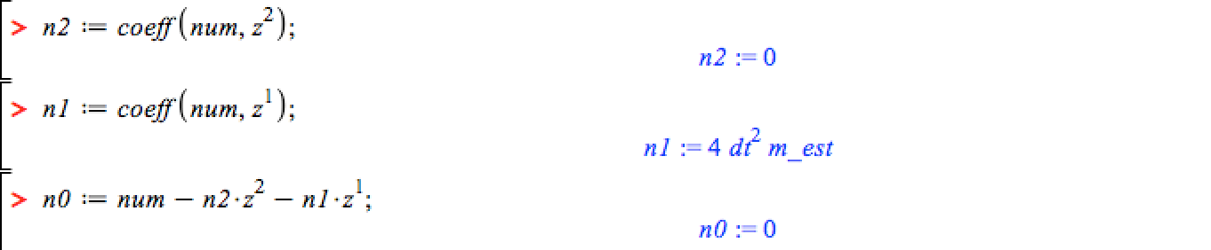
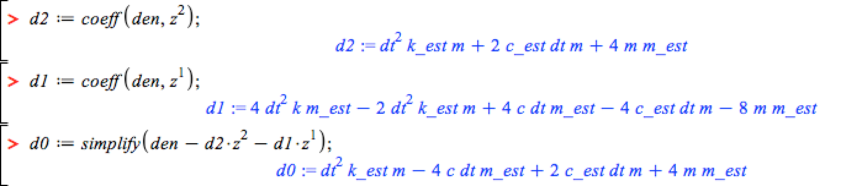

12
Structural Property Estimation
Method: Maple
Z- transform function:
G(z) = $\frac{X(z)}{F(z)}=\frac{n_{2}z^{2}+n_{1}z+n_{0}}{d_{2}z^{2}+d_{1}z+d_{0}}$
Notes:
Talk about Maple equations a bit.
Helped up solve diff eq, these are results of maple calculations
Line 2: solving three equations w/3 unk(x, xd, xdd)
Flow chart. Maple->Simulink->MATLAB->graphs

Slide 13
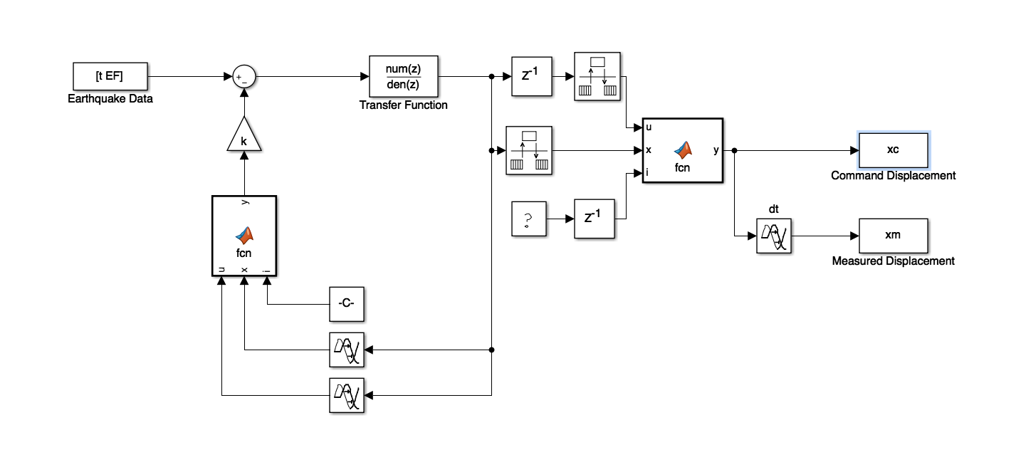
13
Structural Property Estimation
Method: Simulink for CR
Notes:
Talk about Maple equations a bit.
Line 2: solving three equations w/3 unk(x, xd, xdd)

Slide 14
14
Structural Property Estimation
Method: MATLAB
Analyze Simulink Model
Plot Root Locus (Stability)
Calculate RMS Error (Accuracy)

Slide 15
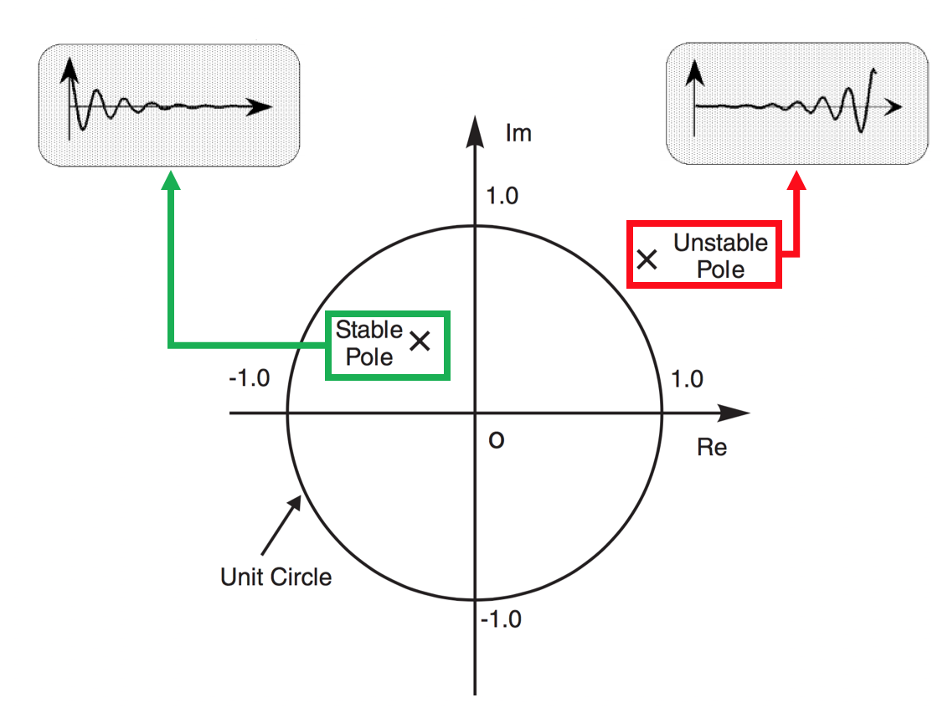
15
Structural Property Estimation
Stability
Root Locus
Graphical analysis that shows the trajectory of closed-loop poles
Finds Poles and Zeros
Notes:
In control theory and stability theory, root locus analysis is a graphical method for examining how the roots of a system change with variation of a certain system parameter.
Add picture of Z transform

Slide 16
Vary the Natural Period
16

Slide 17
17
Illustrate Pole Trajectories for Different Natural Periods
Notes:
Change Tn to Wn

Slide 18
Stability for Mass Estimation
18

Slide 19
Stability for Damping Estimation
19

Slide 20
Stability for Stiffness Estimation
20

Slide 21
21
Structural Property Estimation
Stability: Summary
Mass Estimation Error: Minute Effect
Damping Estimation Error: Minute Effect
Stiffness Estimation Error: Minute Effect
Need to Determine Stability Limit for Further Study (Damping and Stiffness)
Notes:
Small font

Slide 22
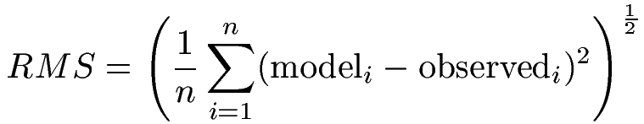
22
Structural Property Estimation
Accuracy
Root Mean Squared Error(RMSE)
Way to show larger differences than other methods by measuring the quality and predictability of the models.
Takes into account outliers in data
Notes:
Mention:
Model = Command
Observed = Measured
Using root-mean-square-error (RMSE) is the best way to show larger differences (taking into account the outliers) than other methods by measuring the quality and predictability of the models.

Slide 23
23
Structural Property Estimation
Accuracy: Mass
Notes:
Use bolder lines
Not positively related
Ran 44, showing 2

Slide 24
24
Structural Property Estimation
Accuracy: Damping
Notes:
tn in seconds

Slide 25
25
Structural Property Estimation
Accuracy: Stiffness

Slide 26
26
Structural Property Estimation
Accuracy: Summary
Mass Estimation Error: Minute Effect
Damping Estimation Error: Minute Effect
Stiffness Estimation Error: Minute Effect
Notes:
Add Summary of Stability

Slide 27
27
KR-𝛼 Integration Algorithm
Use Maple to obtain the KR-alpha transfer function,
In MATLAB vary the energy dissipation parameter
ρ infinity - numerical energy dissipation (parameter for KR-alpha)
Add new coefficients to MATLAB
Change parameters and analyze
Notes:
Add Summary of Stability

Slide 28
28
KR-𝛼 Integration Algorithm
Notes:
Show graph with different rho infinities

Slide 29
29
Summary
Real Time Hybrid Simulation
Structural Property Estimation
Stability
Accuracy
Implications
Notes:
Implications: Using our research, engineers now know that when conducted RTHS, the estimation of the structural properties doesn't have to be incredibly precise to get accurate results
**Mention retrofitting a building

Slide 30
30
Acknowledgments
ASPIRES Program
Director: Dr. Amelito Enriquez
This project was partly supported by the US Department of Education through Minority Science and Engineering Improvement Program (MSEIP, Award No. P120A15014), and the Hispanic-Serving Institution Science, Technology, Engineering, and Mathematics (HSI STEM) Program, Award No. P031C110159.
Notes:
Department of Eduation(where the money is coming from

Slide 31
31
References
Chen, C. and Ricles, J. M. (2008), Stability analysis of SDOF real-time hybrid testing systems with explicit integration algorithms and actuator delay. Earthquake Engng. Struct. Dyn., 37: no. doi: 10.1002/eqe.795
Cheng Chen, James M. Ricles, Theodore L. Karavasilis, Yunbyeong Chae, and Richard Sause. 2012. "Evaluation of a real-time hybrid simulation system for performance evaluation of structures with rate dependent devices subjected to seismic loading." Engineering Structures 35: 71-82.
http://peer.berkeley.edu/
Matlab & Simulink. Natick, MA: MathWorks, 2016. Computer software.
Maple16. Waterloo, ON Canada: Maplesoft, 2012. Computer software.

Slide 32
32
Questions?

