Slide 1


Human-Machine Interface
for Myoelectric Applications using EMG and IMU
Bianca Doronila, James Dalton, Jeffrey Yan,
Victor Melara, Kattia Chang Kam
Advisor: Dr. Xiaorong Zhang
Mentor: Ian Donovan
ASPIRES Summer 2016 | Computer Engineering
San Francisco State University
Cañada College
Notes:
Bianca

Slide 2
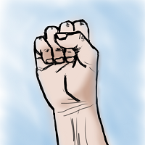
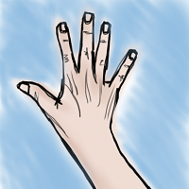
HMI for Myoelectric
Controlled Applications
Myoelectric - electric properties of muscles
Designed to aid and improve human lifestyle
Rehabilitation
Prostheses
Virtual Reality
Gaming
Main goal: Further develop existing low cost, open source and flexible HMI
More gestures and implement VR
Exoskeletons/Stroke Therapy
1
Notes:
Bianca
// HMI - Controller Operating Panel
Myoelectric - Electric properties of muscles sending out signals
Knowledge of HMI for Myoelectricity: this will aid/improve human lifestyle
Returning usability for amputees via Prostheses
Advancing mobility using exoskeletons: for ex, being able to lift a 50lb object with one arm and with ease
For entertainment, a really high demand in our generation is virtual reality and specifically gaming,
this enhances the user’s gaming experience and could be a replacement of mouse or joysticks
So this project’s main goal is to further develop LAST YEAR’S INTERN’S existing,
keeping in mind that we like it to be Low cost, open source, and flexible.

Slide 3
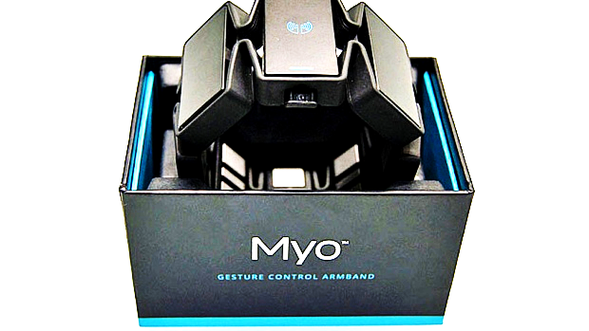
Myo Armband
Commercially available device
8 EMG sensors
9-Axis IMU
Haptic feedback
Low cost: $199
User-friendly, easy to set up
Previous research on Electromyography (EMG)
Gesture Recognition
EMG
Static Gestures
2
Notes:
Bianca
So then we go to the commercial device we used for this project called the Myo Armband developed by Thalmic Labs.
It contains 8 channels of EMG sensors,
9 axis of Inertial Measurement Unit
it also is able to provide haptic feedback to the user.
Why we chose this product is because it is very low cost compared to other devices for this type of user, it’s very user friendly and easy to set up
You slide it on to your arm, and it should be able to do most of the work
So there are already existing research for EMG gesture recognition: but it’s expensive, some you need to obtain licenses for or the device they use are expensive,
also their data systems are usually nonportable, or in other words incompatibly with other programs.
So really, the development of this armband opened up many affordable opportunities for interns and other researchers

Slide 4
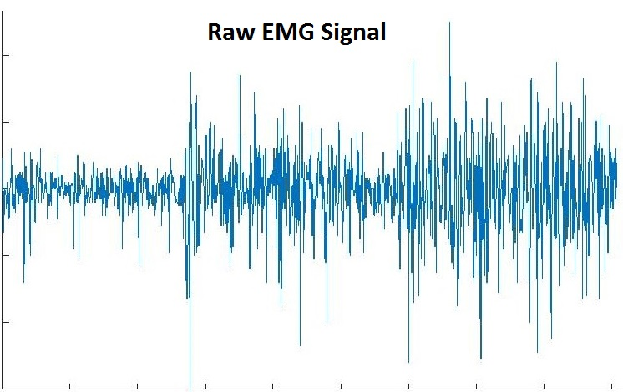
EMG
Electromyography (EMG) - electrical activity of muscle tissue:
Signals processed for expressing movement intent
Signals need to be filtered and features extracted
3
Notes:
James

Slide 5
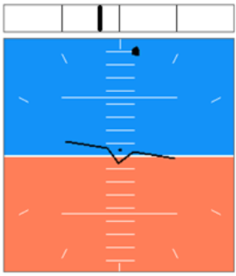
IMU
Inertial Measurement Unit (IMU) -
acceleration, angular velocity, and magnetic forces
3-axis accelerometer
3-axis gyroscope
3-axis magnetometer
Each channel streams data at 50 Hz
4
Notes:
James

Slide 6
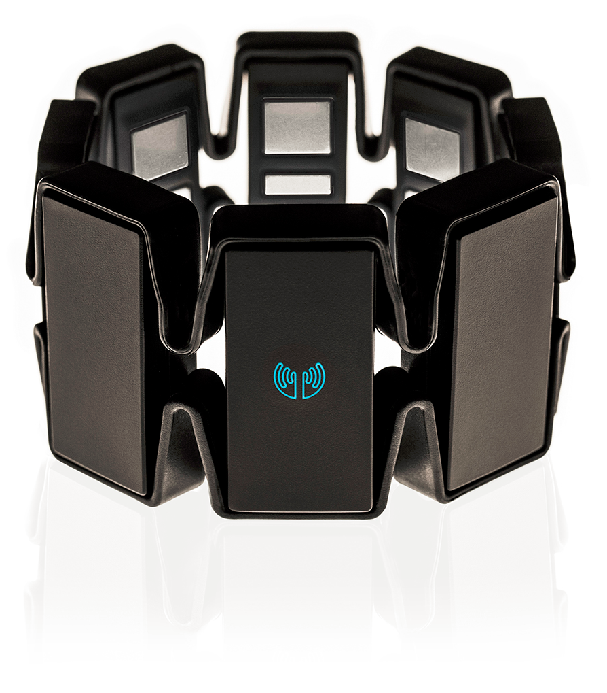
Gesture Recognition
Classifier Training
Data Windowing
Feature Extraction
Classification
Gesture Decision
Myo Armband
Client Application
5
Notes:
Jeff
The “Method” of our project in one picture. General idea/process

Slide 7
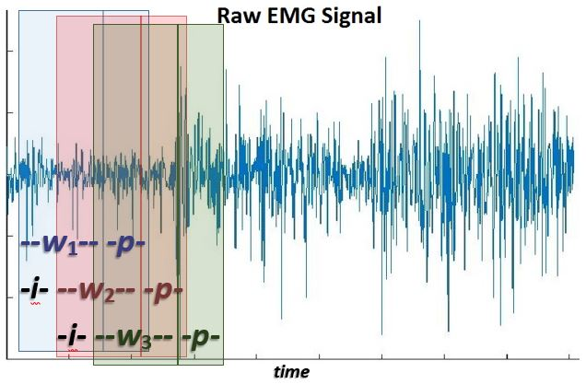
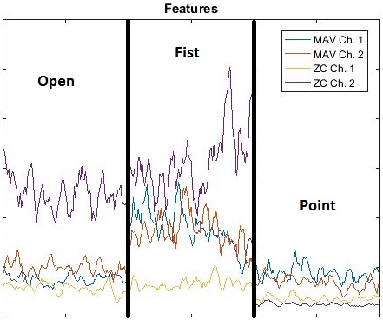
Gesture Recognition
Data Windowing
Feature Extraction
Feature - Characteristic property that distinguishes signals of different gestures
6
Notes:
Jeff ** Update features picture

Slide 8
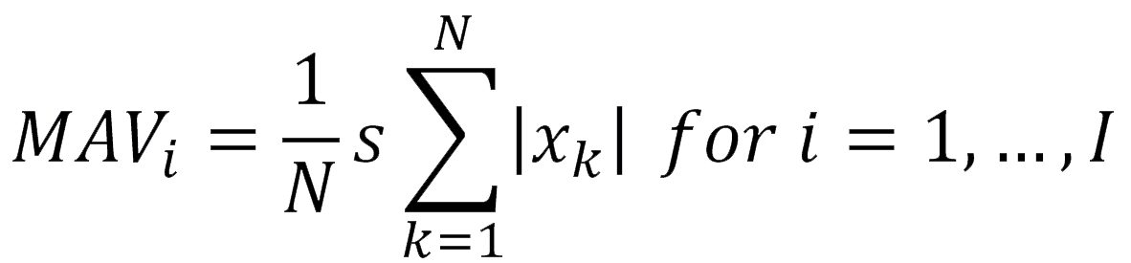
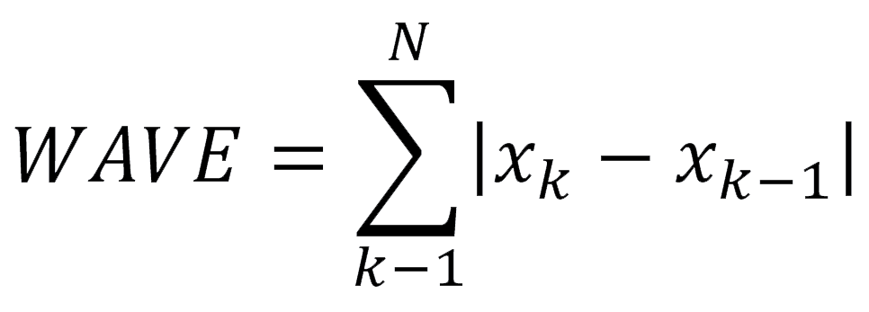
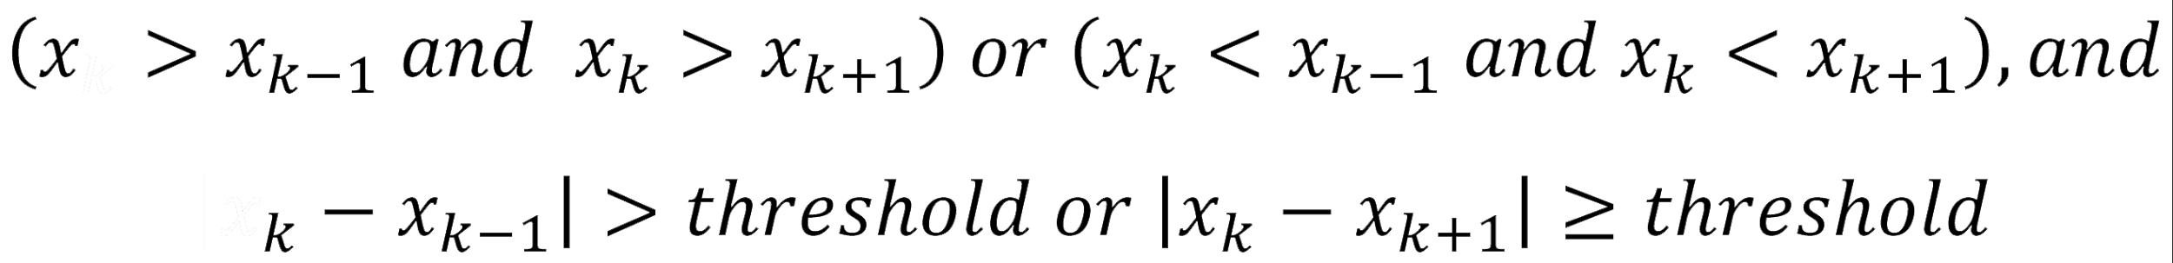
Features
Mean Absolute Value
Waveform Length
Zero Crossings
Slope Turns
7
Notes:
Jeff

Slide 9
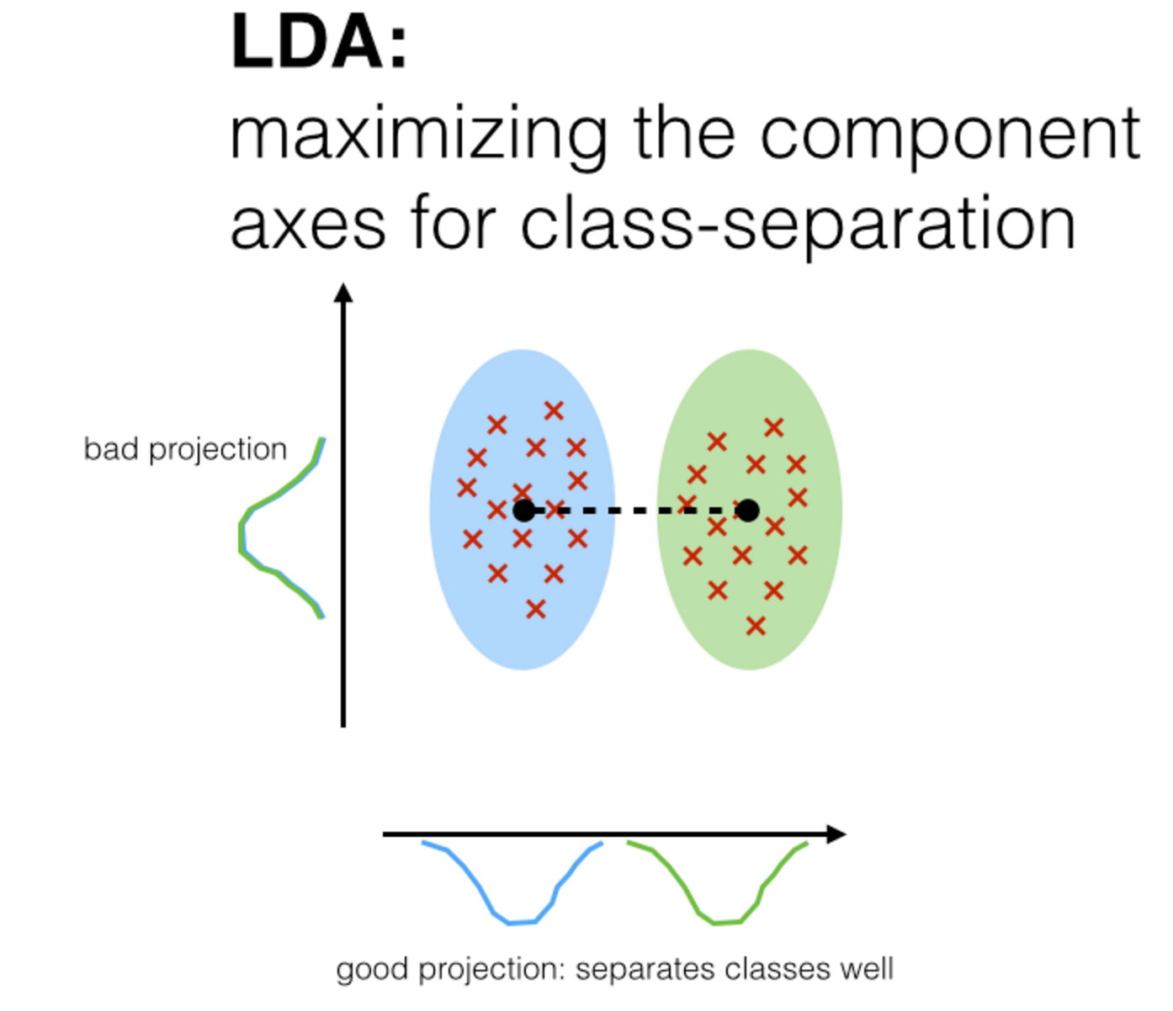
Classifiers
Linear Discriminant Analysis (LDA)
8
Notes:
Victor

Slide 10
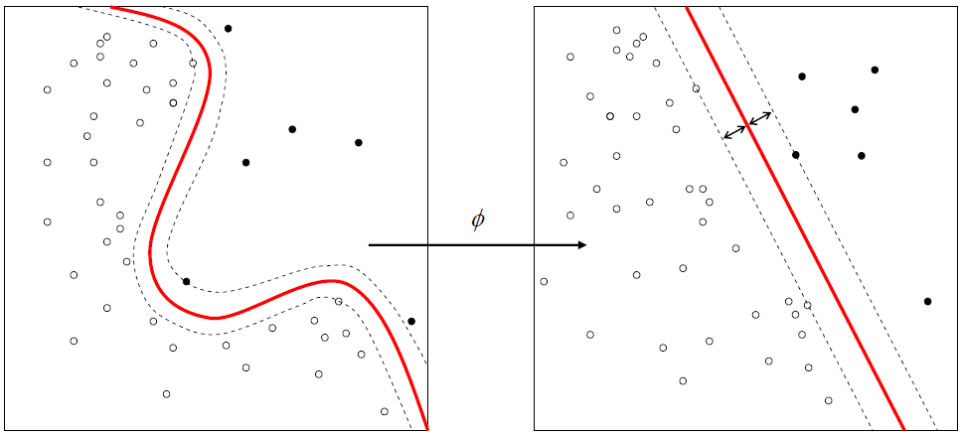
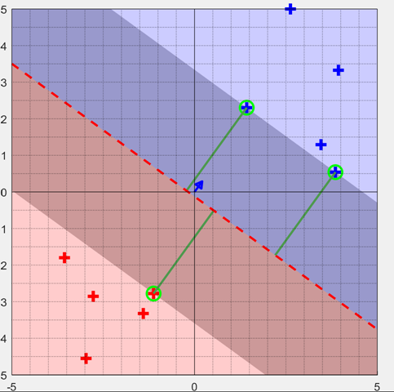
Classifiers (cont.)
Support Vector Machine (SVM)
9
Notes:
Victor

Slide 11
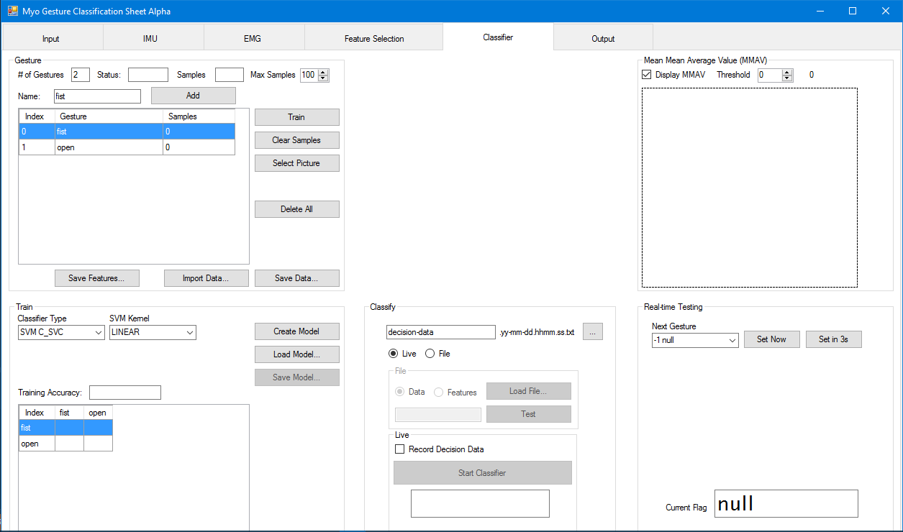
Train Gestures
Live gesture classification
Create Model
10
Notes:
Bianca
This is the HMI that we started off, it was a collaborative effort from last year’s interns and a grad student who cleaned up their code
Able to train gestures using EMG data only, EMG stands for Electromyography, and again, will be explained in the next slides
Can create a model and give a live gesture classification.
Essentially if I train the HMI that I’m making a fist and make an open hand, then create a model, and start classifying: it should be able to tell which gesture im making.

Slide 12
Group Project Goals
Expand current low-cost and flexible HMI for myoelectric controlled applications
Static and dynamic gesture recognition algorithm
EMG and IMU compared to EMG only
Friendly and flexible interface that provides output
Develop a usability assessment platform
Backend architecture work for further development
11
Notes:
Kattia
Expand current low-cost and flexible HMI for myoelectric controlled applications
Static and dynamic gesture recognition algorithm
EMG and IMU compared to EMG only
Friendly and flexible interface providing output:
Gestures, speed control, vision, and haptic feedback
Develop a usability assessment platform
Backend architecture work for further development
Group project goals
Our first goal is to expand on the current low-cost and flexible HMI for myoelectric controlled applications. This means that we want to add our own contributions to the previous version of the HMI that the last summer aspires interns worked on.
Our second goal is the development of static and dynamic gesture recognition algorithm. Static gestures are those that remain constant during a period of time; in contrast, dynamic gestures change during a period of time. We will research more on the topic of hidden Markov models since they are used for the dynamic gestures recognition. We want to make tests in which we compare the performance of the gesture recognition algorithm using EMG and IMU data in contrast to EMG data only.
Our third goal is to have a friendly and flexible user interface that is able to provide output such as gestures, speed control, vision, and haptic feedback
Our fourth goal is to develop a target achievement control test usability assessment platform
backend architecture work to further development

Slide 13
Additions/Changes
‘Feature Selection’ grid
Use IMU data for rudimentary dynamic gesture recognition
Auto-train feature
Picture output for static gestures
CrossAccuracy function
Pipeline to VR game
Haptic feedback
12
Notes:
Kattia
Addition/Changes
SS train class previous version vs our version
The HMI is able to pick up IMU data from all three sensors. This data is used for dynamic gesture recognition.
Picture output for static gestures were added back to the HMI.
Auto-train feature, which allows us to save time during the training and data collection process.
A feature selection grid was added, which allows us to select what features we want the HMI to use in its classifier. Additionally, it gives us flexibility to add or remove features to the HMI. One of the features that was added is the scaled MAV
Rudimentary dyn gesture recognition: mean mean absolute value peak finder, steady state or transition state finder//Prevents misclassifications
Mean mean absolute value peak finder, which is used for the VR application it enables the user to perform the same gesture several times by tensing their muscles instead of repeating the complete motion again and again.
The crossAccuracy function was rewritten to work with both the SVM and LDA models and provide better classifications
Modified existing pipeline to work with the VR application
Vibration feedback

Slide 14
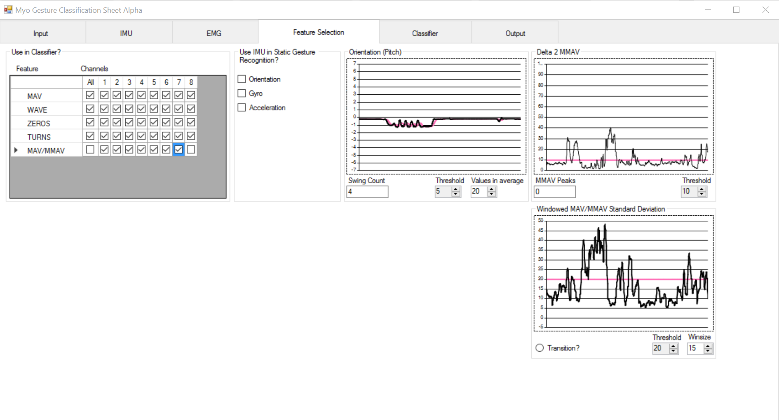
Feature Selection Grid
Dynamic Gesture Recognition
13
Notes:
Kattia

Slide 15
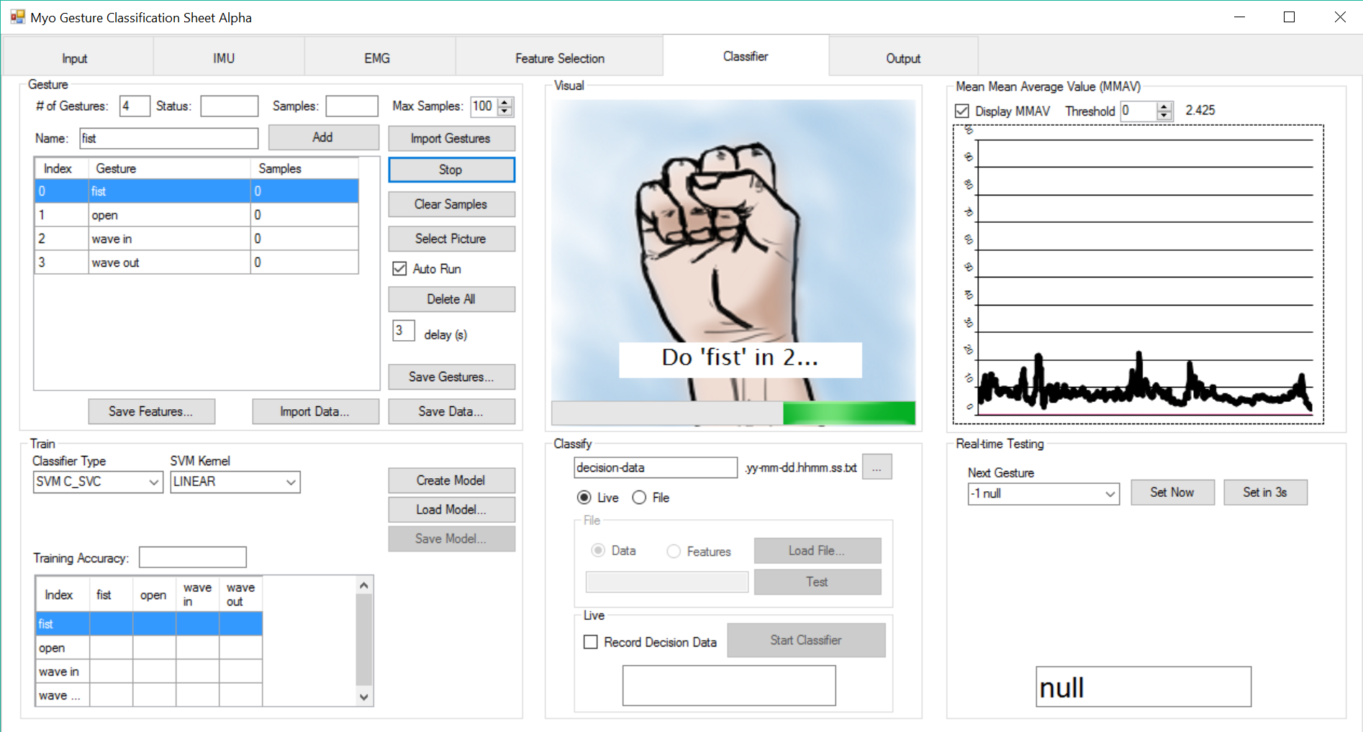
Picture Output
14
Notes:
Kattia

Slide 16
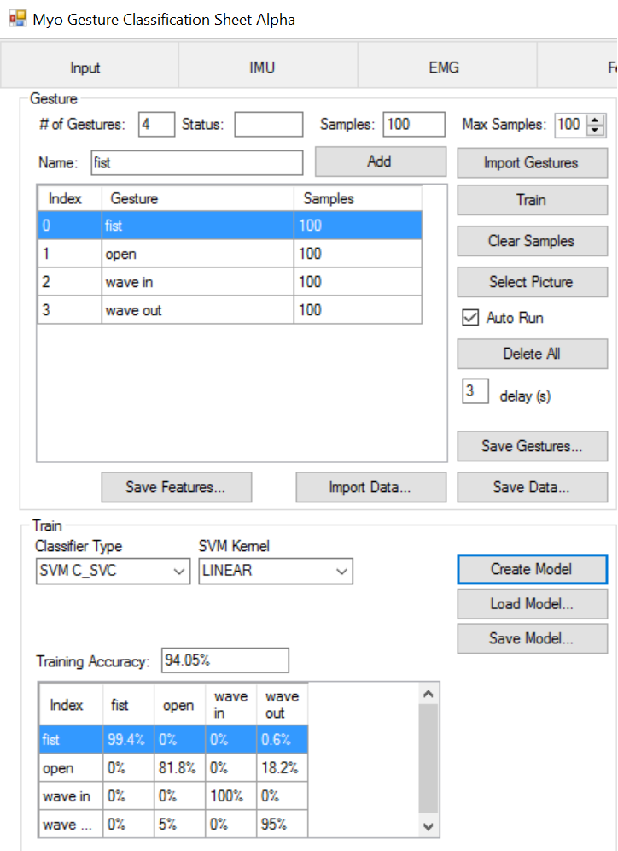
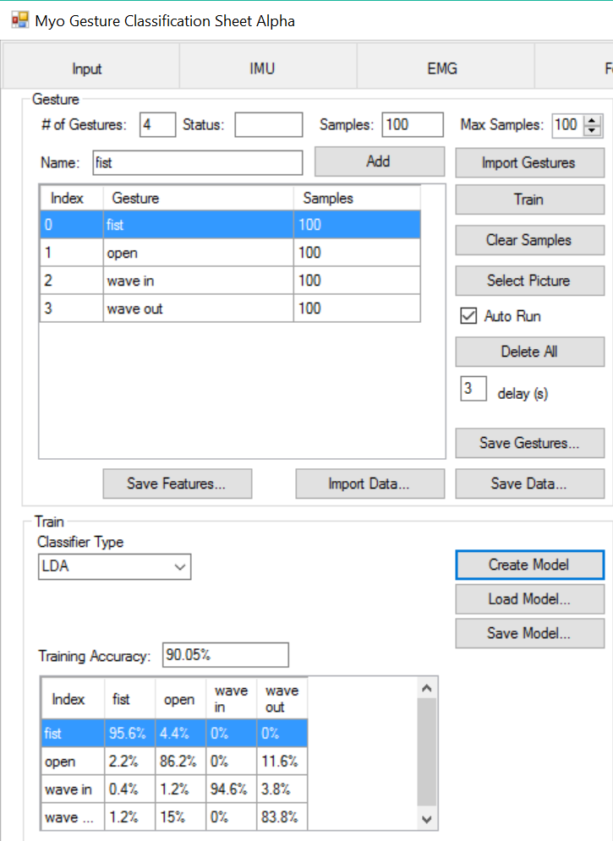
15
Notes:
Kattia

Slide 17
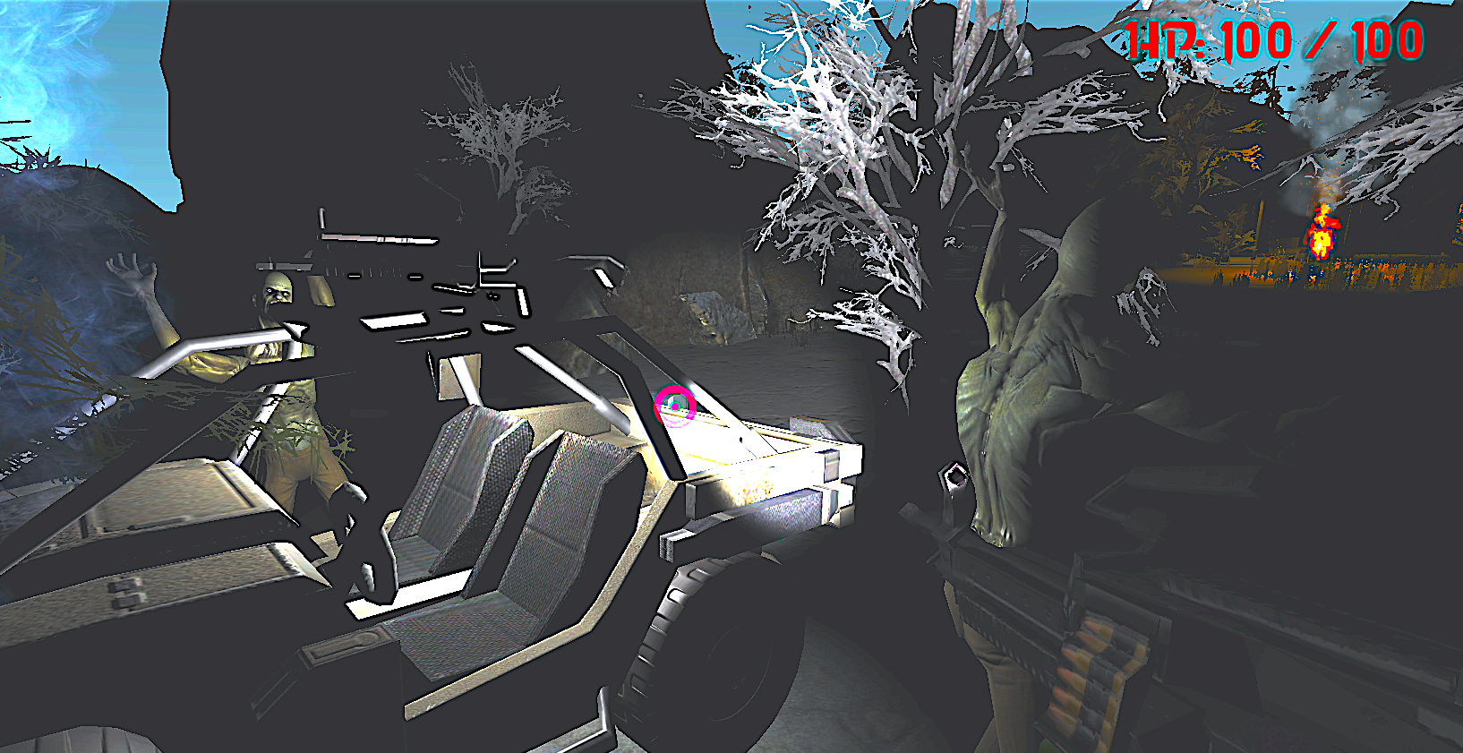
Experimental Protocol
Chris developed a VR game as an application for the HMI
The game was used as a usability assessment platform to test the usability of the Myo Armband as a controller
Gesture classifications
IMU arm swings
Haptic feedback
Metrics used
Hit-miss ratio
Remaining health
Final score
16
Notes:
James

Slide 18
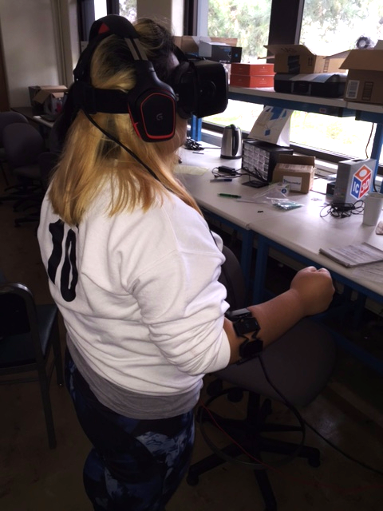
Experimental Protocol (cont.)
11 subjects (9 male, 2 female)
Four gestures: fist (shoot), rock on
(change weapon), fist right (reload), and
index, middle, ring fingers up (headlight)
Pre-survey
Training
Two trials per subject
Trial #1: mouse
Trial #2: Myo armband
Post-survey
17
Notes:
James
Gestures:
Shoot: Fist Tense (Classifier must see fist, and MMAVPk must occur)
Reload: Fist Right
Change Weapon: Rock On
Headlights Toggle: Index, Middle, and Ring Fingers Up

Slide 19
Results/Discussion
Usability
Improved Functionality
Interface can recognize more gestures (IMU, arm swings)
Groundwork for Continued Development of the Interface
Addition of more features
Steady state finder
18
Notes:
Victor
Our experiment was intended to test the usability of our interface as a control system for a client application, however the results were inconclusive. In the next presentation, Chris will continue to discuss the results of this experiment.
There were however other goals that we had for this internship that we were able to meet.
The result from our project comes down to three main areas: Usability, Functionality and the addition of dynamic Gestures. We laid groundwork for Continued Development of the Interface
Usability in the HMI was improved by adding things like Auto-Train, where the user doesn’t need to train each of the gestures manually he/she can upload a list of gestures into the classifier and do the training much easier. Usability was also improved by the reinstallation the “Select Picture”. This addition to the HMI let’s the user choose what pictures do they want to display with the gesture they are making in the classifier.
The “Feature Selection” grid lets the user choose what calculations or data sets does the HMI need to take from the MYO band in order to do the feature extraction. This addition to the HMI let’s the user choose what data to consider from the MYO band in performing static gesture recognition. Feature selection grid also improves functionality as the user can do changes to the data capture by a simple click of a button. Moreover, it can be easily expandable.
On that note, the addition of things like CrossAccuracy funtion we were able to improve functionality by adding Dynamic Gestures. With the addition of Dynamic Gestures are able to take the HMI into a new level of functionality. What I mean by this is that now the HMI can be used in multiple third-party platform; one good example is Chris’ VR. Game.
The addition of the Standard Deviation to find steady states can potentially reduce misclassifications in later versions of the interface.
However, the way we have implement the Dynamic Gestures

Slide 20
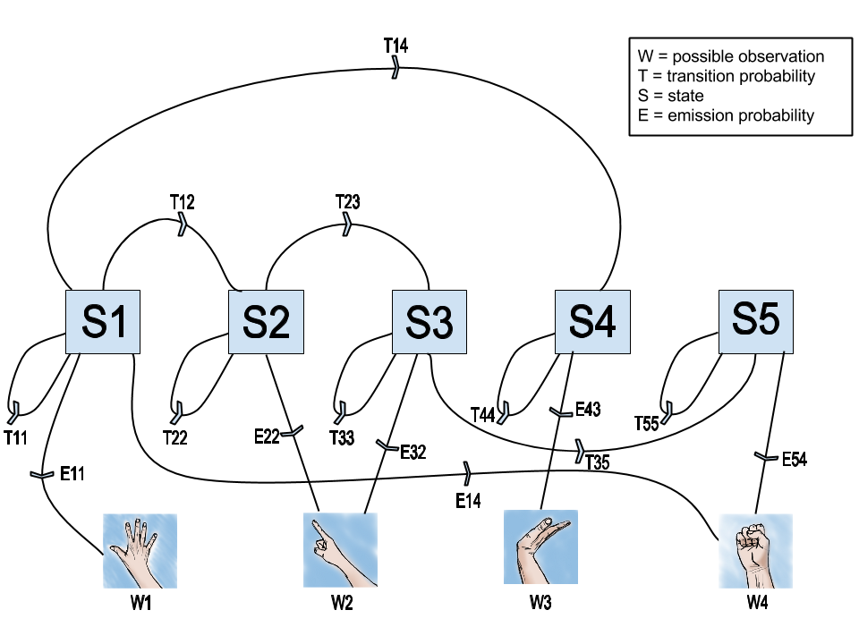
Future Plans
Feature optimization
More robust dynamic gesture recognition (Hidden Markov)
19
Notes:
Jeff

Slide 21
Questions?
20
Notes:
QUESTIONS?

Slide 22
Works Cited
I. Donovan, K. Valenzuela, A. Ortiz, S. Dusheyko, H. Jiang, K. Okada, X. Zhang, MyoHMI: A Low-Cost and Flexible Platform for Developing Real-Time Human Machine Interface for Myoelectric Controlled Applications, (2016).
X. Zhang, COMETS Research Internship Program Computer Engineering Project Introduction (2016).
K. Englehart, B. Hudgins, A robust, real-time control scheme for multifunction myoelectric control, IEEE Trans. Biomed. Eng. 50 (7) (2003).
Electromyography at the US National Library of Medicine Medical Subject Headings (MeSH)
21

