Slide 1


Integrating Mobile and Cloud Computing for Electromyography (EMG) and Inertial Measurement Unit (IMU)-based Neural-Machine Interface
Victor Delaplaine, Ricardo Colin, Danny Ceron, Paul Leung
Advisor: Dr. Xiaorong Zhang
Mentor: Alex David
ASPIRES Summer 2018 | Computer Engineering
San Francisco State University
Cañada College

Slide 2
Project Outline
Motivation and Background
Research Goal and Specific Tasks
Design and Implementation
Experimental Results
Conclusion
Future Work
Notes:
Follow structure of final paper

Slide 3
Motivation
Estimated number of over 32 million amputees around the world.
11.7 million patients go to Physical Therapy for a spectrum of issues.
There are no affordable solutions that can help these patient

Slide 4
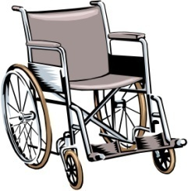
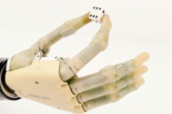
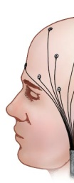
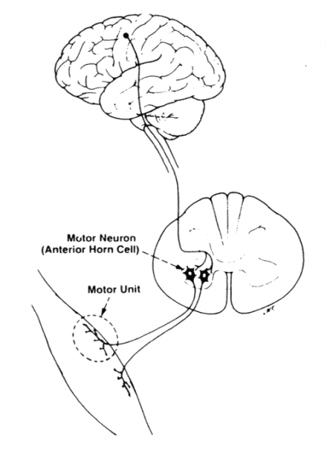
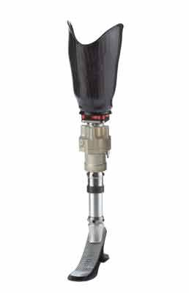
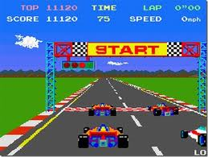
Neural-Machine Interface (NMI)
NMI utilizes neural activities to control machines.
External Devices
Human Neural
Control System
Neural
Machine Interface
Notes:
Takes sensors from the body and displays it from the human to machines

Slide 5
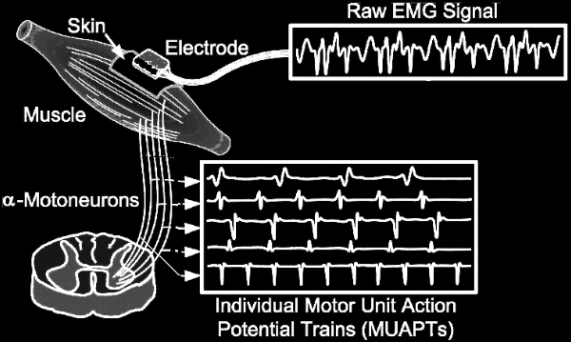
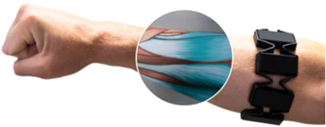
EMG-based NMI
EMG (Electromyographic) signals: Effective bioelectric signals for expressing movement intent

Slide 6
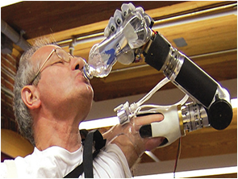
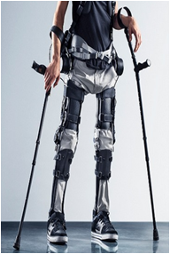
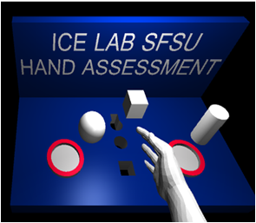
EMG Pattern Recognition
Processing EMG Signals to classify gestures
2 phases.
Training
classifies incoming data into gestures.
Testing
Utilizes the classified data to make prediction of the gesture.
Notes:
Mention pictures this are some of the application of patttern recognition

Slide 7
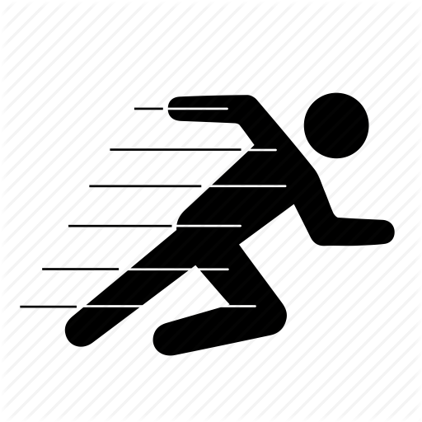
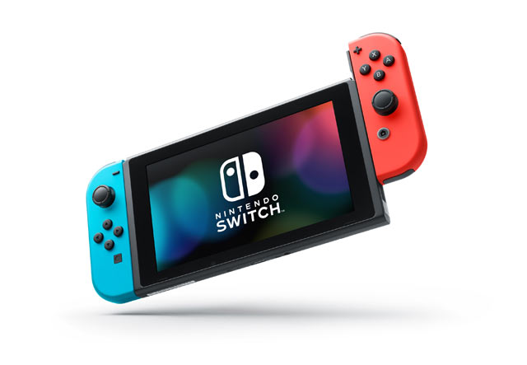
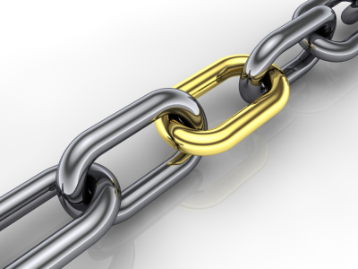
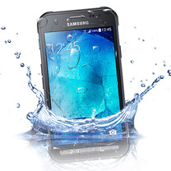
Requirements for EMG-base NMIs
Fast → Needs to work in real time: Lag time < 200ms
Portable → Can be taken anywhere
Reliable → Predict gestures accurately
Durable & Robust → Withstand everyday occurrences like sweat and shifts in the armband
Notes:
No existing nmi meeting these requirements. So we are trying to develop a system that does this.

Slide 8
Research Goal
Develop an open, low-cost, portable and flexible research platform (MyoHMI) for developing EMG and IMU-based NMI by integrating edge and cloud computing techniques

Slide 9
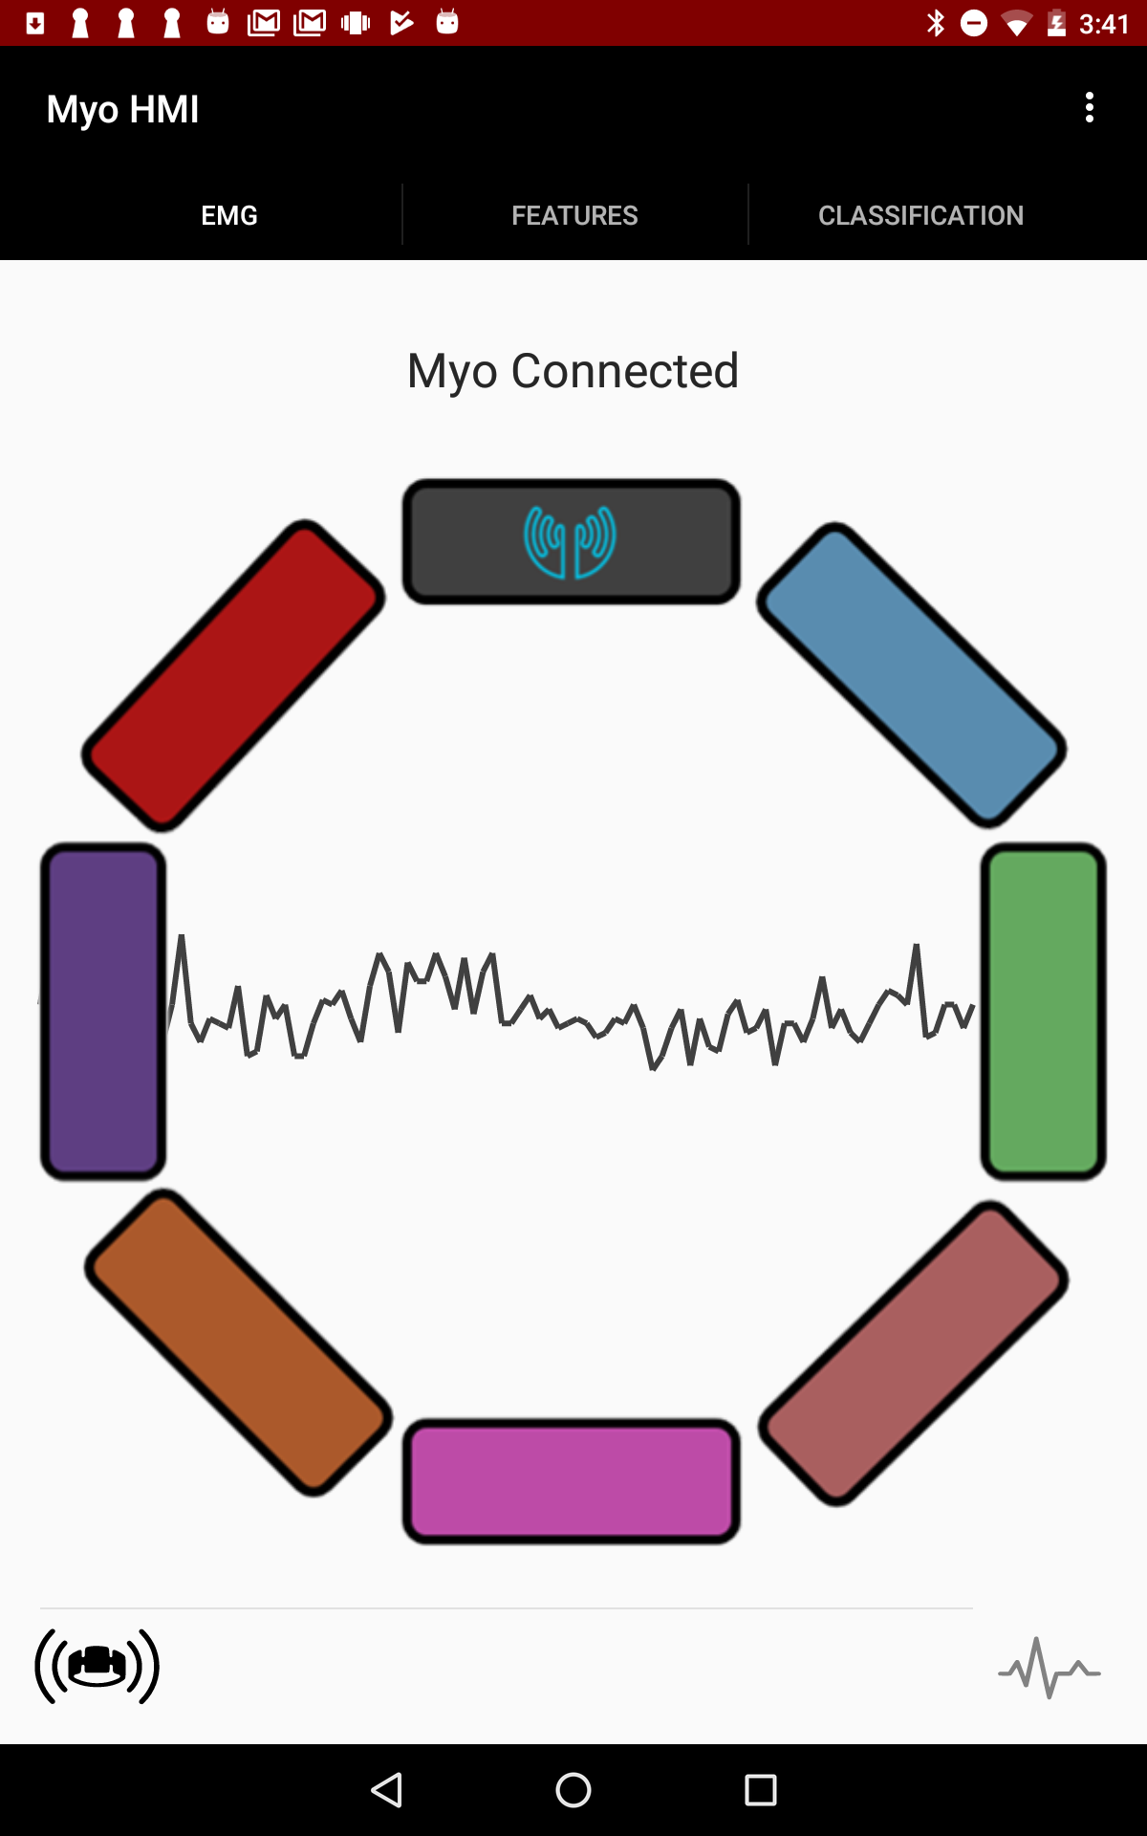
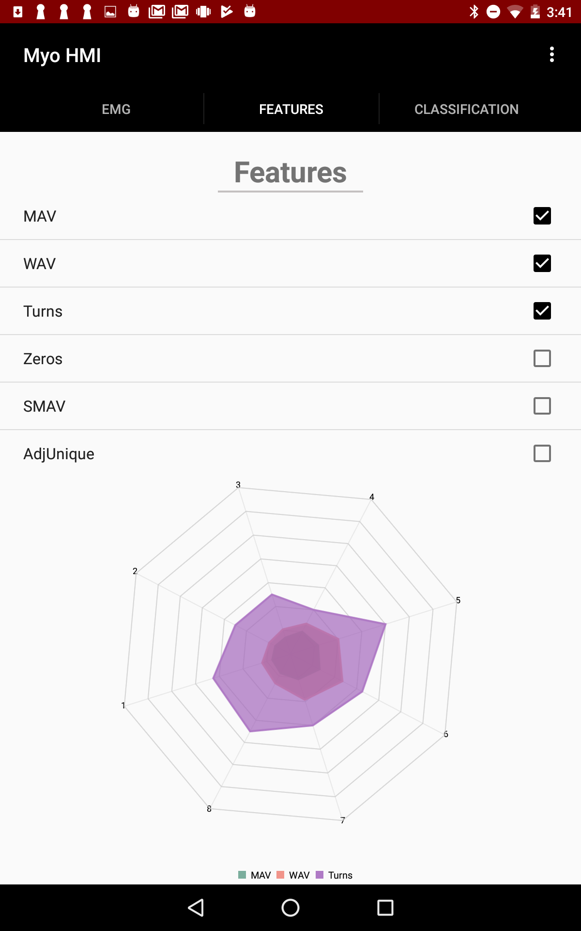
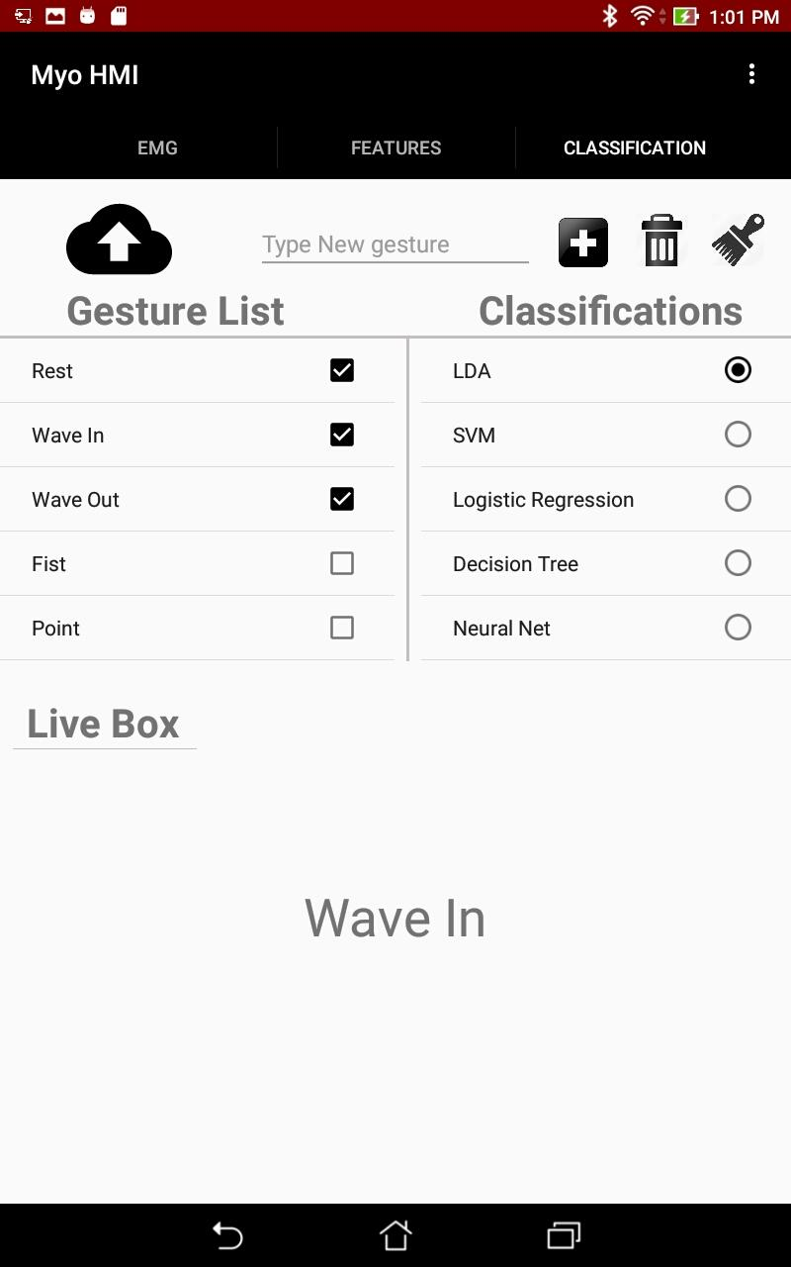
Previous Work
Notes:
The way we had the cloud upload was unorganized

Slide 10
Specific Tasks
Improve the previously developed MyoHMI software by
Integrating IMU tab
Integrating Cloud Computing
Creating a website to make our project open source
Creating an User Independent Pattern Recognition experiment

Slide 11

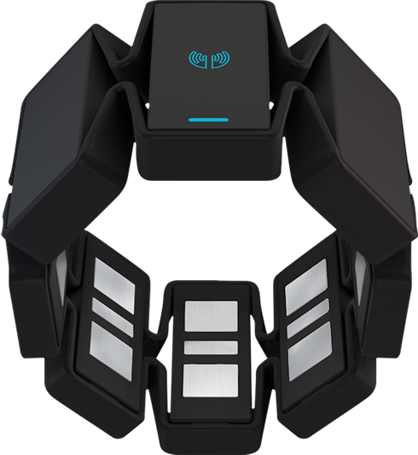
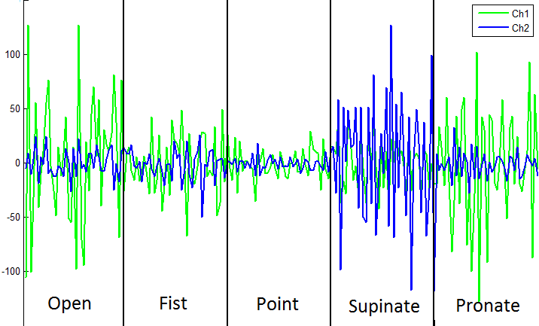
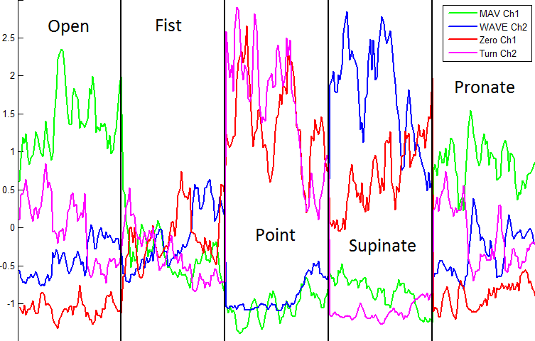
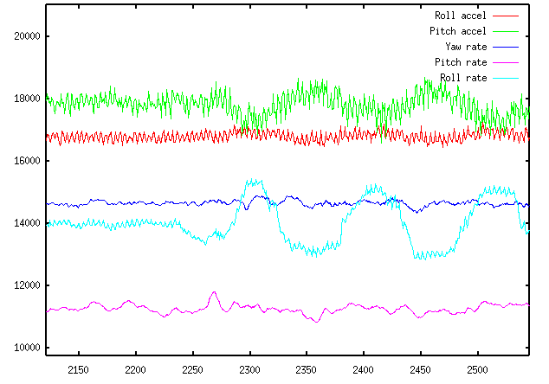






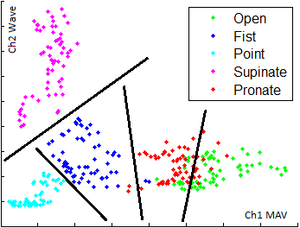
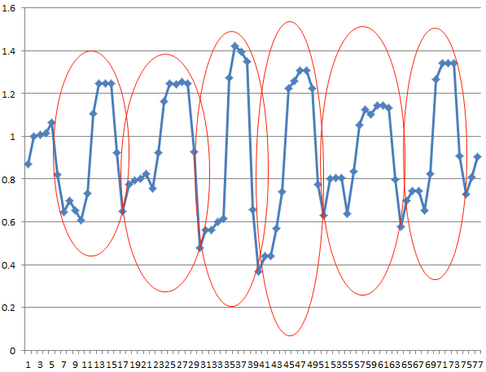
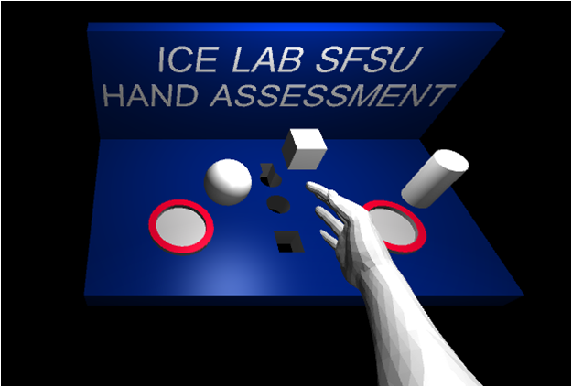
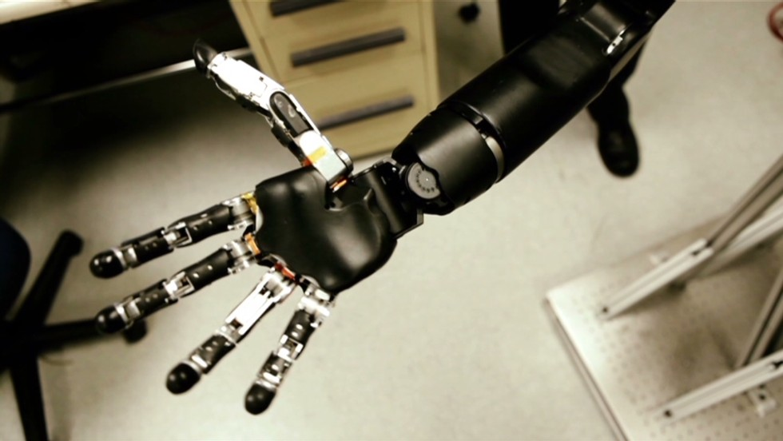
MyoHMI - System Architecture
Raw Data
Myo Armband
Raw EMG and IMU Data
Featured Data
Database/Server
Gesture Output
Classification Model
Cloud Pattern Recognition
Virtual Reality
Prosthetics

Slide 12
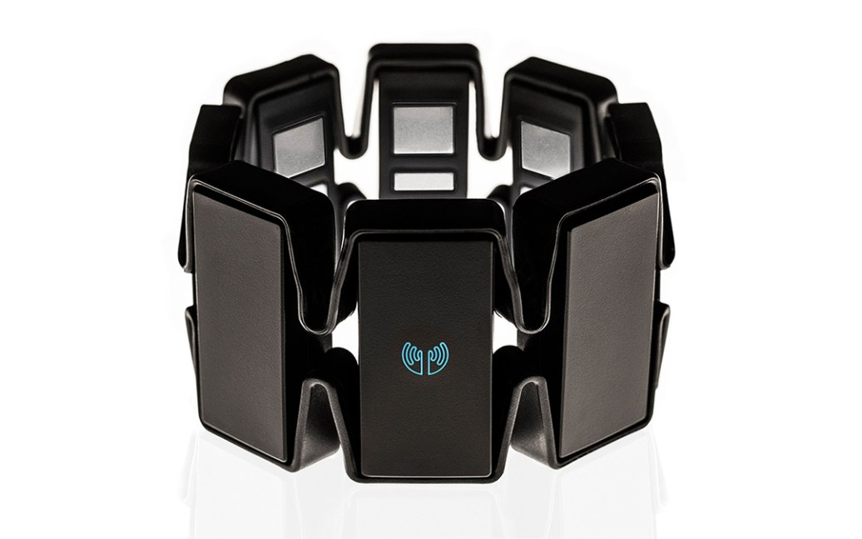
Myo Armband
8 EMG sensors surrounding the forearm
9-axis Inertial Measurement Unit (IMU): measures acceleration, angular velocity, and magnetic forces
Bluetooth Low Energy (BLE) wireless communication

Slide 13
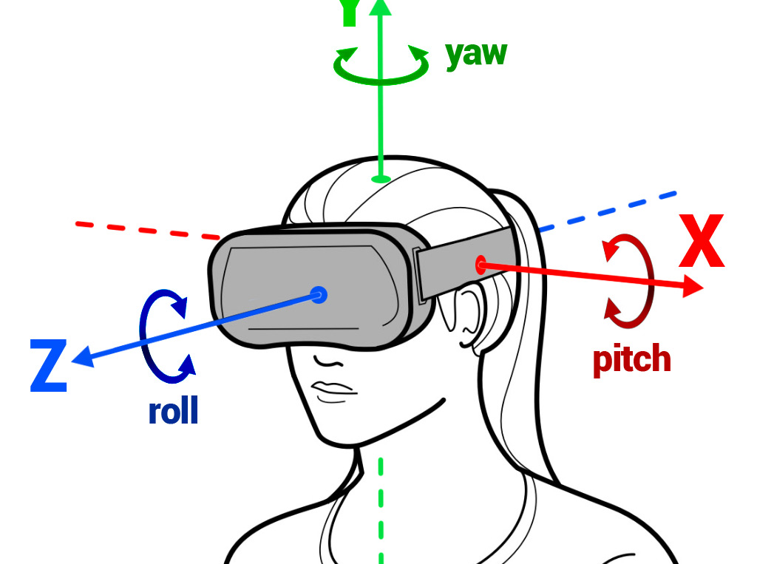
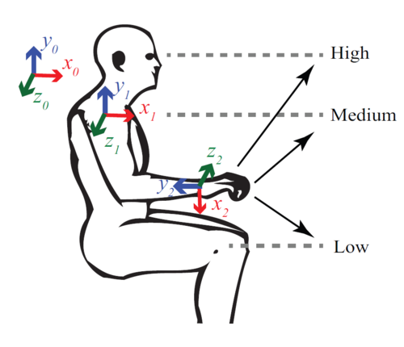
Integrating IMU
Possible uses with MyoHMI:
Detect hand and arm motion and orientation
Possible applications include:
VR/AR rehabilitation games
Sign language recognition
Control of assistive robots and prostheses

Slide 14
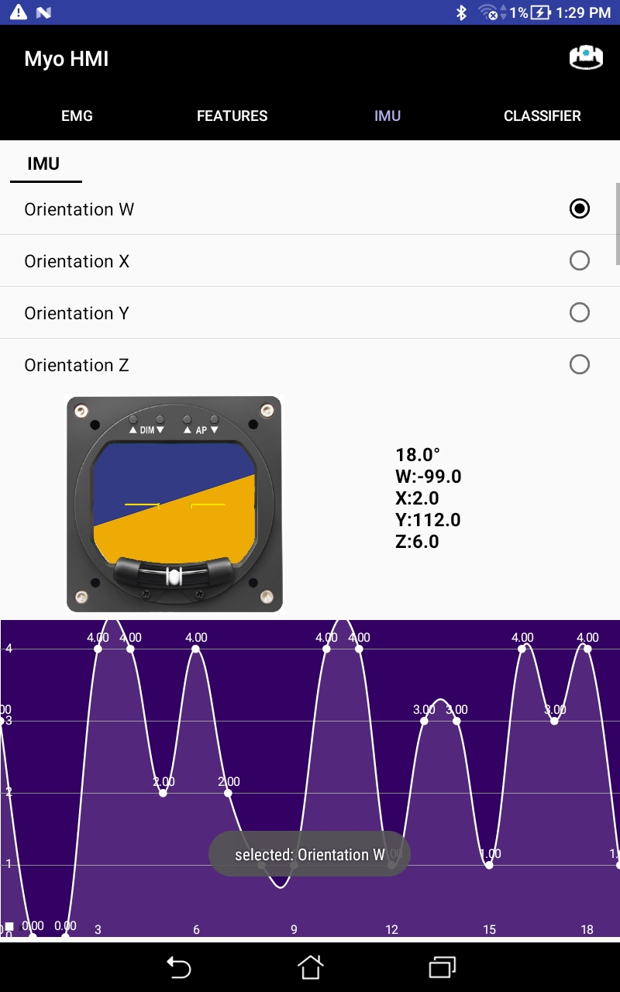
IMU Tab
Collects two sets of IMU data from armband
Data is utilized to calculate motion of the armband.
Values are displayed on the screen
An artificial horizon used to see the tilt of the armband

Slide 15
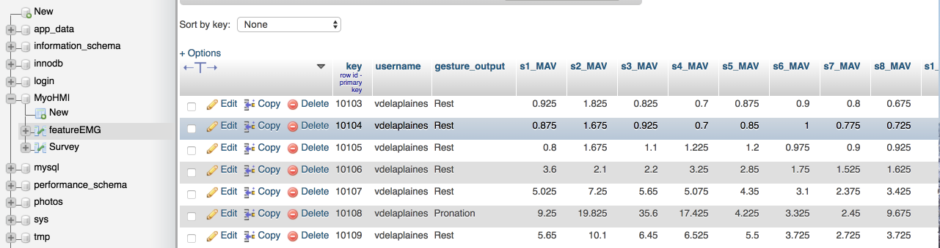
Integrating Data Storage
Setup Elastic Compute Cloud (EC2) AWS
Setup Amazon Relational Database Service (RDS) AWS
Setup mySQL database
Included method in MyoHMI to store users EMG data.
Notes:
EC2: web service that provides secure, resizable compute capacity in the cloud. It is designed to make web-scale cloud computing easier for developers.
RDS: makes it easy to set up, operate, and scale a relational database in the cloud.

Slide 16
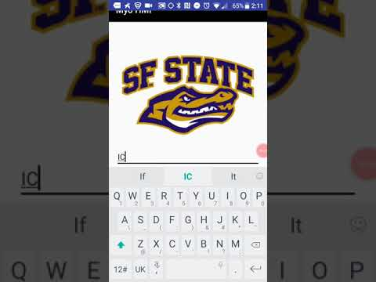
User Login
User login allows us to store user’s specific data to the cloud.
Raw Data
Extracted Feature Data
Trained Models

Slide 17
Website
Showcase product, and provide installation guidance
Shows basic instructions on how to use the app
Open to the community
To make the app open source
Help us grow our featured EMG Database
Increase User Independent Pattern Recognition Accuracy

Slide 18
Website
Menu Content
Home
How to use
Guidance of how to download, install the app
Contact us
Survey

Slide 19
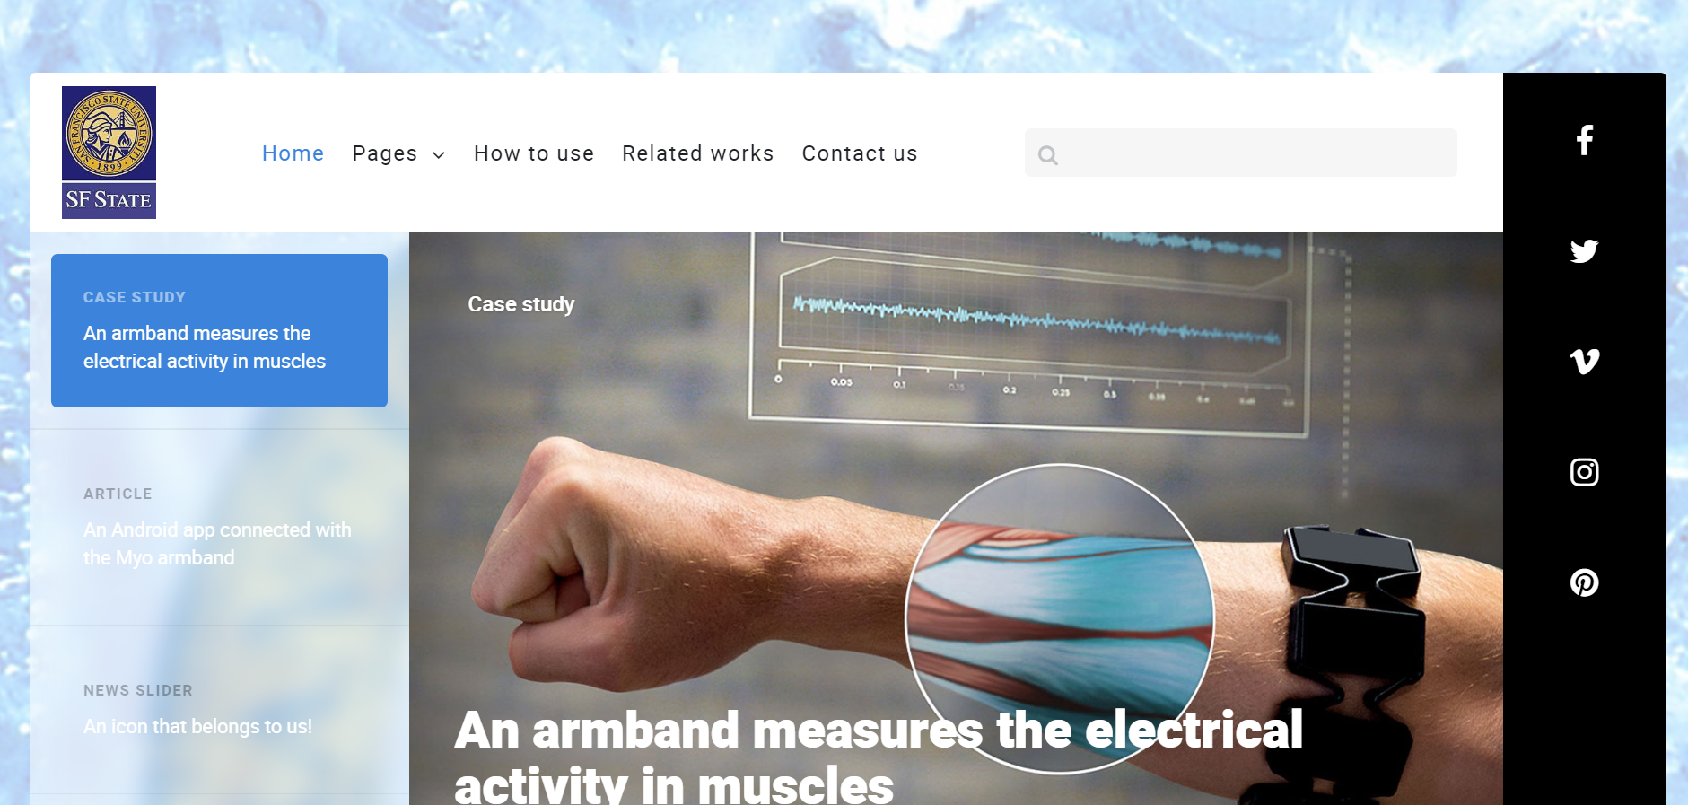
Website - Home Page

Slide 20
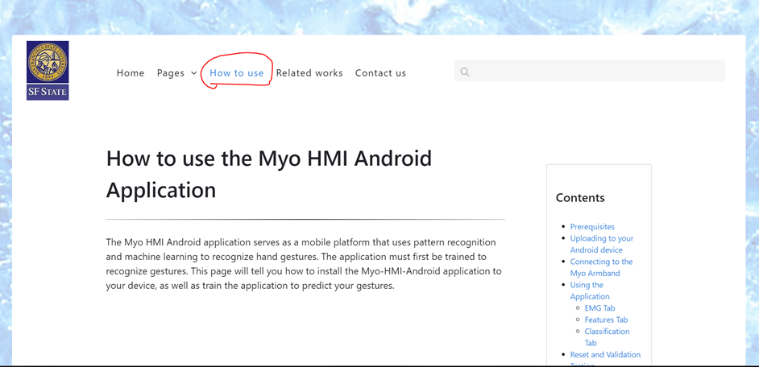
Website - How to Use

Slide 21
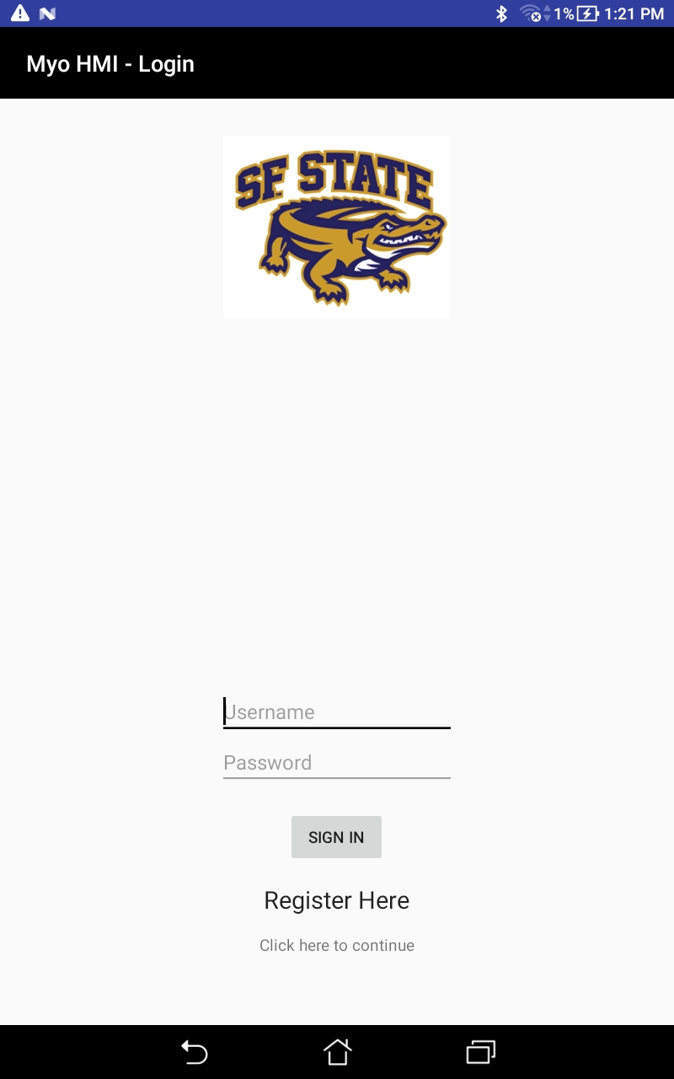
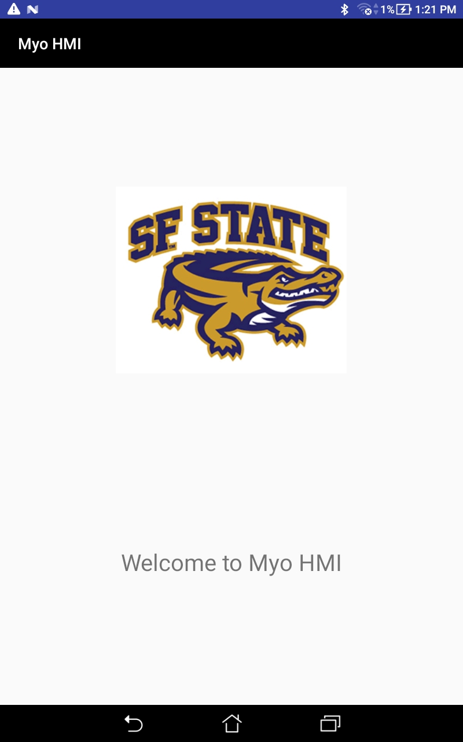
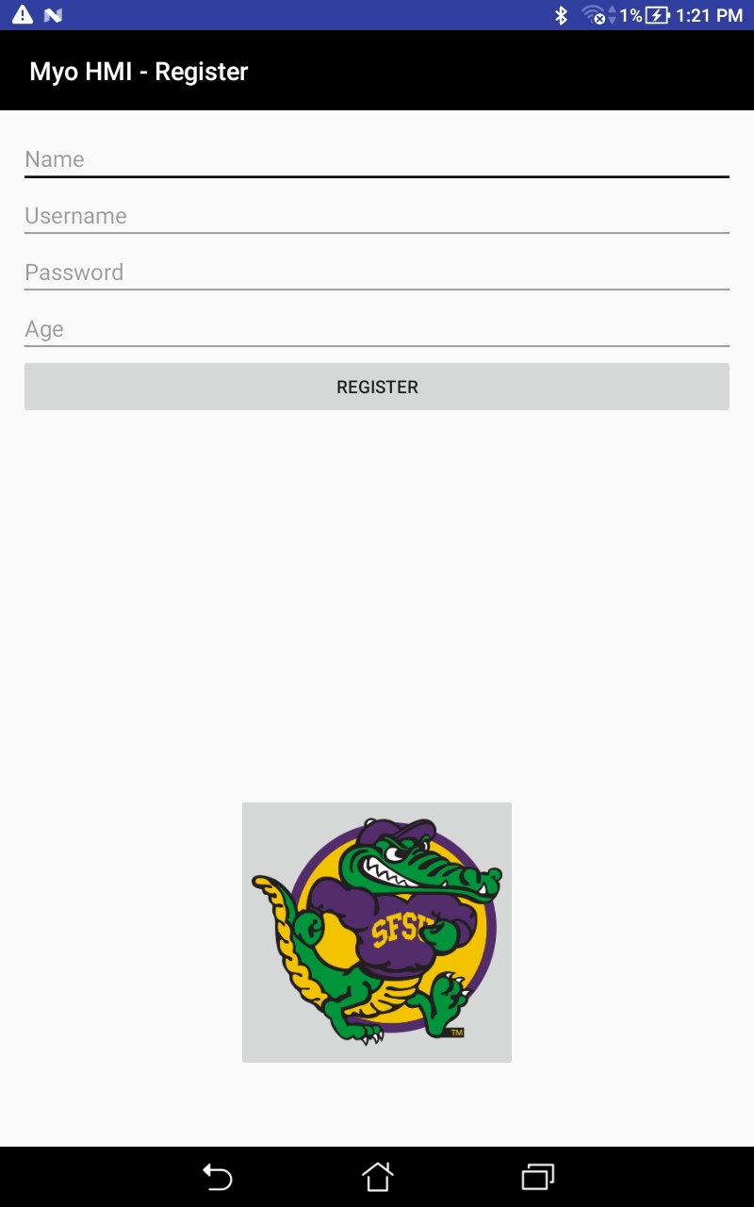
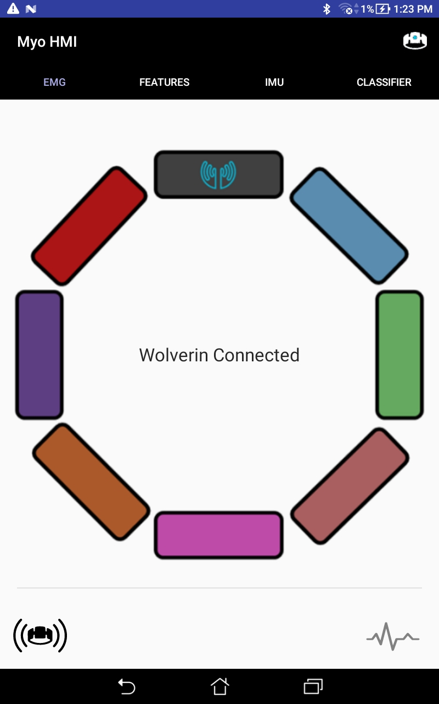
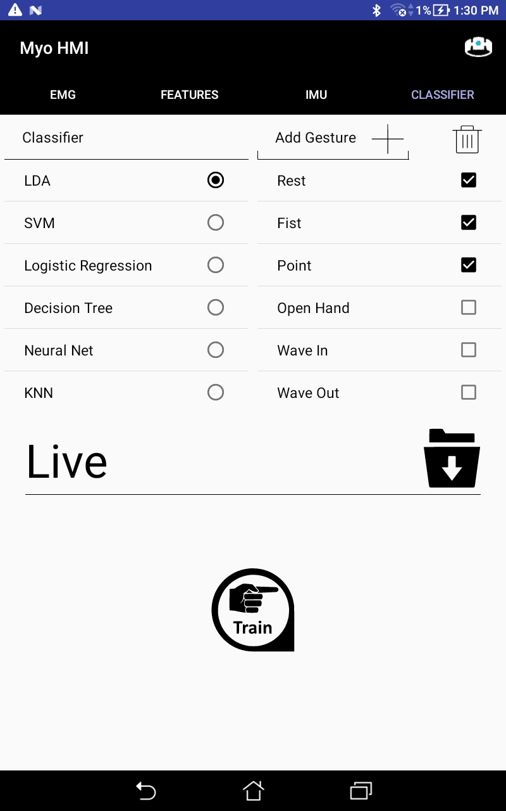
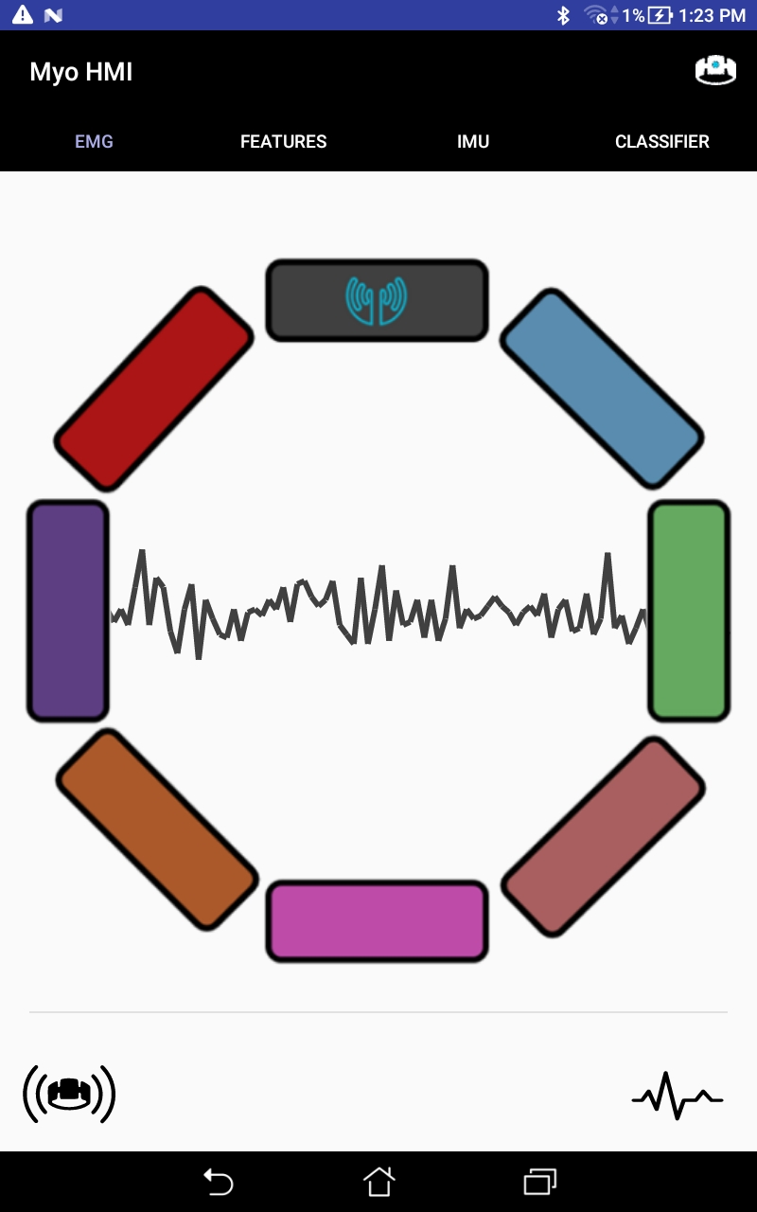
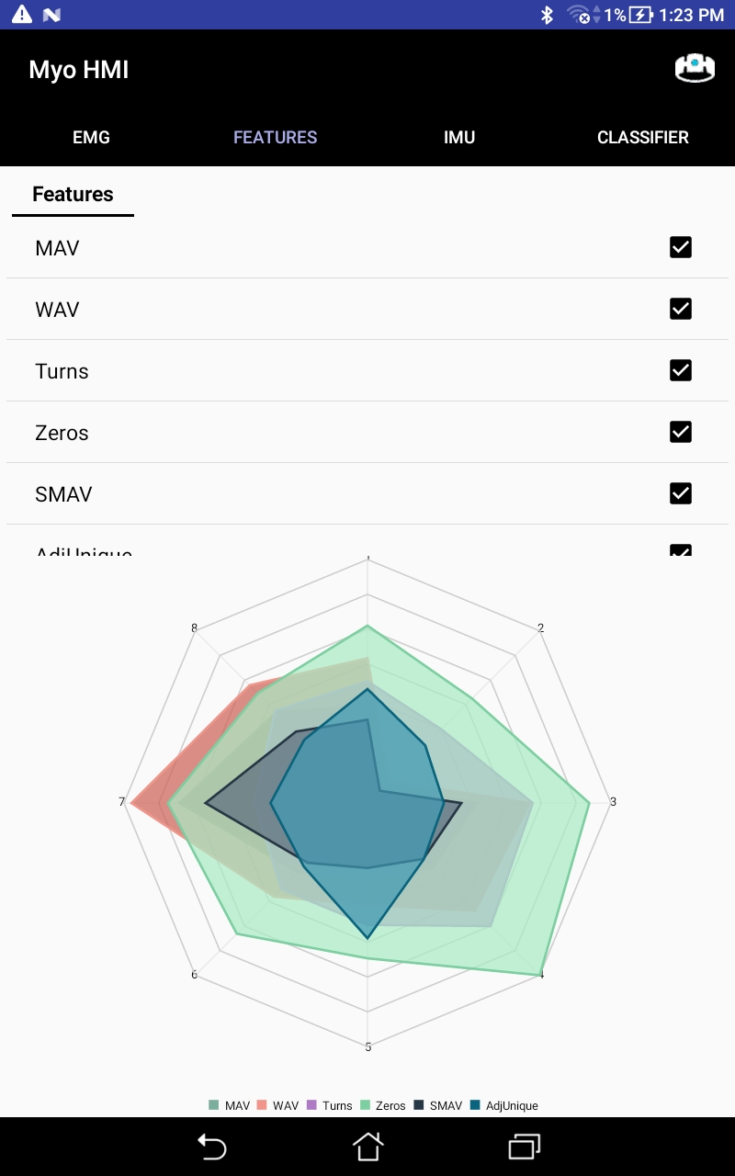
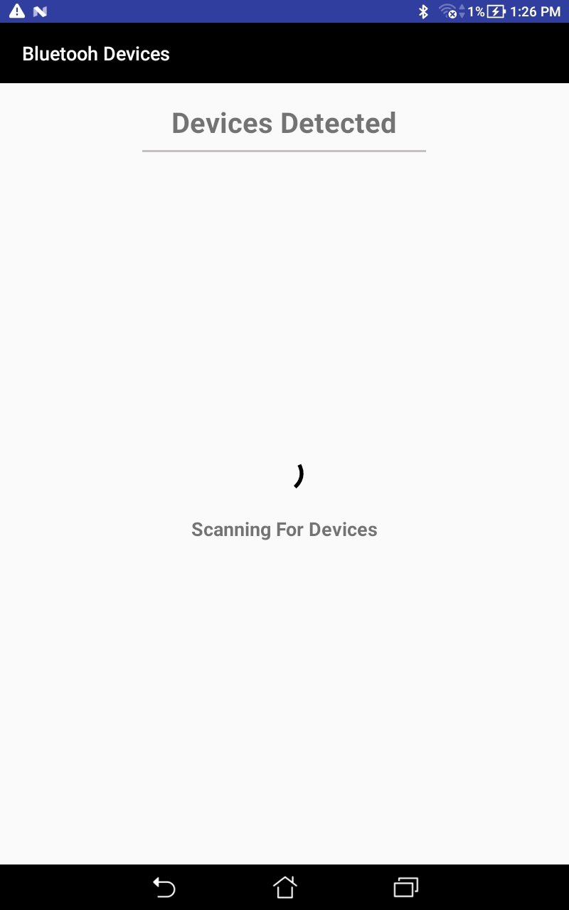
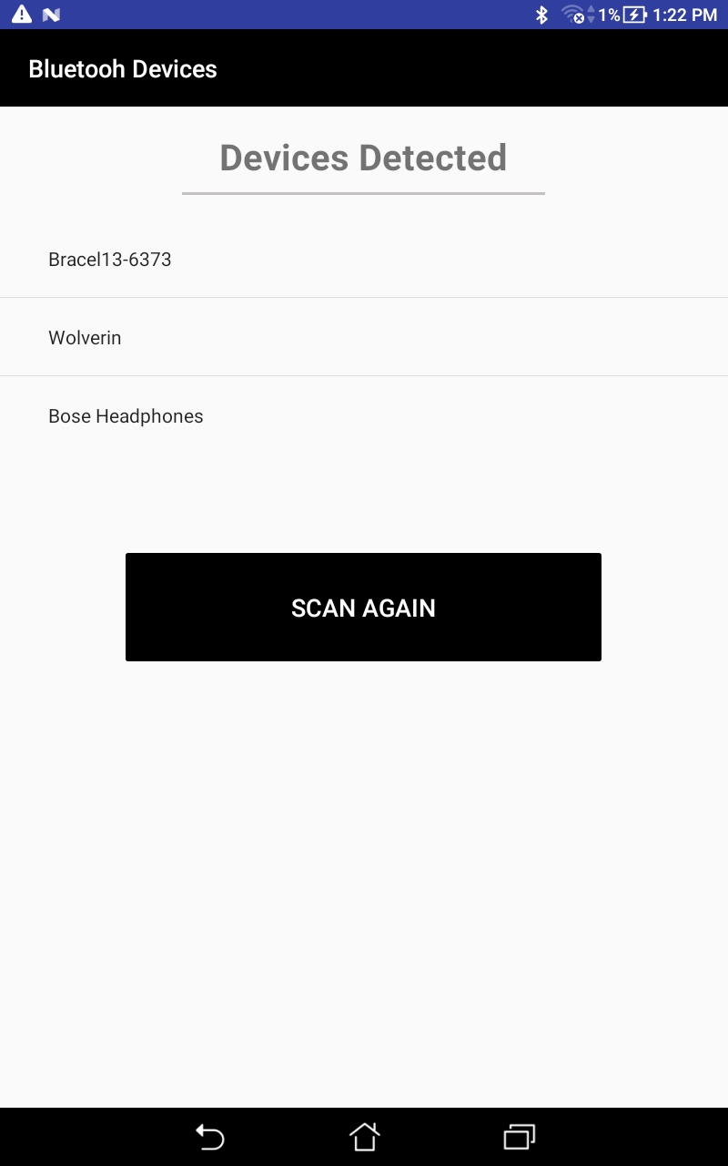
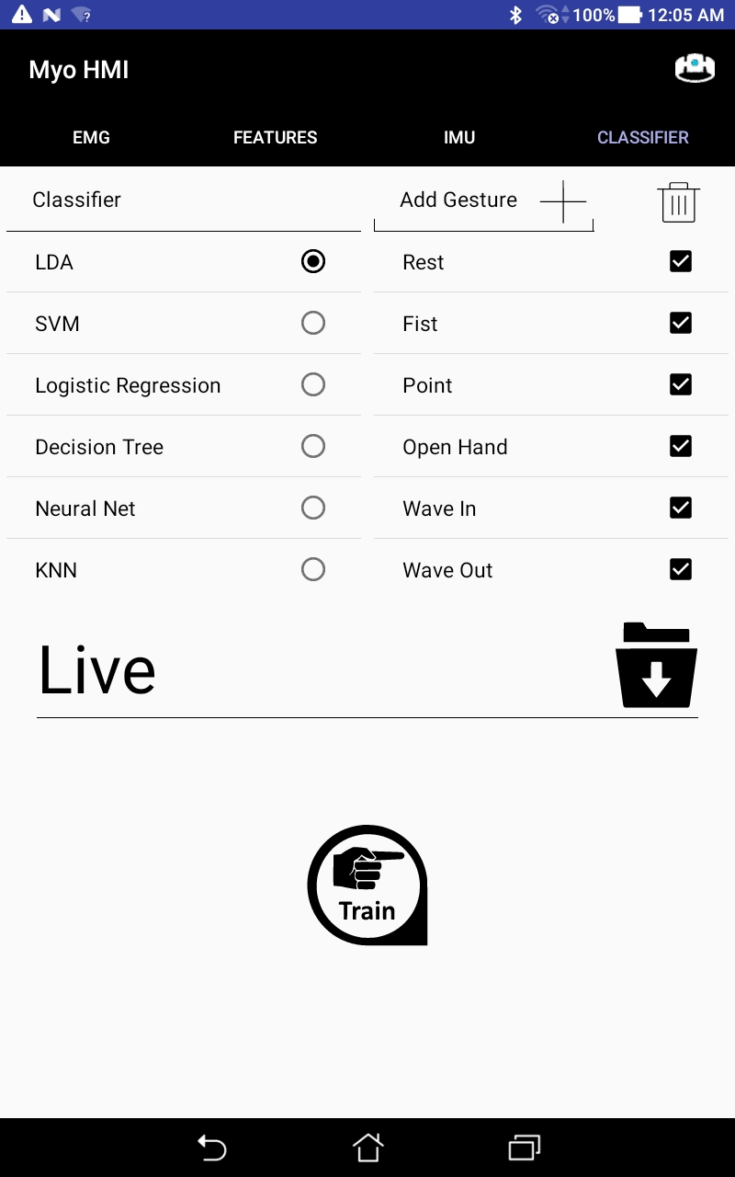
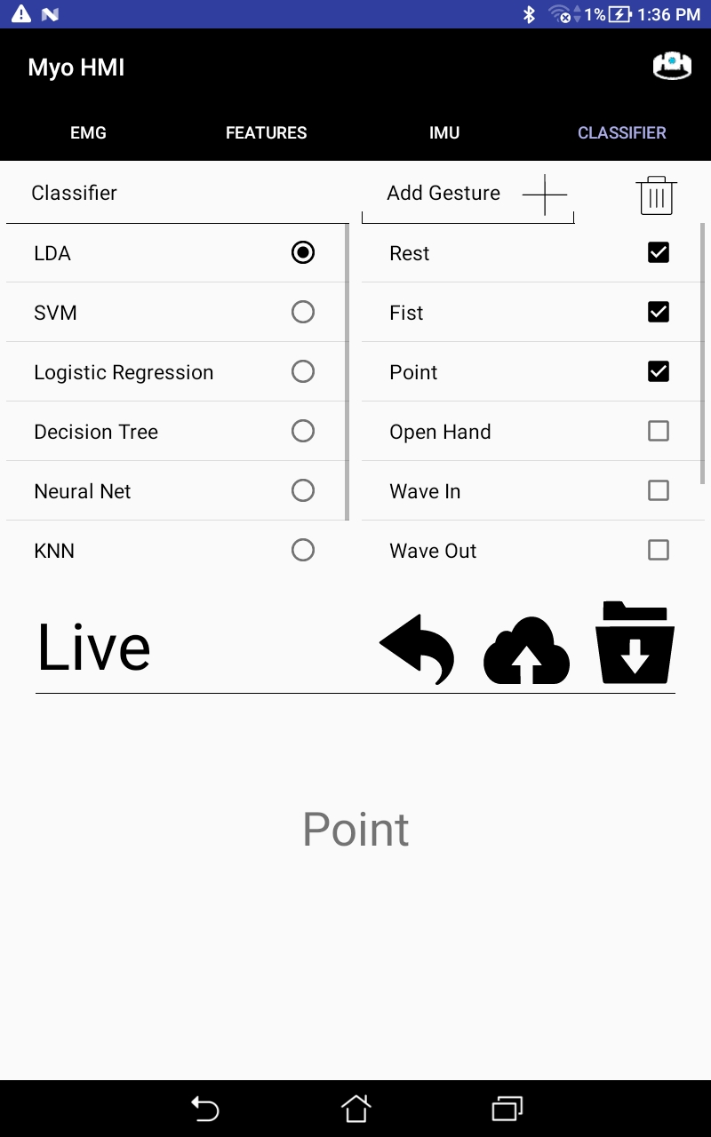

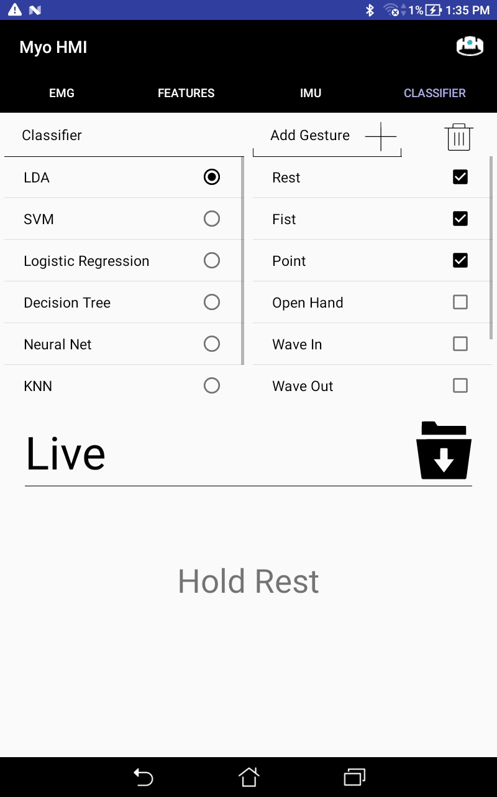
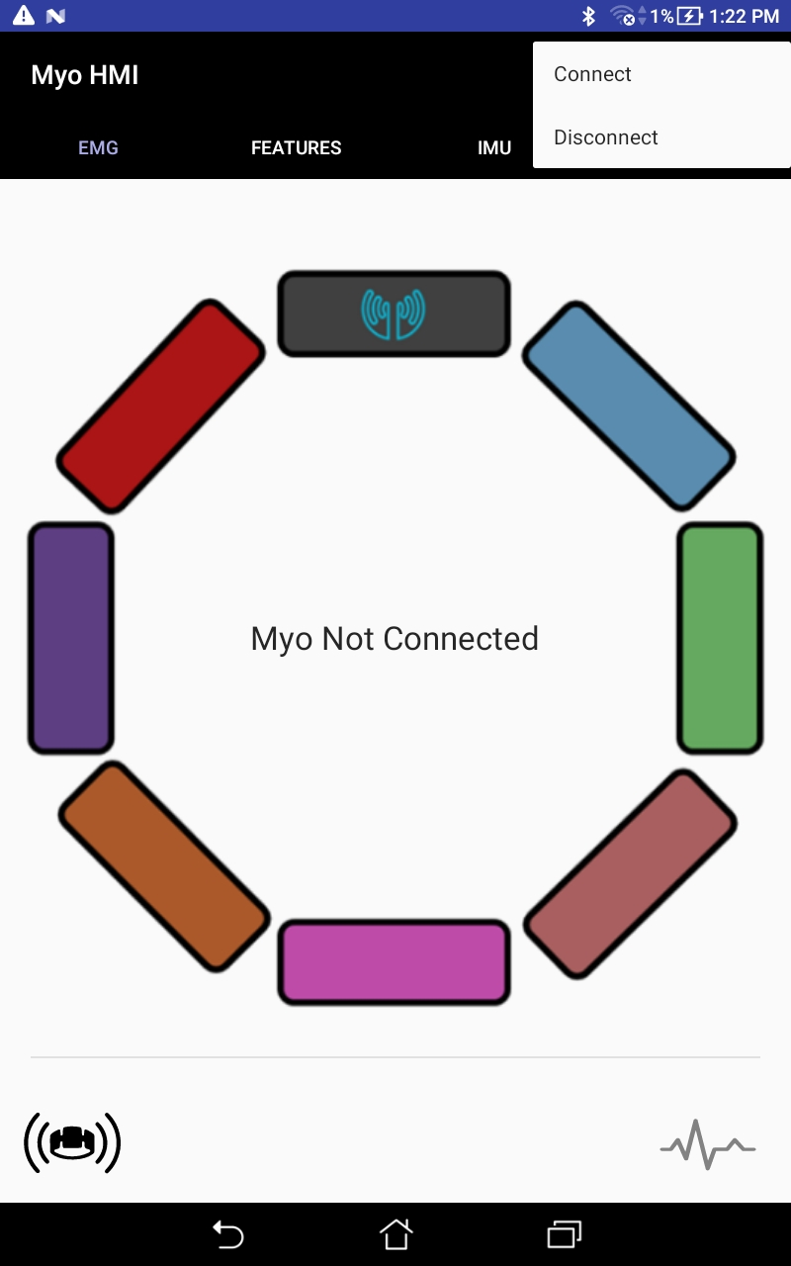
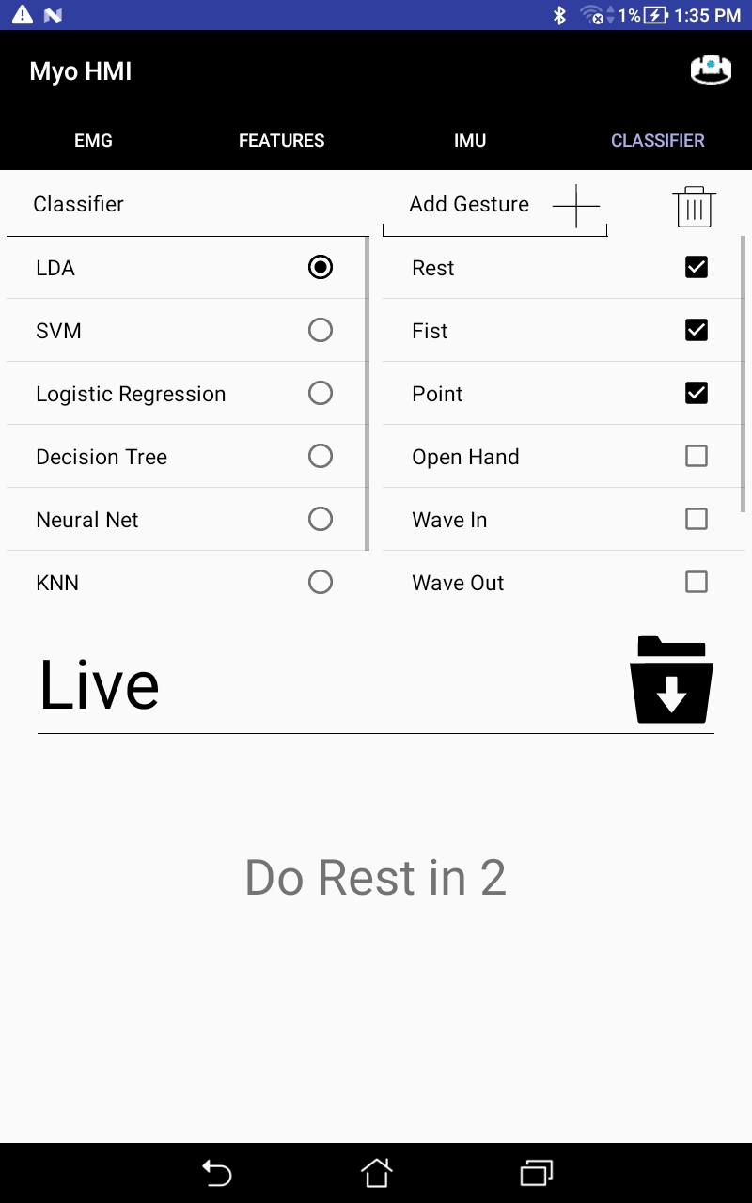

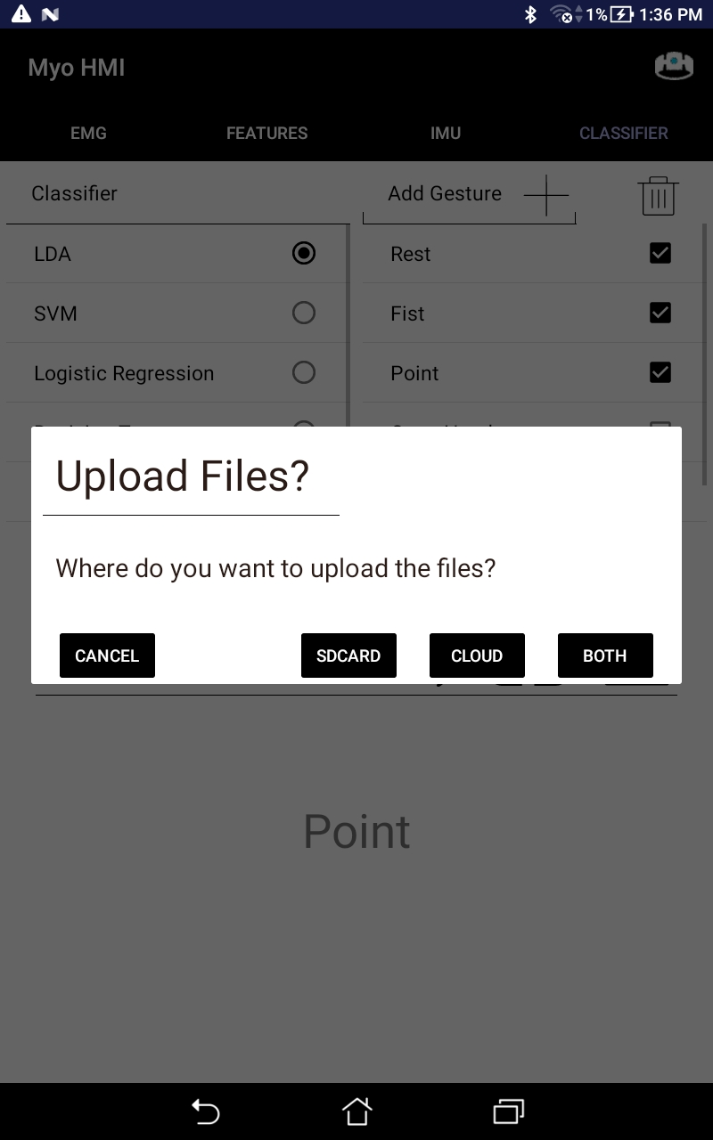
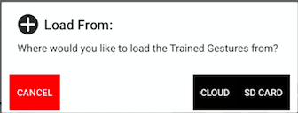
Android Application - Preview

Slide 22
Experiment - User Independent Pattern Recognition
If we collect data from multiple users and train one model based on all of that data, we hope this model can be applied to any human
We conducted an experiment collecting data from several users and developed model based on all data collected and tested data from each user against it

Slide 23

Experimental Controls
The armband must be in a consistent position across all subjects.
Align the light on the armband with the middle finger

Slide 24
Experimental Protocol
10 Subjects
Train 8 Gestures: Rest, Fist, Point, Open Hand, Wave In, Wave Out, Supination, Pronation
Upload to cloud (Tap “Cloud Image” button)

Slide 25

Experimental Results
Developed a Java program, to be ran in the cloud, that trains one model from 9 subjects
(excluding 1)
Run data from each excluded subject against this model to see how it performs
Notes:
We like our accuracy around 90 percent or above to be used and its not feasible

Slide 26
Experimental Results - User Survey
Question Topic | Responsiveness | Accuracy | Ease of Use | Aesthetic
Average Rating | 4.25 | 4.125 | 4.125 | 4.0
Table 1. Average Rating of Mobile Application from 10 users

Slide 27
Conclusion
Integrated Inertial Measurement Unit (IMU) GUI
Needs further testing and implementation
Successfully implemented MySQL for Cloud Computing
Created a website that provides instructions and is open source
Created an User Independent Pattern Recognition experiment
50% accurate with 10 test subjects
need more subjects
Notes:
Basically dr x wants us to go over the specific tasks from earlier and re present our results of each task. Focus on results for each task and the how each one worked out

Slide 28
Future Work
Fully implement the IMU for gesture recognition
Improve website instructions
Gather additional trained data for User Independent Pattern Recognition
Improve accuracy of the gesture recognition

Slide 29

Questions?

Slide 30
Resources
MEMS gyro works Retrieved from: https://www.youtube.com/watch?v=WNf_kdrfeB4
Inertial Measurement Units I: https://stanford.edu/class/ee267/lectures/lecture9.pdf
Introduction to IMU: http://students.iitk.ac.in/roboclub/lectures/IMU.pdf
the standard coordinate 3-space system, aka 6DoF: http://dsky9.com/rift/vr-tech-6dof/
Design, Analysis, and Control of Prosthetic Hands: http://bretl.csl.illinois.edu/prosthetics/
Amputees statistics: https://web.stanford.edu/class/engr110/2011/LeBlanc-03a.pdf
Physical Therapy: https://www.webpt.com/blog/post/7-thought-provoking-facts-about-physical-therapy-you-cant-ignore

Slide 31





Integrating Mobile and Cloud Computing for Electromyography (EMG) and Inertial Measurement Unit (IMU)-based Neural-Machine Interface
Alex David¹, Victor Delaplaine², Ricardo Colin², Danny Ceron², Paul Leung²
Advisor: ¹Dr. Xiaorong Zhang, Computer Engineering Department
¹San Francisco State University, ²Cañada College
Background
MyoHMI Architecture
Results
Motivation: There is an estimated number of 6.7 million amputees around the world. Developing an inexpensive inutive, and reliable platform would help toward those limbless patients.
Goal: Anticipate the human motion intention in real time from wearable sensors and by using basic Machine Learning algorithms.
EMG: The application was created through visual studios receives raw EMG from the myo armband through the use of bluetooth low energy (BLE)
Myo Armband
Raw EMG and IMU Data
Feature Extraction EMG
8 EMG sensors streaming at 200Hz
A 9-axis IMU that streaming around 50Hz
Communicates via Bluetooth Low Energy
10 test subjects perform 1 trial of 8 gestures
Following the training phase records data for all gestures to be stored in a mySQL database hosted on AWS.
Amazon Web Services
Raw EMG on the app.
Raw IMU on the app.
Selected Features
Objectives
References
Develop an open, low-cost, portable and flexible research platform for developing EMG PR-based NMI by integrating edge and cloud computing techniques
Take advantage of Amazon Web Services storage and find a good method to store data so it is very accessible for user independent pattern recognition.
To Integrate the IMU data in MyoHMI so that the gesture predicted can be more precise.
Zhang, X., Chen, X., Li, Y., Wang, Kongqiao., and Yang, J. “A Framework for Hand Gesture Recognition Based on Accelerometer and EMG Sensors.” IEEE Transactions on Systems, Man, and Cybernetics. 41.6 (2011).
Aspires paper 2017
Decision tree. Wikipedia. https://en.wikipedia.org/wiki/Decision_tree
Cloud Pattern Recognition
Gesture Classification
Supervised Machine Learning
Acknowledgements
This project is supported by the US Department of Education through the Minority Science and Engineering Improvement Program (MSEIP, Award No. P120A150014); and through the Hispanic-Serving Institution Science, Technology, Engineering, and Mathematics (HSI STEM) Program, Award No. P031C110159.
We would like to thank Dr. Amelito Enriquez from Canada College for the opportunity to participate in this internship and for guiding us through the whole program. Also, we would like to express ur appreciation to Dr. Xiaorong Zhang from San Francisco State University, our faculty advisor, and our San Francisco State graduate mentor, Alexander David, for all his guidance and advice throughout the whole internship.
Conclusions
The User Independent PR module in the application has an estimated value of 50 % accuracy with 10 different subjects when testing a gesture fist.
The most effective way to store data is using a using a structured query language database.
Virtual Reality
Prosthetics
Notes:
Feature Calculator:
data windowing: uses overlapping sliding window, it allow the application to obtain a denser data set, meaning the receiving device allows input of many sets of data and perform analysis before waiting for an acknowledgment or the current window to finish
Feature extraction:
Classifications and cross validations:

