Slide 1


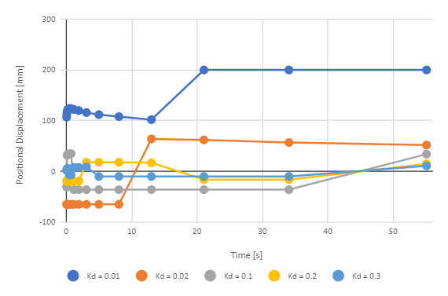
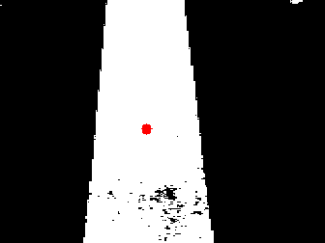
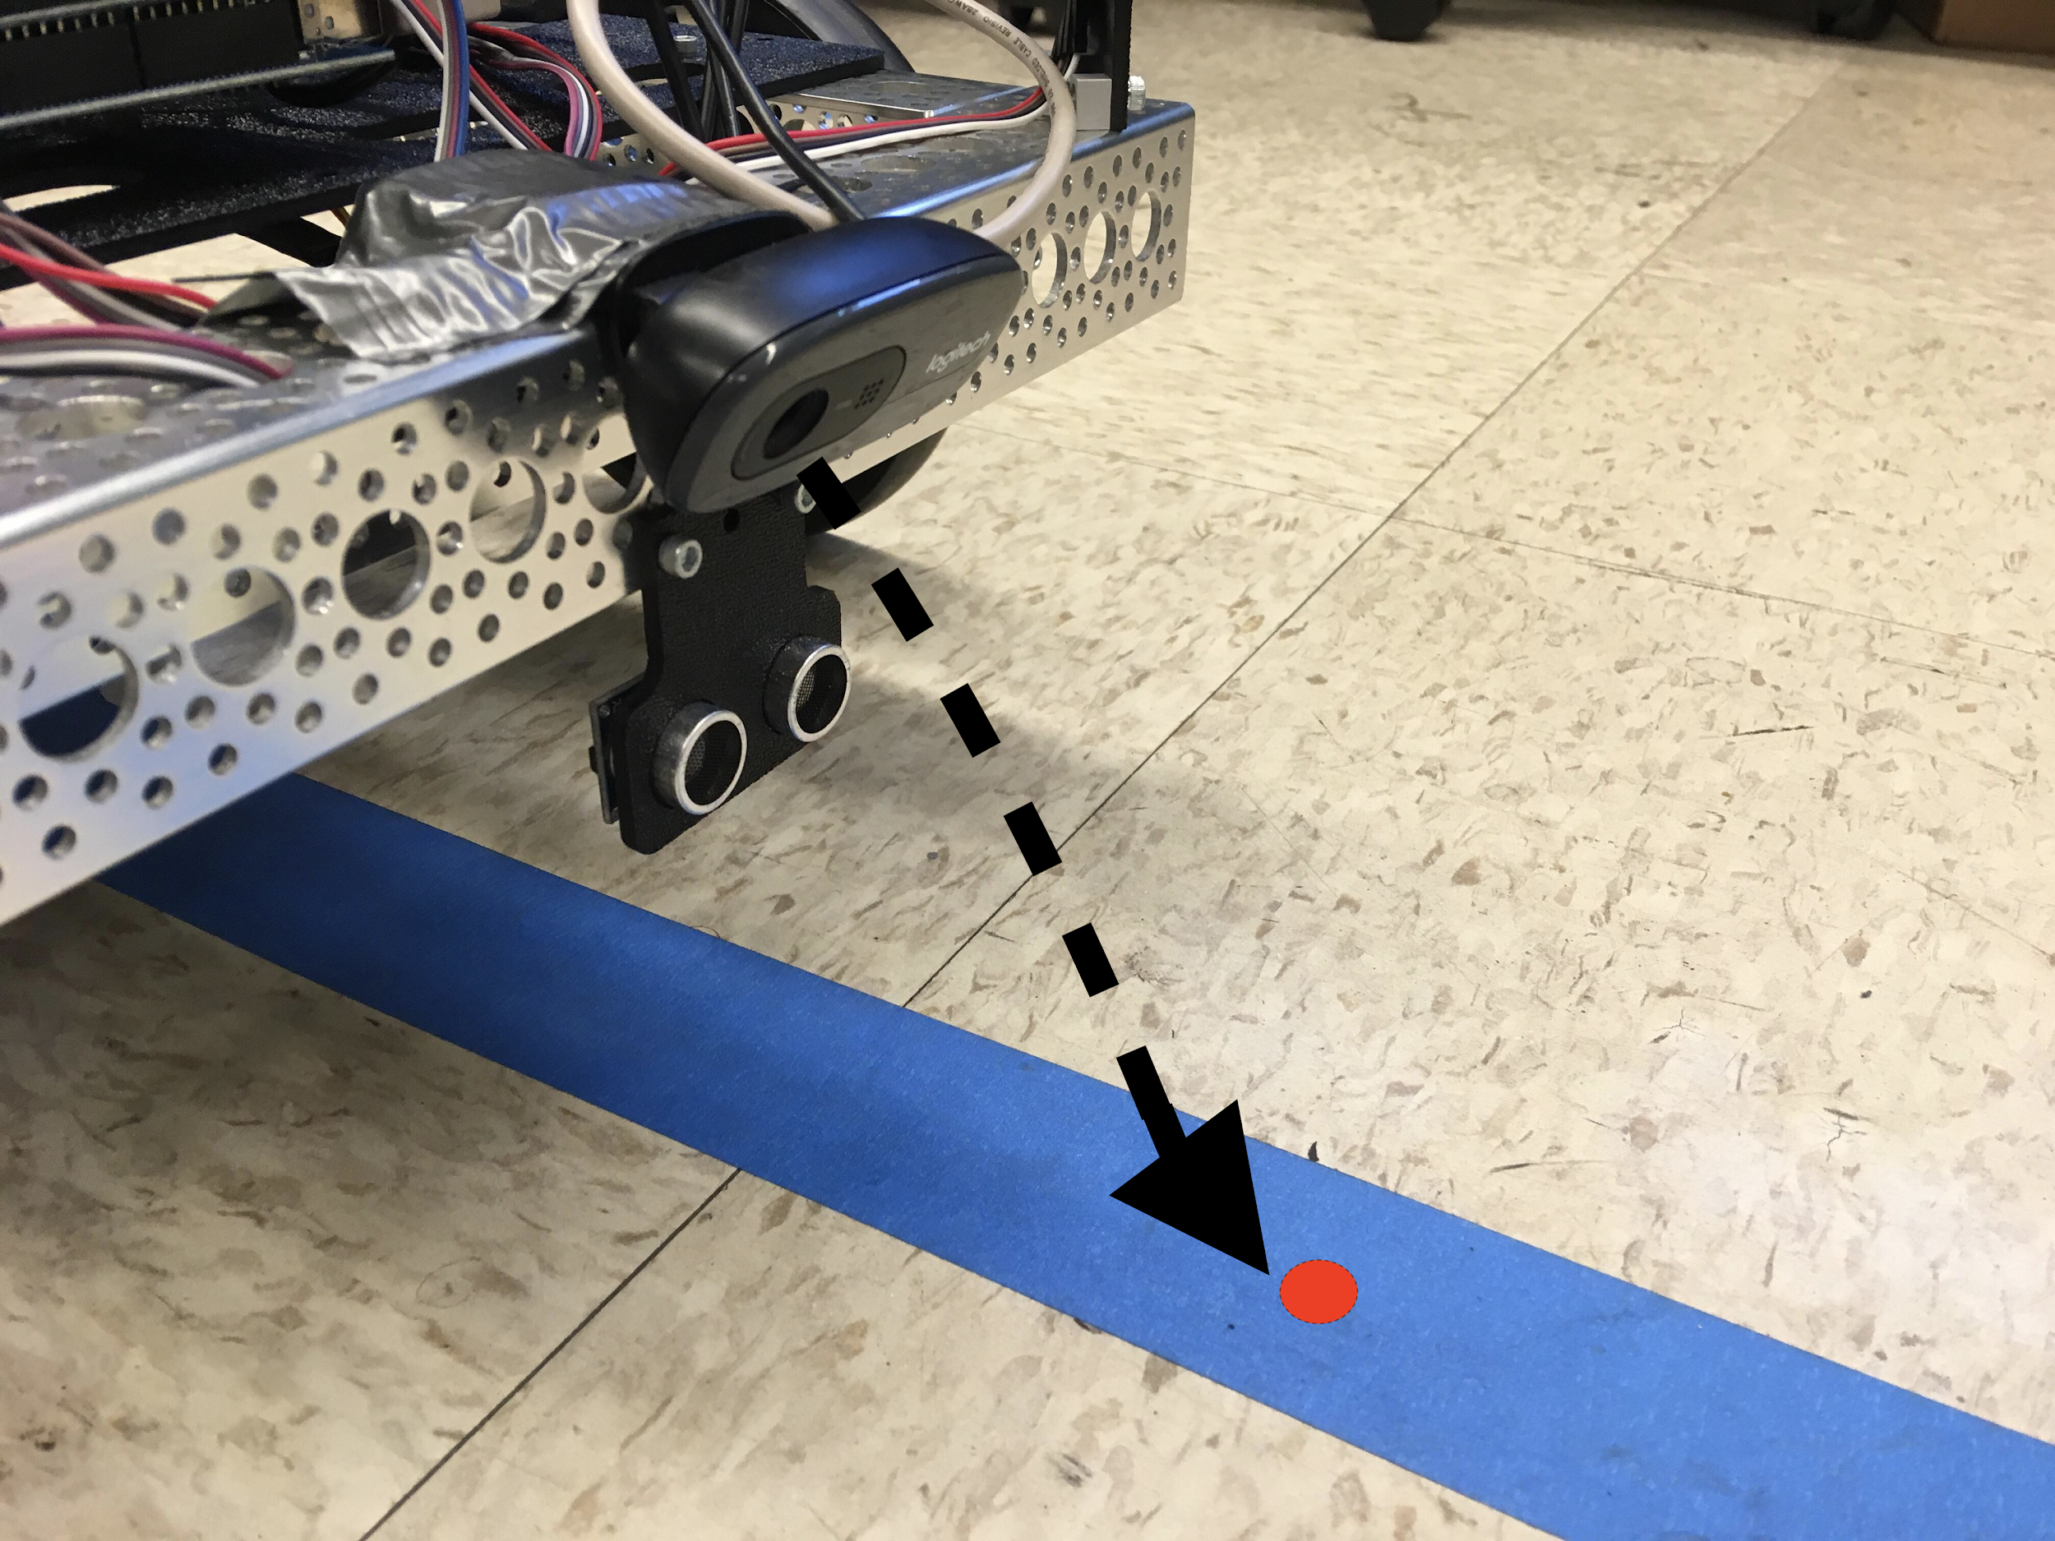
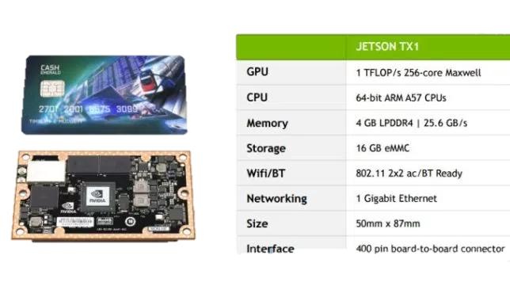
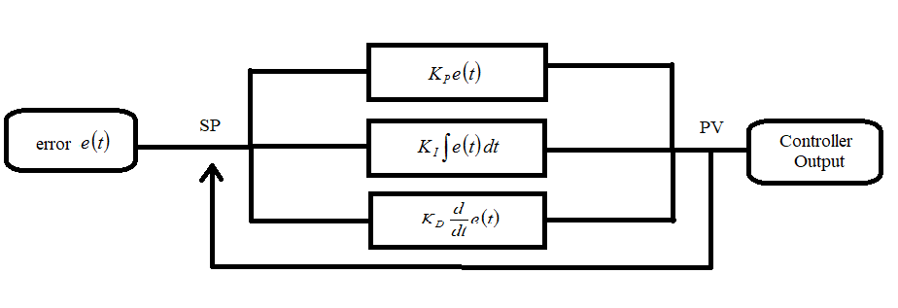
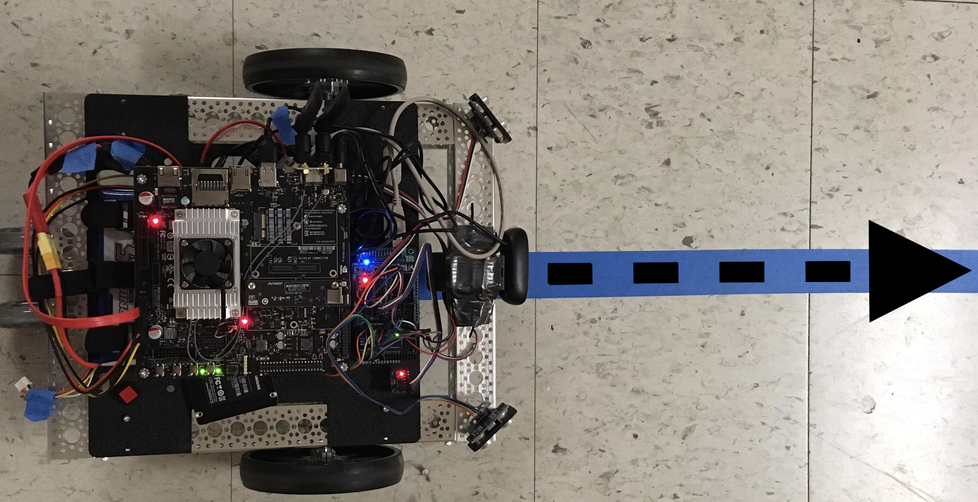
Jetson-Enabled Autonomous Vehicle
Alexis Gilmore, Jose L. Guzman, Luis Jibaja
Advisors: Dr. Hao Jiang, Student Mentor: Tommy Kwok
School of Engineering, San Francisco State University, San Francisco, CA 94132, USA
MOTIVATION
HSV SEGMENTATION
Learn about advancements in image processing applications and autonomous behavior.
Explore the NVIDIA Jetson TX1 and its potential for image processing programs.
Transform image pixel data from camera to highlight segments of interest (blue line vs rest of image).
Deviation of central tracking area (red dot) from segment edges provides continuous error for movement feedback system.
OBJECTIVE
Build a vehicle that can track and follow a line.
Develop a program that uses HSV segmentation to track a line.
Tune a feedback system to stabilize vehicle movement.
NVIDIA’s Jetson is the ideal solution for compute-intensive embedded applications (image processing).
The Jetson offers high-performance parallel processing power from onboard GPU, while consuming less than 10 watts of power.
Supports vehicle components for mobility, such as Arduino, USB Camera, LiPo Battery Power.
JETSON TX1
Fig 2. Transformed image pixel data with central tracking area (left).
FIg 3. Demonstration of the Jetson vehicle’s camera routine.
Fig 5. Parametrizing for Kd (derivative coefficient). Negative displacement is left of the segment, Positive is right. Stable movement converges at zero.
PID CONTROL SYSTEM
Tuned the PID Kp (Proportional), Ki (Integral), and Kd (derivate) parameters to optimize error correction based on HSV segmentation data.
Vehicle performs stabilized movement along the blue line, correctly aligning central tracking area with line segment.
Incorporated ROS as a framework to connect the image algorithm and movement feedback subroutines with low-level device control.
Successful runs around blue-line track.
Continuous error from image processing is the input for PID algorithm.
PID uses the error to correct vehicular position to align the central tracking area with the segmented colored line.
CONCLUSION
Fig 4. PID feedback control loop involving the proportional, integral, and derivative terms of the error.
Built an autonomous vehicle that tracks and follows a line using the Jetson TX1.
Implemented the HSV segmentation image processing algorithm and PID movement feedback algorithm.
Used ROS as a framework to to connect high-level instruction subroutines with low-level device control.
RESULTS
Fig 1. Jetson TX1 Power Processing onboard GPU
Successfully implemented HSV segmentation algorithm to dissociate blue line from rest of image and clarify segment edges.
ROS (Robot Operating System)
Robotics software framework that connects low-level device control with high-level programmed subroutines.
Used to control vehicle components via instructions sent to Arduino.
Programming workspace used to implement image processing and movement feedback algorithms.
FUTURE WORK
Implement deep learning, image recognition programs for autonomous behavior.
Expand on movement and feedback routines to accomplish complex tasks.
ACKNOWLEDGEMENTS
This project is supported by the US Department of Education through the Minority Science and Engineering Improvement Program (MSEIP, Award No. P120A150014); and through the Hispanic-Serving Institution Science, Technology, Engineering, and Mathematics (HSI STEM) Program, Award No. P031C110159. ​
Fig 5. Diagram of the autonomous vehicle’s behavior.

