Slide 1
Jetson-Enabled
Autonomous Vehicle
Alexis Gilmore
Jose L. Guzman
Luis Jibaja
Student Mentor: Thomas Kwok
Advisor: Dr. Hao Jiang
8/8/18
Notes:
https://meet.google.com/efz-ikvz-fxw

Slide 2
Overview
Motivation
Project Recap
Project Approach
Image Processing
GPU Device - Jetson TX1
Vehicle / ROS
PID Jet Control System
Video Demonstration
Project Summary
Questions / Comments

Slide 3
Motivation
Learn about new advancements in technology, with particular focus on autonomous behavior.
Learn how to implement these advancements on an applicable device.
Develop engineering knowledge and skills.
Familiarize with a research environment.

Slide 4
Project Recap
Goals:
Build a program that can learn and recognize images.
Build a vehicle connected to the device running the image recognition program.
Interface the device so that the vehicle responds to recognized images.

Slide 5
Project Recap
We initially settled on deep learning and neural networks for autonomous behavior.
Problem:
Compatibility issue with deep learning software (Caffe).
Consequences:
Inability to learn and recognize images.
Incomplete interface for vehicle response to images.

Slide 6
Project Approach
Update: Build a vehicle that can autonomously follow a line.
Requirements:
Live image processing program.
Device that can run this type of program.
Vehicle assembly that can be powered by the same device.
Software to interface the vehicle components and the autonomous program.

Slide 7
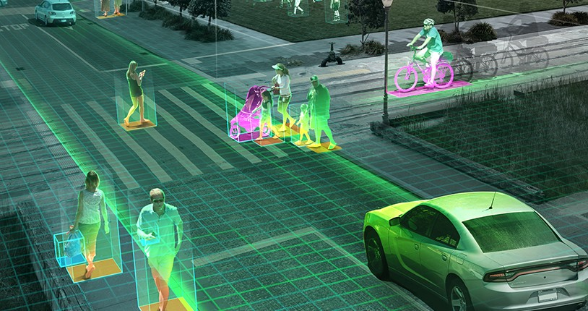
Image Processing
Analysis and manipulation of a digitized image (represented by pixel data).
Wide range of algorithms that can transform images into useful data.

Slide 8
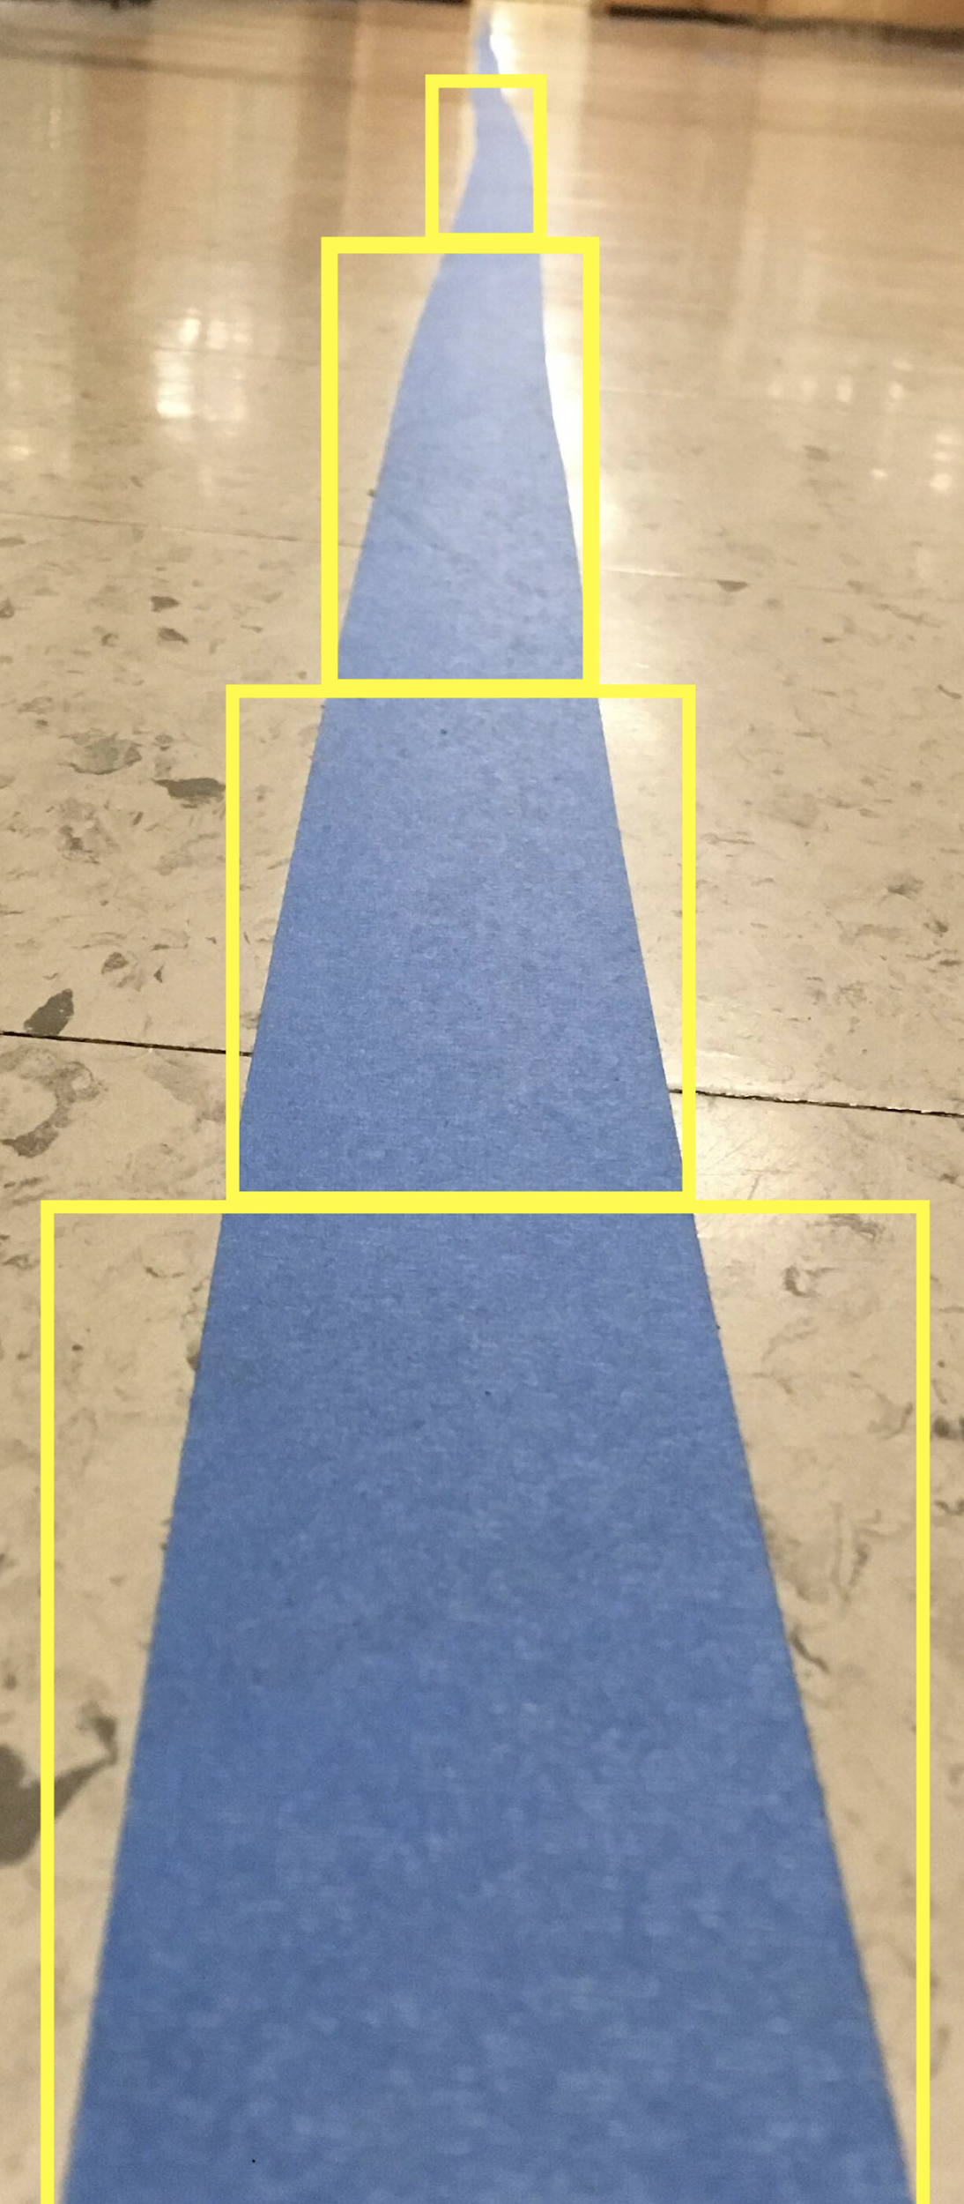
Image Processing
Task: Use live image feed from a moving camera to track a blue line.
Use image processing algorithm to dissociate blue line from the rest of the image.
Challenge: Image processing
requires large amounts of parallel
computations.

Slide 9
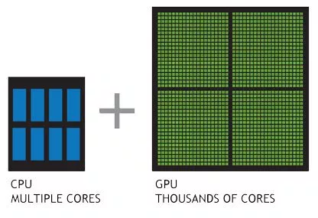
Parallel Processing (CPU vs GPU)
CPU (central processing unit)
Composed of a few cores that can handle a few software threads at a time (task by task)
GPU (graphics processing unit)
Composed of thousands of cores that can handle thousands of threads simultaneously (Simultaneously handles thousands of tasks)

Slide 10
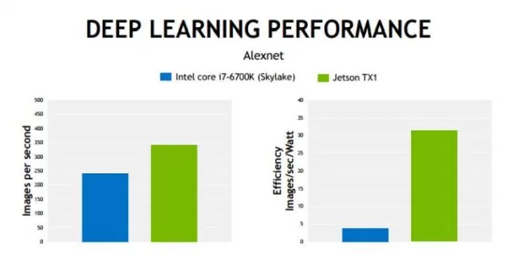
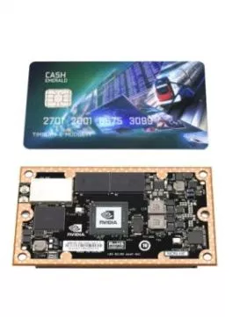
GPU Device - Jetson TX1
NVIDIA’s Jetson is an accessible solution for compute-intensive embedded applications (deploying image processing programs).
Jetson TX1 is used for drones, robots, and other autonomous devices.
The Jetson offers high-performance parallel processing power from onboard GPU, while consuming less than 10 watts of power.

Slide 11
Vehicle
Vehicle Requirements:
The Jetson TX1 requires input image data for the image processing algorithm (camera).
After the algorithm provides useful data, instructions must be buffered to components that make the vehicle move (microcontroller).
Other components for functional operation (power).

Slide 12
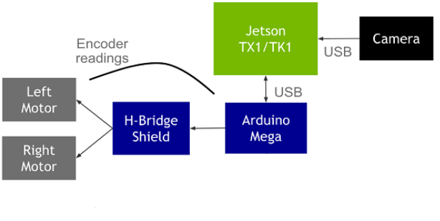
Vehicle
System Diagram:

Slide 13
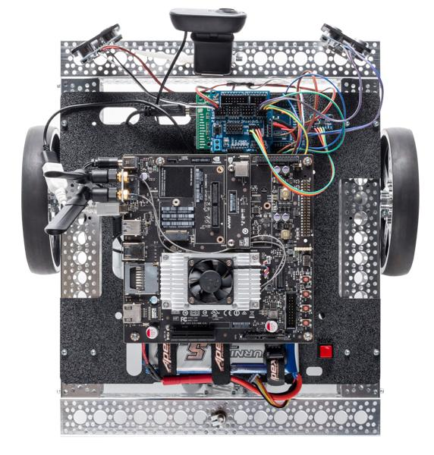
Vehicle

Slide 14
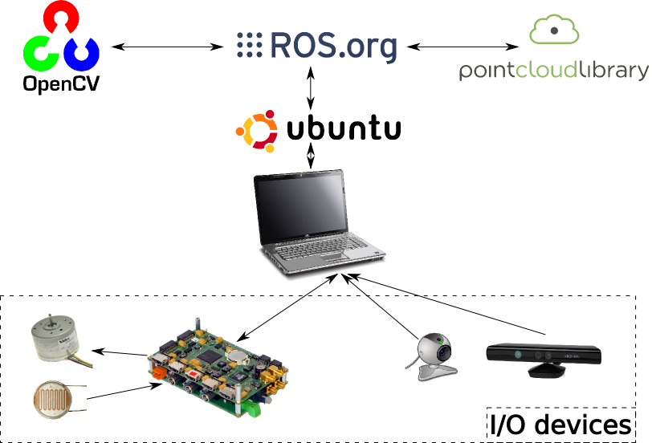
ROS
We use ROS to control the vehicle components via Jetson TX1 -> Arduino
ROS is a robotics software framework that connects low-level device control with high-level programmed subroutines

Slide 15
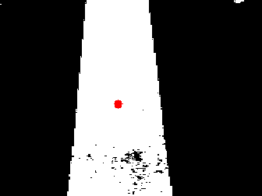
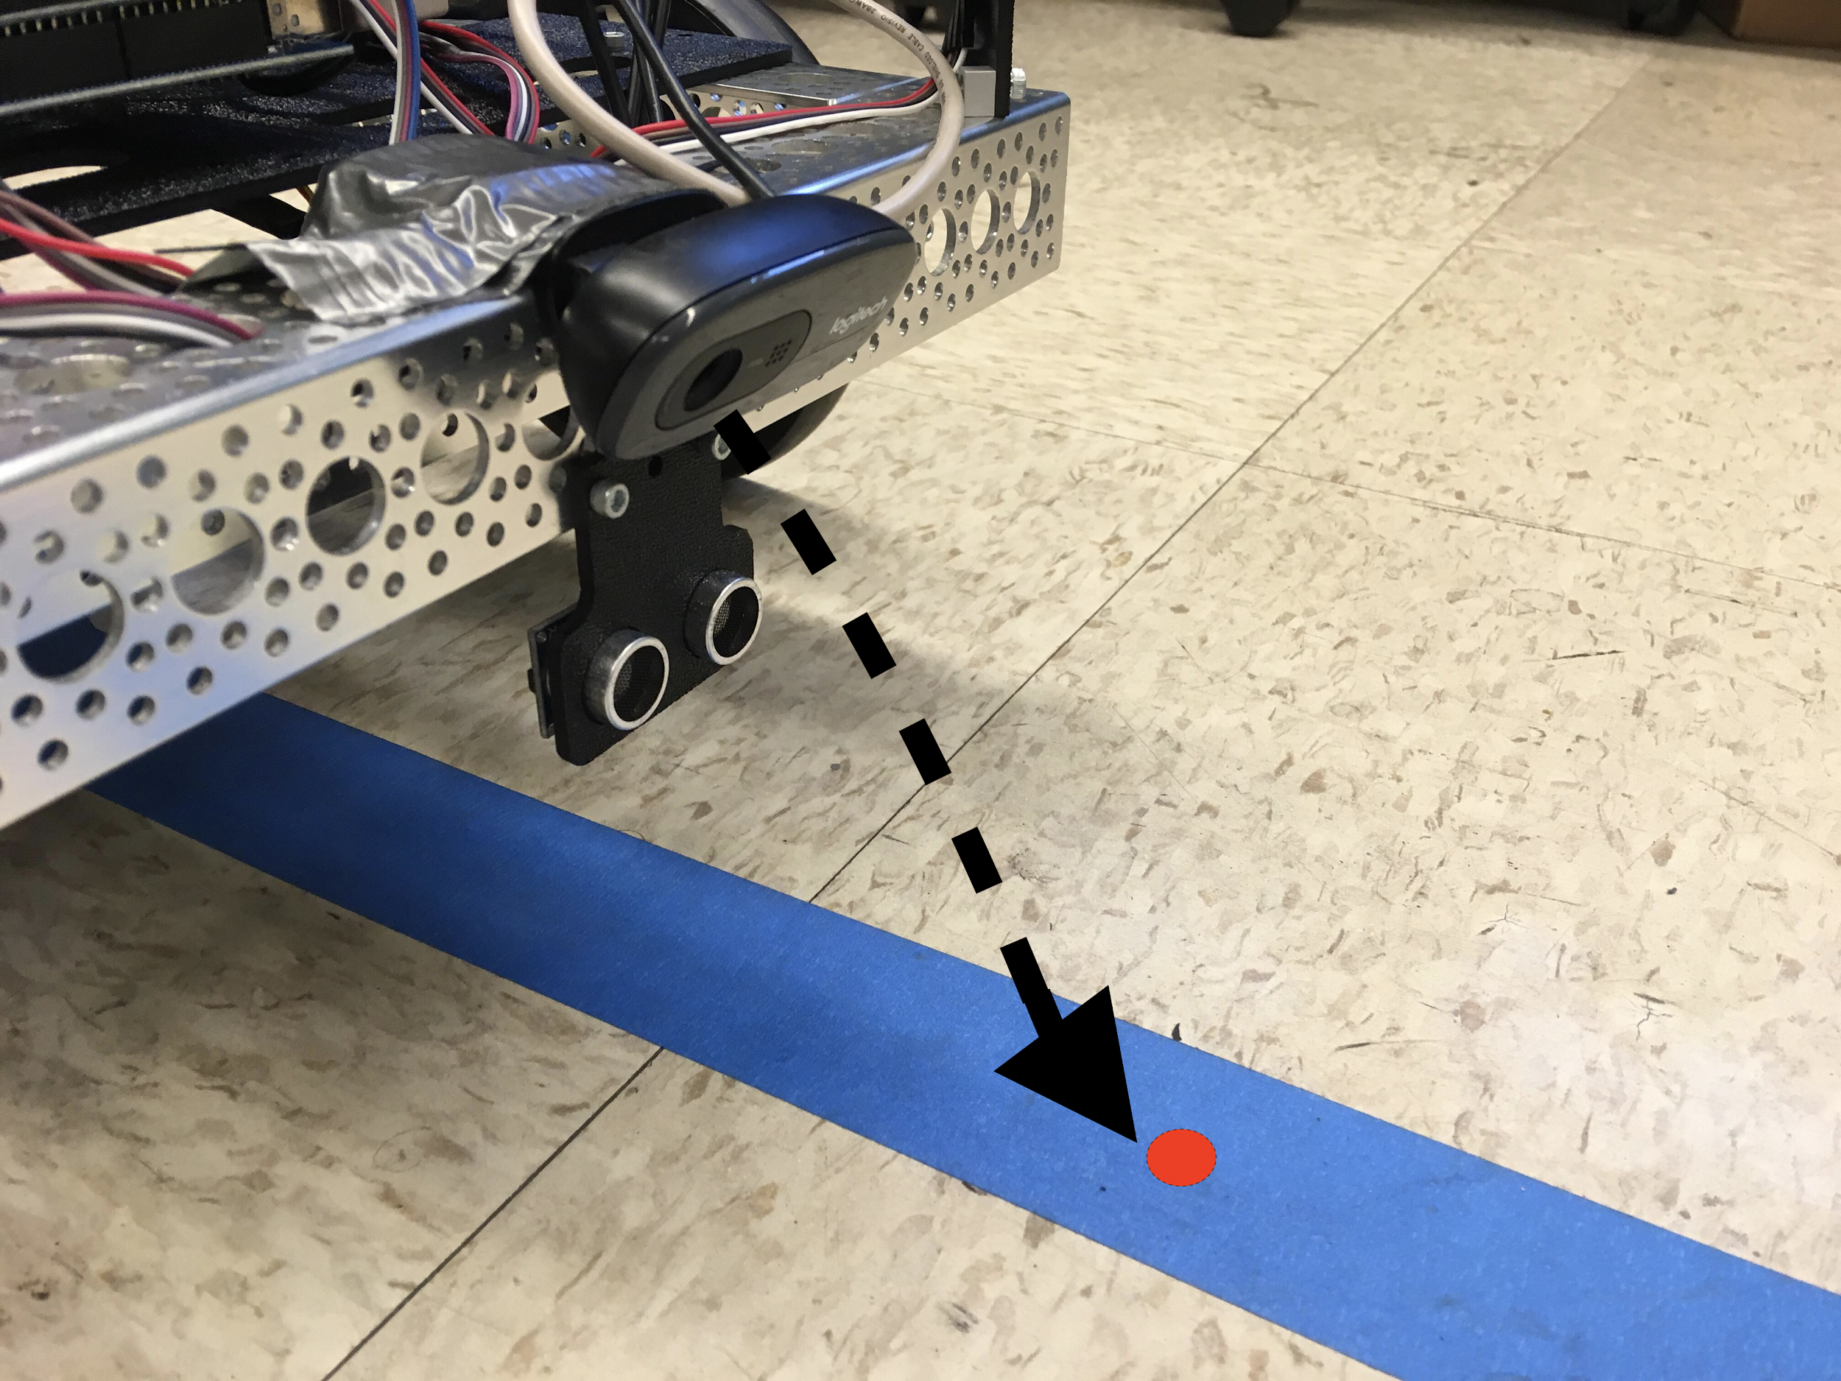
Jet PID Control System
Image Processing Technique: HSV Segmentation
Algorithm allows us to analyze the image to extract significant data from the blue-colored line.
Image pixel values are transformed using color data analysis to highlight areas of interest.
Helps create a clear picture of segmented objects and determine the limits of the colored line.

Slide 16
Jet PID Control System
Stable vehicular movement along blue line requires feedback system.
Deviation of central tracking area (red dot) from segment edges provides continuous “error”.
Continuous error is used as input for a PID algorithm that corrects vehicular position to align the tracker with the segmented colored line.

Slide 17

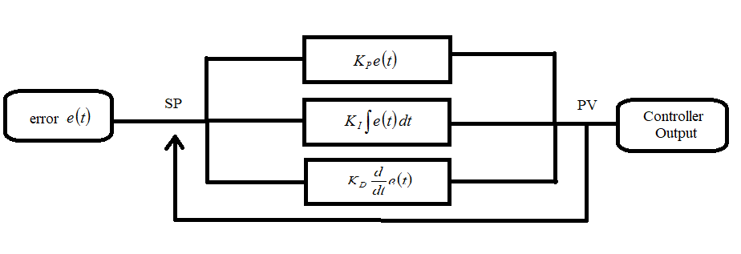
Jet PID Control System
PID Overview:
Applies error correction based on proportional, integral, and derivative terms of the input error value.
Modulate PID coefficients (K) to optimize error correction.
Continuous, accurate, and responsive when optimized.

Slide 18
Jet PID Control System
Tuning PID parameters Kp (Proportional), Ki (Integral), and Kd (Derivative).
Increment each parameter to produce minimum continuous error deviation from segmented line.
Ki is set as zero, since the integral parameter accumulates past error.

Slide 19
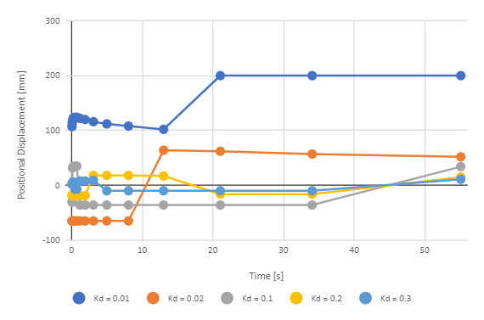
Jet PID Control System
Example parametrizing for increments of Kd.

Slide 20
Jet PID Control System
Final PID parameters for stable vehicle tracking movement.
Kp = 0.01
Ki = 0.00
Kd = 0.30

Slide 21
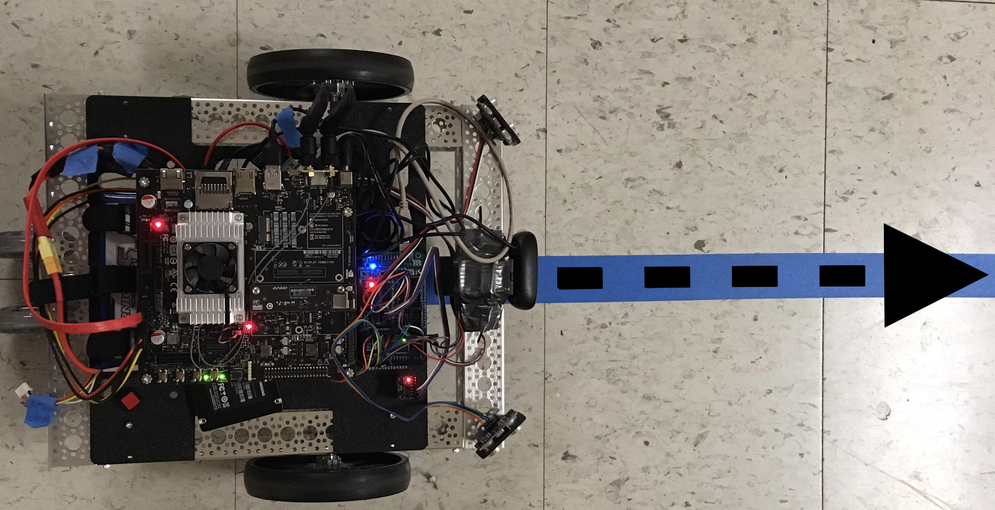
Jet PID Control System
Result:
Vehicle autonomously follows blue line.
Uses HSV image segmentation to identify blue line, and tuned PID algorithm to stabilize movement along the line.

Slide 22

Video Demonstration

Slide 23
Project Summary
Researched concepts on a trending autonomous technology and applied them using the Jetson TX1.
Experienced a comprehensive engineering project involving hardware and software.
Experienced serious constraints and learned how to navigate challenges.
Familiarized with the research environment.

Slide 24
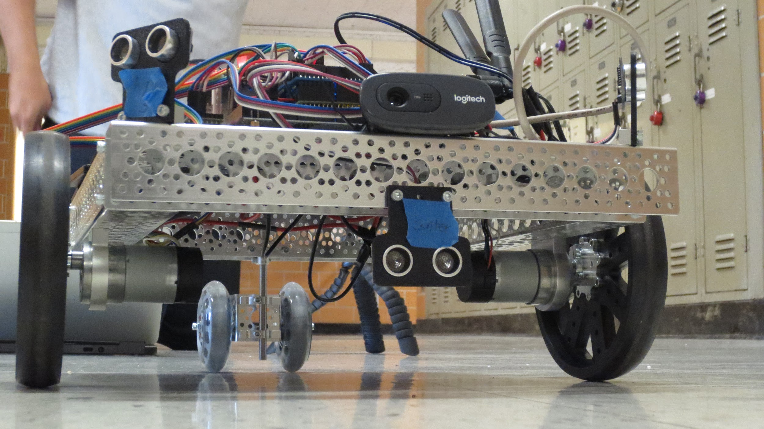
Questions / Comments

