Slide 1
Contact Etiquette
Jolani Chun-Moy and Lina Tsvirkunova
ASCC Spring Retreat 2014

Slide 2
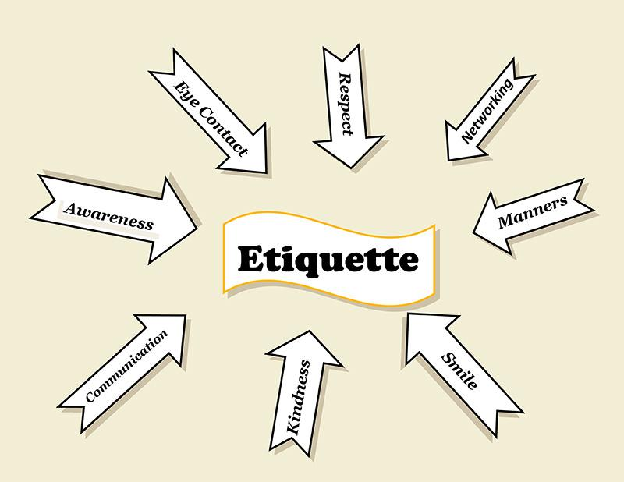
What is Etiquette?
Who are you?
Mr. Stinky or Mr. Clean?

Slide 3
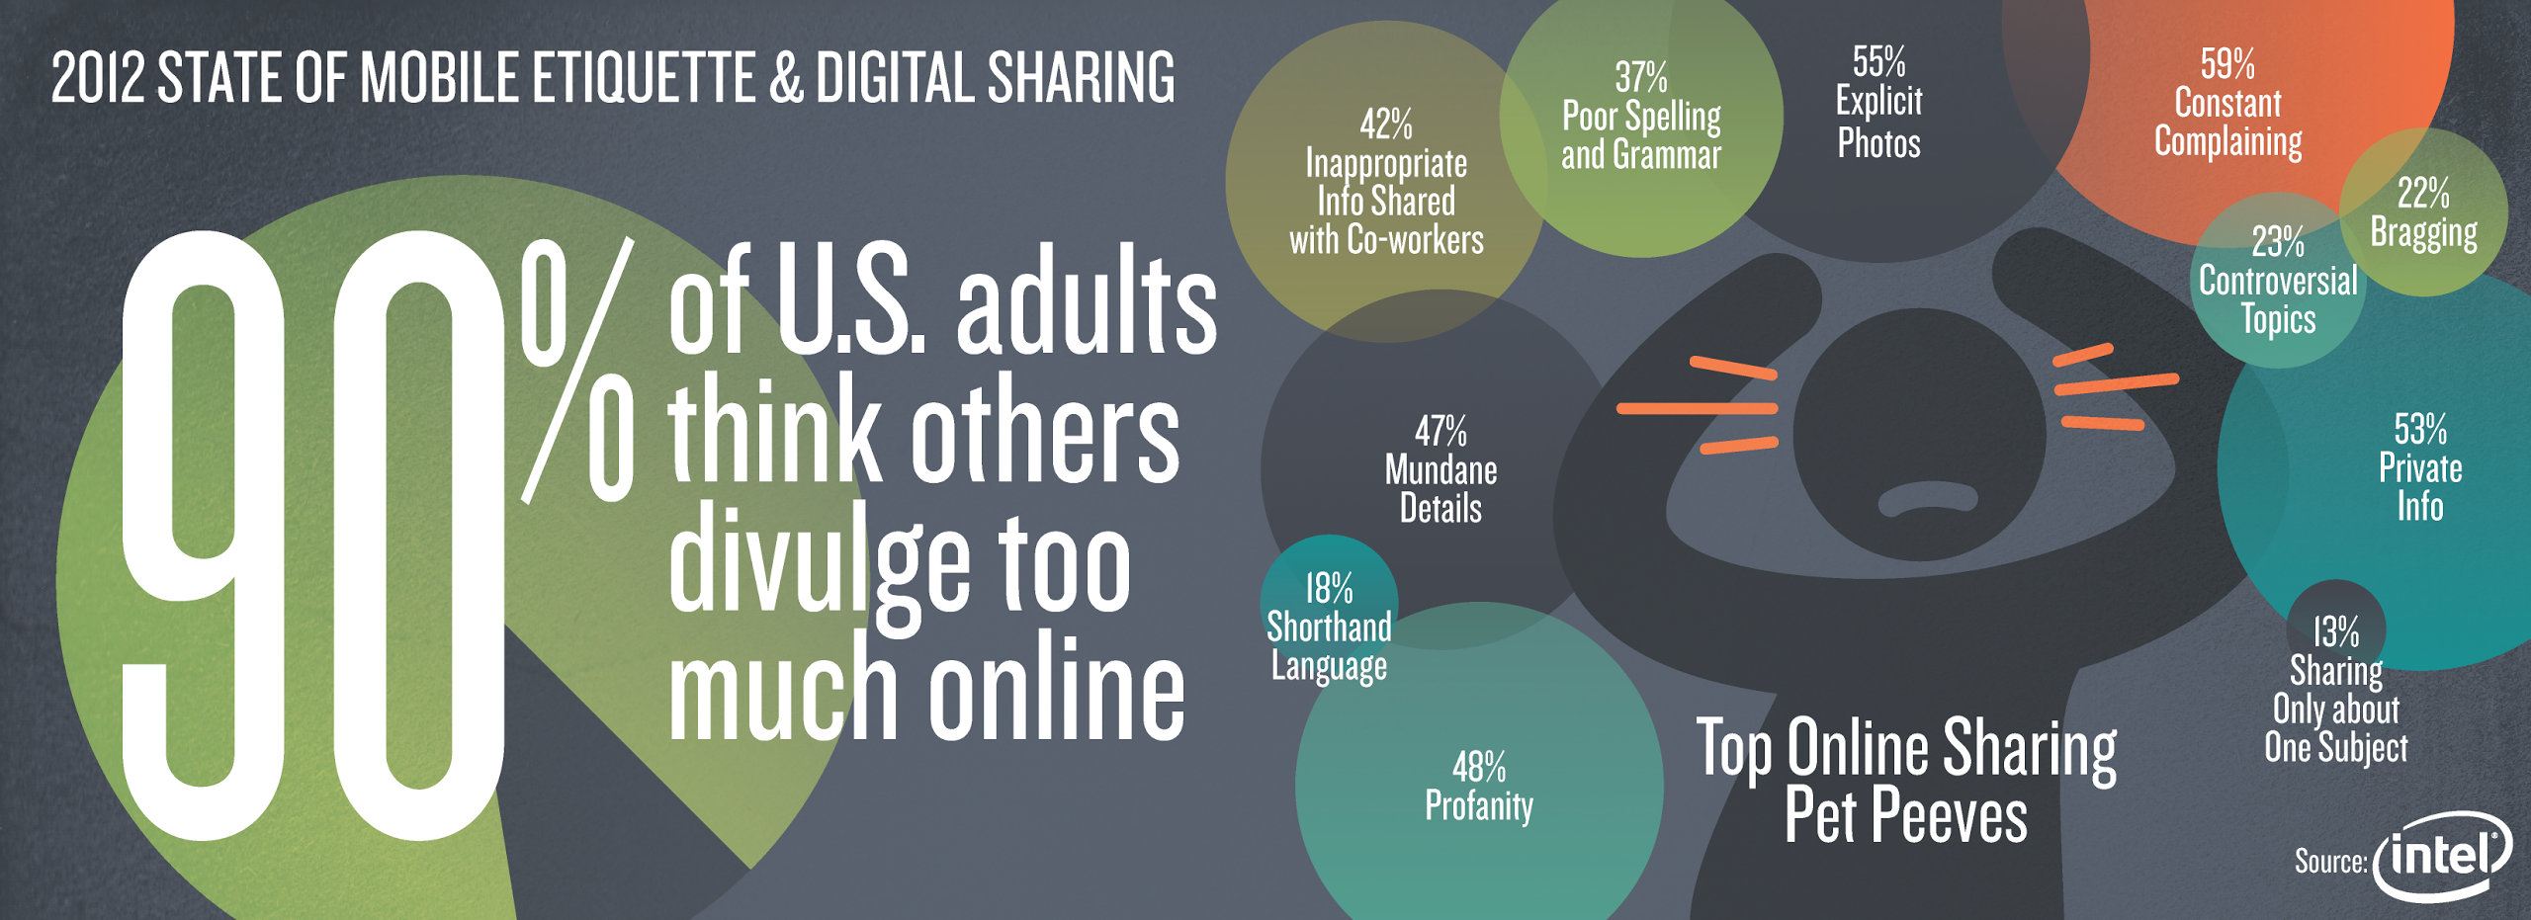
Lets Take a Look

Slide 4
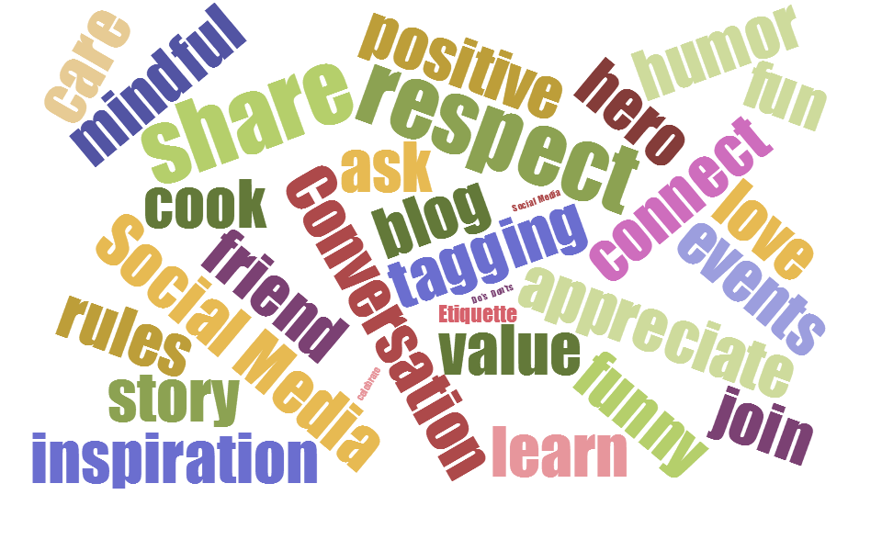

Slide 5
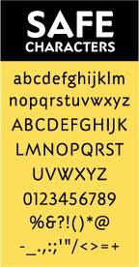
Please Remember
The Golden Rule
““Do unto others, as you’d have them do unto you”.”

Slide 6
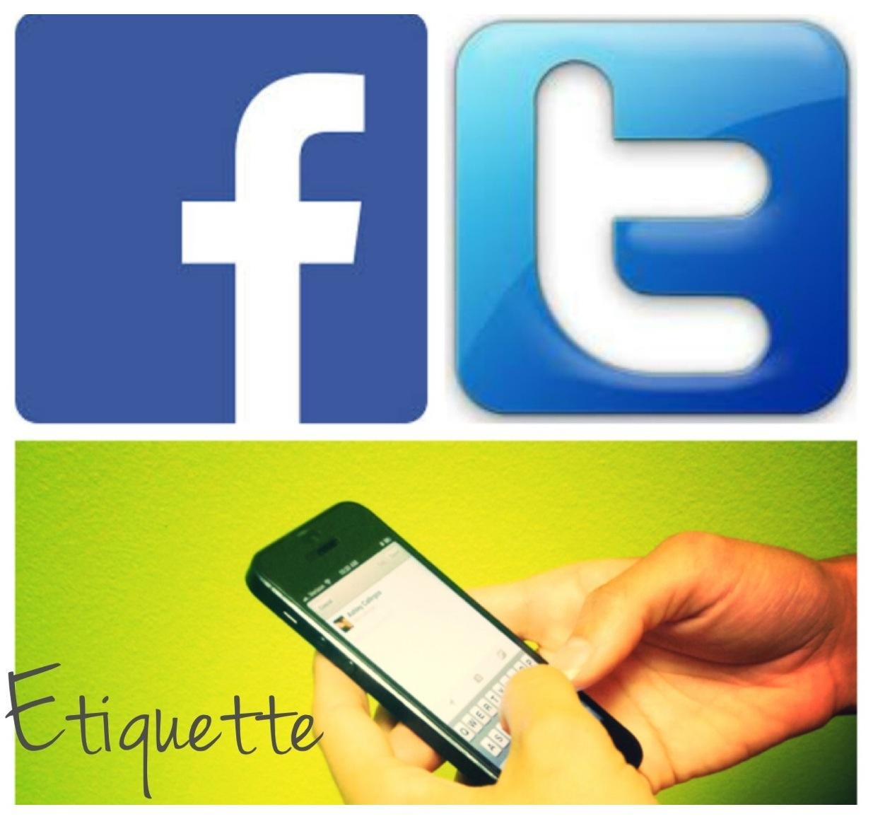

Slide 7
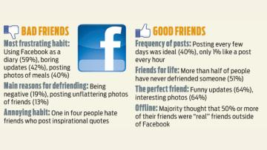
Social Media: Facebook

Slide 8
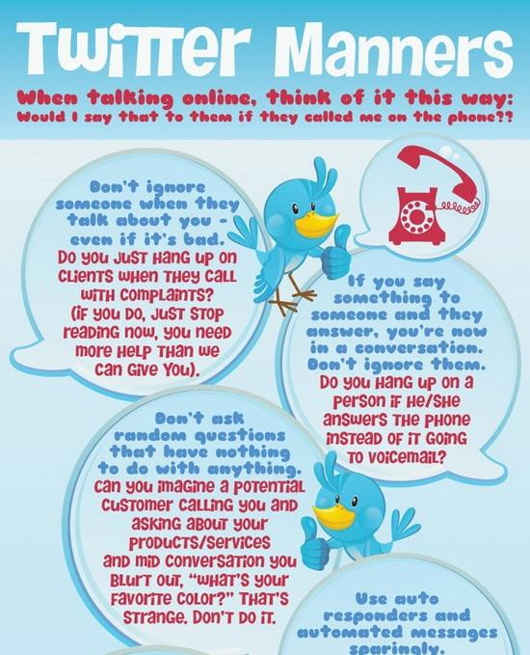
Social Media: Twitter

Slide 10
Why is email etiquette important?
Interaction through digital means has become the main mode of communication for many fields
It is important to communicate proper amounts of respect to one’s superiors and refrain from using condescending tones with subordinates; offending people left and right does not get the job done
One hopes to have their actual meaning understood when another reads their correspondence

Slide 11
Email Etiquette
Start by introducing yourself.
Use exclamation marks sparingly.
Respond in a timely manner.
Avoid one-liner emails.
Avoid 1337.
Have a descriptive subject line!
Keep it clean! No extra distracting characters, make sure the spacing is easy on the eyes.
Regarding attachments:
Large attachments: Send a warning before. Ask if the receiver is ok with a large attachment.
Number: Try to have less than two attachments per email.
Name: Logical names are best.
Evaluate the importance of your email.
Know your audience.
Keep it to the point.
Maintain privacy.
Include a signature.
The way you email is a reflection of your character, whether you like it or not.

Slide 12
Epithets: What are they?
Describe a quality of a person.
In the instances of etiquette, epithets are very important. The difference between “professor” and “doctor” is huge; such differences can affect respect directed to you.
Always use a person’s preferred epithet or title. Ask a person how they prefer to be called or use clues in what they tell you to determine how to refer to them. For example if Mr. Smith says that he got his PhD from Stanford, then he is Dr. Smith.

Slide 13
7 Deadly Sins of Email
The Urgent Email – Email is the new snail mail. People are not sitting at their desks awaiting your messages. If something is truly urgent, email is not the medium you should be using. Call, text, tweet, or anything more immediate.
The Reply All – Everyone does not need to see your “Thank You” to the original sender. When thanking someone, “Reply” directly to that individual. Otherwise, 57 people suddenly end up with 57 “Thank You” emails cluttering their inboxes. (True Story: I have seen a Fortune 20 company have to shut down their email due to a company-wide “Reply All” message run amok.)
The Email to Too Many People – Avoid sending emails to more than 2–3 people. Copying the whole gang only creates confusion and clutters inboxes. Only send emails to the individuals that directly need the information. Avoid using CC, and never use BCC (ever!).
The Email to No One – I recently received an email addressed to 8 people. The message said, “Can someone please make sure this gets done?” Yet, the email did not say which person should take the action. In essence, it was addressed to no one and everyone at the same time. As you can guess, everyone assumed that someone else was going to do the task, and it didn’t get done at all.

Slide 14
7 Deadly Sins Cont’d
The Spam Email – People can find enough random stuff to surf on the Internet, they don’t need your topics, as well. Passing along random articles, gossip, and websites only clutters up others’ inboxes.
The Conversation Email – If your email message cannot be conveyed in less than half a page, then it probably shouldn’t be an email. It is probably better handled as a direct conversation. As well, if your email is going to require more than 2–3 back-and-forth responses, it is better to talk to the person than play email Ping-Pong.
The Bad News Email – Never deliver criticism via email. Never. Ever. Never. Bad news should always be delivered in person, not in a bad email. Even constructive criticism can easily be taken out of context or be misunderstood.

Slide 15
And now for some sample censored emails, courtesy of Lina and her poor choices in life.

Slide 16
Bad Email
Hello Mr X
About a month ago, I sent you a request for a teacher recommendation for Program Y, and I checked recently and noticed you had not filled it out yet. I just wanted to request that you fill out the recommendation soon, because the deadline for the application is in one week. I will duly resend the request for recommendation.
Thank you,
Me
I actually sent an uncensored version of this email to a high school teacher (who incidentally had a doctorate) back in my sophomore year of high school. This is a bad email and my teacher actually lectured about the importance of email etiquette two days later.
What’s wrong with this email?

Slide 17
Decent Email
Hello Professor A,
I am not in your course but I would like to be. Is there room in your course? Could I please join? Please let me know.
Thank you very much,
Me
What’s good here? What could be better?

Slide 18
Pretty darn fantastic email if I say so myself
Hello Sir or Madam,
My name is X and I am student at Some College intending to pursue a career in Something. I was wondering if there are any open volunteer positions at Your Org; I'd be interested in volunteering in any Division Y that allows volunteers.
So that you can get an idea of my experience from Time A to Time B, I volunteered at Org A doing task A, B, and C, as well as Org B performing task A, C, and D. I have also volunteered at Org C at a large conference and during many of their holiday events.
For the next few months, I am available on day X from This Time to That Time, day Y from That Time to Another Time, and day Z from This TIme to Another TIme.
Could you please let me know if there's any current availability and what sort of applications I would need to submit? Are there orientations or trainings I would need to attend?
I have heard so much about your organization and I would be thrilled at the prospect of working with such a reputable group of people.
Thank you very much,
X
emailx@domain.com
XHA.SAP.HONE

Slide 19
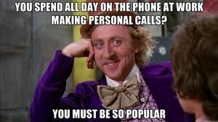
Just Pick Up The Phone
When a topic has lots of parameters that need to be explained or negotiated and will generate too many questions and confusion, don't handle it via e-mail. Also, e-mail should not be used for last minute cancellations of meetings, lunches, interviews, and never for devastating news. If you have an employee or a friend you need to deliver bad news to, a phone call is preferable. If it's news you have to deliver to a large group, e-mail is more practical.

Slide 20
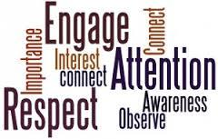
Personal Etiquette

Slide 21
Why is personal etiquette important?
What you say, how you say, and how your body says the same thing all have a huge effect on how your audience perceives your statements and their willingness to oblige

Slide 22
General Social Etiquette
If you agreed to meet somebody, be on time.
If you’re running late, let them know!
Make sure you have their contact info!
Don’t gossip.
Learn and use names.
Refrain from rude and prying conversations.
Think before you speak.
Don’t use your cell phone while you’re speaking with someone!
Dress for the occasion.
Know how to shake hands.
If you don’t have something nice to say, don’t say anything.
If you really have to say something not nice, try a compliment sandwich:
“Your presentation was very aesthetically pleasing! Your slides were very information dense though and it was a bit hard to process the information. However, I can tell you care and spent quite a bit of time on it.”
It’s really just common sense when you get down to it.

Slide 23
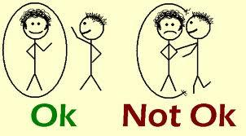
Body Language
Body language is an important indicator of respect and interest
Don’t twiddle your thumbs, don’t slouch, and try not to cross your arms.

Slide 24
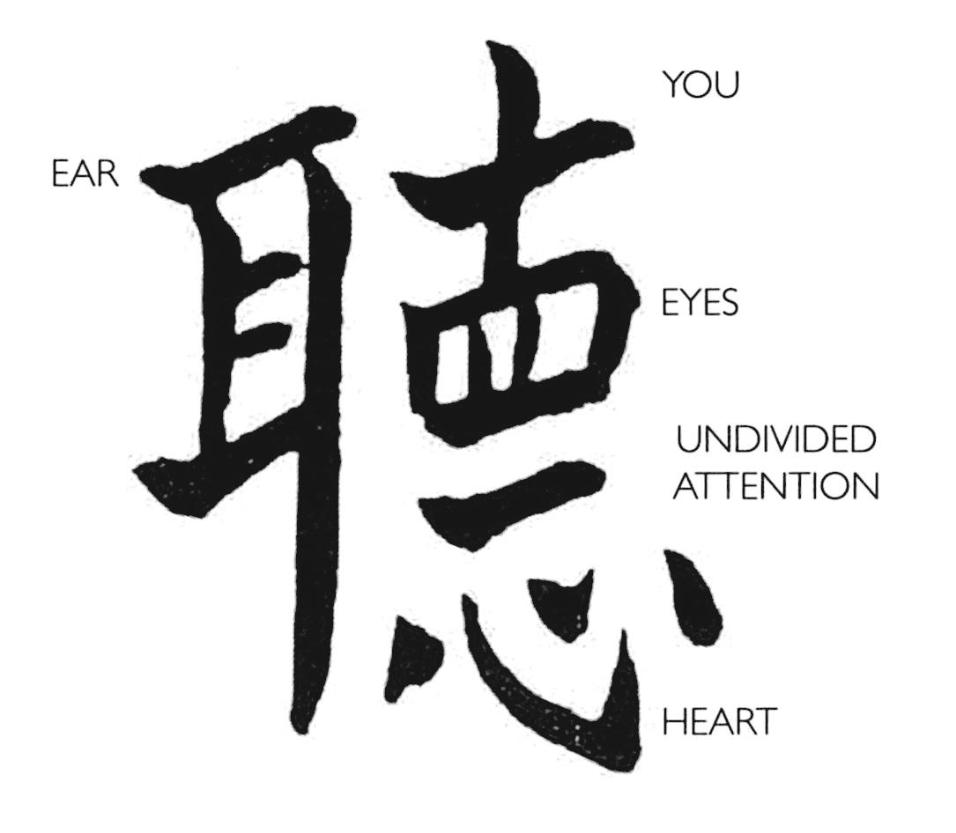
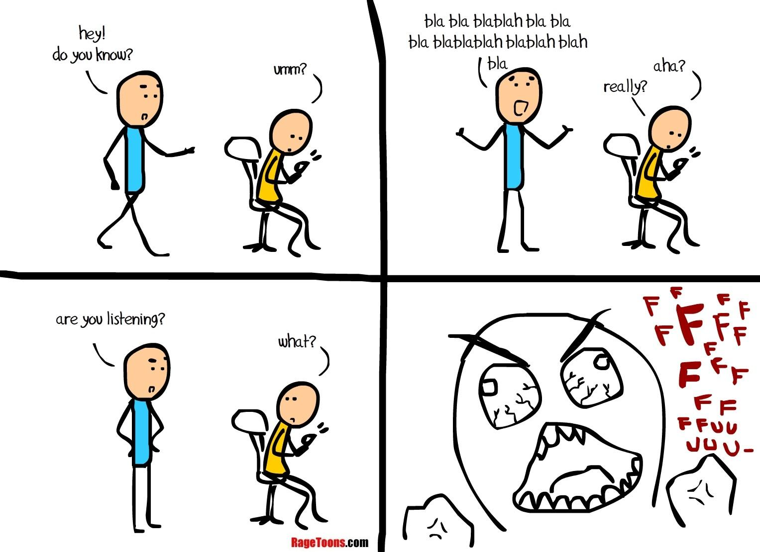
Listen!
Don’t interrupt, keep your eyes on the person you’re speaking with.

Slide 25
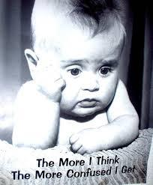
Activity
Activity 1: Who, What, When, Where
Get into your family groups
Wait for instructions
Activity 2: Roleplay Etiquette

Slide 26
What Do I Do?
Questions to Answer:
Is it necessary to contact anyone in the situation?
If so, who?
What form of contact would you use?
Why ?
What would not be the best form of contact?
Why?
If applicable, what is the acceptable time range to contact the person. ie) 2am, 3 days before, 1 week later

Slide 27
Scenario 1
You just finished your 1st triathlon and want to share the news with your friends.
Scenario 2
You received a grade that was lower than you expected in a class. You believe that you deserved a higher grade.

Slide 28
Scenario 3
You broke your leg in a skiing accident over winter break.
Scenario 4
You just finished baking the most amazing and delicious cupcakes and have too many to eat by yourself.

Slide 29
Scenario 5
You are looking for a summer job and want to know if any of your friends’ parents are hiring.
Scenario 6
You will be out of town with your parents and will be missing school for three days.

