Slide 1
James Ford
ASCC Commissioner of Finances
ASCC End of Year Presentation
May 19th, 2016

Slide 2
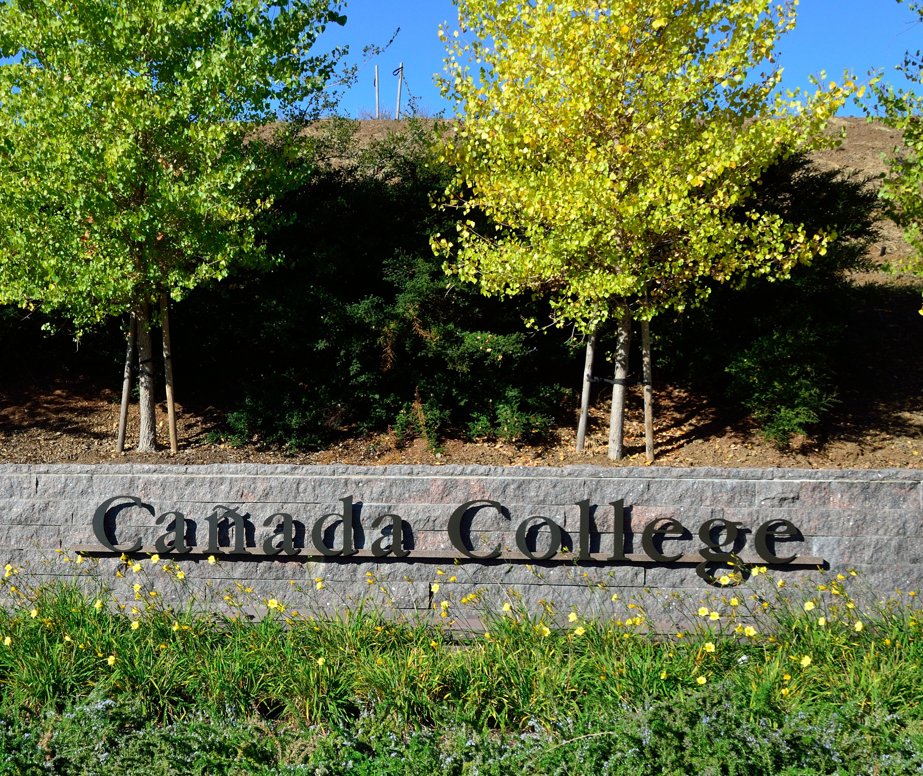


Change
What have I learned from ASCC Meetings?
Following Brown Act to a T
Parliamentary Procedure
How to run an efficient & organized meeting
How to participate
What have I learned from the SPACE and Budget and Finance committees?
Voice your opinion
Make an agenda and stick to it
Hold people accountable for assigned duties
Student voice really matters

Slide 3
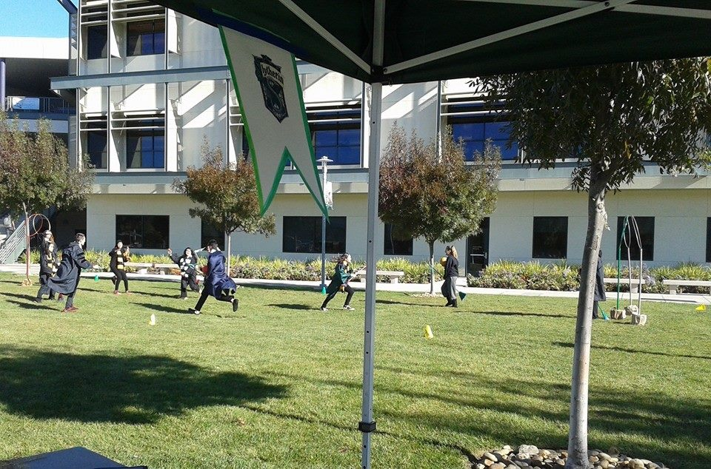
Community
Event: Quidditch (International Ed Week)
Coordinate with others for supply runs
Vocalize your goals
Learned how to run an efficient & organized meeting as a chair
Top success: Coordinating an active event on the small Upper lawn
Takeaway: Connect with clubs, focus more on getting people to join events spontaneously
Committee: Welcome Week
Hold people accountable for assigned duties
Delegate work and highlight strengths
Ask for input- event depends on it!

Slide 4
Mentorship!

Slide 5
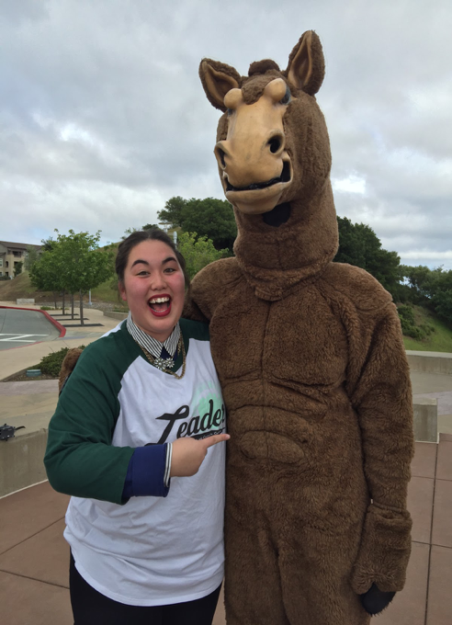
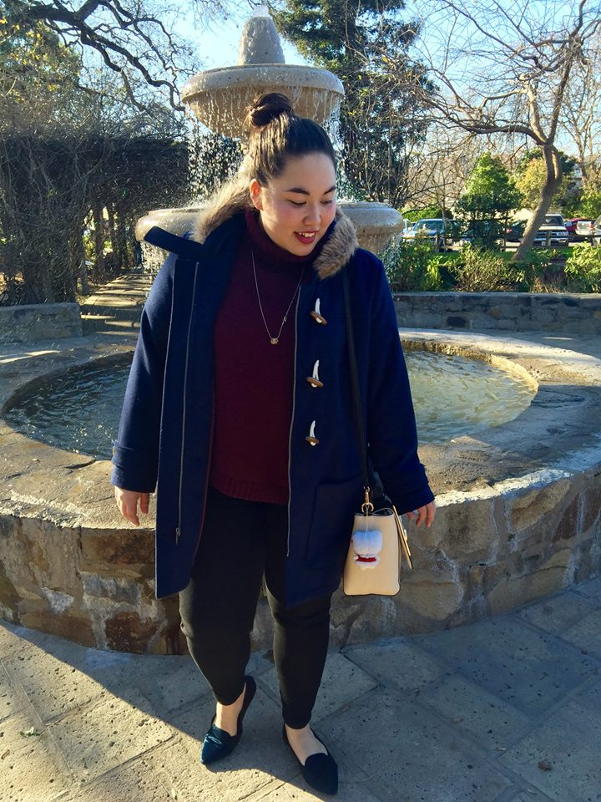
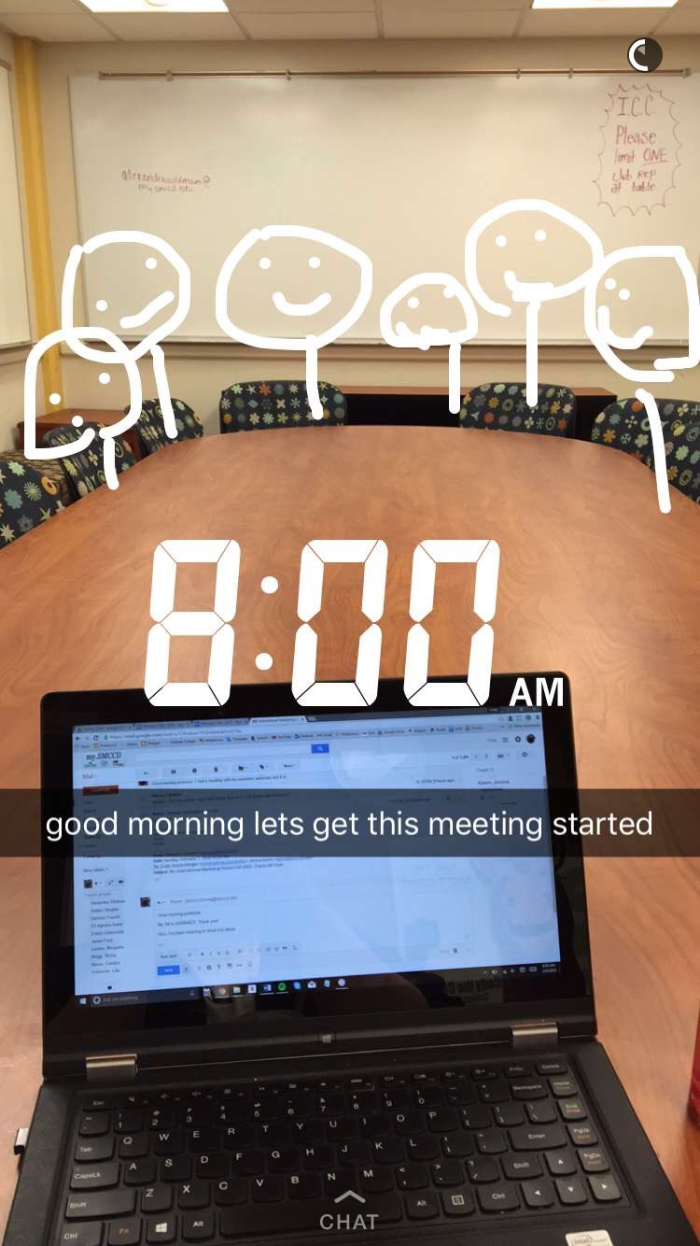
CINDY! My Little
Cindy is:
Thoughtful and dedicated
An incredible leader
Fashion goals
Easygoing and hilarious

Slide 6
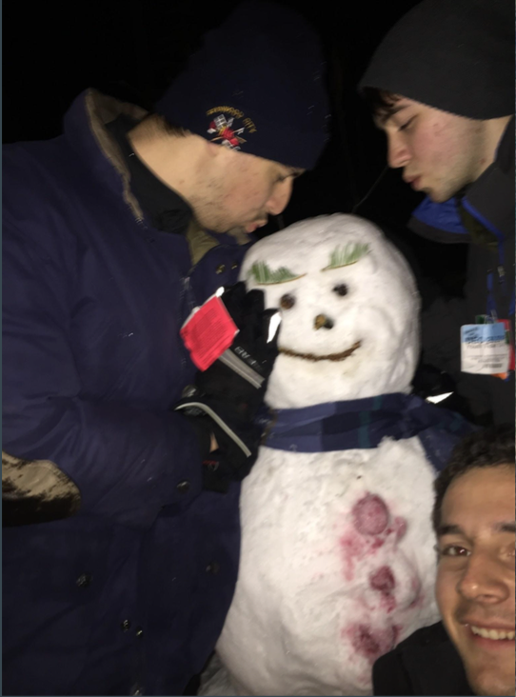
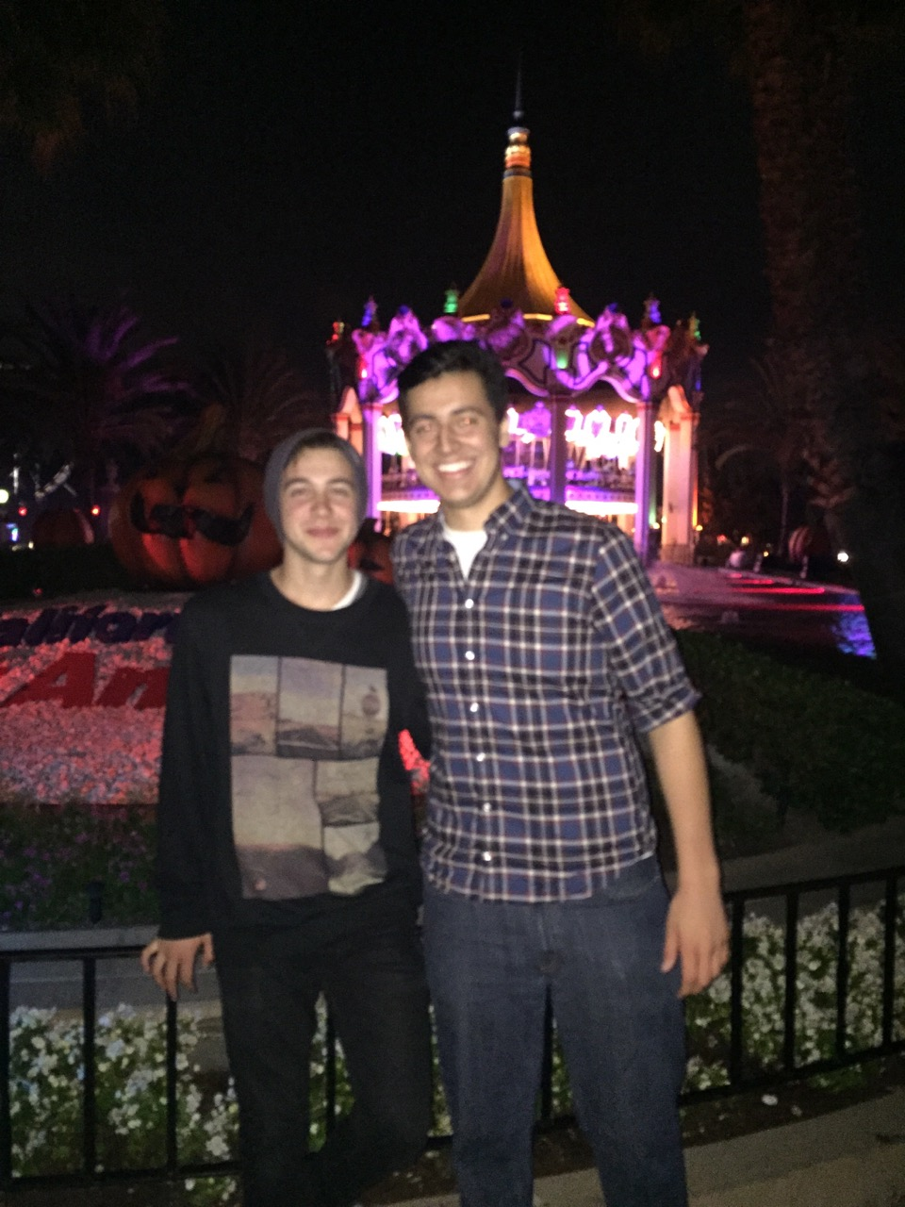
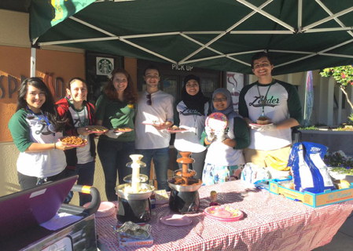
DOM! My Little
Dom is:
Determined and creative
An incredible singer/performer
Loyal and supportive
Dauntless and brave
Bert the Snowman

Slide 7
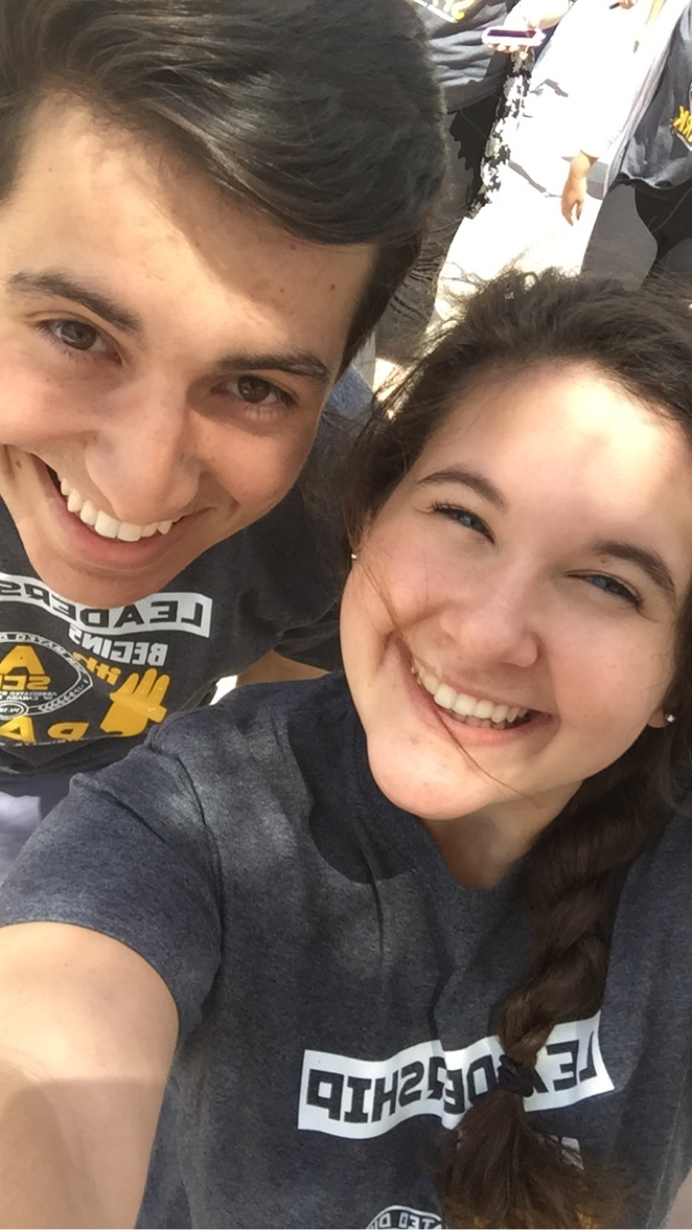
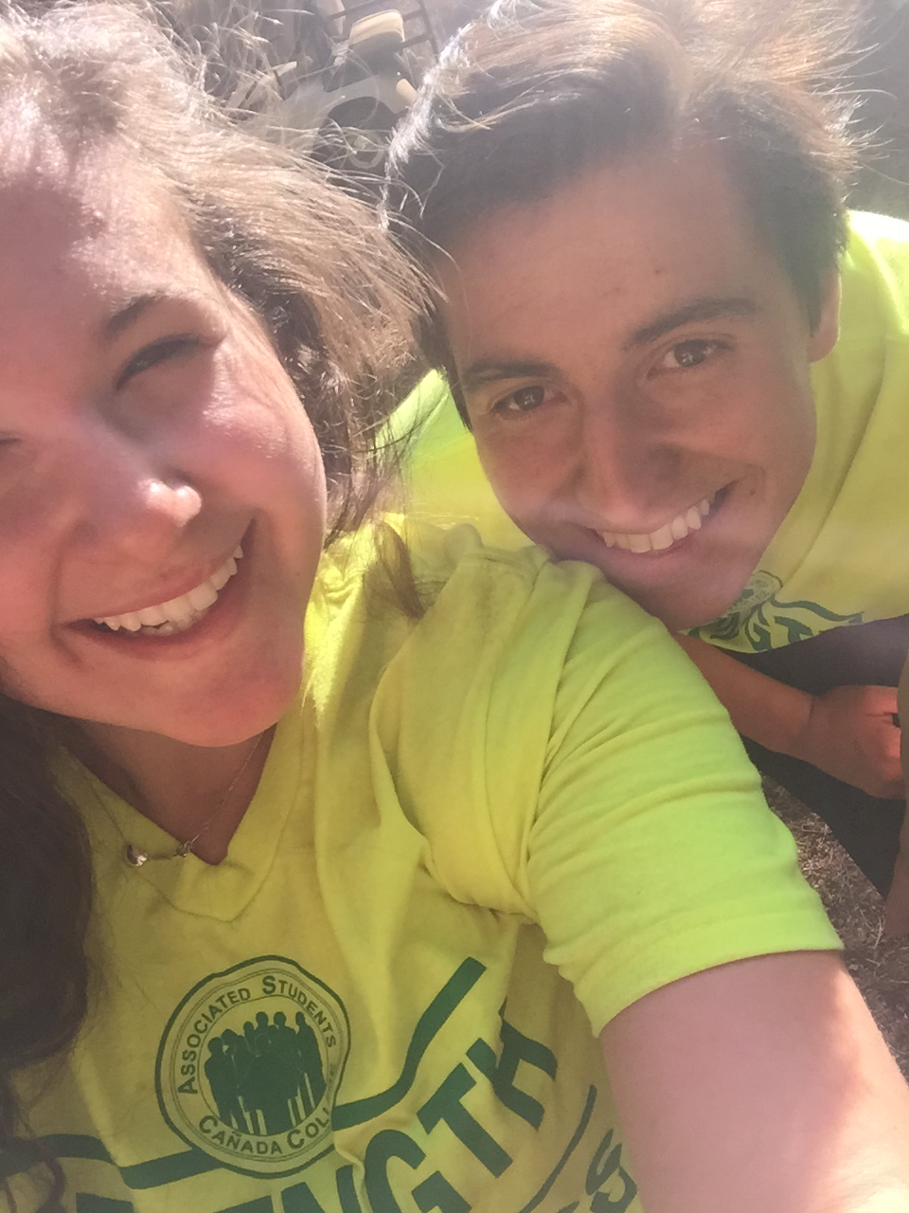
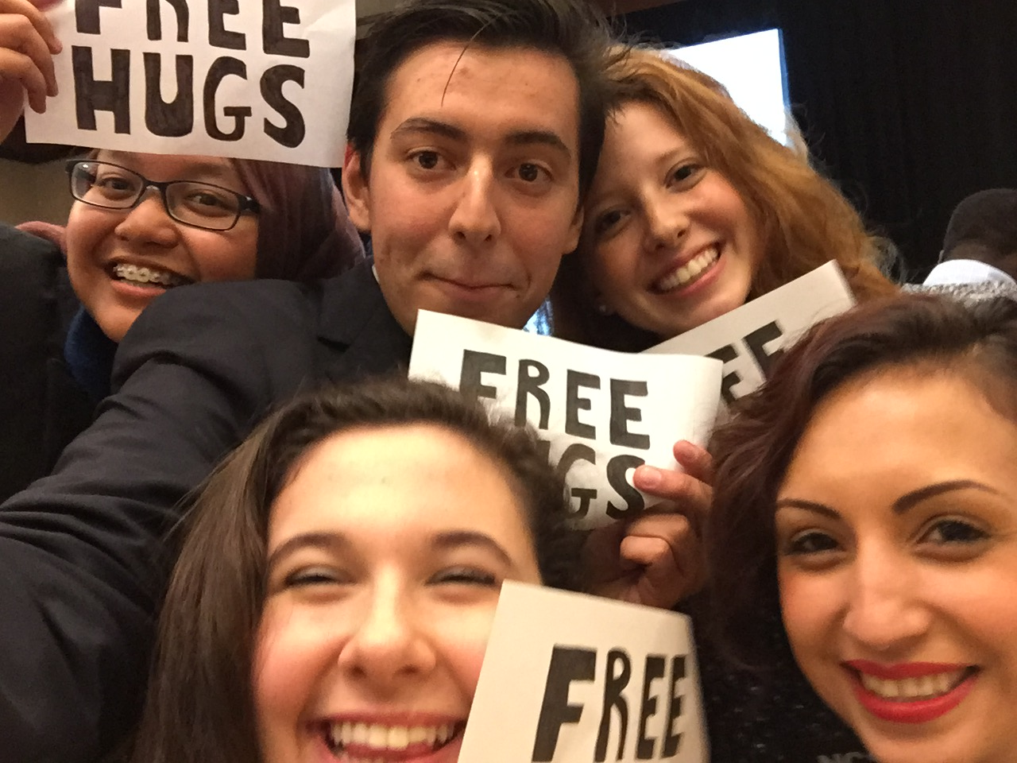
ALEX! My Big
Alex is:
Organized and focused
Enthusiastic and engaging
A patient and open-minded leader
Sweet and caring
^ PC: Alex Wildman
^ PC: Alex Wildman

Slide 8
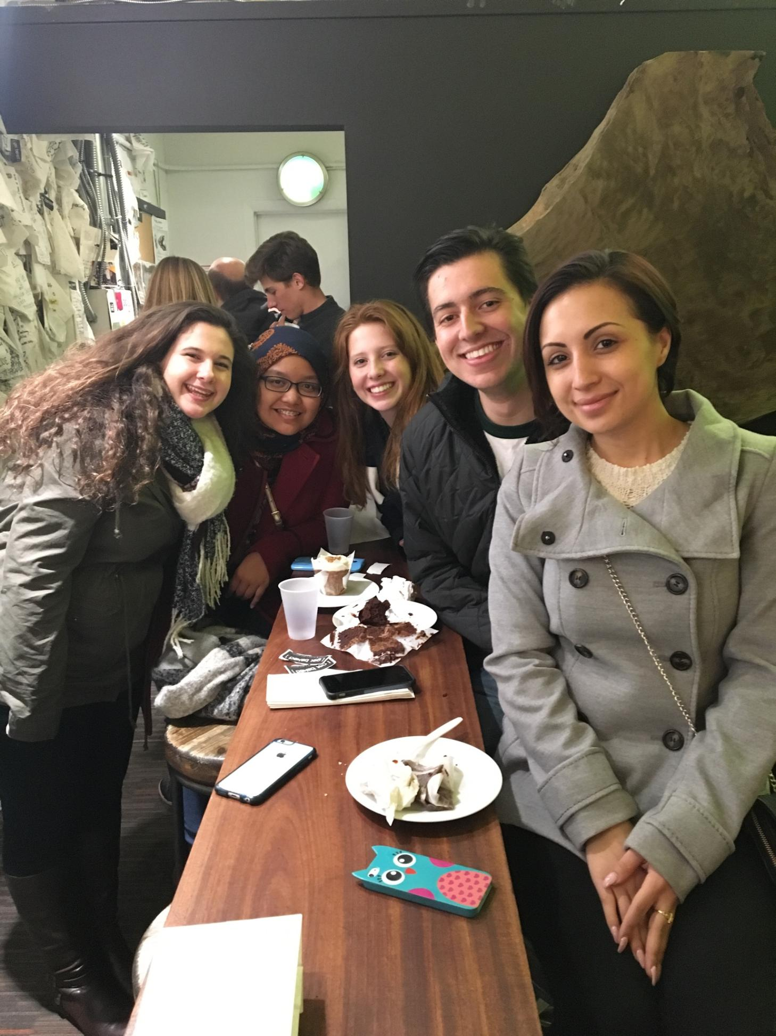
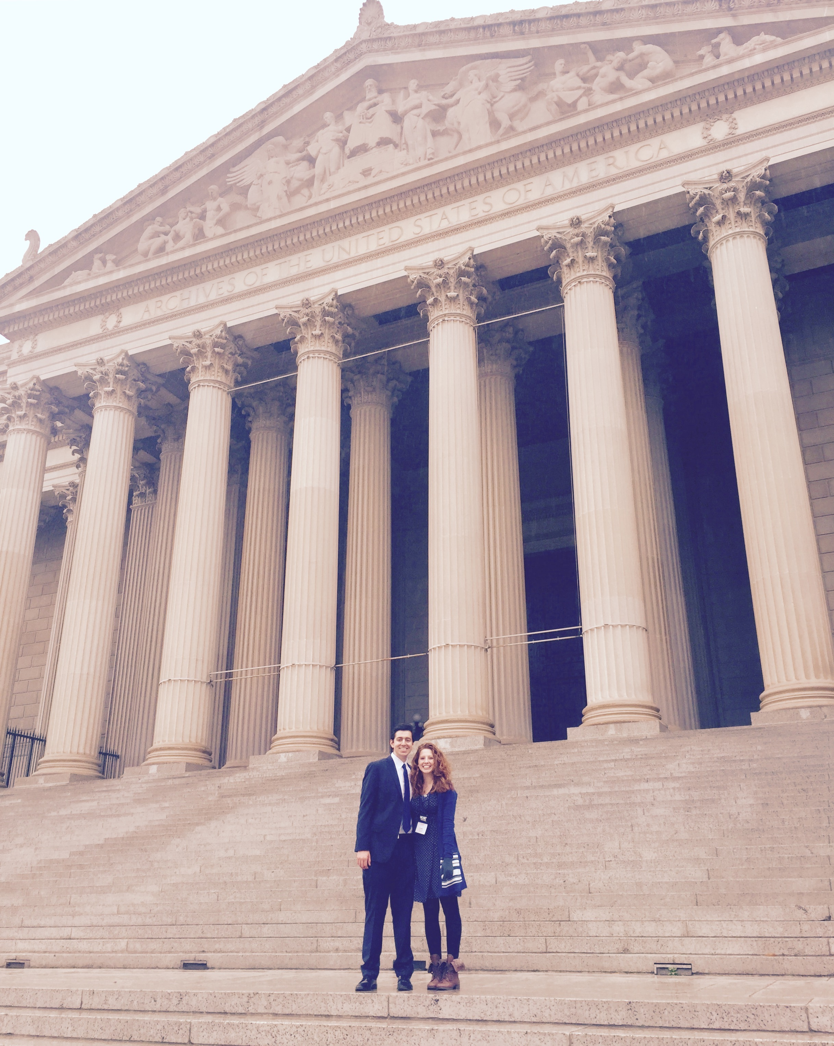
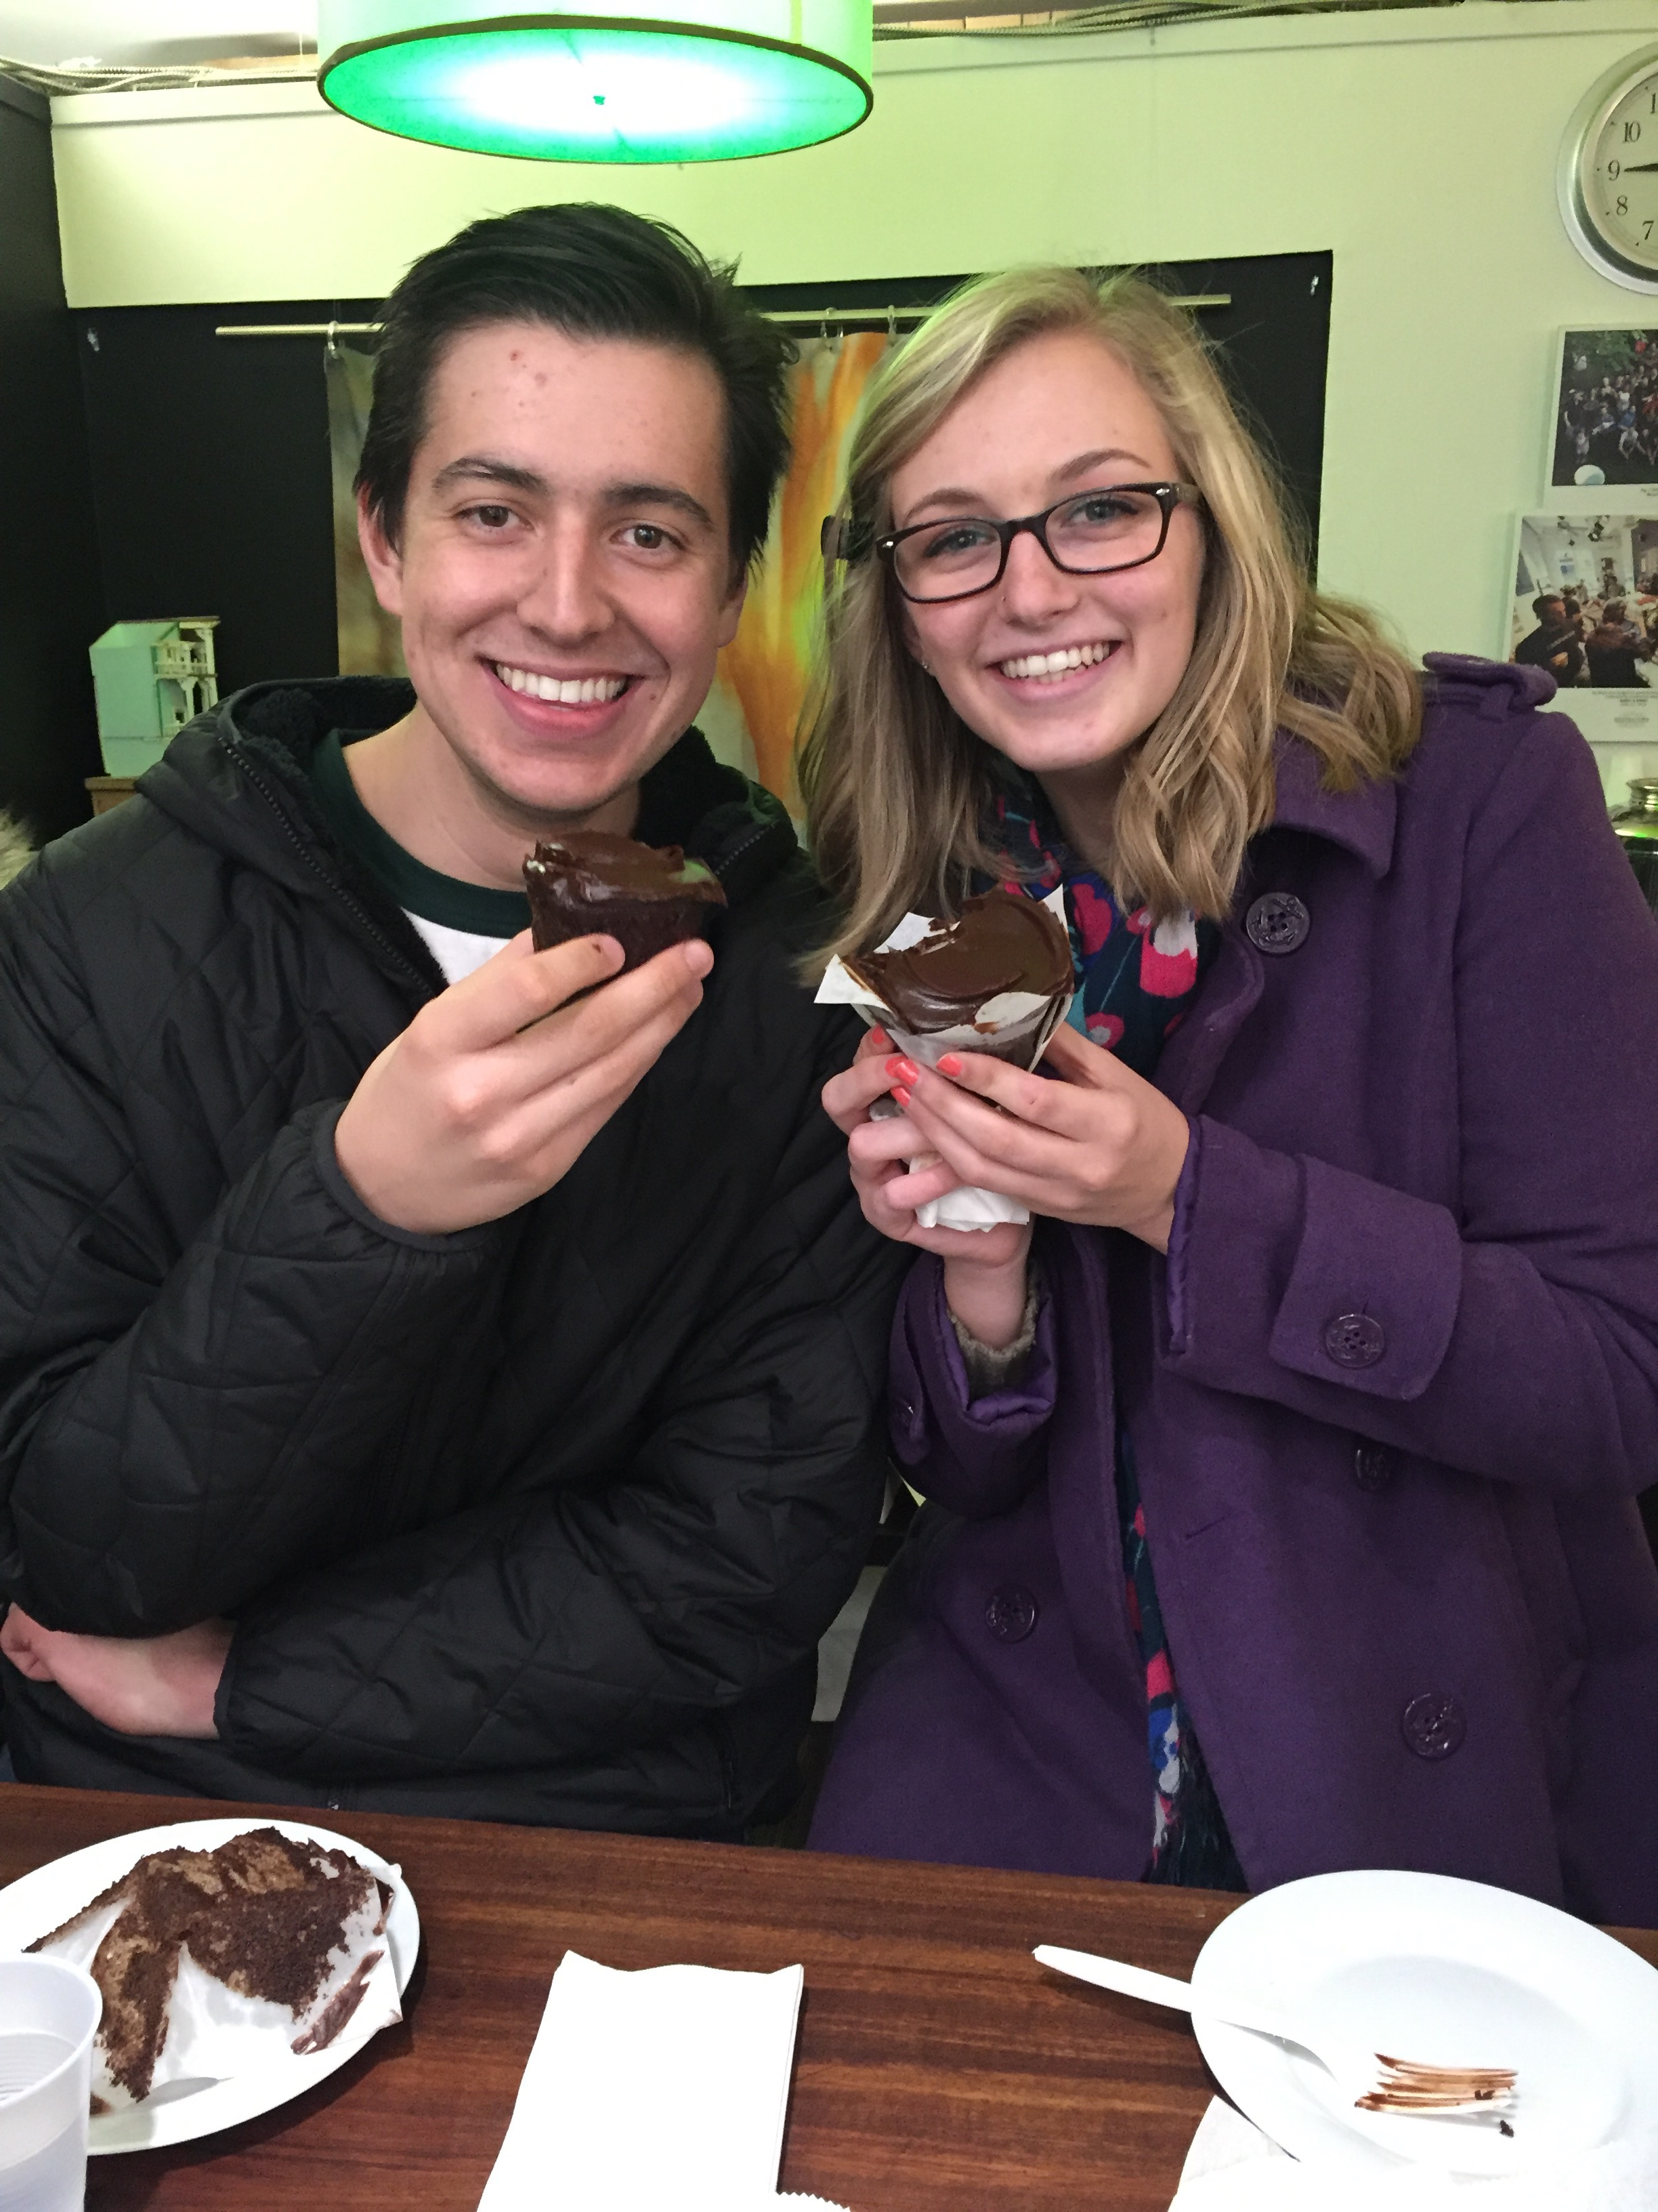
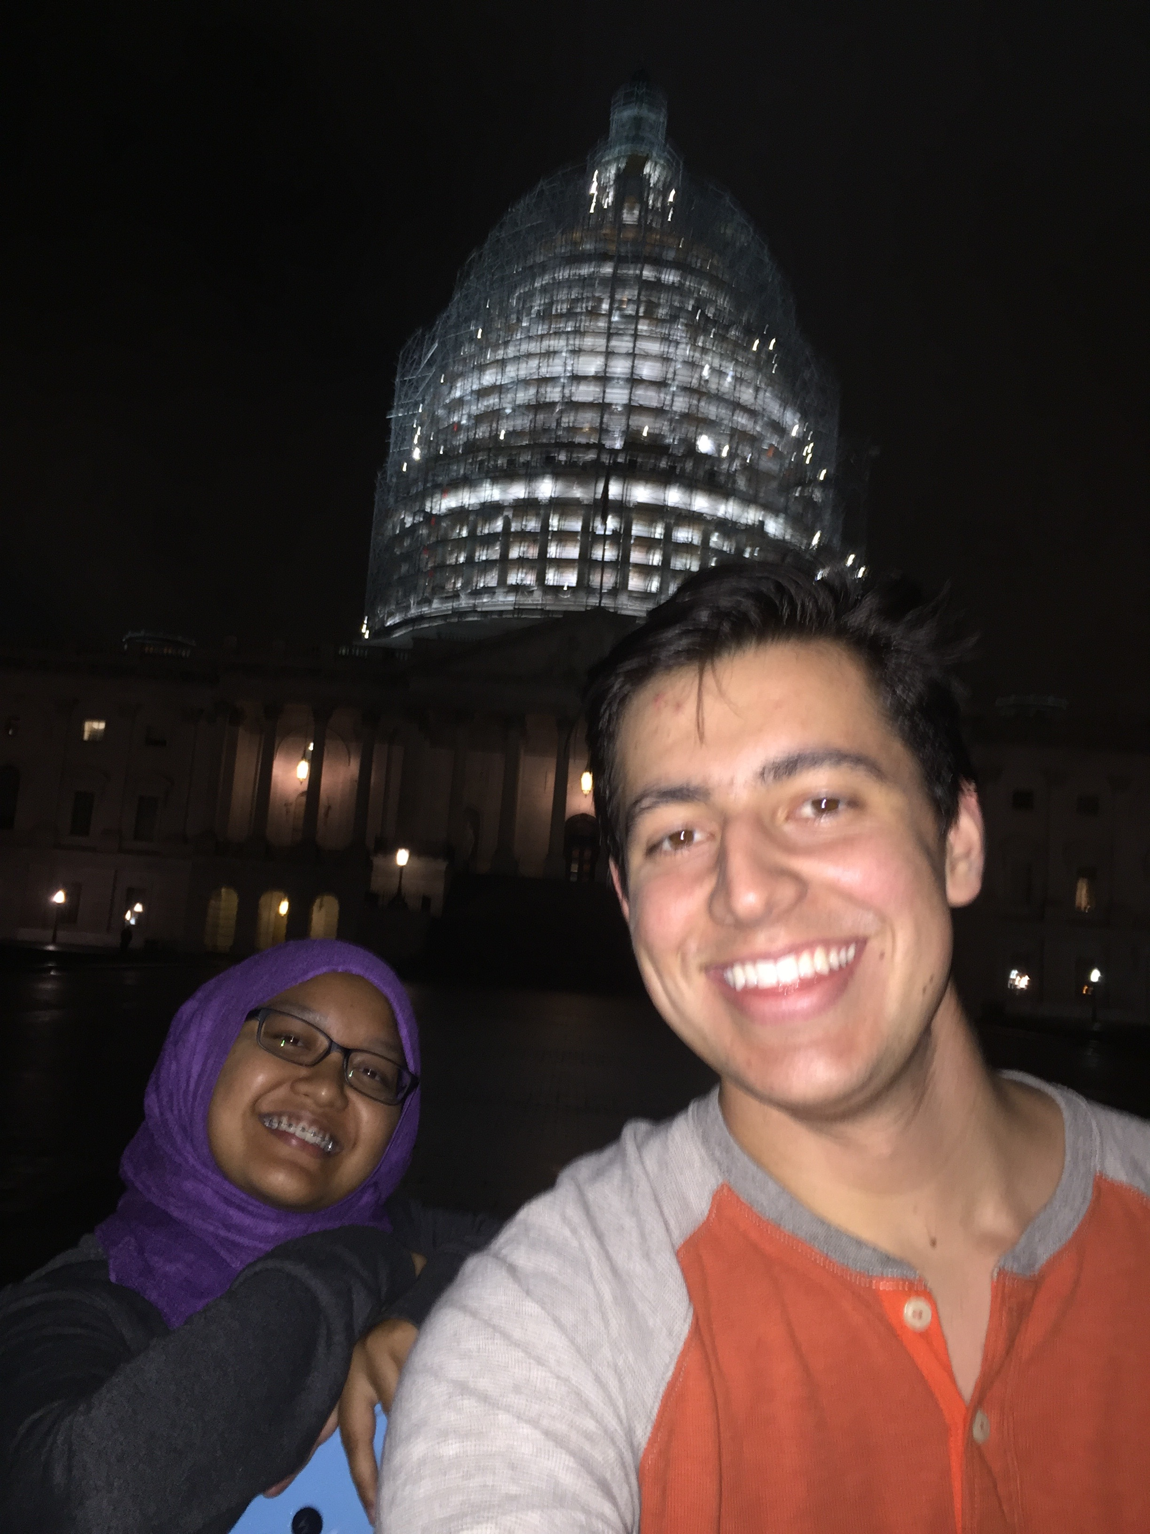
Conferences and my strengths
My Strengths
Achiever
Relator
Input
Learner
Significance
NCSL Takeaways
Reflect on areas of improvement & give yourself credit
Self esteem is a foundational piece of a strong leader
Making connections with others is key to successful events and a happy student body
Challenge, motivate, appreciate

Slide 9
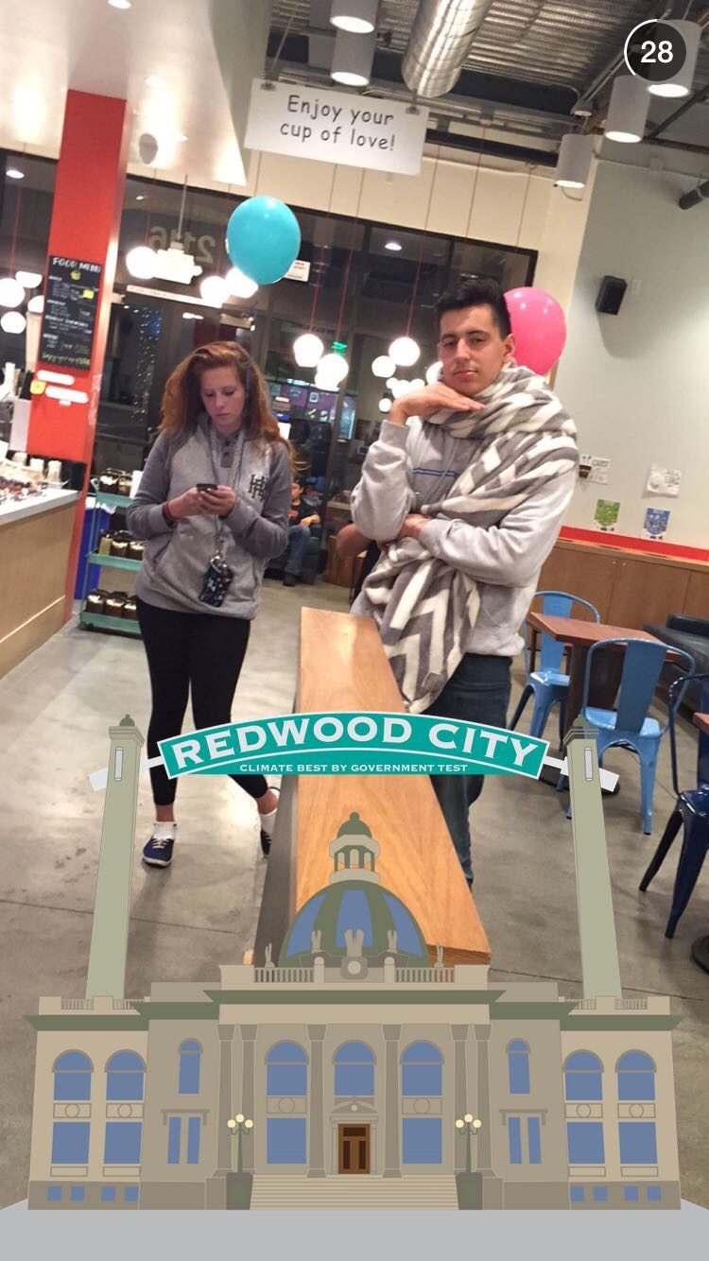
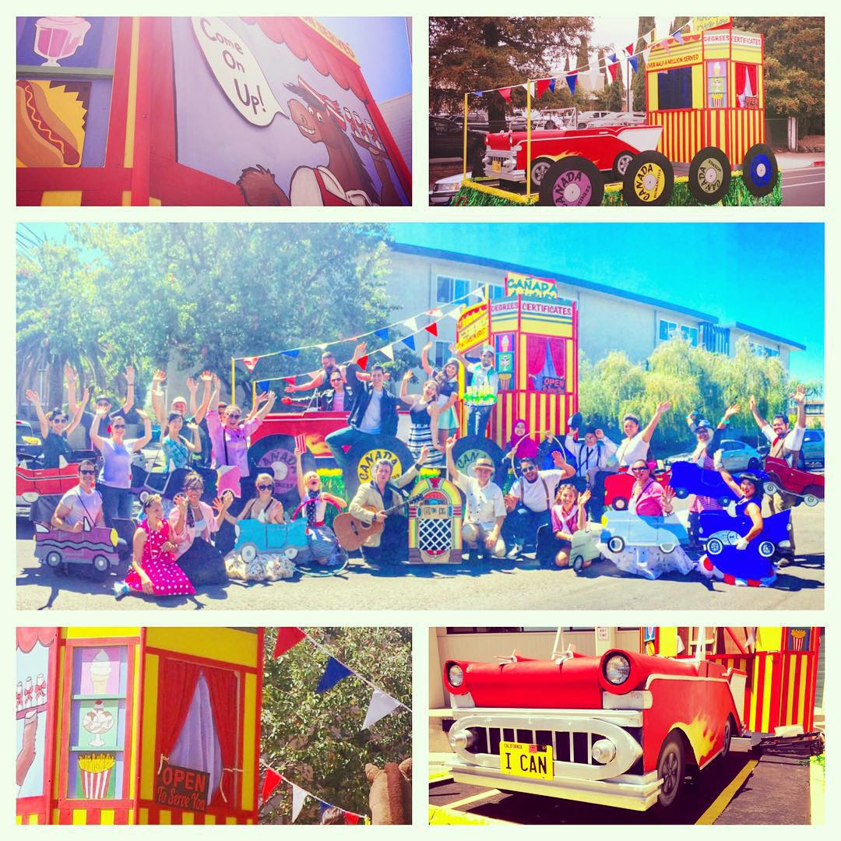
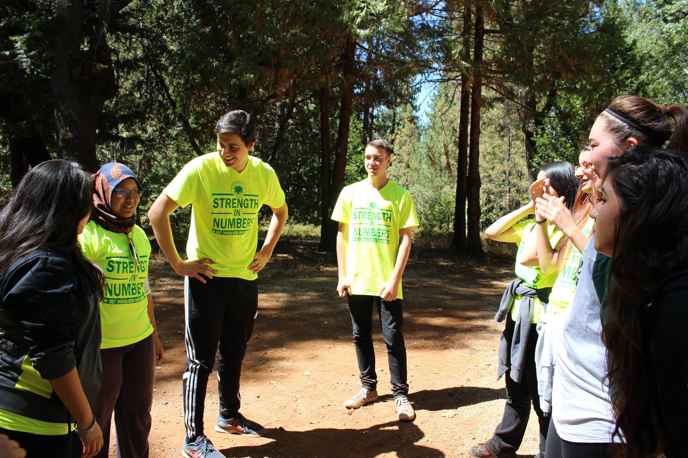
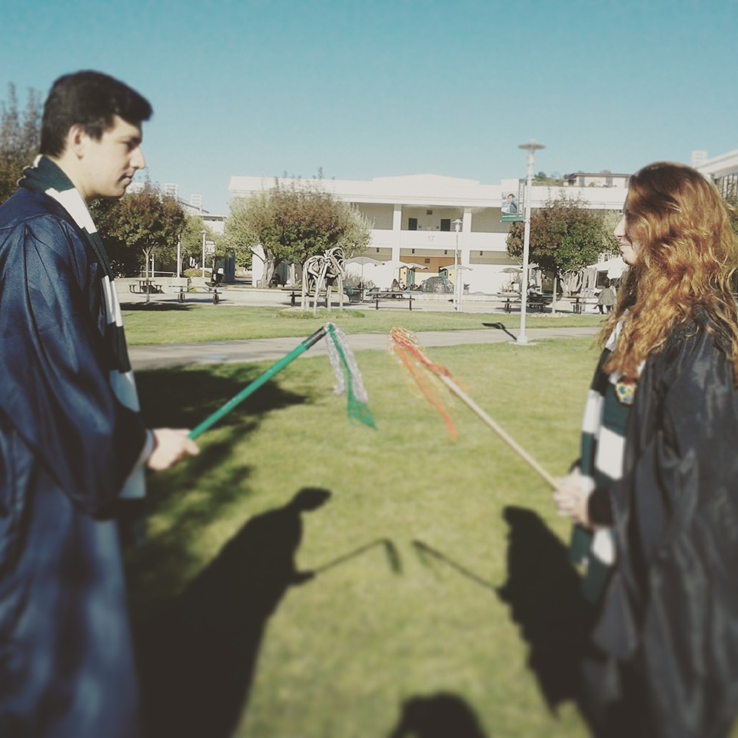
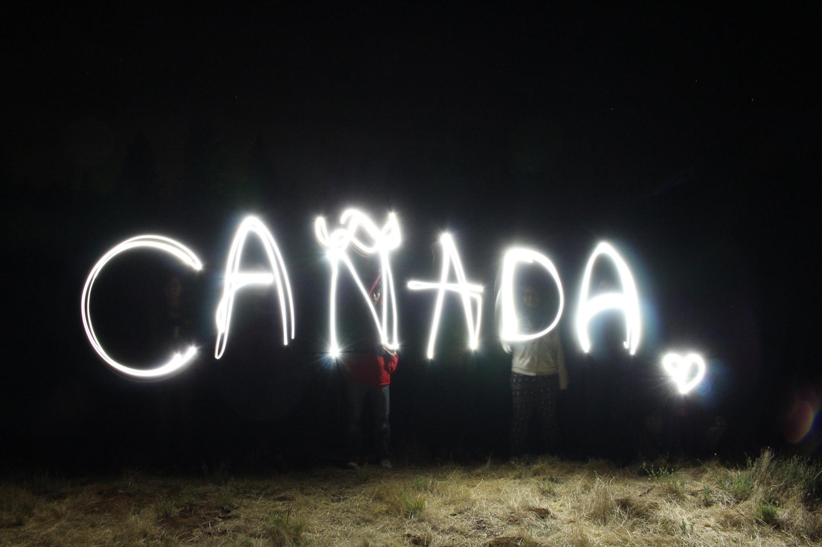

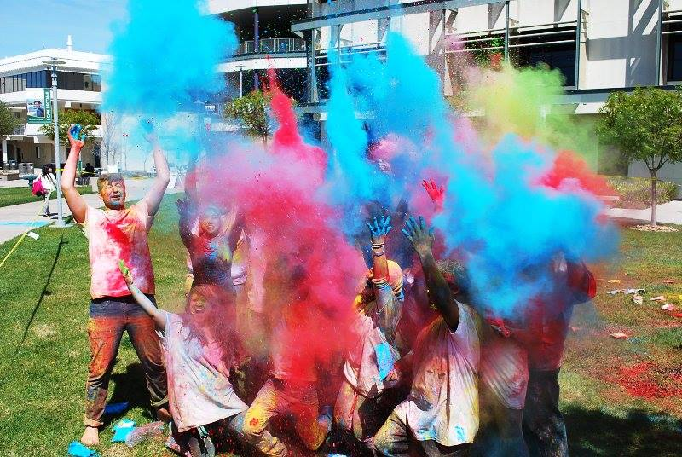
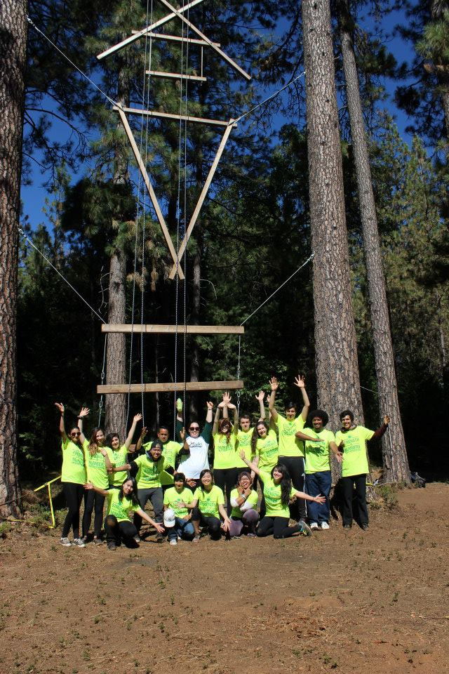
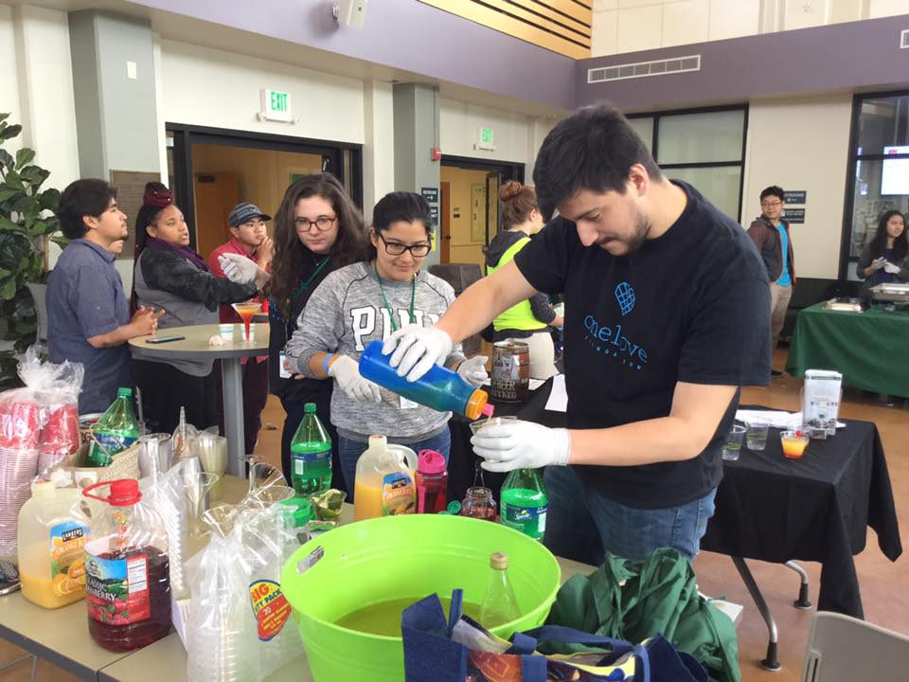

Slide 10
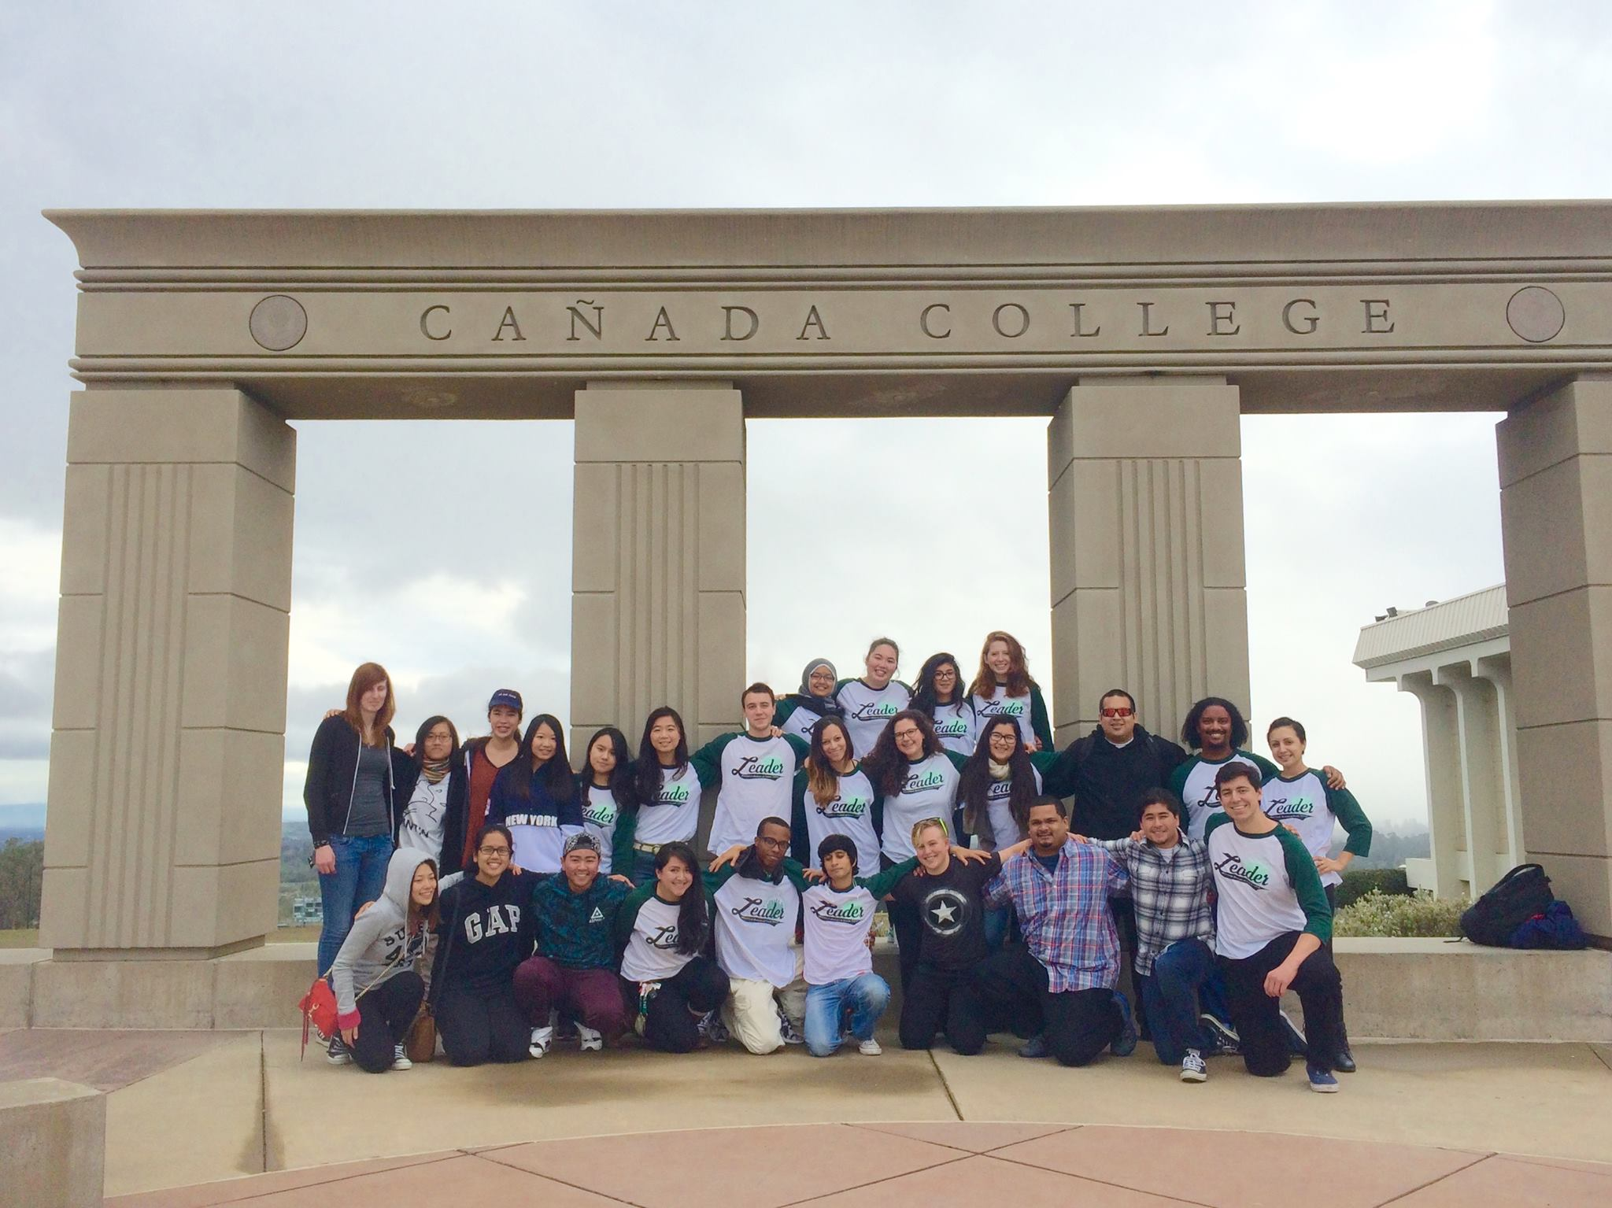
AS FAM

Slide 11
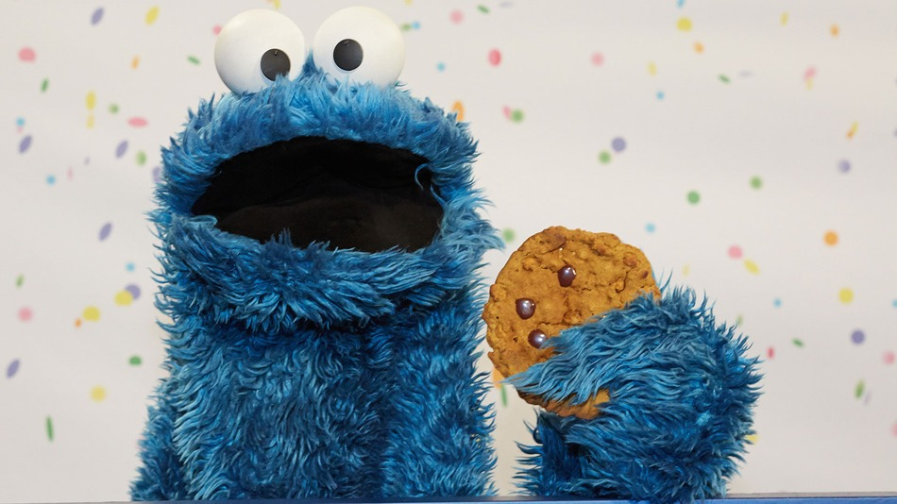
“Sometimes Me Think, ‘What is friend?’ And then me say, ‘Friend is someone to share the last cookie with.’”
-Cookie Monster
Thank you all for such an amazing year!
Love,
Supertreasurer

