Slide 1

Tori Sazio Commissioner of Publicity 4/26/16 2 Semesters in ASCC

Slide 2

Change
By attending weekly Student Senate meetings, what have you learned about group discussion and dynamics and holding an effective meeting?
One mic, one voice
Parli Pro
Participatory Governance:
Technology Committee

Slide 3
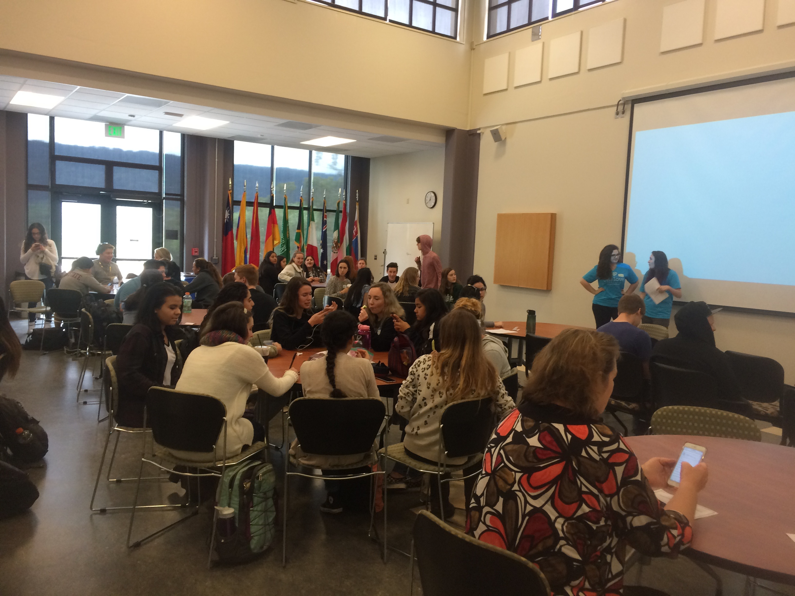

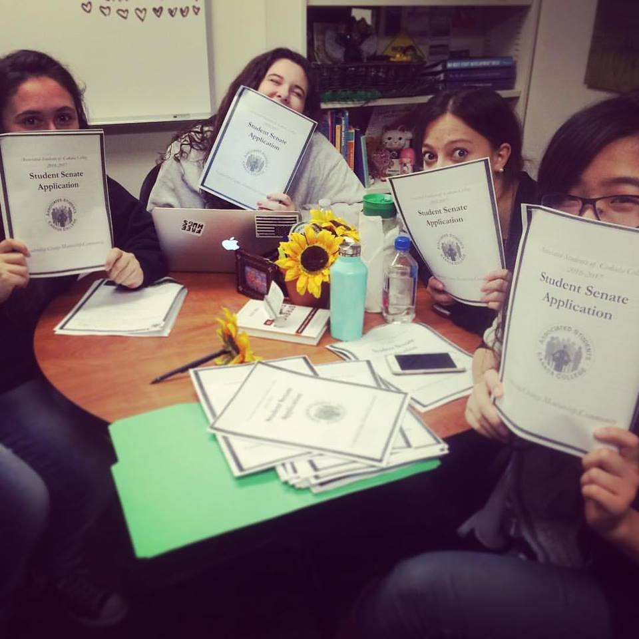
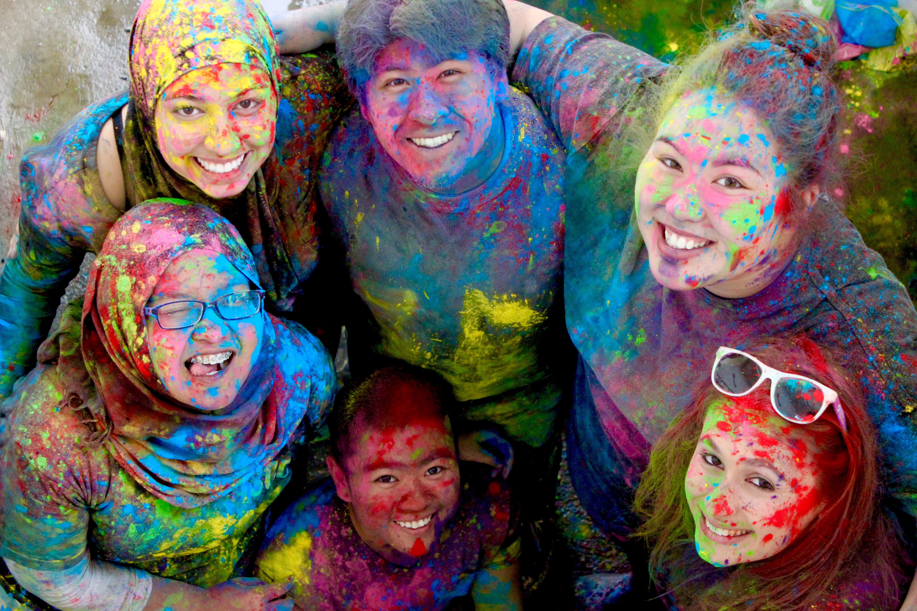
Community
Event chaired:
Alcohol and Sexual Assault Awareness Week
Top success and one thing I would do differently:
One Love AD
Time Management
Event committees:
hAPI
Elections

Slide 4

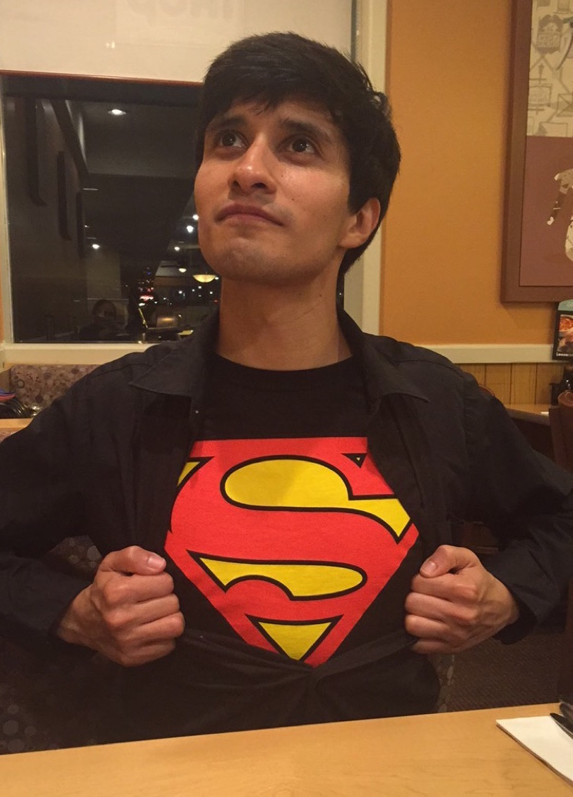

ELI!!

Slide 5
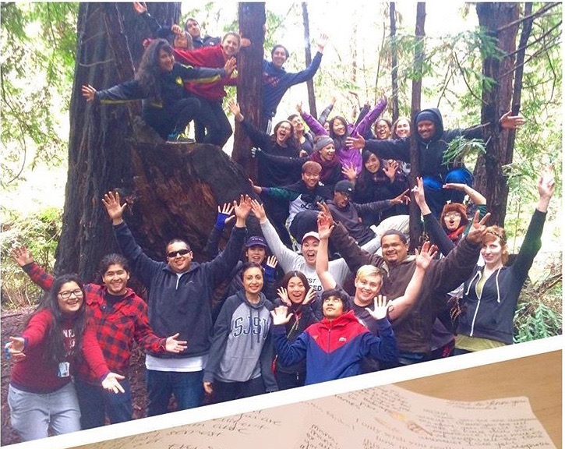
Leadership
What retreats and conferences did you attend during your term?
Spring 2016 Retreat
Strengths:
Strategic
Empathy
Includer
Adaptability
Input

Slide 6
